Slide 1
When Best Supportive Care Is Not Enough: Who Is Eligible for Targeted Therapy in
Non-Advanced Systemic Mastocytosis?
Deepti H. Radia, MD
Hematology Consultant
Guy’s and St Thomas’ Hospitals NHS Foundation Trust
London, UK

Slide 2



Resource Information
About This Resource
These slides are one component of a continuing education program available online at MedEd On The Go titled Non-Advanced Systemic Mastocytosis - When the Best Supportive Care is Not Enough
Program Learning Objectives:
Describe the most recent updates to the World Health Organization (WHO) and NCCN guidelines on classifying non-advanced SM
Explain the advantages and limitations of each criterion and test that are relevant to nonAdvSM
Discuss how to use information from validated assessments for patient symptom reporting and risk stratification to enhance clinical assessment and inform treatment decisions
Explain which specialists are best suited to dealing with each type of symptom common to patients with nonAdvSM
Formulate approaches to provide optimal management of patients with nonAdvSM
MedEd On The Go®
www.mededonthego.com
This content or portions thereof may not be published, posted online or used in presentations without permission.
This content can be saved for personal use (non-commercial use only) with credit given to the resource authors.
To contact us regarding inaccuracies, omissions or permissions please email us at support@MedEdOTG.com

Slide 3
Disclaimer
The views and opinions expressed in this educational activity are those of the faculty and do not necessarily represent the views of Total CME, LLC, the CME providers, or the companies providing educational grants. This presentation is not intended to define an exclusive course of patient management; the participant should use their clinical judgment, knowledge, experience, and diagnostic skills in applying or adopting for professional use any of the information provided herein. Any procedures, medications, or other courses of diagnosis or treatment discussed or suggested in this activity should not be used by clinicians without evaluation of their patient's conditions and possible contraindications or dangers in use, review of any applicable manufacturer’s product information, and comparison with recommendations of other authorities. Links to other sites may be provided as additional sources of information.

Slide 4
Therapeutic Options for Symptom Management in ISM Patients
Avoidance of known triggers
Epinephrine auto-injectors for anaphylaxis treatment
Bisphosphonates for bone disease
Venom immunotherapy for Hymenoptera allergy
H1 antihistamines: Loratadine, Cetirizine, Fexofenadine**, Ketotifen, Rupatadine
H2 antihistamines: Ranitidine, famotidine,
cimetidine, nizatidine
Mast Cell Stabilizers: Cromolyn **, ketotifen
Antileukotrienes: Montelukast
TCA: Amitriptyline
GABA analog: Gabapentin
Glucocorticoids: Steroids in tapering doses
Diagnosis of ISM
ISM
Asymptomatic
ISM or SSM
Symptomatic
Observe
Look for skeletal involvement
Drugs for mediator symptoms
Refractory
2-CdA or IFN-α or clinical trial, eg, PIONEER

Slide 5

Which Patient with Non-Advanced Systemic Mastocytosis Would I Consider for Targeted Therapy?
Multiple antimediator treatments, more than 3 or 4 regular medications
Multiple organs affected, affecting the ability to function
High symptom burden despite increasing treatment doses, reflected by tryptase level and symptom assessment
Inadequate symptom control
Persistent Symptoms
GI symptoms
“Allergy” symptoms
Multiple triggers for episodes or “attacks”
Recurrent anaphylaxis, ITT not option
Intractable pruritis
Consider targeted therapy
Tyrosine kinase inhibitors (TKI) trial

Slide 6
Registrational PIONEER Study: Randomized, Double-Blind, Placebo-Controlled Study in Patients with ISM
PIONEER is the first randomized, placebo-controlled trial of a highly selective KIT D816V-targeting agent in patients with ISM
Avapritinib-treated patients showed rapid, durable, and clinically meaningful improvements in biomarkers of mast cell burden, symptoms, and quality of life versus placebo patients at 24 weeks of treatment
Avapritinib was well tolerated with a similar safety profile to placebo
Open-label extension assessing long-term safety and efficacy of 25 mg avapritinib ongoing

Slide 7
ISM-SAF, a Reliable Construct-Valid PRO Tool for ISM
ISM-SAF©
Symptom | Score | Groups
Abdominal pain | Scored 0-10 daily (24-hour recall) on a handheld device 0 is no symptoms 10 is worst Analyzed as a 14-day moving average | GI (0-30)
Diarrhea
Nausea
Spots |  | Skin (0-30)
Itching
Flushing
Brain fog |  | Neurological (0-30)
Headache
Dizziness
Bone pain
Fatigue
ISM-SAF©
Clinical benefit measure and primary endpoint for PIONEER trial
Designed with input from disease experts, patients, and regulatory authorities as a clinical benefit measure to support regulatory approval
ISM-SAF© is a reliable construct valid PRO
tool for ISM¹
  Clinical benefit measure and primary endpoint in PIONEER part 2
  Symptoms in 3 domains scored daily from 0 to 10, to generate a TSS from 0 to 110, and analyzed as a 14-day moving average
Total Symptom Score
(0-110)

Slide 8
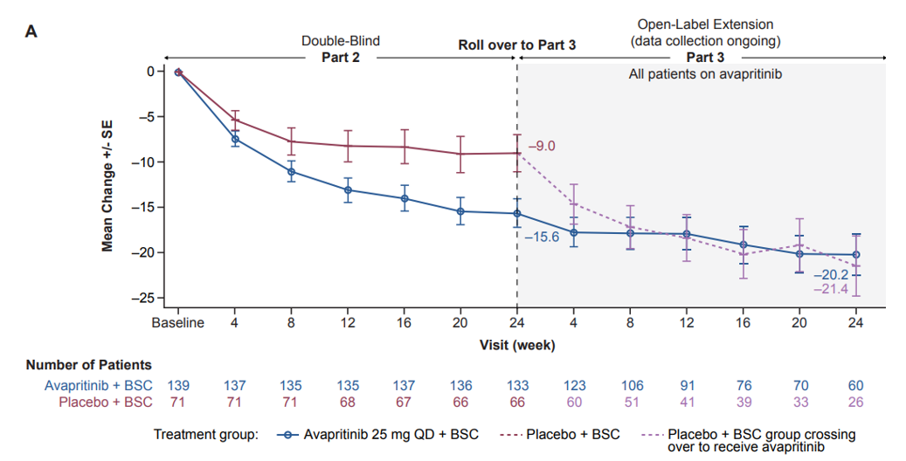
Avapritinib Versus Placebo in ISM:
Effect on Symptom Scores (Primary Endpoint)

Slide 9
Patient case
March 2021 – Consented to take part in PIONEER trial
May 2021 – Screening visit – 18 months from first review
Symptom review: March 2021
General: Increased fatigue and significant sleep disturbance
Skin: Still severe itching and hot flushes. Feet particularly bad with burning sensation all the time
GIT: Acid reflux better with PPI and abdominal distension/bloating. Loose motions 2 to 3 times a day
Cognitive issues: Mild memory impairment in recall
Anaphylaxis: No episodes
Medications:
Fexofenadine 360 mg bid
Famotidine 40 mg bid
Omeprazole 20 mg daily
Cetirizine 20 mg tid
Skin cream prn
Vitamin D and Ca
Inhalers prn/regular
Stopped hydroxyzine; no benefit
Stopped narrow band PUVA; little benefit
Results of investigations:
FBC: Hb 160 g/L, WBC 7.4 x 10⁹/L, normal differential, PLT 336 x10⁹/L
Blood film normal
Normal renal and liver profiles
Tryptase 102 ug/L
Screening bone marrow biopsy:
Aspirate: Normocellular aspirate with 6% mast cells: Spindle-shaped and rounded.
Trephine: Systemic mastocytosis: 10-15% disease bulk. No AHN
Cytogenetics: Normal
Molecular: C-KIT D816V positive ddPCR*

Slide 10
Patient case
June 2021: Patient started on PIONEER trial part 2: Symptom reports
Symptom review: March 2021
General: Increased fatigue and significant sleep disturbance
Skin: Still severe itching and hot flushes. Feet particularly bad with burning sensation all the time
GIT: Acid reflux better with PPI and abdominal distension/bloating. Loose motions 2 to 3 times a day
Cognitive issues: Mild memory impairment in recall
Anaphylaxis: No episodes
Symptom review: 1 month later on trial. Placebo versus avapritinib 25 mg od
Skin: Itching improved, less pruritis
Skin rash visibly lighter in color
Feet burning less
Sleeping better
GIT: Loose motions, stable appetite and weight
OE: Grade 1 periorbital oedema noted
No changes in medications
Symptom review: 3 months later on trial. Avapritinib 25 mg daily
Skin: Itching much improved, less pruritis
Skin rash visibly lighter in color and macules flatter
Sleeping better
Less fatigue
GIT: Stable, no change
OE: Grade 1 periorbital edema noted
Stopped cetirizine and reduced fexofenadine to 180 mg bid/daily

Slide 11
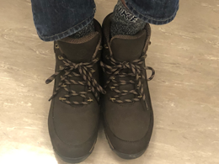
Patient Case
Symptom review: 9 months later on trial. Avapritinib 25 mg daily
Skin: Markedly improved
Skin rash visibly lighter in color and macules flatter
OE: Grade 1 periorbital
edema noted
Stopped cetirizine and reduced fexofenadine prn
Tryptase 102 ug/L to 75 ug/L
At baseline
At 9 months
Patient had not worn closed shoes for more than 4 years. Very happy to show me his boots

Slide 12
Summary
Patients with ISM can have debilitating symptom burden despite being on multiple antimediator medications
ISM patients on 2 or more antimediator treatments who are suboptimally controlled can be considered for targeted TKI treatment
Avapritinib 25 mg daily in PIONEER trial demonstrated significant improvements on symptom burden for asymptomatic ISM patients
Avapritinib 25 mg daily in PIONEER trial showed significant improvements in reducing mast cell burden, cutaneous lesions, tryptase levels, and bone or skin biopsies

Slide 13



Looking for more resources
on this topic?
CME/CE in minutes
Congress highlights
Late-breaking data
Quizzes
Webinars
In-person events
Slides & resources
www.MedEdOTG.com

