Slide 1
Who Are the Key Players for a Multidisciplinary Approach to Diagnosis and Management of Non-Advanced Systemic Mastocytosis?
Cem Akin, MD, PhD
Professor of Medicine
University of Michigan
Ann Arbor, MI

Slide 2



Resource Information
About This Resource
These slides are one component of a continuing education program available online at MedEd On The Go titled Non-Advanced Systemic Mastocytosis - When the Best Supportive Care is Not Enough
Program Learning Objectives:
Describe the most recent updates to the World Health Organization (WHO) and NCCN guidelines on classifying non-advanced SM
Explain the advantages and limitations of each criterion and test that are relevant to nonAdvSM
Discuss how to use information from validated assessments for patient symptom reporting and risk stratification to enhance clinical assessment and inform treatment decisions
Explain which specialists are best suited to dealing with each type of symptom common to patients with nonAdvSM
Formulate approaches to provide optimal management of patients with nonAdvSM
MedEd On The Go®
www.mededonthego.com
This content or portions thereof may not be published, posted online or used in presentations without permission.
This content can be saved for personal use (non-commercial use only) with credit given to the resource authors.
To contact us regarding inaccuracies, omissions or permissions please email us at support@MedEdOTG.com

Slide 3
Disclaimer
The views and opinions expressed in this educational activity are those of the faculty and do not necessarily represent the views of Total CME, LLC, the CME providers, or the companies providing educational grants. This presentation is not intended to define an exclusive course of patient management; the participant should use their clinical judgment, knowledge, experience, and diagnostic skills in applying or adopting for professional use any of the information provided herein. Any procedures, medications, or other courses of diagnosis or treatment discussed or suggested in this activity should not be used by clinicians without evaluation of their patient's conditions and possible contraindications or dangers in use, review of any applicable manufacturer’s product information, and comparison with recommendations of other authorities. Links to other sites may be provided as additional sources of information.

Slide 4
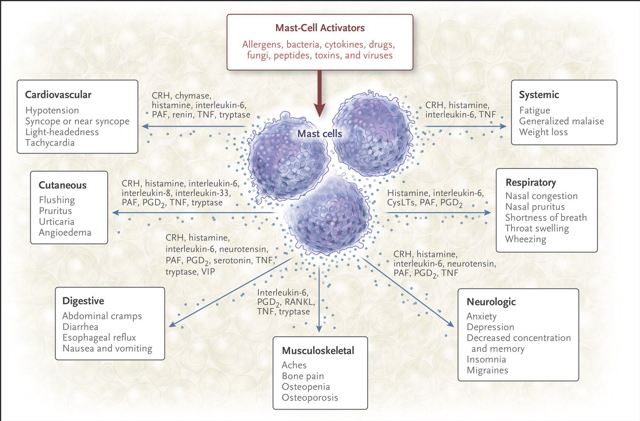
Clinically Relevant Mediators Released from Mast Cells and Putative Effects

Slide 5
Presentation of Non-Advanced Systemic Mastocytosis
Skin lesions of urticaria pigmentosa (maculopapular cutaneous mastocytosis) (about 70-80%)
  Dermatologist
  Dermatopathologist
Anaphylaxis, flushing or other signs of mast cell activation
  Allergist
  Gastroenterologist
  Endocrinologist

Slide 6
REMA Score to Predict Mastocytosis in Patients with Mast Cell Activation Symptoms
Variable |  | Score
Gender | Male | +1
 | Female | +1
Clinical Symptoms | Absence of urticaria and angioedema | +1
 | Urticaria and/or angioedema | -2
 | Presyncope and/or syncope | +3
Tryptase* | <15 ng/mL | -1
 | ≥25 ng/mL | +2
Score <2: low probability of clonal MCAD
Score ≥2: high probability of clonal MCAD
Sensitivity: 0.92
Positive Predictive Value: 0.89
Specificity: 0.81
Negative Predictive Value: 0.87

Slide 7
Multidisciplinary Approach to Management of Non-Advanced Systemic Mastocytosis
Hematologist and hematopathologist
  Initial diagnosis of systemic mastocytosis (bone marrow biopsy)
  Management of advanced systemic mastocytosis
Allergist and Immunologist
  General management of the patient
  Mast cell activation symptoms, anaphylaxis
  Venom allergy
Gastroenterologist
  Management of GI symptoms (abdominal pain, nausea, vomiting, diarrhea)
  Endoscopic evaluation with biopsies
Endocrinologist
  Osteoporosis

Slide 8

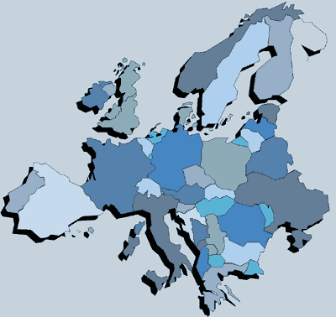
Referral Centers
American Initiative in Mast Cell Diseases (AIM)
  www.aimcd.net
European Competence Network on Mastocytosis (ECNM)
  ECNM - The European Competence Network on Mastocytosis (meduniwien.ac.at)

Slide 9



Looking for more resources
on this topic?
CME/CE in minutes
Congress highlights
Late-breaking data
Quizzes
Webinars
In-person events
Slides & resources
www.MedEdOTG.com

