Slide 1





New Frontiers in Anticoagulation:
Factor XI/XIa Inhibitors
Saturday, November 11, 2023 | 6:00pm – 7:30pm ET
Philadelphia Marriott Downtown | Salon H | Philadelphia, PA
This activity has been designed to meet the educational needs of the interprofessional team approach intended for clinical cardiologists, emergency medicine physicians, hematologists, hospitalists, neurologists, primary care physicians, vascular medicine practitioners, and vascular surgeons, as well as other clinicians involved in the management of patients with anticoagulation.
Supported by an educational grant from Bayer HealthCare Pharmaceuticals Inc. Jointly provided by the Global Learning Collaborative (GLC), Duke Heart, and Total CME, LLC.

Slide 2



Resource Information
About This Resource
These slides are one component of a continuing education program available online at MedEd On The Go titled New Frontiers in Anticoagulation: Factor XI/XIa Inhibitors
Program Learning Objectives:
Review the currently available therapeutics and how they affect multiple pathways involved in the coagulation cascade, thereby increasing the potential for serious bleeds
Review current decision pathways for initiation of anticoagulation treatment and shared patient-physician decision-making, emphasizing potential prescriber bias that limits more widespread adoption of DOAC therapy
Review cardiac and non-cardiac patient populations where DOACs have limitations or contraindications
Discuss factor XI and factor XIa inhibition and review new and emerging anticoagulation pharmacotherapy for VTE, AF, secondary stroke prevention, and post-MI
MedEd On The Go®
www.mededonthego.com
This content or portions thereof may not be published, posted online or used in presentations without permission.
This content can be saved for personal use (non-commercial use only) with credit given to the resource authors.
To contact us regarding inaccuracies, omissions or permissions please email us at support@MedEdOTG.com

Slide 3
Disclaimer
The views and opinions expressed in this educational activity are those of the faculty and do not necessarily represent the views of Total CME, LLC, the CME providers, or the companies providing educational grants. This presentation is not intended to define an exclusive course of patient management; the participant should use their clinical judgment, knowledge, experience, and diagnostic skills in applying or adopting for professional use any of the information provided herein. Any procedures, medications, or other courses of diagnosis or treatment discussed or suggested in this activity should not be used by clinicians without evaluation of their patient's conditions and possible contraindications or dangers in use, review of any applicable manufacturer’s product information, and comparison with recommendations of other authorities. Links to other sites may be provided as additional sources of information.

Slide 4


The Path Forward: What’s On The Horizon?
Factor XI/XIa Inhibition – Where Are We?
Manesh R. Patel, MD
Richard S. Stack Distinguished Professor
Chief, Division of Cardiology
Co-Director Duke Heart Center
Duke Clinical Research Institute
Duke University
Durham, NC

Slide 5
Learning Objectives
Understand the normal role of Factor XI in hemostasis
Understand the pre-clinical data of Factor XI as a target for therapy
Understand the mechanism of Factor XI/XIa inhibitors
Understand the existing clinical data around Factor XI/XIa inhibition
Understand the Factor XI/XIa inhibitors and ongoing trials, indications, and populations being studied

Slide 6
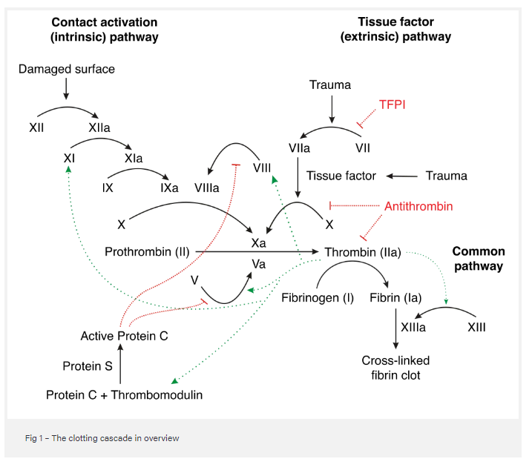
Where is Factor XI in the Clotting cascade?

Slide 7
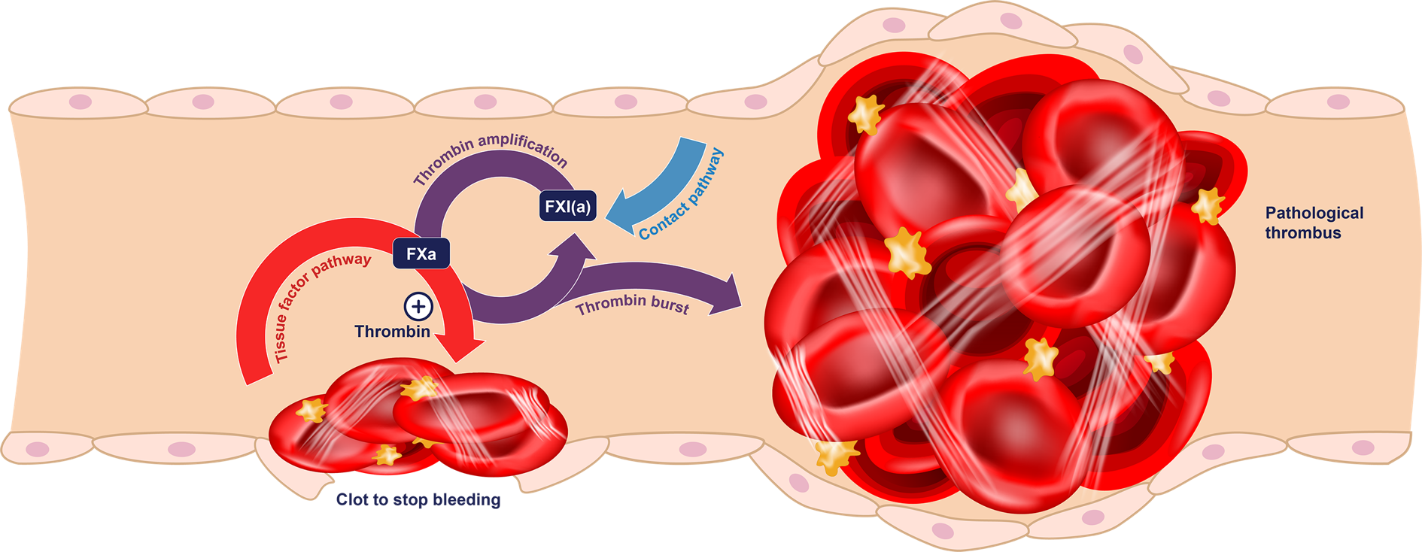


Normal Physiology: Without an Anticoagulant
When no anticoagulant is used, a clot is formed to stop the bleeding—
BUT a pathological thrombus could also be created.

Slide 8
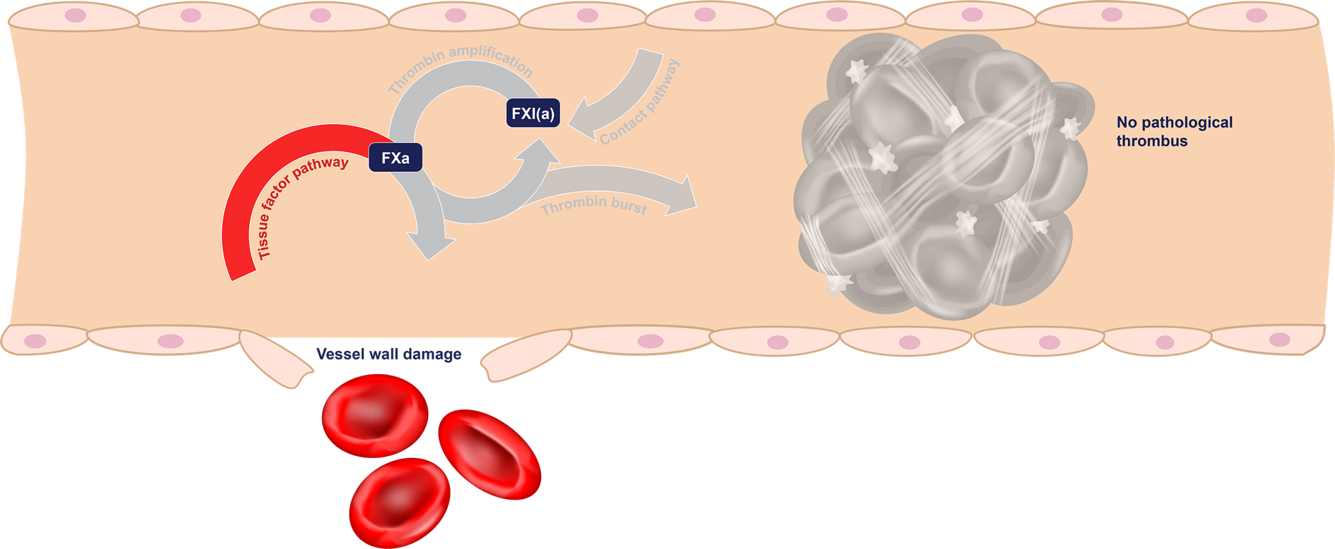






With a DOAC (e.g., apixaban or rivaroxaban)
DOAC
When a DOAC is used, FXa is inhibited, which prevents pathological thrombi—
BUT can also prevent the beneficial blood clots that stop bleeding in damaged vessels.

Slide 9
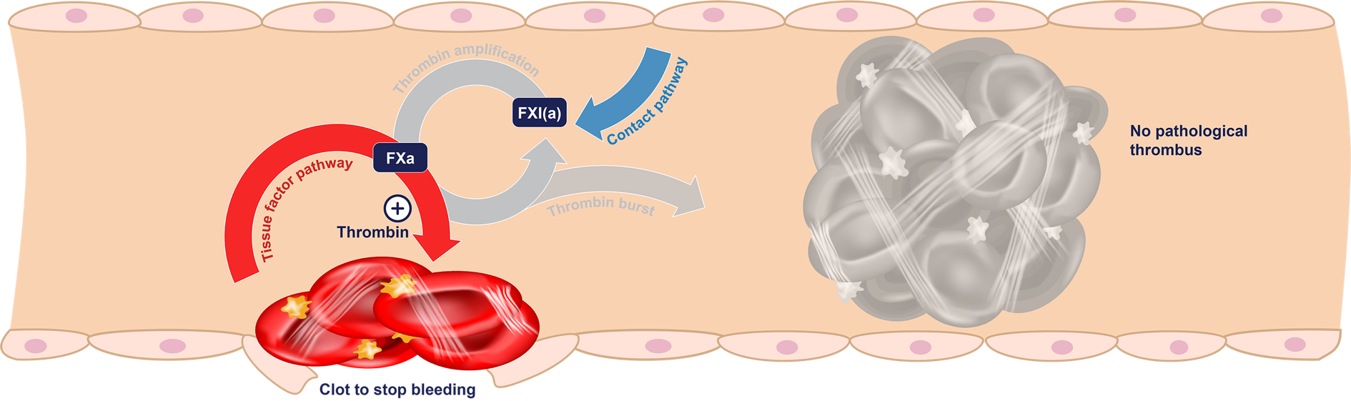
With a Factor XI/XIa Inhibition (Hypothesis: Uncoupling Hemostasis from Thrombosis)
Factor XI
inhibition
When a Factor XI inhibitor is used, thrombin amplification is inhibited, which prevents pathological thrombi—
AND the tissue factor pathway still produces thrombin, which allows beneficial blood clots to form.

Slide 10
The Preclinical and Observational Data Supporting Factor XI Inhibition as a target for therapy

Slide 11
Genetic Predisposition to Low FXI Levels is Associated with Reduced Risk of Ischaemic Stroke and VTE
Thrombotic events
(MI, ischaemic stroke and VTE)
Stroke subtypes
0.83
1.0
0.52
p<0.001
0.47
p<0.001
0.16
p<0.001
0.1

Slide 12
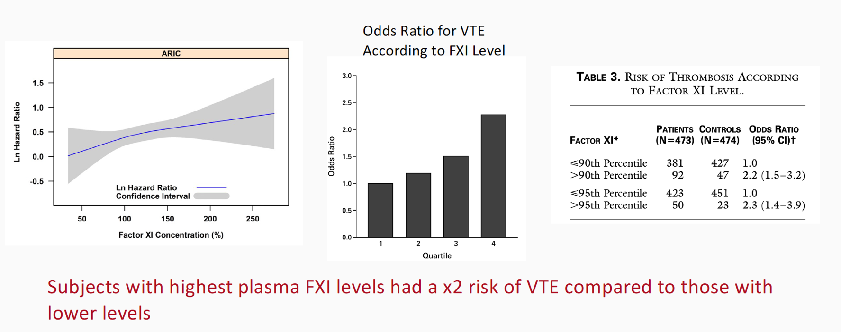
FXI Level Inversely Related to Risk of Thrombosis

Slide 13
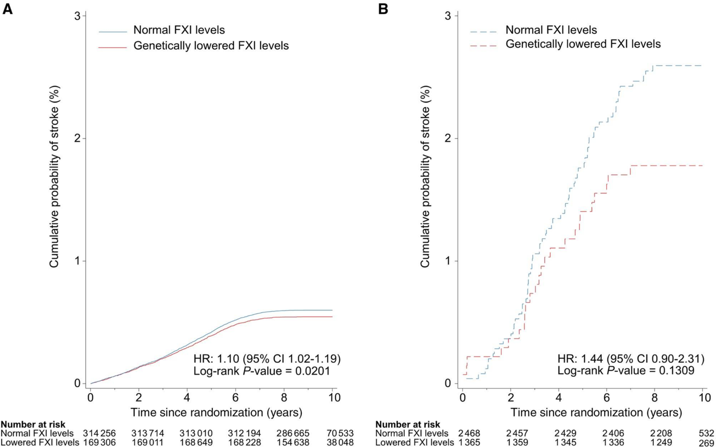
Probability of Ischaemic Stroke in Individuals with Normal and Genetically Lowered Levels of FXI Activity
Participants without AF
Participants with AF

Slide 14
Current Evidence Supporting FXI(a) Inhibition as a Target
CONDITION
OBSERVATION
FXI-knockout mice¹
Homozygous FXI-knockout mice are protected from thrombosis
At the same time, they do not show a bleeding phenotype differing from wild-type mice
In vivo animal models²
Reducing/inhibiting FXI showed strong antithrombotic effects in vivo
No increase in bleeding time even at very high doses or on top of dual antiplatelet therapy
Inherited FXI deficiency³
Individuals with FXI deficiency are reported to have a reduced incidence of VTE and stroke
Hemorrhage occasionally reported after trauma or surgery (dental extractions, tonsillectomies, surgery in the urinary and genital tracts, and nasal surgery)

Slide 15
Learning Objectives
Understand the normal role of Factor XI in hemostasis
Understand the pre-clinical data of Factor XI as a target for therapy
Understand the mechanism of Factor XI/XIa inhibitors
Understand the existing clinical data around Factor XI/XIa inhibition
Understand the Factor XI/XIa inhibitors and ongoing trials, indications, and populations being studied

Slide 16
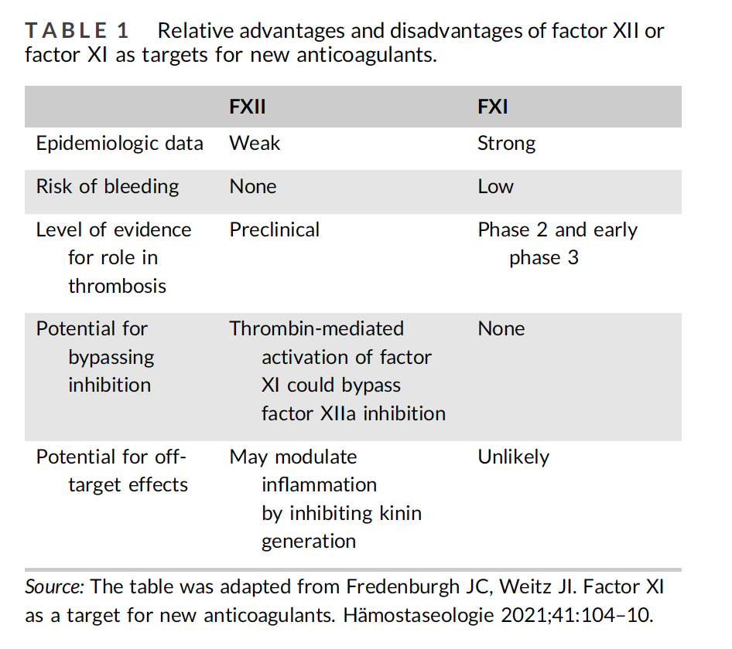

Why target Factor XI?

Slide 17
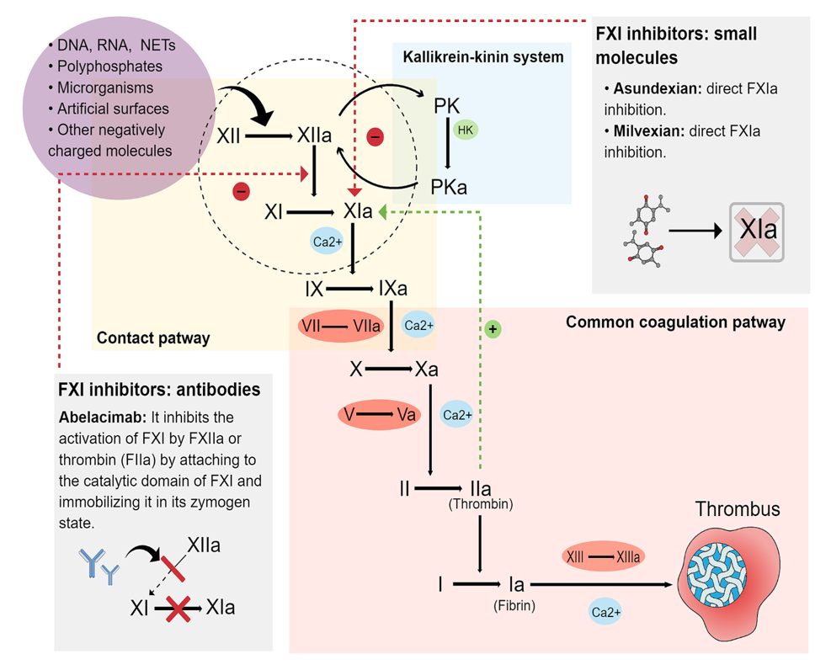
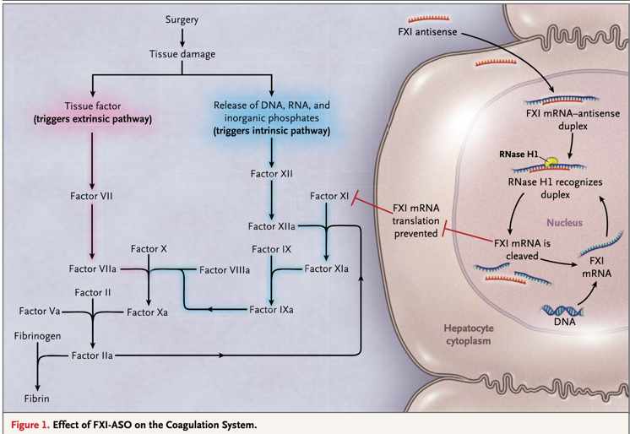
Targets for Factor XI Inhibition
Human Monoclonal Antibody (Abelacimab): to catalytic domain of FXI immobilizes in inactive form (preventing FXIa formation)
Small molecule (Asundexian, Milvexian): high affinity direct inhibition of activated FXI(FXIa)
Anti-sense inhibition: FXI-ASO FXI targeted anti-sense oligonucleotide – prevents proteins synthesis FXI

Slide 18
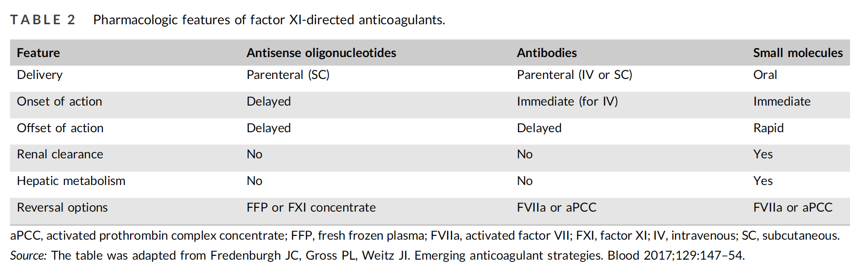
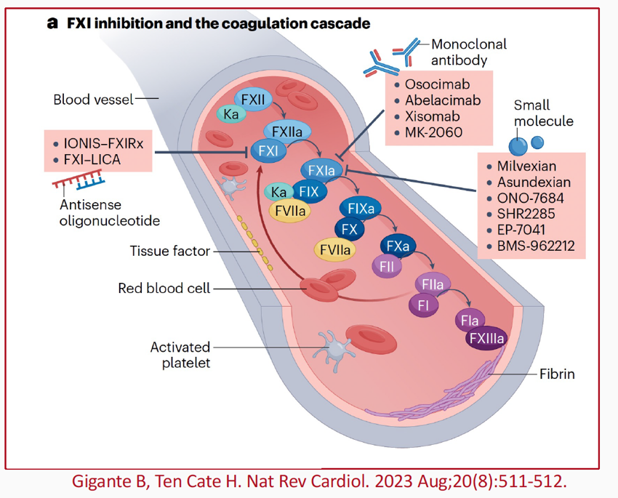
Relative Pharmacologic Features of Factor XI directed therapies

Slide 19
Phase II Clinical Data with FXI/FXIa therapies

Slide 20
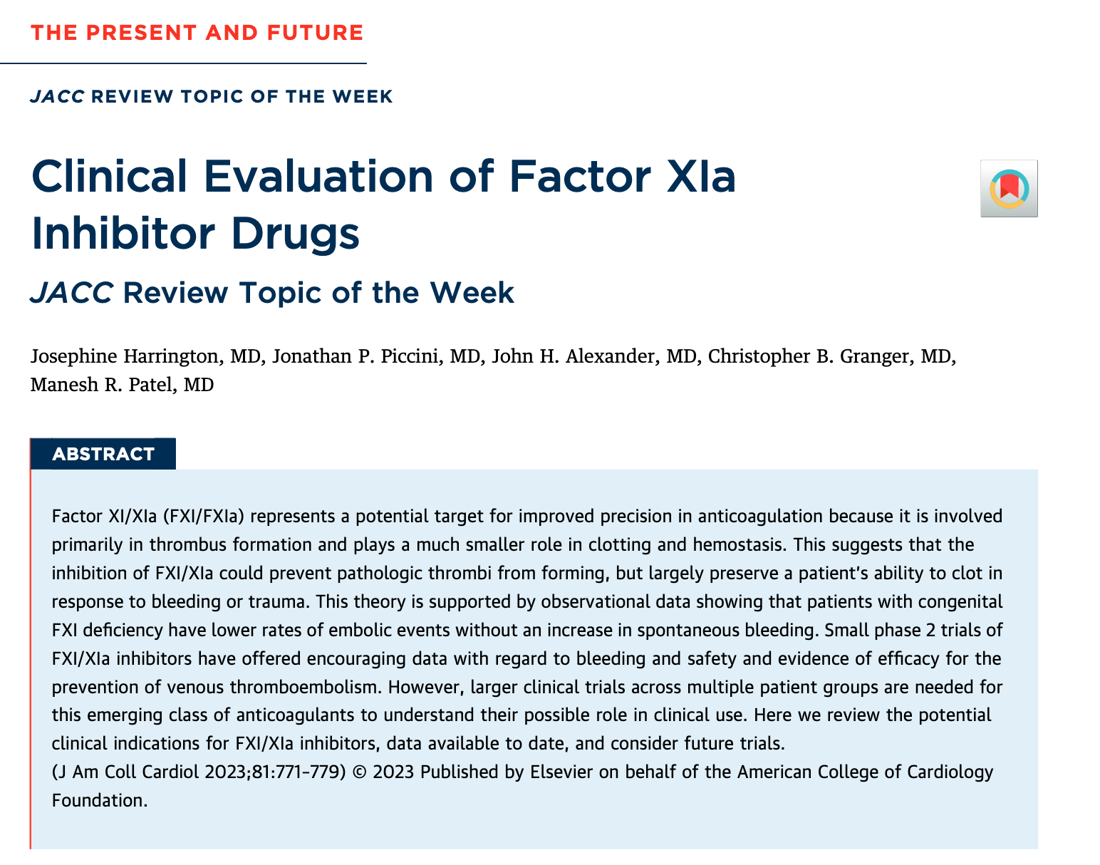
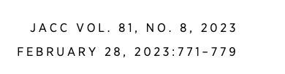

Slide 21
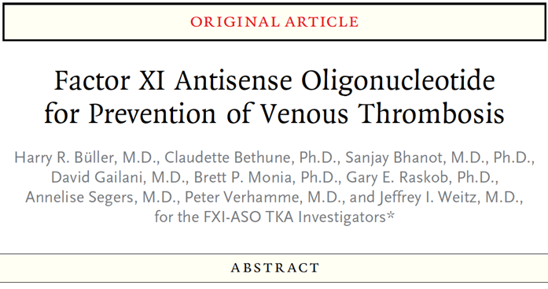
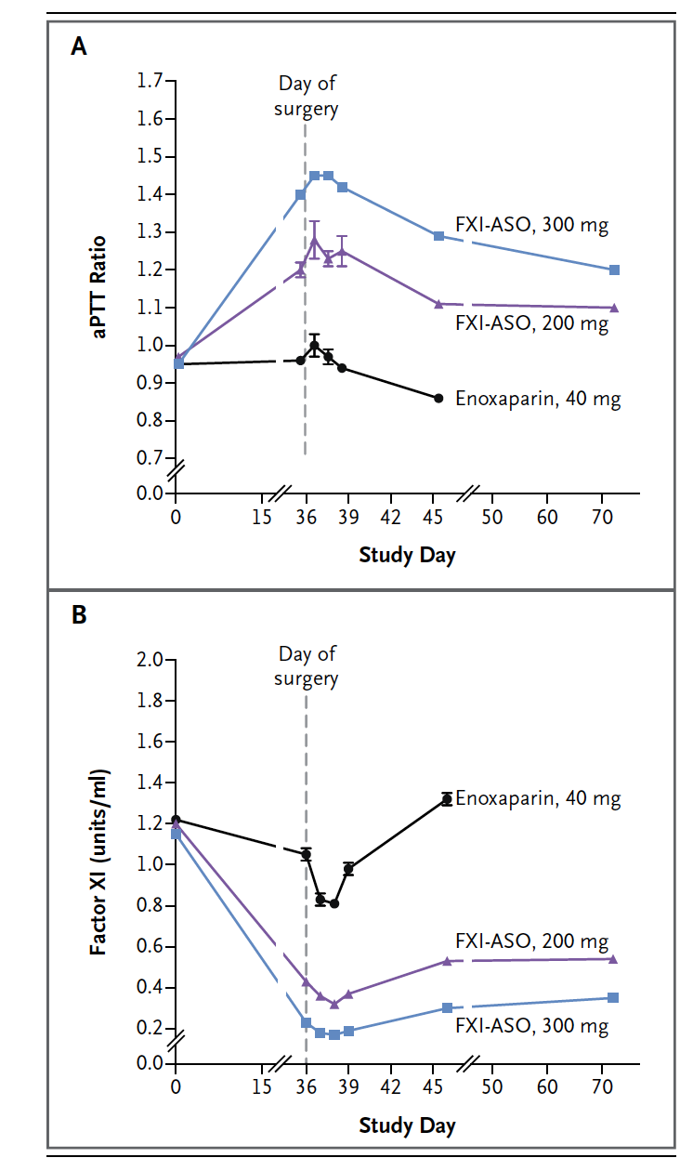
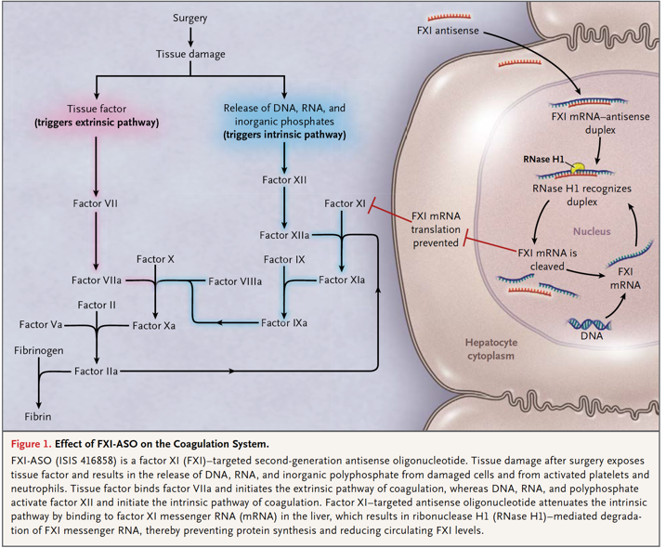
Early Proof of Concept: Phase 2 study - Demonstrated FXI (intrinsic pathway) as having affect on thrombosis without any relative increase in bleeding
ASO not moving forward in phase 3 studies

Slide 22
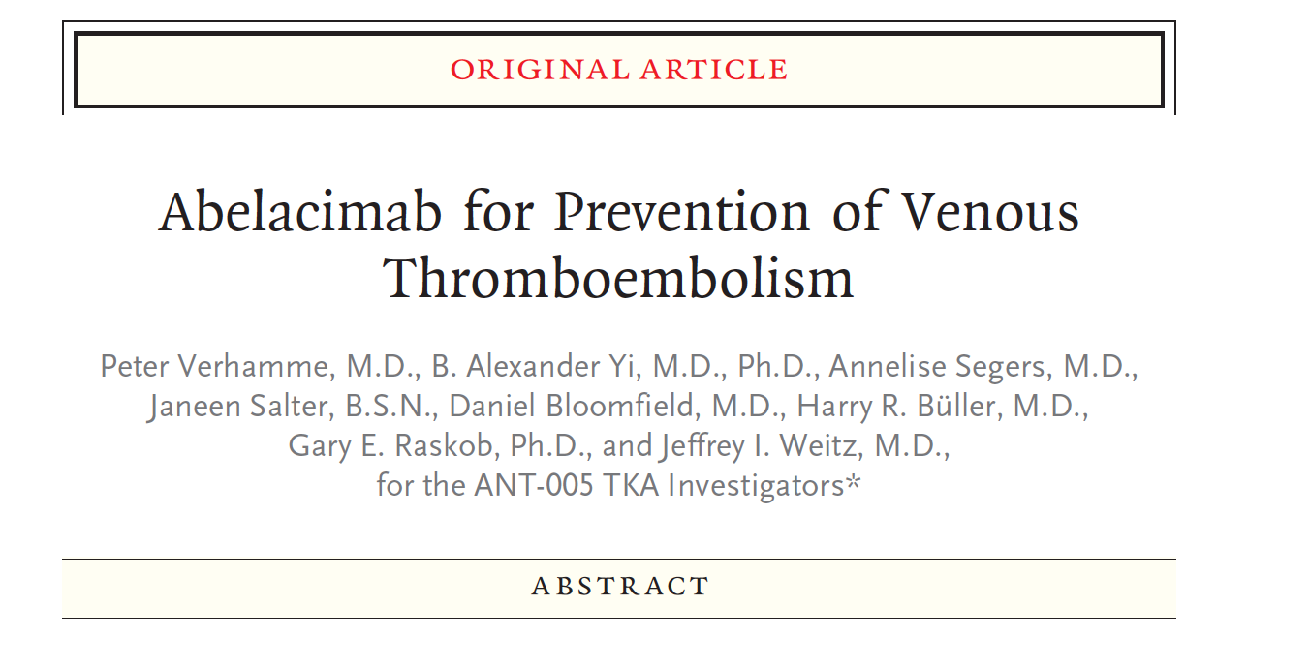
ANT-005 TKA Investigated the Use of Abelacimab Versus Enoxaparin in Patients Undergoing Elective Unilateral TKA
Abelacimab
Abelacimab

Slide 23
ANT-005 TKA Investigated the Use of Abelacimab Versus Enoxaparin in Patients Undergoing Elective Unilateral TKA
Abelacimab
Abelacimab

Slide 24
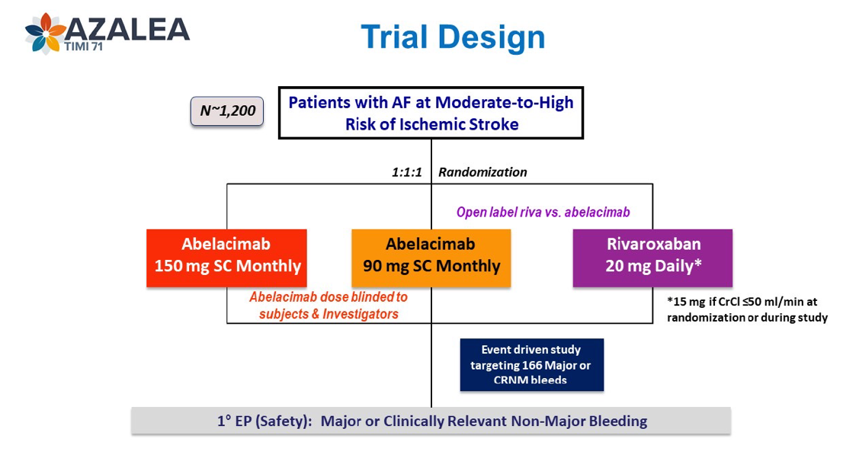
AZALEA-TIMI 71
Late Breaking Science AHA – November 12th 2023 - Sunday AM
Phase 2 study to evaluate the safety and tolerability of two blinded doses of abelacimab compared with open-label rivaroxaban in patients with AF.
Inclusion Criteria:
Patients ≥55 years old
Patients with a history of AF or atrial flutter with planned indefinite anticoagulation
CHA2DS2-VASc of ≥4 OR a CHA2DS2-VASc of ≥3 with at least 1 of the following:
  Planned concomitant use of antiplatelet medication use (i.e., aspirin and/or P2Y12 inhibitor) for the duration of the trial
  Creative Clearance ≤50ml/min

Slide 25
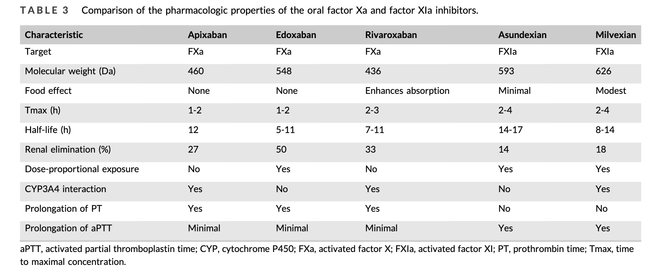
Comparison of FXa and Factor XIa inhibitors – small molecules

Slide 26
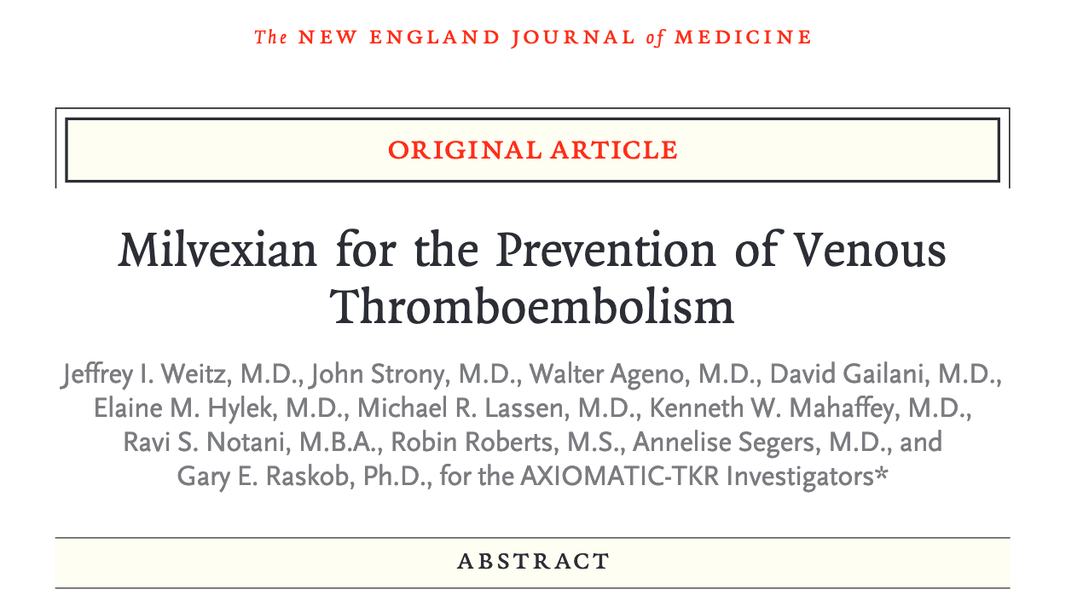
AXIOMATIC-TKR Investigated the Use of Milvexian Versus Enoxaparin in Patients Undergoing Elective Unilateral TKA
Milvexian twice daily
Milvexian once daily
Milvexian twice daily
Milvexian once daily

Slide 27
AXIOMATIC-TKR Investigated the Use of Milvexian Versus Enoxaparin in Patients Undergoing Elective Unilateral TKA
Milvexian twice daily
Milvexian once daily
Milvexian twice daily
Milvexian once daily

Slide 28
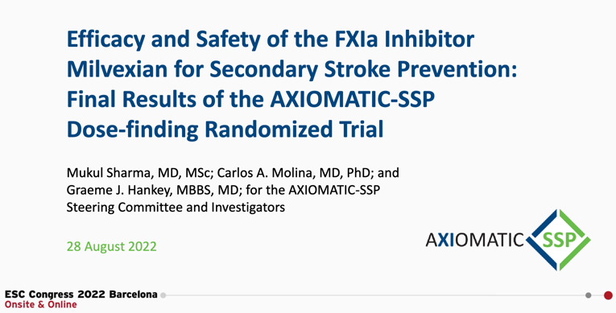
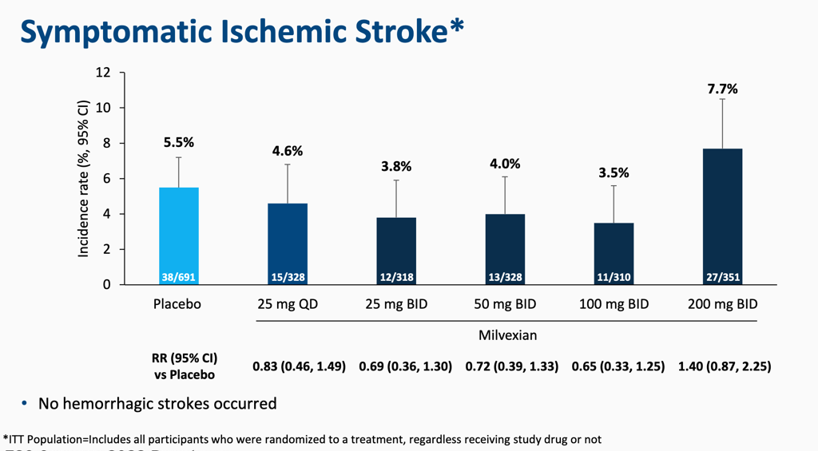
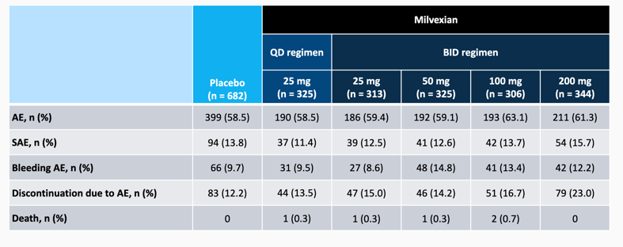
Phase 2: Milvexian in Secondary Stroke Prevention

Slide 29
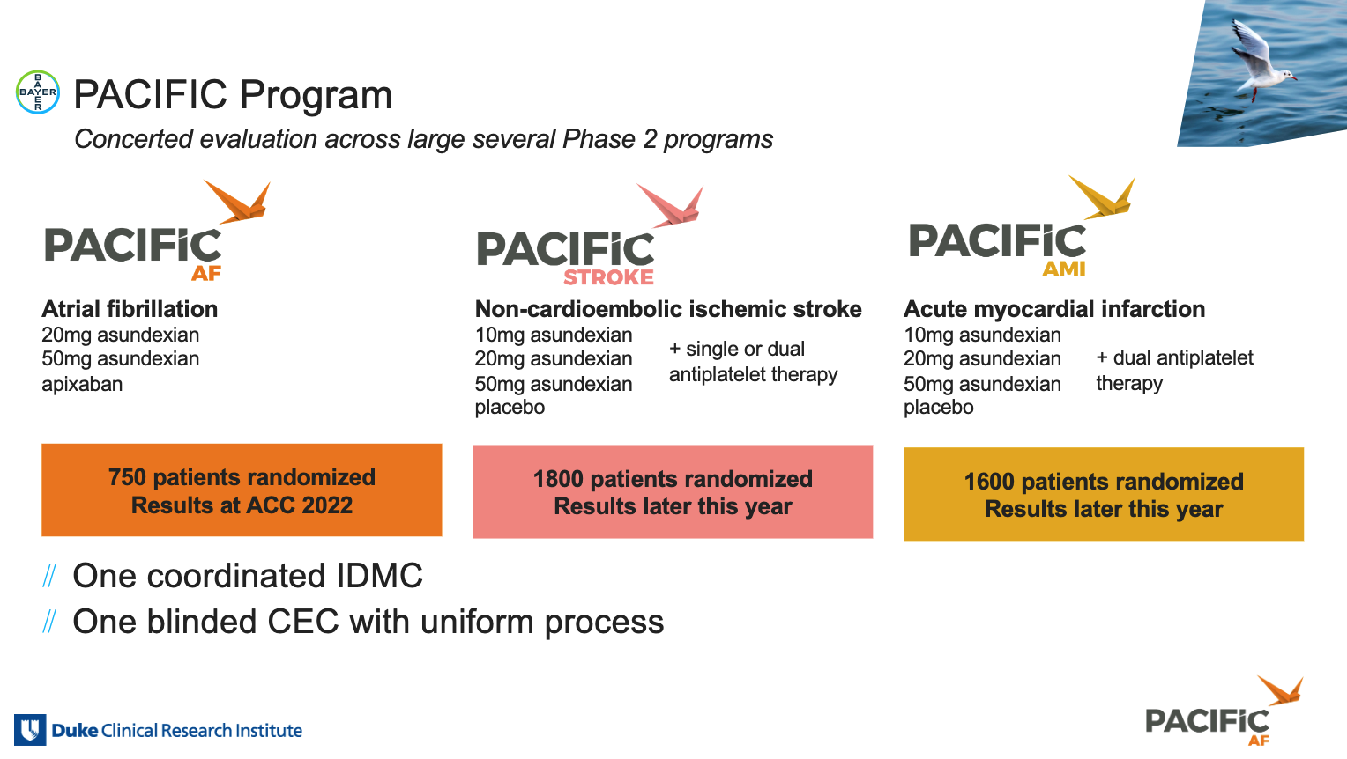
Phase II Clinical Data for Asundexian
Results available –
Piccini JP, et al. Lancet. 2022;399(10333):1383-1390.
Results available –
Shoamanesh A, et al. Lancet. 2022;400(10357):997-1007.
Results available –
Rao SV, et al. Circulation. 2022;146(16):1196-1206.

Slide 30
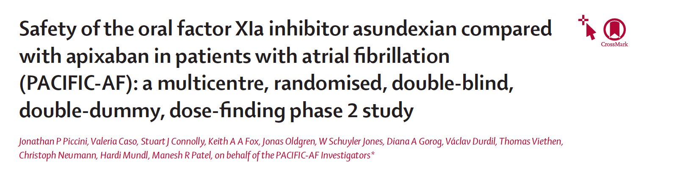
Prospective, randomized, double-blind, active-comparator, phase 2 study
Primary safety endpoint: bleeding (ISTH major and non-major clinically relevant bleeding)
Quantification of Factor XI inhibition
Exploratory efficacy endpoint: stroke, systemic embolism, CV death, MI
Asundexian 50 mg n = 250
2 weeks
post study drug
observation period
Patients with
atrial fibrillation
Asundexian 20 mg n = 250
R
Apixaban n = 250
Day 1
Randomization
W12
EOT
EOS
Primary Objective:
to evaluate that the oral FXIa inhibitor asundexian when compared to apixaban leads to a lower incidence of bleeding in participants with AF

Slide 31
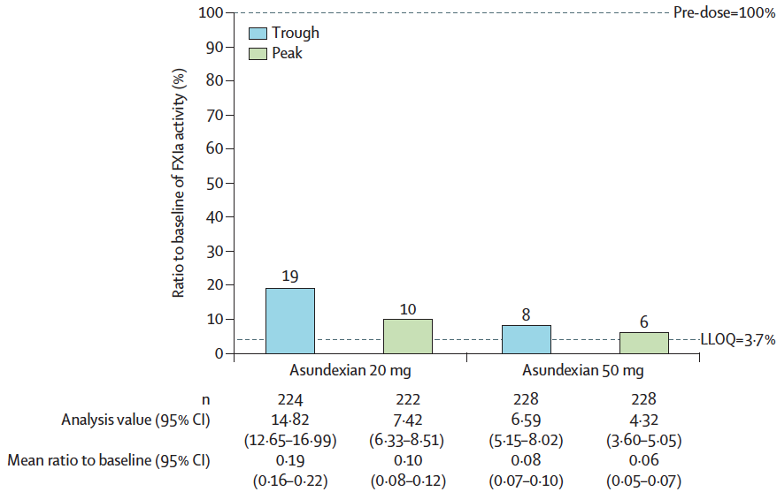
FXIa Activity - Inhibition Data
  Vertical bars indicate the percent reduction in FXIa activity when compared with baseline. FXIa=activated coagulation factor XI.
  LLOQ=lower level of quantification.

Slide 32
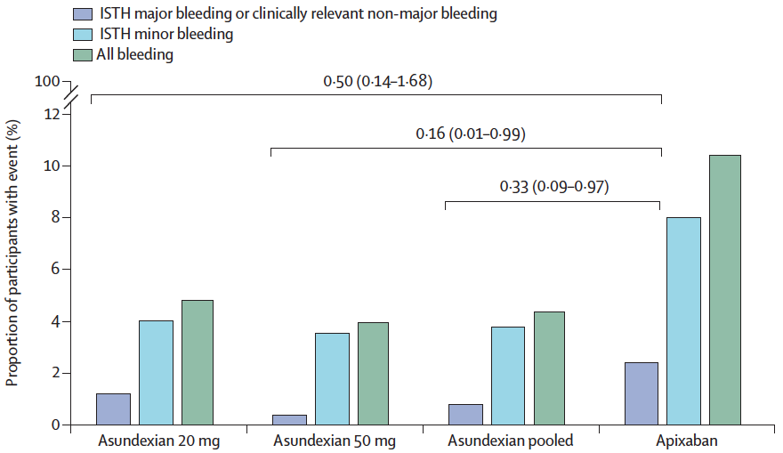
Primary Safety Outcome (ISTH bleeding classification)
On-treatment analysis, % of patients
  No ISTH major bleeding in any treatment arm
  Less bleeding in the 2 asundexian arms reported, when compared to apixaban for different severities of bleeding
  Consistent also for BARC and TIMI bleeding definitions

Slide 33
PACIFIC-Stroke: Schema
Prospective, randomized, double-blind, placebo-controlled, phase 2, dose-ranging study
Asundexian 50 mg QD n = 447
Patients with
Non-Cardioembolic Ischemic stroke ≤48 hrs from symptom onset
2 weeks
post study drug
observation period
Asundexian 20 mg QD n = 450
R
Asundexian 10 mg QD n = 455
Placebo QD n = 456
Background APT
Day 1
Randomization
MRI prior to or up to 72 hours post randomization
6-12 Months
EOT
MRI
EOS
Enrollment: 1808 patients between June 15, 2020 and July 22, 2021 at 196 sites in 23 countries

Slide 34
Primary Efficacy Outcome
Ischemic Stroke or Covert Infarcts at 6 months
No observed dose-response (Emax2 model t statistic: -0.68, p=0.80)

Slide 35

Secondary Exploratory Outcomes
Total follow-up (median 10.6 months)
Outcome | Asundexian, 10 (N=455) | Asundexian, 10 vs. placebo | Asundexian, 20 (N=450) | Asundexian, 20 vs. placebo | Asundexian, 50 (N=447) | Asundexian 50 vs. placebo | Placebo (N=456)
 | No. of patients (%) | HR (90% CI) | No. of patients (%) | HR (90% CI) | No. of patients (%) | HR (90% CI) | No. of patients (%)
TIA | 10 (2.2%) | 0.91 (0.44-1.87) | 2 (0.4%) | 0.18 (0.05-0.64) | 2 (0.4%) | 0.18 (0.05-0.65) | 11 (2.4%)
Recurrent ischemic stroke or TIA | 35 (7.7%) | 0.92 (0.63-1.35) | 28 (6.2%) | 0.74 (0.49-1.12) | 24 (5.4%) | 0.64 (0.41-0.98) | 38 (8.3%)
Dose dependent reduction of composite of ischemic stroke or TIA with asundexian

Slide 36
Bleeding Outcomes
A. Major or Clinically-Relevant Non-Major Bleeding (ISTH)¹
B. All Bleeding
HR 1.57, 90% CI 0.91 – 2.71
C. Hemorrhagic transformation in patients with baseline MRI after randomization
 | Asundexian 10 (N=277) | Asundexian 20 (N=265) | Asundexian, 50 (N=277) | Placebo (N=296)
HI1 and 2 | 29.6% | 29.4% | 30.3% | 32.8%
PH1 and 2 | 1.1% | 0.4% | 0% | 1.4%
No significant increase in bleeding and hemorrhagic transformation of index stroke
ASU = Asundexian, HI = hemorrhagic infarct, PH = parenchymal hematoma

Slide 37
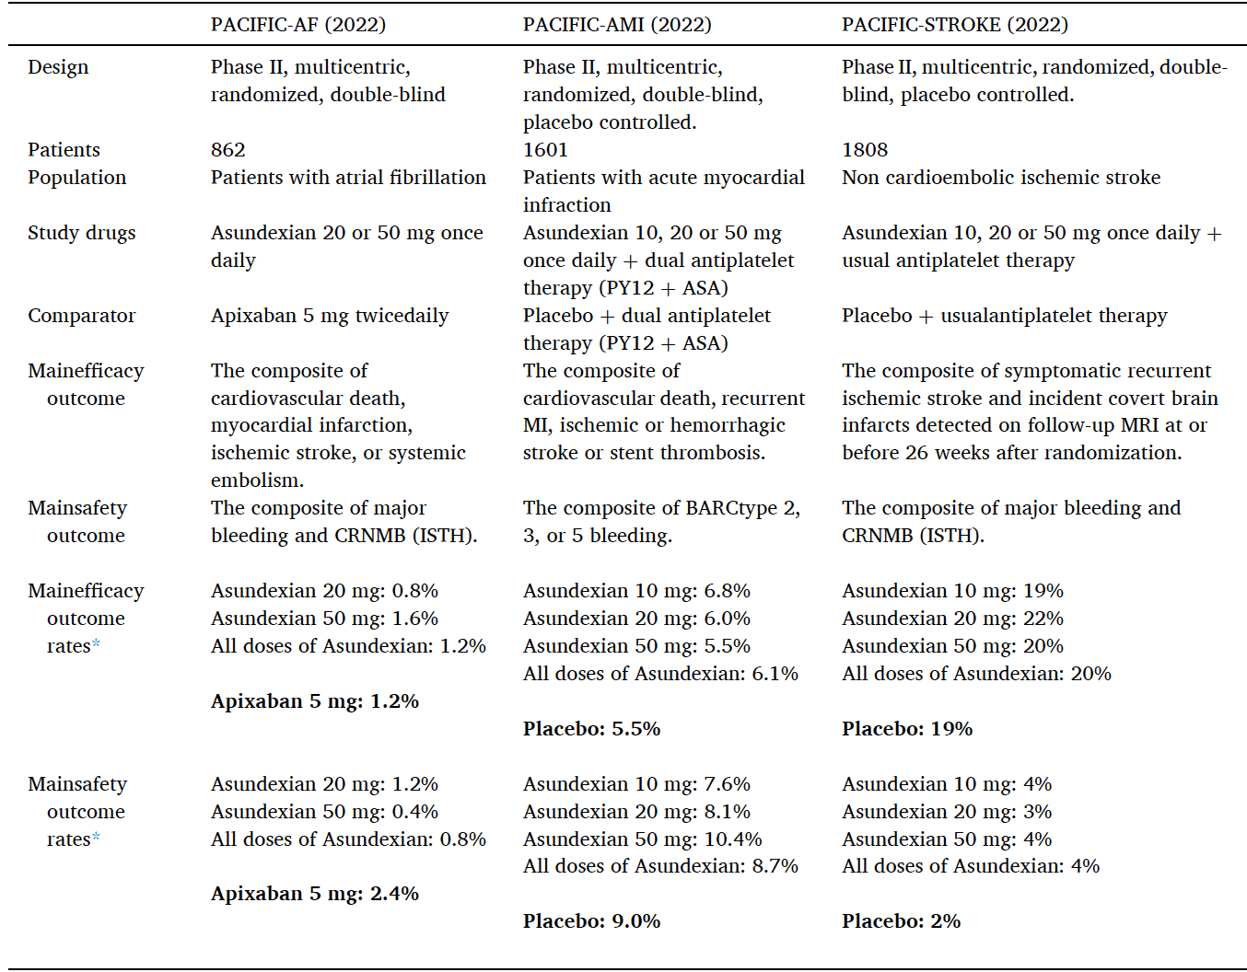
Summary of Phase II Clinical Data for Asundexian

Slide 38
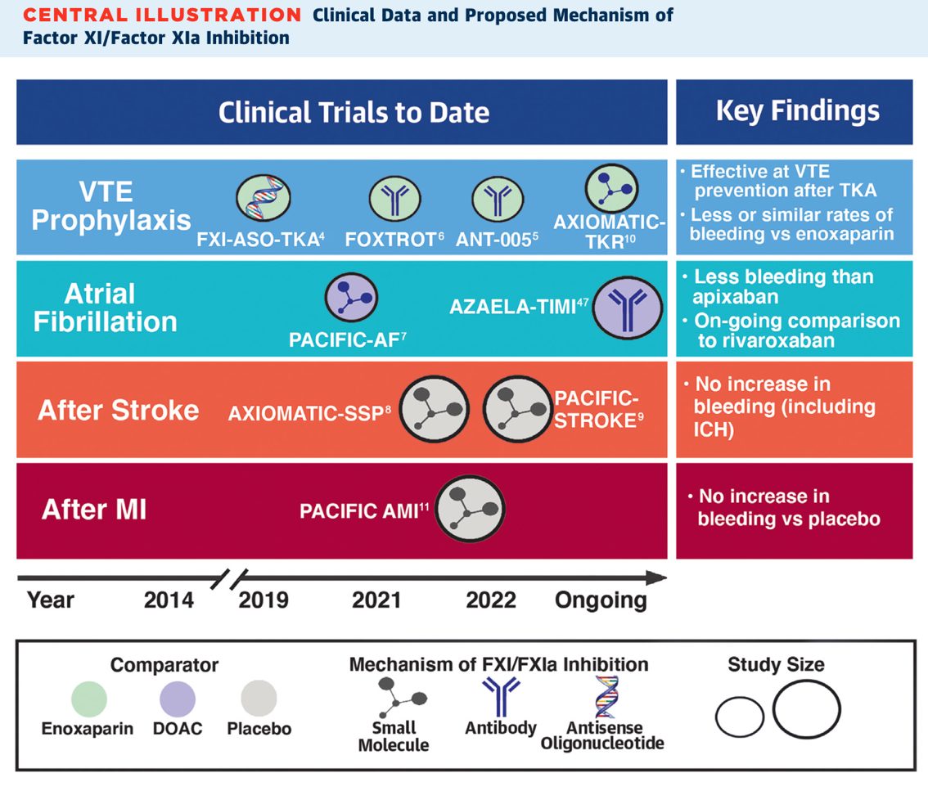
Phase 2 Data have shown
Less Bleeding than both enoxaparin and apixaban (PACIFIC AF)
No increase in bleeding in Secondary Stroke with signals towards less thrombosis
No increase in bleeding in AMI – efficacy signals limited

Slide 39
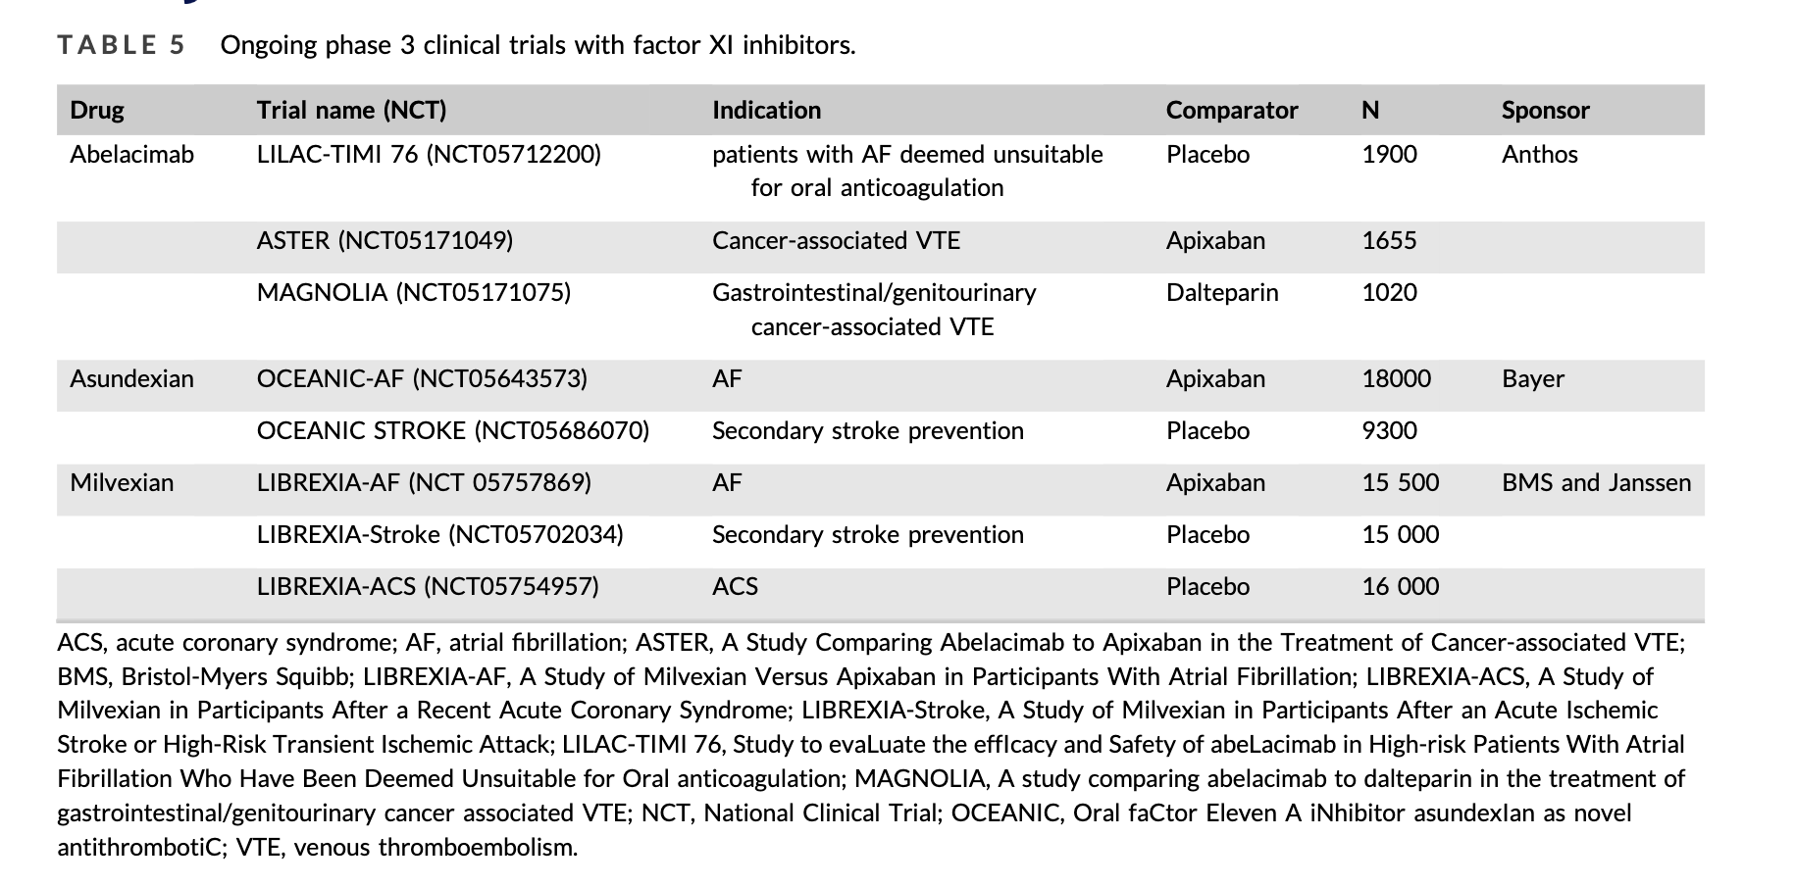
Summary of Ongoing Phase 3 Trials Targeting Factor XI Inhibition

Slide 40
Summary - Factor XI/XIa Inhibitors
Many untreated patients and clinical needs (AF, secondary stroke, ACS, Renal failure, mechanical valves)
Inhibition of Factor XI with biologic plausibility and Phase 2 data showing promising results for less bleeding and similar or less thrombosis.
ASO, mAB, and small molecules being tested against FXI (Abelacimab, Asundexian, and Milvexian farthest along)
Keys will be maximizing the compounds strengths to the patients, comparators, and use in clinical practice.
Understanding patient preferences and net benefits will lead to improved next decade of anti-thrombotic therapy –
  Aim at enrolling at risk populations (including those at high risk for bleeding many not getting therapy currently)
  Capture relevant endpoints (thrombotic, bleeding, and other) and patient’s perspectives and preferences.
  Work on defining the relative value of the bleeding protection from these agents at same or better thrombosis protection

Slide 41
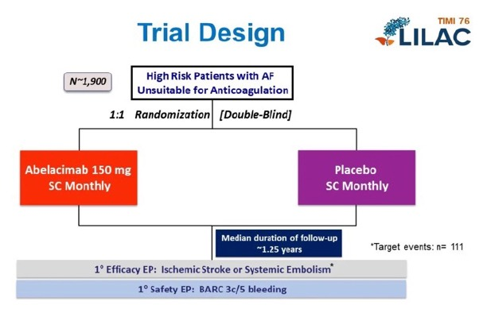
LILAC-TIMI 76
Phase 3 trial investigating the efficacy and safety of abelacimab in patients with AF deemed unsuitable for OAC
Main inclusion criteria
Age 65 to 74 and CHA2DS2VASc of 5 or greater
OR
Age 75 and older and a CHA2DS2VASc of 4 or greater
Unsuitable for oral anticoagulation
At least 1 bleeding risk factor e.g. severe renal insufficiency, use of antiplatelet medication, history of bleeding from a critical area, frailty or multiple falls

Slide 42
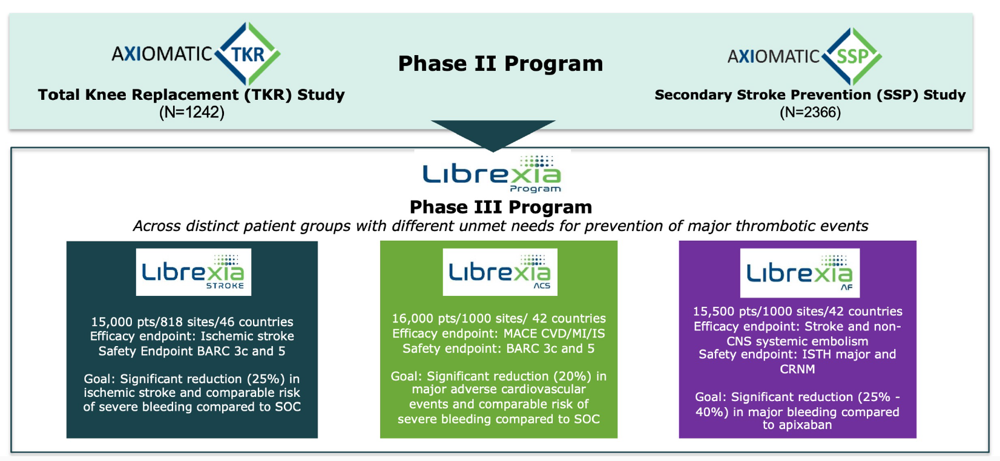
Librexia-AF (Milvexian)

Slide 43
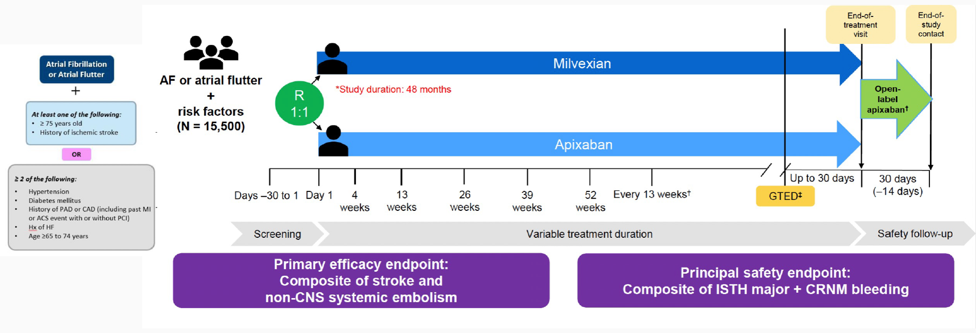
Librexia-AF: Study design (non-inferiority)
A Phase 3, Randomized, Double-Blind, Double-Dummy, Parallel Group, Active-Controlled Study to Evaluate the Efficacy and Safety of Milvexian Versus Apixaban in Participants With Atrial Fibrillation

Slide 44
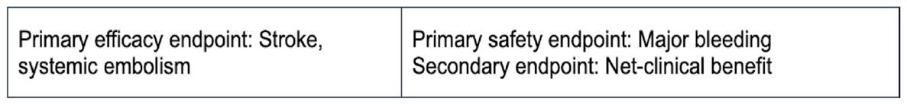

Study Design Overview
SCREENING
≤ 14 days
TREATMENT DURATION: 9-33 months
FOLLOW-UP
2 weeks after end of
study drug intake
Informed Consent
  Asundexian 50 mg OD N ≈ 9000
RND
N ≈ 18000
  Apixaban 5 mg or 2.5 mg BID ǂ N ≈ 9000
VISIT 1
Screening
VISIT 2
DAY 1
VISIT 3
M 1
VISIT 4
M 3
VISITS 5, 7, 9, 11, 13, etc.*
M 6, 12, 18, 24, 30, etc.
VISITS 6, 8, 10, 12, etc.*
M 9, 15, 21, 27, etc.
CEOT VISIT
~ M 33 *
CEOT FU
CEOT + 2 W
Duration of Treatment: ~9-33 months

Slide 45



Looking for more resources
on this topic?
CME/CE in minutes
Congress highlights
Late-breaking data
Quizzes
Webinars
In-person events
Slides & resources
www.MedEdOTG.com

