Slide 1





New Frontiers in Anticoagulation:
Factor XI/XIa Inhibitors
Saturday, November 11, 2023 | 6:00pm – 7:30pm ET
Philadelphia Marriott Downtown | Salon H | Philadelphia, PA
This activity has been designed to meet the educational needs of the interprofessional team approach intended for clinical cardiologists, emergency medicine physicians, hematologists, hospitalists, neurologists, primary care physicians, vascular medicine practitioners, and vascular surgeons, as well as other clinicians involved in the management of patients with anticoagulation.
Supported by an educational grant from Bayer HealthCare Pharmaceuticals Inc. Jointly provided by the Global Learning Collaborative (GLC), Duke Heart, and Total CME, LLC.

Slide 2



Resource Information
About This Resource
These slides are one component of a continuing education program available online at MedEd On The Go titled New Frontiers in Anticoagulation: Factor XI/XIa Inhibitors
Program Learning Objectives:
Review the currently available therapeutics and how they affect multiple pathways involved in the coagulation cascade, thereby increasing the potential for serious bleeds
Review current decision pathways for initiation of anticoagulation treatment and shared patient-physician decision-making, emphasizing potential prescriber bias that limits more widespread adoption of DOAC therapy
Review cardiac and non-cardiac patient populations where DOACs have limitations or contraindications
Discuss factor XI and factor XIa inhibition and review new and emerging anticoagulation pharmacotherapy for VTE, AF, secondary stroke prevention, and post-MI
MedEd On The Go®
www.mededonthego.com
This content or portions thereof may not be published, posted online or used in presentations without permission.
This content can be saved for personal use (non-commercial use only) with credit given to the resource authors.
To contact us regarding inaccuracies, omissions or permissions please email us at support@MedEdOTG.com

Slide 3
Disclaimer
The views and opinions expressed in this educational activity are those of the faculty and do not necessarily represent the views of Total CME, LLC, the CME providers, or the companies providing educational grants. This presentation is not intended to define an exclusive course of patient management; the participant should use their clinical judgment, knowledge, experience, and diagnostic skills in applying or adopting for professional use any of the information provided herein. Any procedures, medications, or other courses of diagnosis or treatment discussed or suggested in this activity should not be used by clinicians without evaluation of their patient's conditions and possible contraindications or dangers in use, review of any applicable manufacturer’s product information, and comparison with recommendations of other authorities. Links to other sites may be provided as additional sources of information.

Slide 4


While DOACs Are Good for Some Things, They Are Not for Everyone
M. Cecilia Bahit, MD
Chief of Cardiology
INECO Neurociencias
Rosario, Argentina

Slide 5
Atrial Fibrillation
Stroke
Post-MI
MI, myocardial infarction.

Slide 6
The Problem with Atrial Fibrillation
5x
Anticoagulation
AF is associated with a five-fold increase in stroke risk
AF-related strokes are associated with a greater risk of mortality and long-term disability compared with other stroke subtypes
This risk is largely modifiable with anticoagulation
↑ Death and Disability

Slide 7
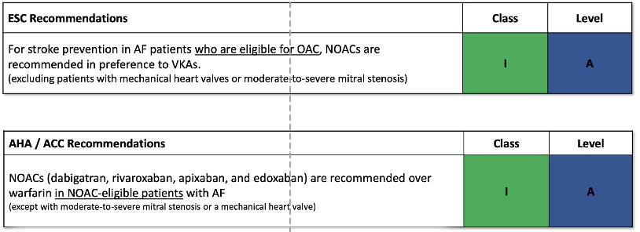
AF Guidelines

Slide 8
Consistent with the Literature, the Risk of Stroke, Bleeding, and Mortality Increased with Declining Renal Function in ARISTOTLE
As renal function deteriorated, associated morbidity and mortality increased
Renal Function
Stroke Rate
Characteristic | Renal function
 | >80 mL/min n=7,518 (42%) | >50-80 mL/min n=7,587 (42%) | <50 mL/min n=3,017 (15%)
Annualized stroke rate | 1.05% | 1.46% | 2.39%
Annualized ischemic stroke rate | 0.76% |  | 1.70%
All-cause mortality | 2.52% |  | 7.71%
Major bleeding | 1.65% |  | 4.80%
Notes:
Tonelli et al., 2006 figure 2 page 2038
Hohnloser 2012 p2823 col1, para3-4

Slide 9
Direct Oral Anticoagulants (“DOACs”)
 | Dabigatran | Rivaroxaban | Apixaban | Edoxaban
Mechanism of action | Selective direct FIIa inhibitor | Selective direct FXa inhibitor | Selective direct FXa inhibitor | Selective direct FXa inhibitor
Bioavailability | Oral prodrug with poor oral bioavailability (6.5%) | Good oral bioavailability | Good oral bioavailability | Good oral bioavailability
T_{½} | 12 - 17 hours | 6 - 9 hours | 12 hours | 9 - 11 hours
Dosing | Twice daily | Once or twice daily | Twice daily | Once or twice daily
Time action | 1 - 4 hrs post-dose for max. inhibition | 1 - 4 hrs post-dose for max. inhibition | 1 - 4 hrs post-dose for max. inhibition | 1 - 4 hrs. post-dose for max. inhibition
Platelet aggregation | No direct effect | No direct effect | No direct effect | No direct effect
Elimination | 80% renal | 35% renal | 25% renal | 50% renal
Head-to-head studies do not exist, therefore comparisons between agents cannot be made.

Slide 10
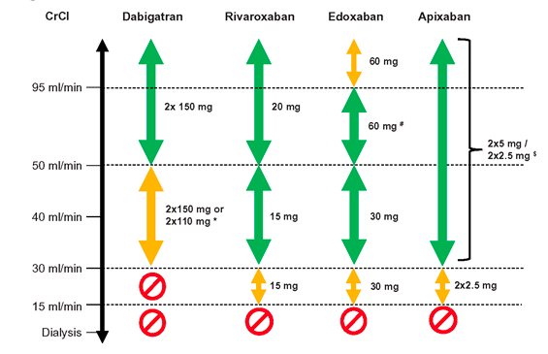
Use of DOACs According to Renal Function

Slide 11
Increasing Age Is Associated with Increased Risk of Stroke and Decreased Use of Oral Anticoagulants
Warfarin use in eligible patients
55% overall use
OAC Use
Unmet Need
High risk of stroke
Low OAC use
Warfarin Use in Eligible Patients
Risk of stroke
The use
of anticoagulation decreases with increasing age.
in AF increases dramatically
with age.
Age
Age (years)

Slide 12
Unmet Need
Abnormal Renal Function
Increased Risk of Bleeding
Increased Risk of Bleeding
Increased Risk of Bleeding
Increased risk of stroke, bleeding and death as renal function declines
Perceived High Bleeding Risk
Data lacking on CrCl ≤25 mL/min, hemodialysis
Patients with high bleeding risk such as elderly, frail, frequent falls
AF prevalence increases with age, as the % of frail patients
Optimal care remains uncertain in patients that require antiplatelet and anticoagulation
Patients unsuitable for anticoagulation
No clear definition for “unable to tolerate”
Only 30-48% of AF eligible patients receive DOACs and 1 out of 4 receive off-label doses
62-85% persists on DOACs at 1 year

Slide 13
Stroke
Stroke Prevalence
Recurrent Stroke
In 2019, stroke prevalence was 77 million people worldwide
Stroke is the second cause of death globally
The risk is higher after the initial ischemic stroke
Death and Disability
One of the leading causes of disability worldwide and in the USA

Slide 14
Guidelines for Antiplatelet Therapy Early After Minor Non-Cardioembolic IS or High-Risk TIA
Non-cardioembolic IS or TIA < 24 hours
Ischemic Stroke
TIA
NIHSS < 5
NIHSS < 3
Low risk
ABCD2 score > 4
ABCD2 score > 6
DAPT
Aspirin+Ticagrelor
30 days* vs 90 days
DAPT
Aspirin+Clopidogrel
21 days* vs 90 days
DAPT
Aspirin+Clopidogrel
21 days* vs 90 days
DAPT
Aspirin+Ticagrelor
30 days* vs 90 days
Single antiplatelet therapy

Slide 15
Guidelines for Long-Term Secondary Prevention
Prior IS or TIA
CAD/PAD
No
Yes
Long-term SAPT
Antiplatelet therapy combined
with low-dose rivaroxaban
can be considered

Slide 16
Residual Risk of Recurrent Stroke Continues to Be High in Contemporary Studies
Ischemic stroke at 90 days
%

Slide 17
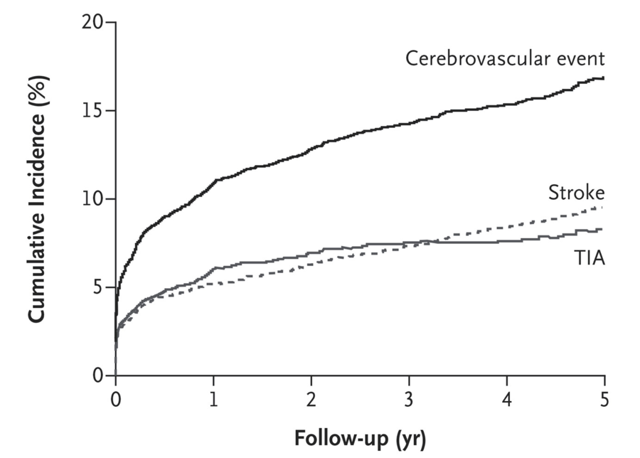
Long-Term Residual Risk After TIA or Minor Stroke
TIAregistry.org project
Cumulative incidence of any cerebrovascular event, any stroke, and TIA.
At 5 years
ASA 70%
Other antiplatelet 36.5%
Dual antiplatelet 6.6%
Anticoagulant 17%

Slide 18
Dual Pathway Inhibition with Antiplatelet Therapy and an Anticoagulant: Subgroup Analysis of COMPASS Trial
Patients with prior stroke (N=1032 in the 3 study arms)
Compared with ASA alone, rivaroxaban + ASA
  ↓ Ischemic Stroke: 3.4% versus 1.1% [HR 0.42 (95%CI 0.19-0.92)]
  ↓ Annualized rate of composite (CV death, stroke or MI): 6.6% versus 3.7%
  ↑ Annualized rate of major bleeding: 0.5% versus 1.9%
Not initiated early after stroke

Slide 19
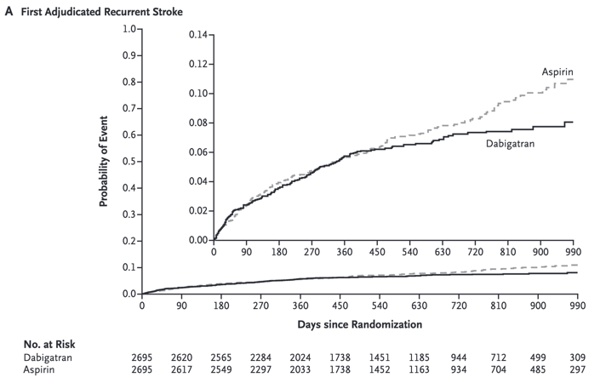
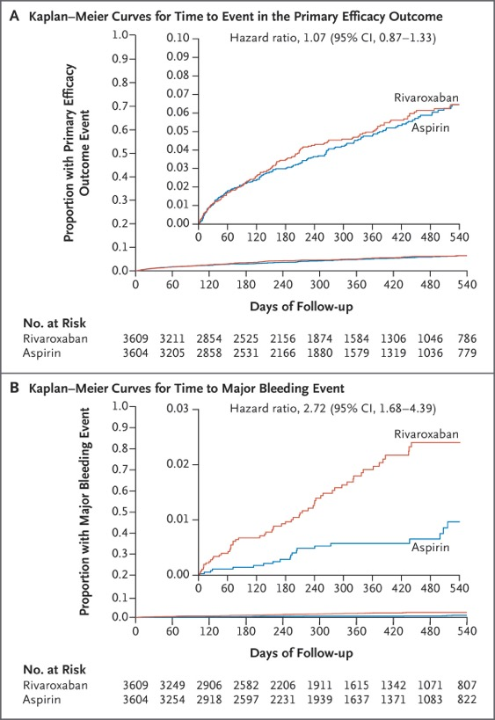
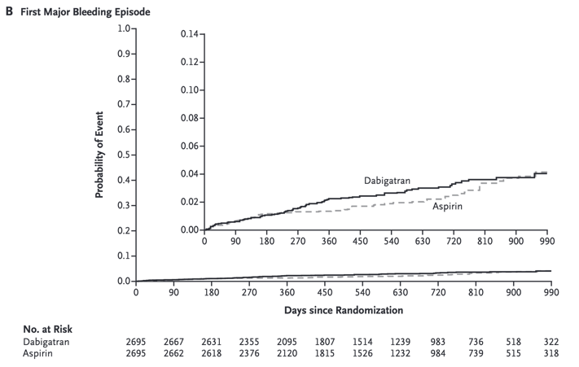
DOACs in ESUS Population
NAVIGATE ESUS
RE-SPECT ESUS

Slide 20
Unmet Need
A subgroup analysis of COMPASS, showed reduction in stroke and MACE but increased risk of bleeding
Current Need
Recurrent Events
DOACs/ Increased
Risk of Bleeding
Despite current antithrombotic treatment in non-cardioembolic stroke, there is an increased risk of recurrent strokes
There is a need for a secondary prevention strategy to prevent recurrent strokes not associated with an increased risk of bleeding

Slide 21
Post-Myocardial Infarction
Recurrent MI
Despite advances in pharmacotherapy and devices, high rates of recurrent MI persists
Half of the events occur within first 90 days
Early
Recurrent MIs are associated with increased mortality
Death

Slide 22
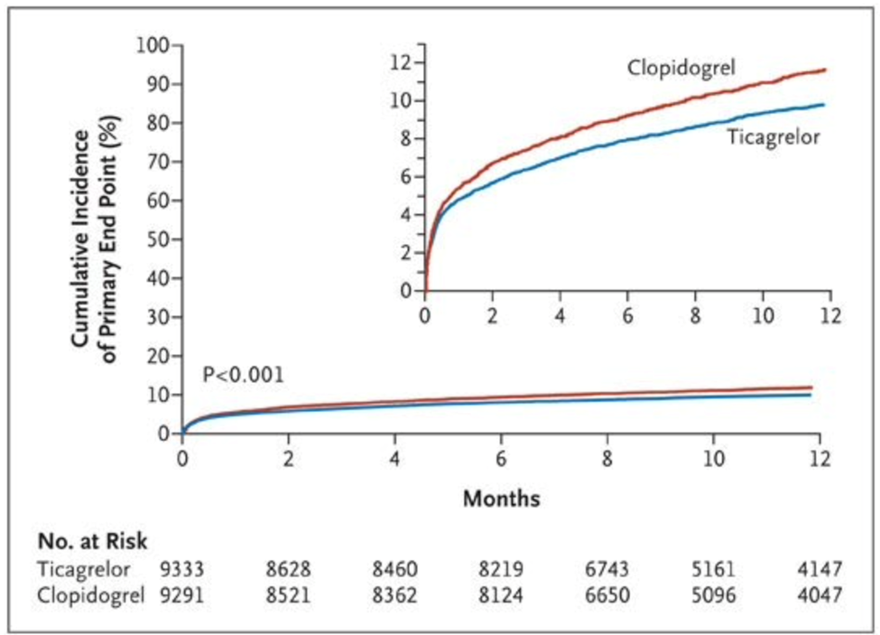
There Is a High Risk of Recurrent CV Events After ACS
Approximately 12% of patients have a recurrent CV event within 1 year of index AMI

Slide 23
Half of Recurrent Events During the First Year
Post-MI Occur Within the First 90 Days
Early and Late Recurrent MACE:
Meta-analysis of 7 Clinical Trials
(N=82,727 patients post ACS)
PLATO (2009)
12
10
8
  Overall, risk of MACE was 4.1% at 90 days vs 8.3% at 360 days
Cumulative incidence of MI/stroke/CV mortality (%)
6
4
Clopidogrel
2
605,000
(75%)
Early (1−90 days)
Ticagrelor
Late (91−360 days)
0
0
2
4
6
8
10
12
Months
Created using data from Chi G, et al. 2022.¹

Slide 24
Half of Recurrent Events During the First Year
Post-MI Occur Within the First 90 Days
Early and Late Recurrent MACE:
Meta-analysis of 7 Clinical Trials
(N=82,727 patients post ACS)
PLATO (2009)
12
90 Days*
10
8
  Overall, risk of MACE was 4.1% at 90 days vs 8.3% at 360 days
Cumulative incidence of MI/stroke/CV mortality (%)
6
4
Clopidogrel
2
605,000
(75%)
Early (1−90 days)
Ticagrelor
Late (91−360 days)
0
0
2
4
6
8
10
12
Months
Created using data from Chi G, et al. 2022.¹

Slide 25
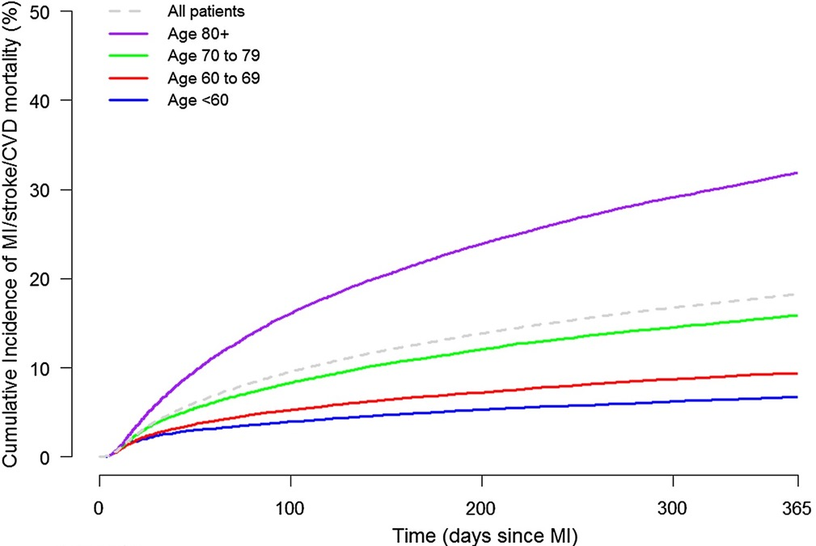
Risk of Recurrent Events in the First 90 Days Post-AMI
Swedish Registry Data
N=97,254
Patients:
  Primary diagnosis of AMI
  1 week after discharge
Primary endpoint: non-fatal MI, non-fatal stroke, or CV death

Slide 26
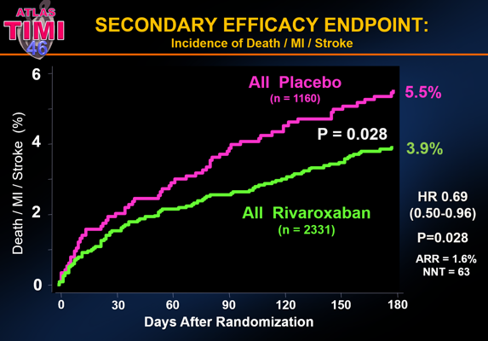
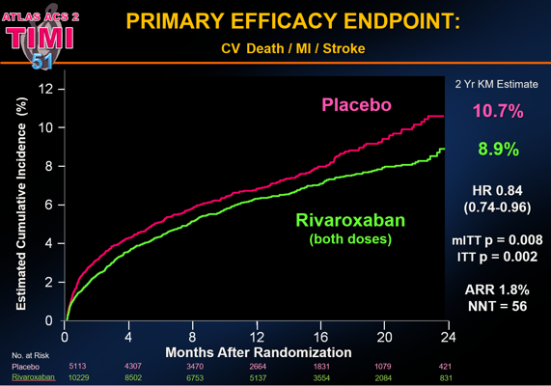
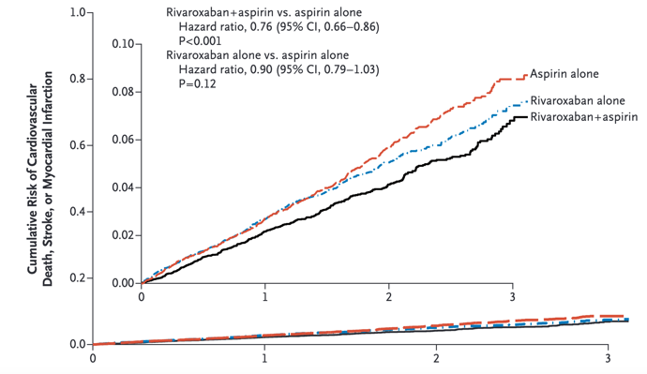
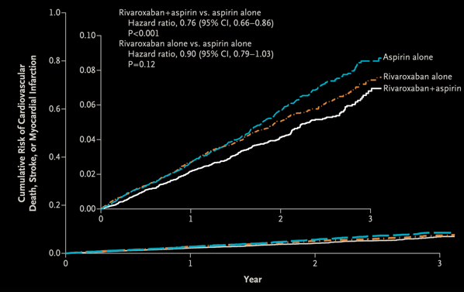
Addition of Anticoagulation to Antiplatelet Therapy Reduces Risk of MACE
Death, Myocardial Infarction or Stroke
ATLAS ACS 1: TIMI 46
ATLAS ACS 2: TIMI 51
COMPASS

Slide 27
Rivaroxaban Reduced Myocardial Infarction
Pooled Analysis
ATLAS TIMI 46 Trial and ATLAS TIMI 51 Trial
Combined rivaroxaban doses were
associated with a significant 46% reduction in the risk of MI
(HR=0.54, 95% CI=0.34–0.85, P=0.008)
COMPASS Trial
14% Reduction in MI Rivaroxaban +ASA vs ASA
11% Reduction in MI Rivaroxaban vs ASA

Slide 28
Reduction in MACE BUT..
ATLAS TIMI 46 Trial
Post ACS
Dose dependent increase in clinically significant bleeding
2x Riva 5 mg, 3x Riva 1- mg, 3.6x Riva 15 mg, 5x Riva 20 mg
ASA or ASA + Thienopyridines
ATLAS TIMI 51 Trial
Recent ACS Median 4.7 days
4 x ↑ TIMI Major Bleeding with Rivaroxaban versus Placebo
Background therapy ASA + Thienopyridines
COMPASS Trial
Stable Atherosclerotic Vascular Disease
1.70 x ↑ Major Bleeding with Rivaroxaban +ASA versus ASA
1.51 x ↑ Major Bleeding with Rivaroxaban versus ASA
Riva, rivaroxaban.
Mega JL, et al. Lancet. 2009;374(9683):29-38; Mega JL, et al. N Engl J Med. 2012;366(1):9–19; Eikelboom JW, et al. N Engl J Med. 2017;377(14):1319–30.

Slide 29
Unmet Need
Low-dose rivaroxaban- reduces thrombin generation- has been associated with improved outcomes post ACS
In the post ACS setting, the efficacy of rivaroxaban was countered by an excess of bleeding
Current Need
Recurrent Events
DOACs
Increased Risk of Bleeding
Increased risk of recurrent events post ACS, despite current treatment
There is a need for a secondary prevention strategy targeting thrombin generation that is not associated with an excess risk of major bleeding

Slide 30
Conclusions
In each of the three settings described—
Atrial fibrillation (high risk bleeding, renal impairment, etc.)
Non-cardioembolic stroke
Post-ACS
—there is an unmet need for a treatment that reduces the rate of events without increasing the risk of bleeding.

Slide 31



Looking for more resources
on this topic?
CME/CE in minutes
Congress highlights
Late-breaking data
Quizzes
Webinars
In-person events
Slides & resources
www.MedEdOTG.com

