Slide 1





New Frontiers in Anticoagulation:
Factor XI/XIa Inhibitors
Saturday, November 11, 2023 | 6:00pm – 7:30pm ET
Philadelphia Marriott Downtown | Salon H | Philadelphia, PA
This activity has been designed to meet the educational needs of the interprofessional team approach intended for clinical cardiologists, emergency medicine physicians, hematologists, hospitalists, neurologists, primary care physicians, vascular medicine practitioners, and vascular surgeons, as well as other clinicians involved in the management of patients with anticoagulation.
Supported by an educational grant from Bayer HealthCare Pharmaceuticals Inc. Jointly provided by the Global Learning Collaborative (GLC), Duke Heart, and Total CME, LLC.

Slide 2



Resource Information
About This Resource
These slides are one component of a continuing education program available online at MedEd On The Go titled New Frontiers in Anticoagulation: Factor XI/XIa Inhibitors
Program Learning Objectives:
Review the currently available therapeutics and how they affect multiple pathways involved in the coagulation cascade, thereby increasing the potential for serious bleeds
Review current decision pathways for initiation of anticoagulation treatment and shared patient-physician decision-making, emphasizing potential prescriber bias that limits more widespread adoption of DOAC therapy
Review cardiac and non-cardiac patient populations where DOACs have limitations or contraindications
Discuss factor XI and factor XIa inhibition and review new and emerging anticoagulation pharmacotherapy for VTE, AF, secondary stroke prevention, and post-MI
MedEd On The Go®
www.mededonthego.com
This content or portions thereof may not be published, posted online or used in presentations without permission.
This content can be saved for personal use (non-commercial use only) with credit given to the resource authors.
To contact us regarding inaccuracies, omissions or permissions please email us at support@MedEdOTG.com

Slide 3
Disclaimer
The views and opinions expressed in this educational activity are those of the faculty and do not necessarily represent the views of Total CME, LLC, the CME providers, or the companies providing educational grants. This presentation is not intended to define an exclusive course of patient management; the participant should use their clinical judgment, knowledge, experience, and diagnostic skills in applying or adopting for professional use any of the information provided herein. Any procedures, medications, or other courses of diagnosis or treatment discussed or suggested in this activity should not be used by clinicians without evaluation of their patient's conditions and possible contraindications or dangers in use, review of any applicable manufacturer’s product information, and comparison with recommendations of other authorities. Links to other sites may be provided as additional sources of information.

Slide 4


Factors Driving the Underuse of Anticoagulant Therapy for Stroke Prevention
While the DOAC Revolution Has Occurred, 40-50% of Patients Remain Untreated… Why?
Elaine M. Hylek, MD, MPH
Professor of Medicine
Boston University School of Medicine
Director, Thrombosis Clinic and Anticoagulation Service
Boston Medical Center
Boston, MA

Slide 5
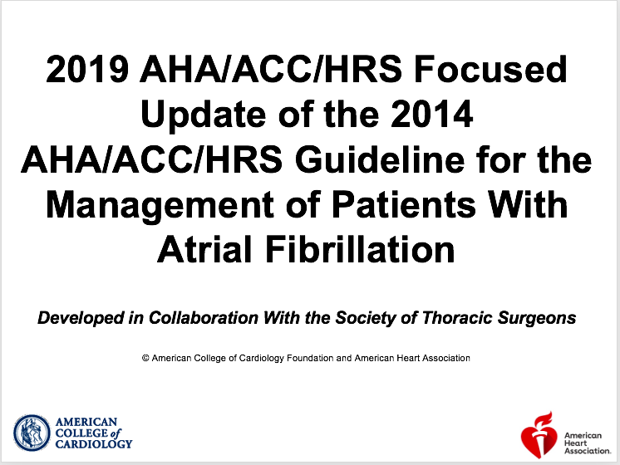

Slide 6
Key Distinctions: 2014 Atrial Fibrillation (AF) Guideline - 2019 AF Focused Update | Atrial Fibrillation (AF) | Guideline - 2019 AF Focused Update
 | 2014 AF Guideline | 2019 AF Focused Update
NOACs approved for stroke prevention | Dabigatran, Rivaroxaban, Apixaban (Class I) | Dabigatran, Rivaroxaban, Apixaban, and Edoxaban (Class I)
Oral anticoagulants recommended for eligible patients | Warfarin or NOACs (Class I) | NOACs recommended over Warfarin (Class I)
Oral anticoagulants recommended for patients with end-stage renal disease or on dialysis | Warfarin (Class IIa) | Warfarin or Apixaban (Class llb)
FDA-approved reversal agent for Dabigatran | N/A | Idarucizumab (Class I)
FDA-approved reversal agent for Rivaroxaban and Apixaban | N/A | Andexanet Alfa (Class IIa)

Slide 7
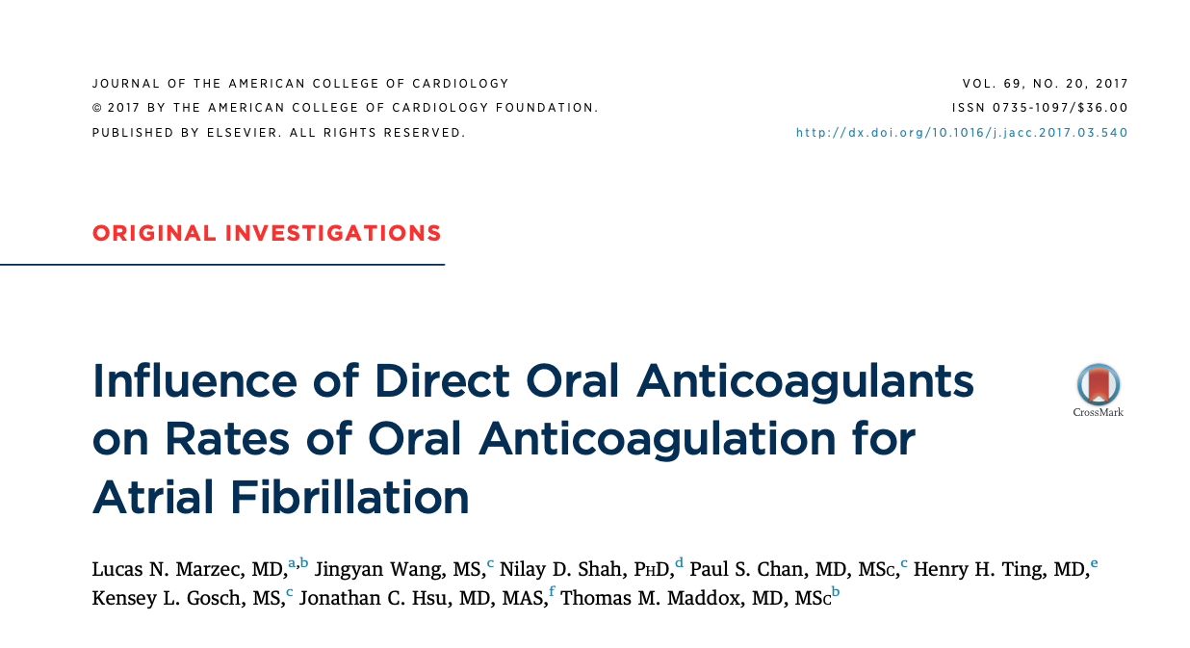

Slide 8
FIGURE 1: Derivation of the Analysis Cohort
740,255 patients with non-valvular AF
53,367 (7.2%) CHA₂DS₂ -VASc ≤1
25,918 (3.5%) prior cardiac valve surgery
658 (0.09%) documented contraindication to OAC
5312 (0.72%) multiple OACs recorded in one visit
655,000 (88.5%) included in primary analysis cohort
The derivation of the analysis cohort is shown. AF = atrial fibrillation: CHA₂DS₂-VASc = congestive heart failure, hypertension, age =75 years, diabetes mellitus, prior stroke, transient ischemic attack, or thromboembolism, vascular disease, age 65-74 years, sex category (female); OAC = oral anticoagulation.

Slide 9
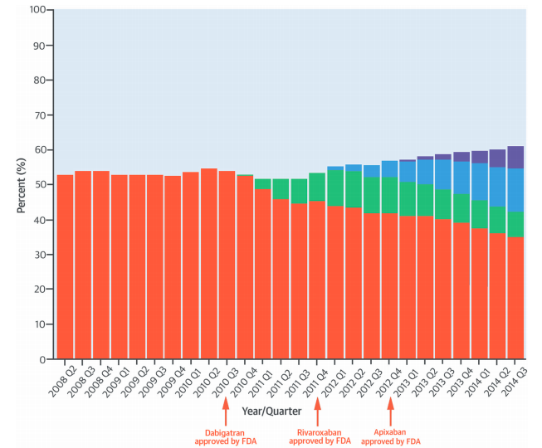
Oral Anticoagulant Use PINNACLE Registry
Warfarin
Dabigatran
Rivaroxaban
Apixaban

Slide 10
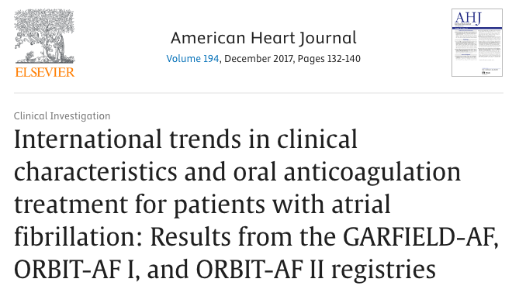
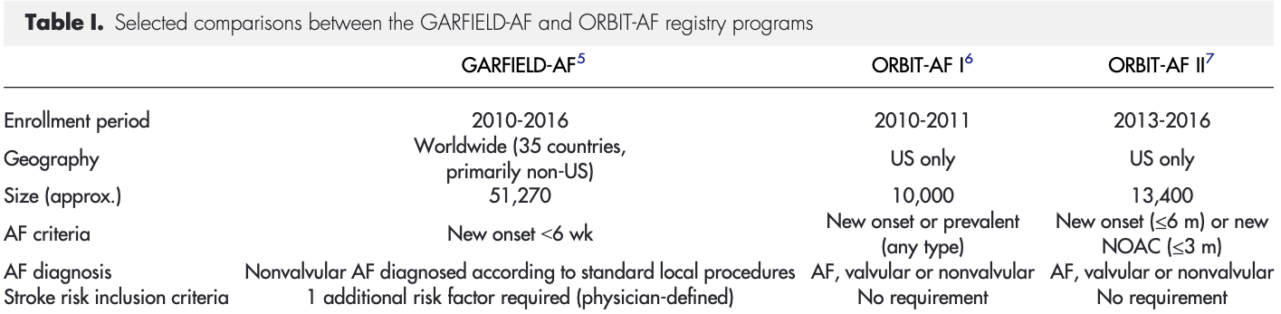

Slide 11
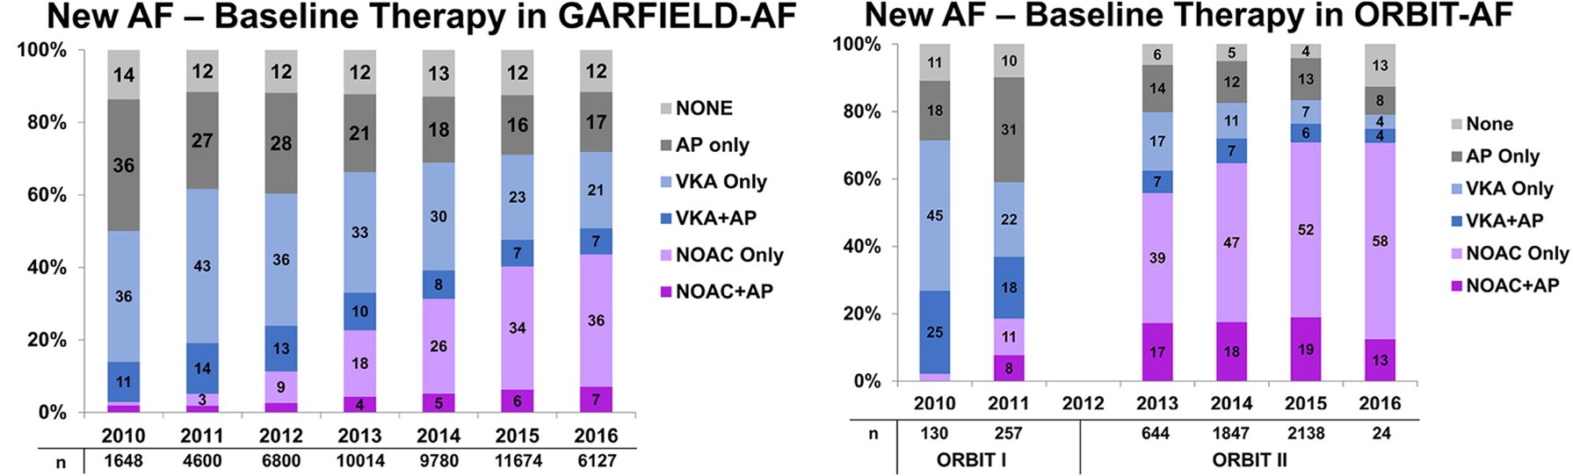
Anticoagulant Use For New Onset
Atrial Fibrillation
71% prescribed AC
79% prescribed AC

Slide 12
Factors Driving Underuse of
Anticoagulant Therapy
Perceived Bleeding Risk
True Bleeding Risk
Fall risk, older age, history of bleeding
Refractory bleeding, thrombocytopenia, prior ICH, severe hepatic or renal impairment
Uncertainty regarding
paroxysmal AF
Uncertainty regarding success of rhythm restoration
Patient preference and mixed messages
Nonadherence

Slide 13
How Frequent is Bleeding with DOACs?
71,683 Patients: 4 Phase III AF DOAC Trials
% / Year

Slide 14
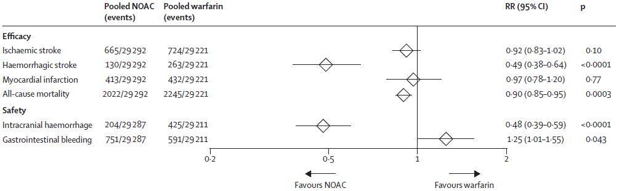
Meta-Analysis: AF RCTs Secondary Endpoints

Slide 15
Modifiable and non-modifiable risk factors for bleeding in anticoagulated patients with AF
Modifiable bleeding risk factors:
Hypertension (especially when systolic blood pressure is > 160 mmHg)
Labile INR or time in therapeutic range <60% in patients on vitamin K antagonists
Medication predisposing to bleeding, such as antiplatelet drugs and non-steroidal anti-inflammatory drugs
Excess alcohol (≥8 drinks/week)
Potentially modifiable bleeding risk factors:
Anaemia
Impaired renal function
Impaired liver function
Reduced platelet count or function
Non-modifiable bleeding risk factors:
Age (>65 years) (≥75 years)
History of major bleeding
Previous stroke
Dialysis-dependent kidney disease or renal transplant
Cirrhotic liver disease
Malignancy
Genetic factors
Biomarker-based bleeding risk factors:
High-sensitivity troponin
Growth differentiation factor-15
Serum creatinine/estimated CrCl

Slide 16
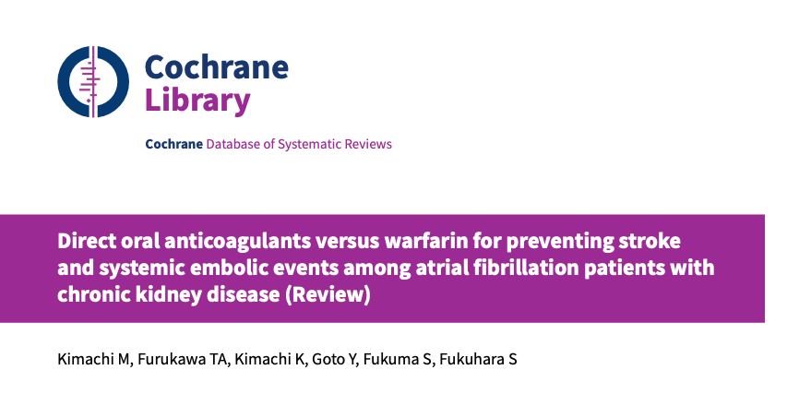

Slide 17
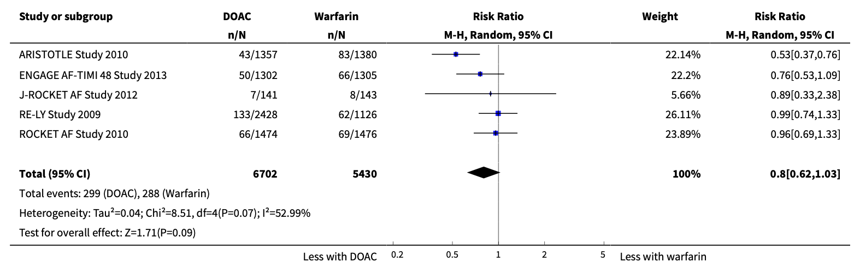
Analysis Comparison of Direct oral anticoagulants versus warfarin: subgroup analysis for participants with CrCI 30 to 50 mL/min, Outcome of Major bleeding.

Slide 18
“Our findings indicate that DOACs are as likely as warfarin to prevent all strokes and systemic embolic events without increasing risk of major bleeding events among AF patients with kidney impairment. The major limitation is that the results of this study chiefly reflect CKD stage G3.”

Slide 19
What About FALL RISK?
Medicare beneficiaries with AF: 18,261 low fall risk
Identified post-discharge: 1,245 high fall risk
Mean age 80 yrs; 48% on warfarin
 | HIGH FALL RISK | LOW FALL RISK
ICH | 2.8% | 1.1%
ISCHEMIC STROKE | 13.7% | 6.9%

Slide 20
Paroxysmal AF Is Associated with the Highest Risk of Not Receiving Anticoagulation
 | OR | [95% CI] | p-value
Age (≥80 yo) | 0.51 | [0.37, 0.72] | <0.01
CHADS₂ | 1.22 | [1.09, 1.37] | <0.01
Perm vs. PAF | 3.25 | [2.25, 4.69] | <0.01
Sex (F vs. M) | 1.22 | [0.88, 1.68] | 0.23

Slide 21
MISCONCEPTIONS
Paroxysmal AF due to something else-transient
Paroxysmal AF isn’t as serious as permanent AF
Checking your pulse is enough
Safe to stop anticoagulation after cardioversion
or ablation regardless of stroke risk
Aspirin is an alternative

Slide 22
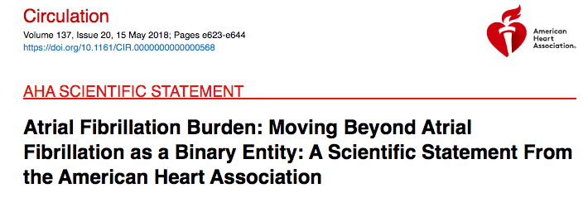
Evidence suggests that patients with persistent AF are at higher risk of stroke than those with paroxysmal AF, but the relationship of increasing AF burden with risk of stroke is not well characterized
Studies are needed to validate definitions and measures of AF burden, and to determine the threshold of AF burden that increases the risk of stroke that warrants anticoagulation

Slide 23
Treatment Persistence and Time to Discontinuation
Survival Function
Adherence |  | Rivaroxaban | Apixaban | Dabigatran | Warfarin
 |  | Cohort [A] (n=13,654) (%) | Cohort [B] (n=6,3044) (%) | Cohort [C] (n=3,360) (%) | Cohort [D] (n=13,366) (%)
Time period after index date
No gap > 30 days | 3 months | 86.0 | 83.4 | 77.3 | 75.3
 | 6 months | 78.2 | 75.8 | 67.2 | 62.6
 | 9 months | 69.3 | 68.1 | 75.8 | 51.5
 | 12 months | 59.7 | 59.0 | 47.8 | 41.2
Health care claims from the IMS Health Real-World Data Adjudicated Claims database (July 2012-June 2015)

Slide 24
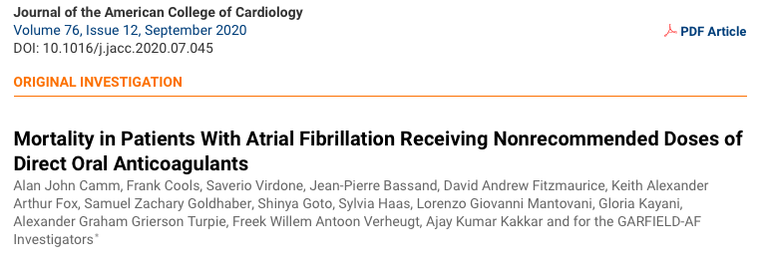

Slide 25
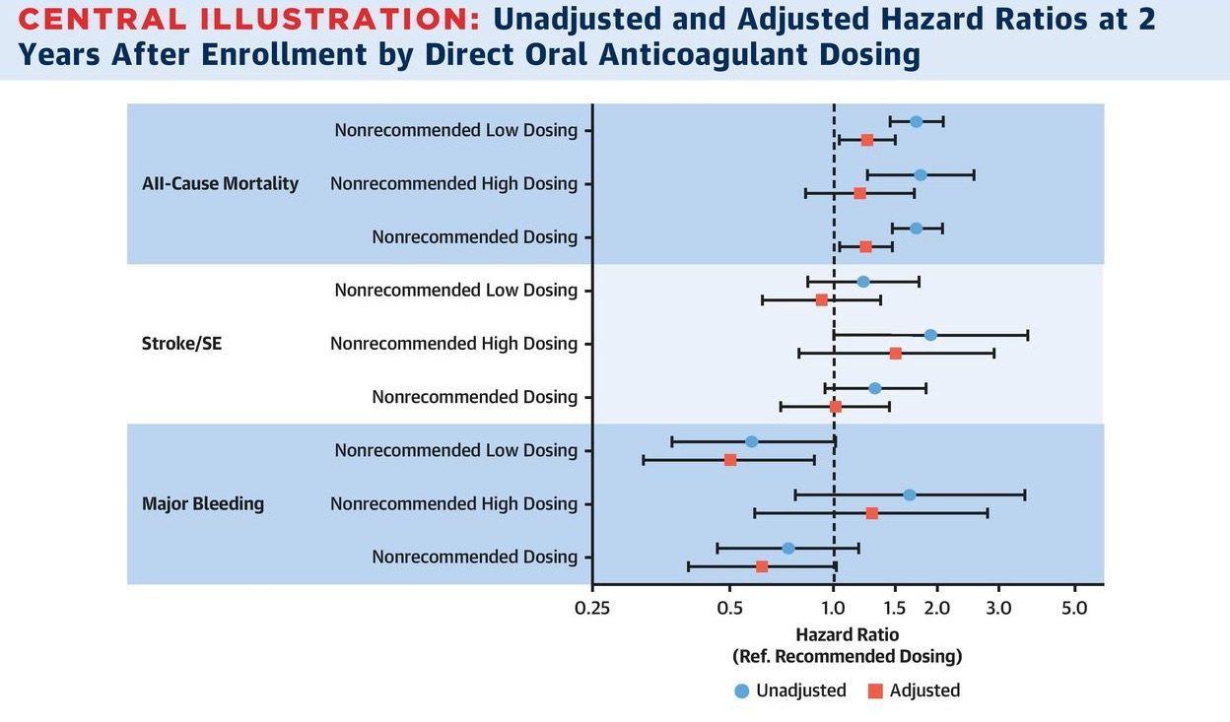
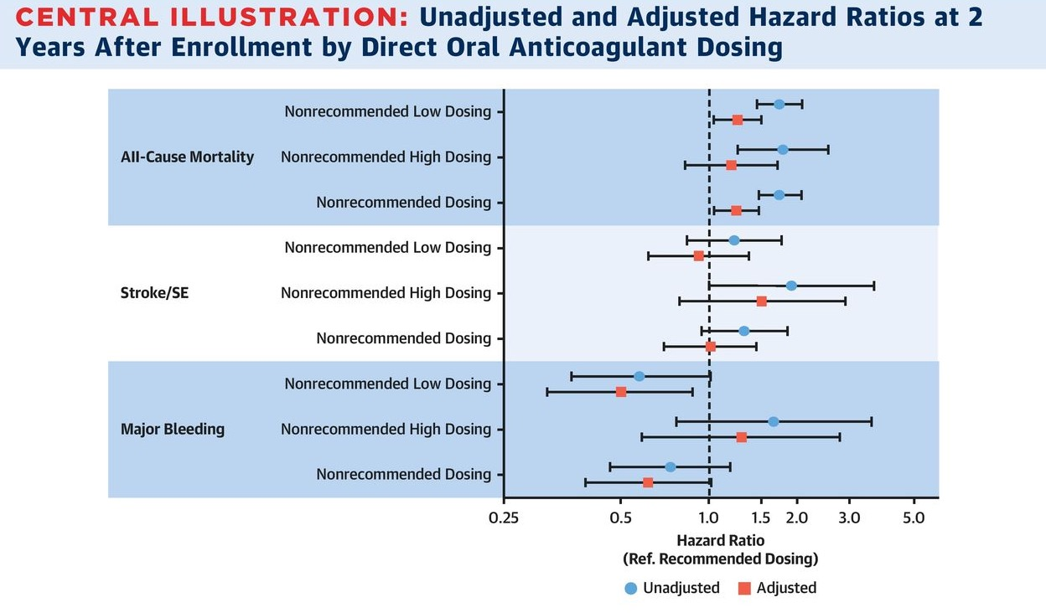

Slide 26
Patient-Directed Information and
Mixed Messages

Slide 27
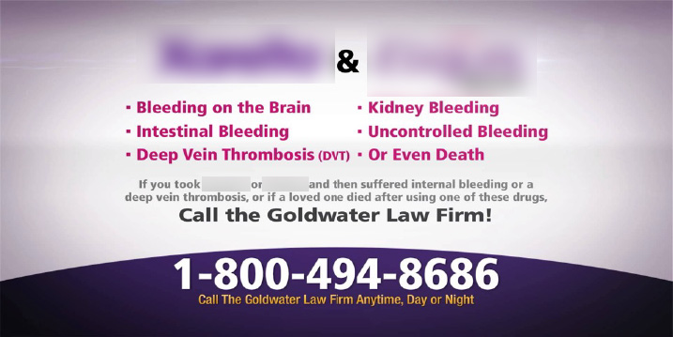
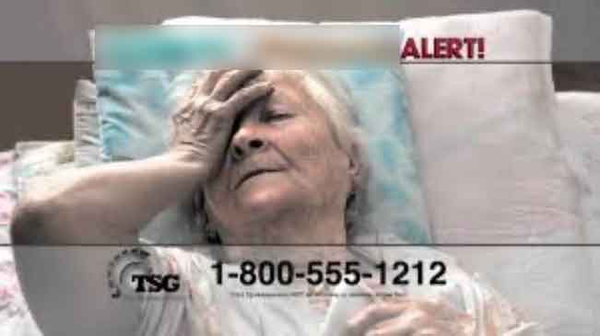
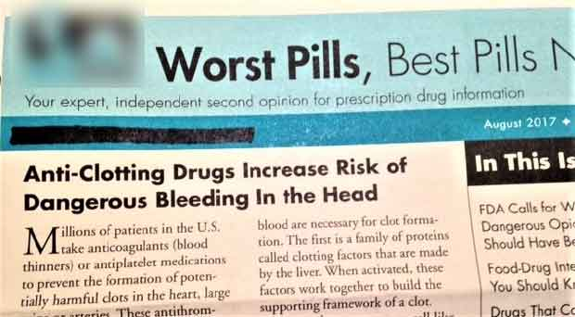


Slide 28
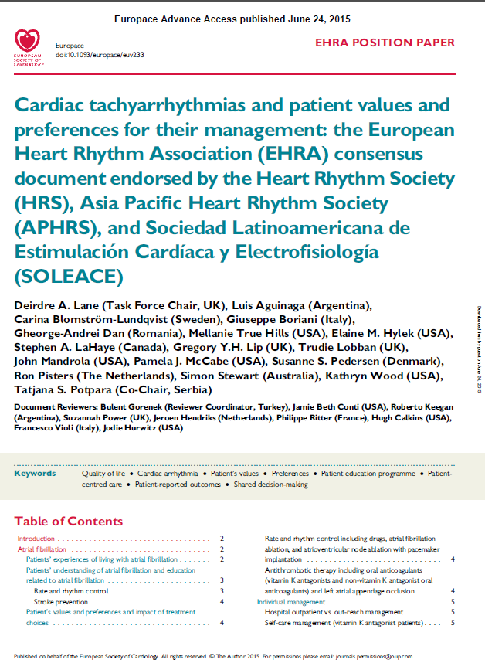
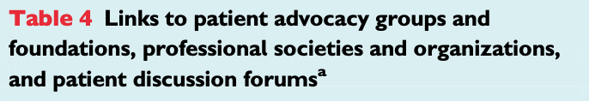
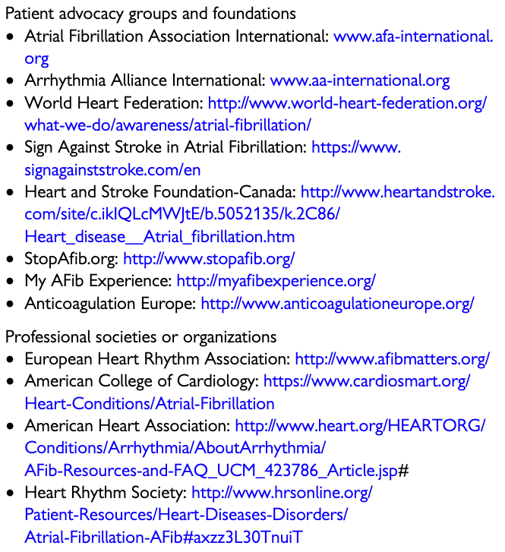
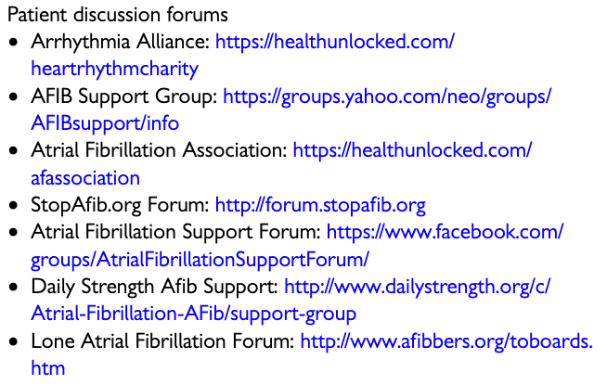
EHRA Consensus Document on Patient Values & Preferences

Slide 29

AF Patient Organization Sites
Empower & support patients to:
Understand what their doctors are telling them
Communicate more effectively with their doctors
Make better decisions about their care
Be adherent to their medications
Know that they are not alone

Slide 30



Looking for more resources
on this topic?
CME/CE in minutes
Congress highlights
Late-breaking data
Quizzes
Webinars
In-person events
Slides & resources
www.MedEdOTG.com

