Slide 1





New Frontiers in Anticoagulation:
Factor XI/XIa Inhibitors
Saturday, November 11, 2023 | 6:00pm – 7:30pm ET
Philadelphia Marriott Downtown | Salon H | Philadelphia, PA
This activity has been designed to meet the educational needs of the interprofessional team approach intended for clinical cardiologists, emergency medicine physicians, hematologists, hospitalists, neurologists, primary care physicians, vascular medicine practitioners, and vascular surgeons, as well as other clinicians involved in the management of patients with anticoagulation.
Supported by an educational grant from Bayer HealthCare Pharmaceuticals Inc. Jointly provided by the Global Learning Collaborative (GLC), Duke Heart, and Total CME, LLC.

Slide 2


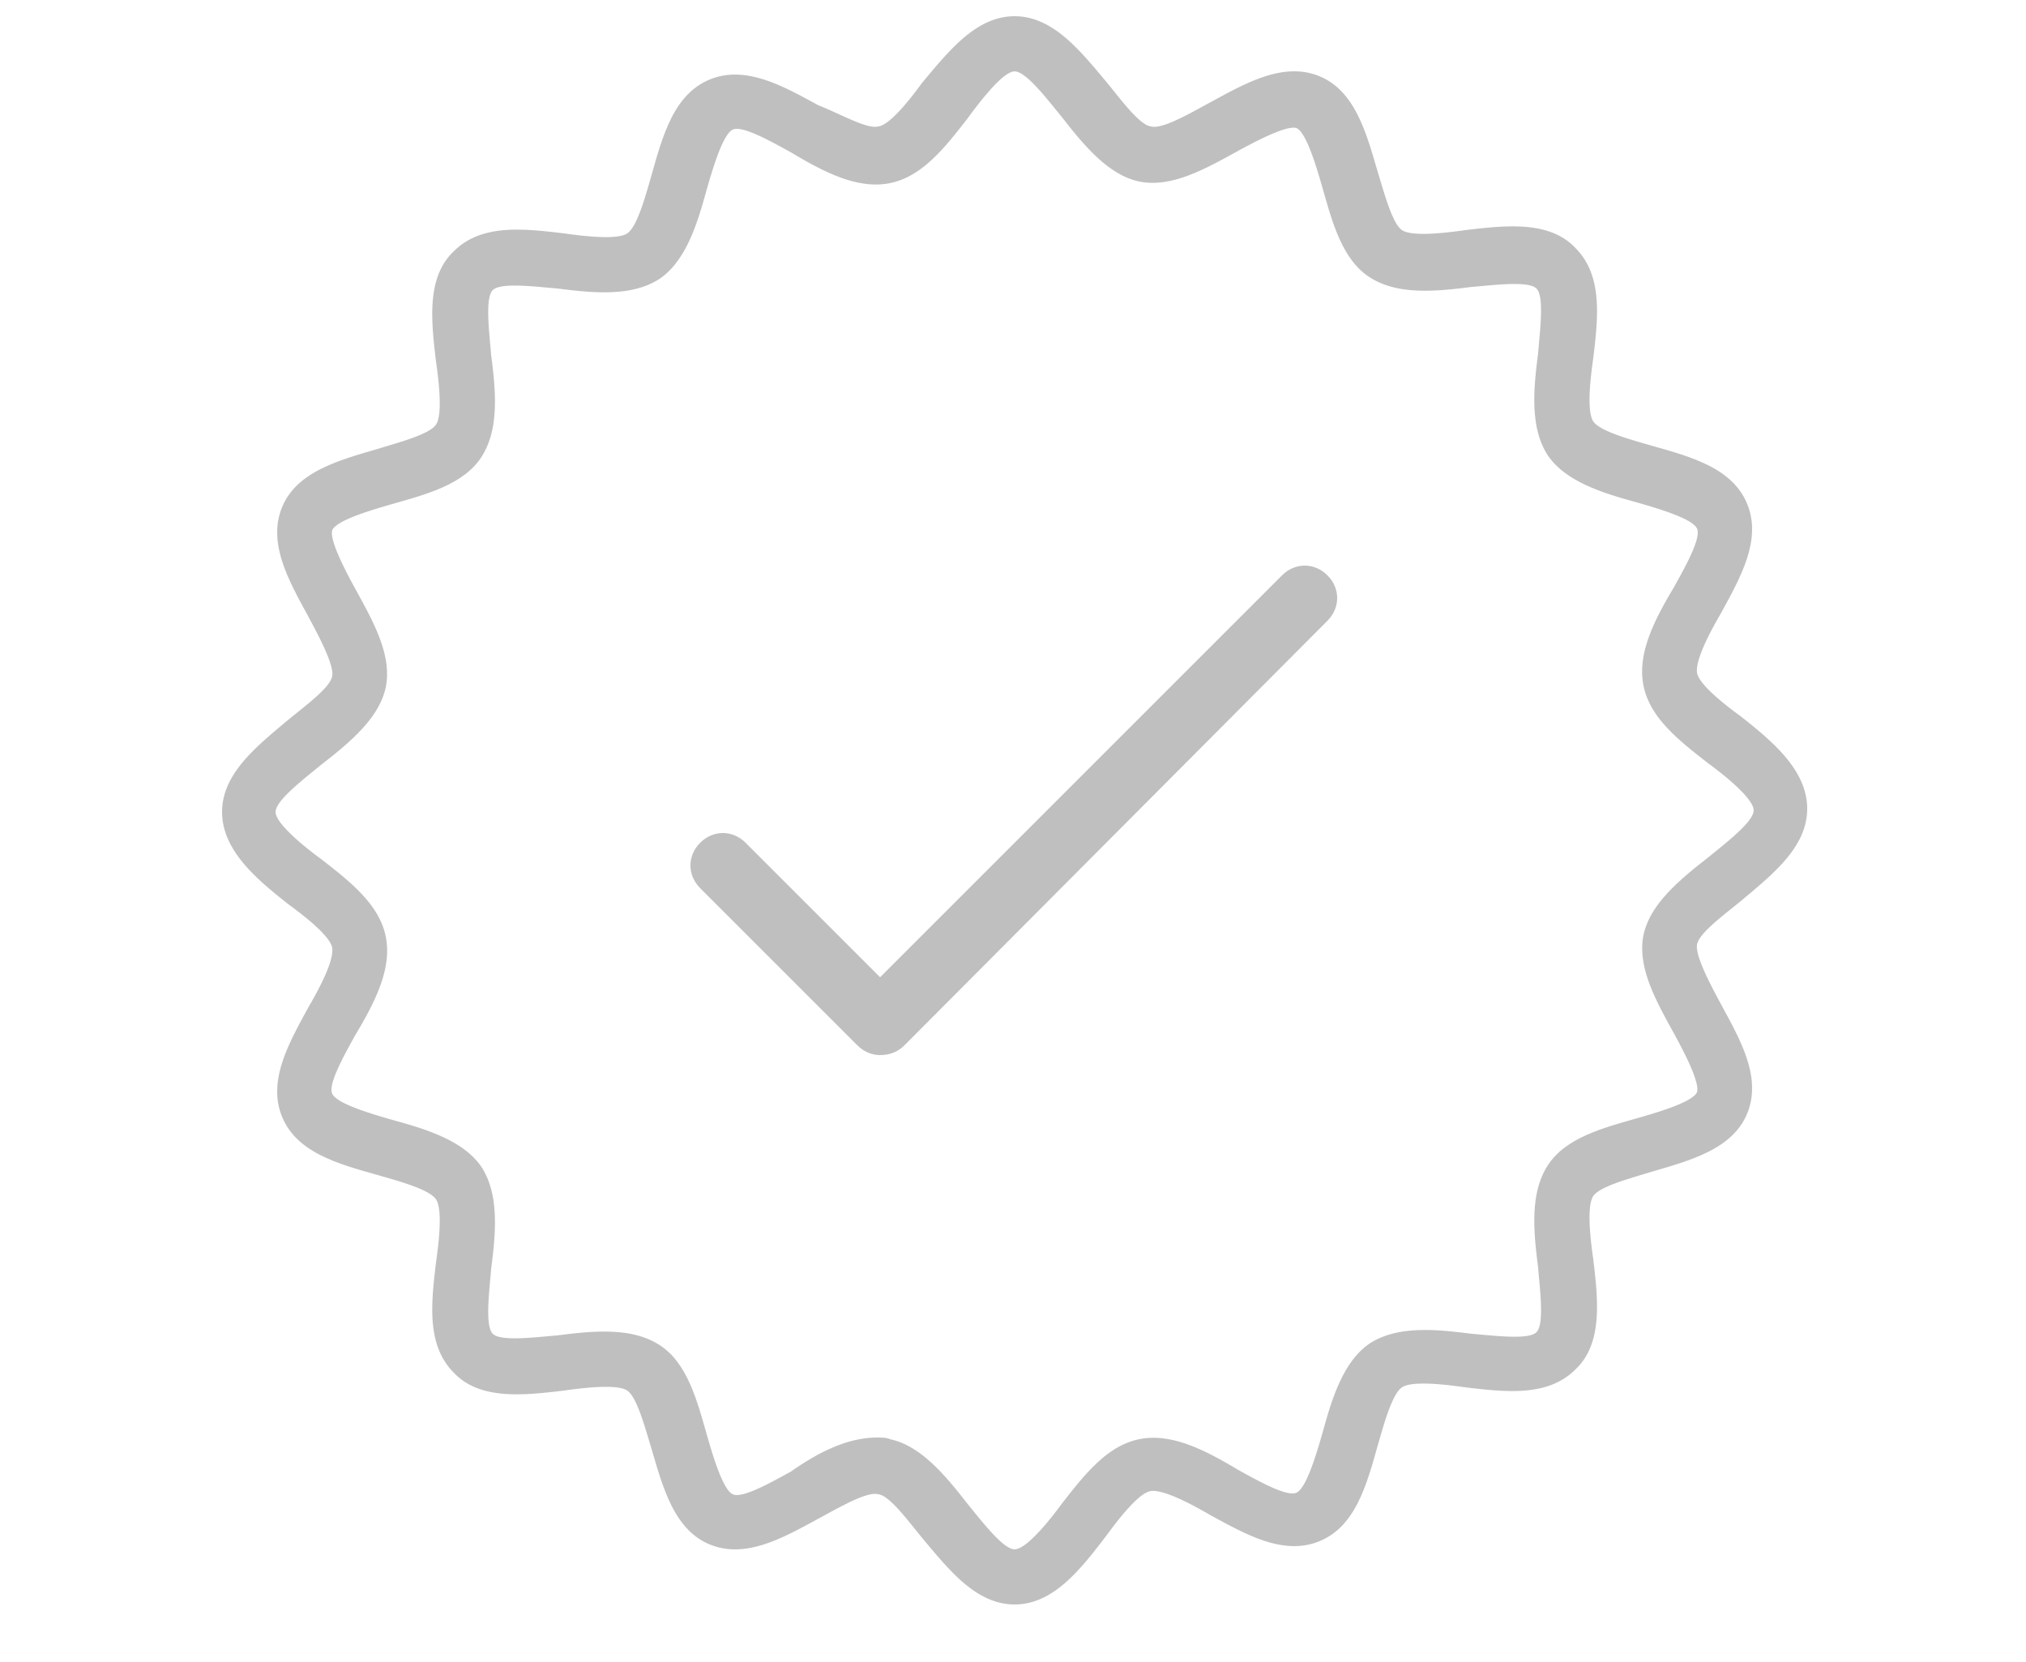
Resource Information
About This Resource
These slides are one component of a continuing education program available online at MedEd On The Go titled New Frontiers in Anticoagulation: Factor XI/XIa Inhibitors
Program Learning Objectives:
Review the currently available therapeutics and how they affect multiple pathways involved in the coagulation cascade, thereby increasing the potential for serious bleeds
Review current decision pathways for initiation of anticoagulation treatment and shared patient-physician decision-making, emphasizing potential prescriber bias that limits more widespread adoption of DOAC therapy
Review cardiac and non-cardiac patient populations where DOACs have limitations or contraindications
Discuss factor XI and factor XIa inhibition and review new and emerging anticoagulation pharmacotherapy for VTE, AF, secondary stroke prevention, and post-MI
MedEd On The Go®
www.mededonthego.com
This content or portions thereof may not be published, posted online or used in presentations without permission.
This content can be saved for personal use (non-commercial use only) with credit given to the resource authors.
To contact us regarding inaccuracies, omissions or permissions please email us at support@MedEdOTG.com

Slide 3
Disclaimer
The views and opinions expressed in this educational activity are those of the faculty and do not necessarily represent the views of Total CME, LLC, the CME providers, or the companies providing educational grants. This presentation is not intended to define an exclusive course of patient management; the participant should use their clinical judgment, knowledge, experience, and diagnostic skills in applying or adopting for professional use any of the information provided herein. Any procedures, medications, or other courses of diagnosis or treatment discussed or suggested in this activity should not be used by clinicians without evaluation of their patient's conditions and possible contraindications or dangers in use, review of any applicable manufacturer’s product information, and comparison with recommendations of other authorities. Links to other sites may be provided as additional sources of information.

Slide 4


The DOAC Revolution –
What Have We Learned?
Christopher B. Granger, MD
Donald F. Fortin, M.D. Distinguished Professor of Medicine
Duke University Medical Center
Durham, NC

Slide 5
Estimated 71% RRR in Stroke, DOAC vs Control
Warfarin compared
to control or placebo
RRR
(95% CI)
NOAC compared
to warfarin
RRR
(95% CI)
Trial
Trial
AFASAK I (1990)
SPAF I (1991)
BAATAF (1990)
CAFA (1991)
SPINAF (1992)
EAFT (1993)
Combined
RE-LY (2009)
ROCKET AF (2011)
ARISTOTLE (2011)
ENGAGE AF-TIMI 48
(2013)
Combined
100%
50%
0
−50%
−100%
50%
0
−50%
Favors warfarin
Favors placebo
or control
Favors NOAC
Favors warfarin
RRR 64%
RRR 19%
Warfarin versus Placebo or Control
(6 trials, total n=2,900)
DOAC versus Warfarin
(4 trials, total n=71,683)

Slide 6
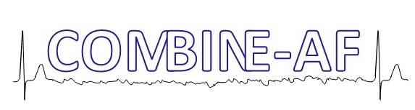

Slide 7
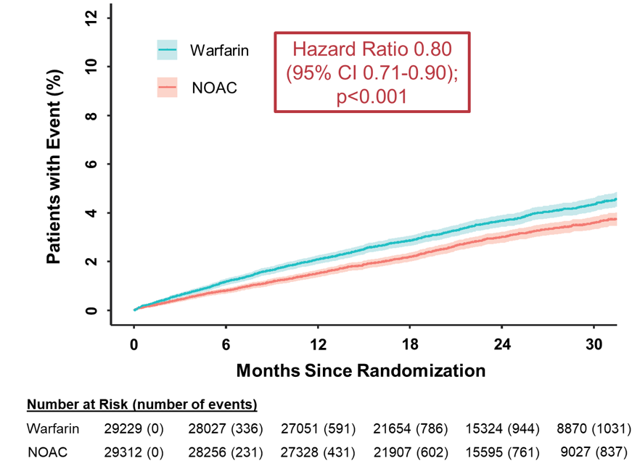
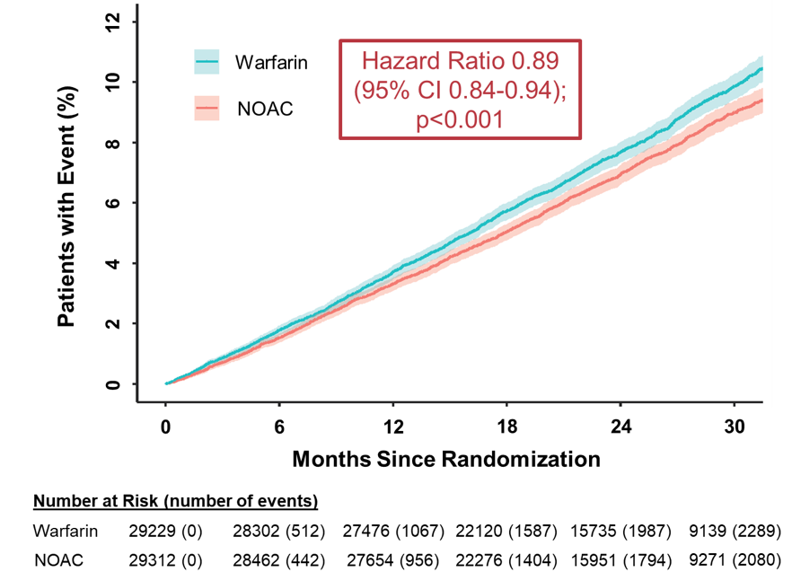
Stroke/Systemic Embolism
All-Cause Death

Slide 8
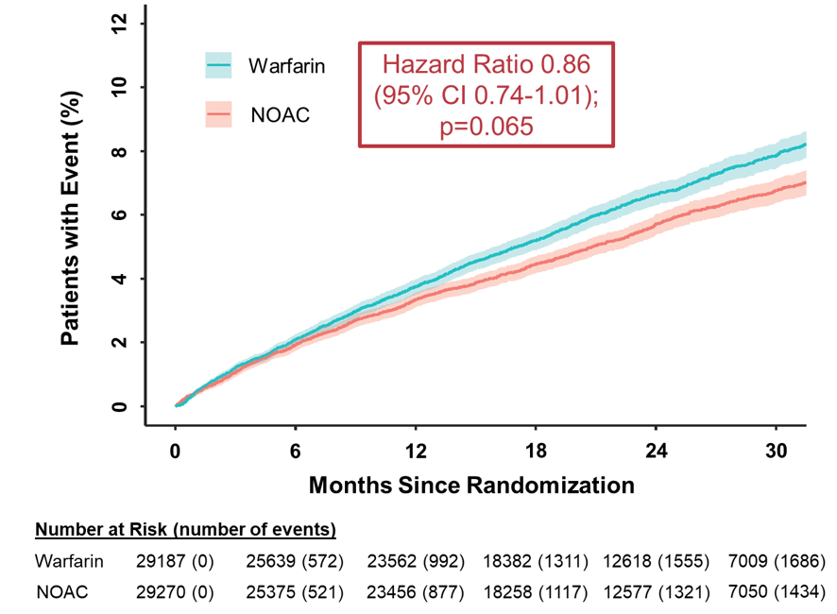
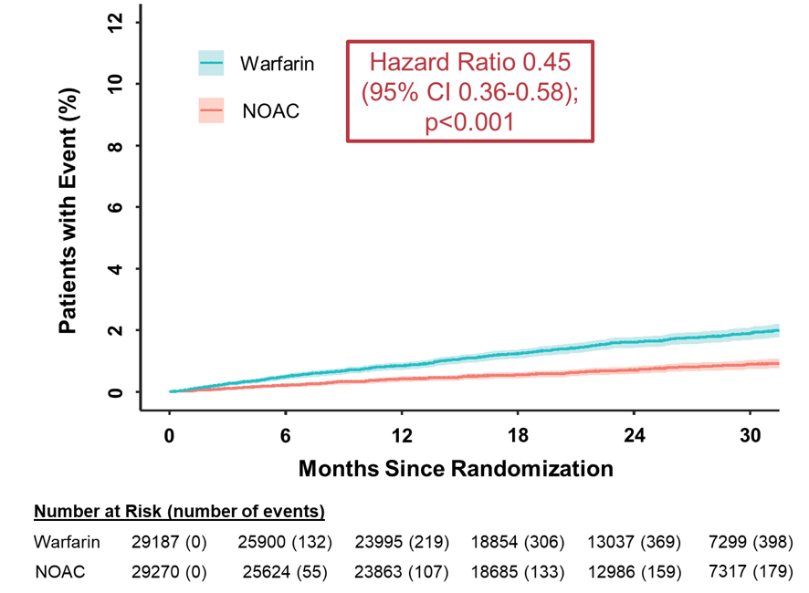
Major Bleeding
Intracranial Bleeding

Slide 9
Do not use aspirin, and do not add aspirin to oral anticoagulation without a clear indication

Slide 10
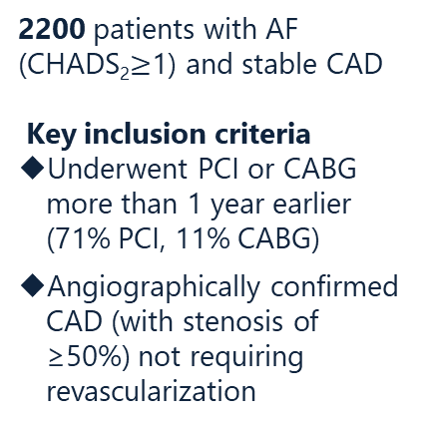
A multicenter, prospective, randomized, open-label, parallel-group trial
R
A
N
D
O
M
I
Z
E
Rivaroxaban Monotherapy
Rivaroxaban 10 or 15 mg/day ^{2)*}
*The level of rivaroxaban in blood samples obtained from Japanese patients who were taking rivaroxaban at the 15-mg dose was similar to the level in white patients who were taking the 20-mg dose.
Combination Therapy
Rivaroxaban 10 or 15 mg/day
Single antiplatelet
Aspirin 81 or 100 mg/day, (70%)
Clopidogrel or Prasugrel (27%)
Noninferiority for primary outcome: stroke, SE, MI, USA requiring revasc, death; stopped early due to excess death with combination therapy

Slide 11
ISTH Major Bleeding:
70% increased with aspirin

Slide 12
ISTH Major Bleeding:
70% increased with aspirin
Primary: Stroke, SE, MI, USA/revasc, death:
39% increased with aspirin
Death 73 versus 41, HR 1.82, p less than 0.001

Slide 13
Major bleeding with OAC

Slide 14
Major Bleeding In Trials (% per year)
Warfarin DOAC
RE-LY 3.4 3.1 dabigatran
ROCKET 3.5 3.6 rivaroxaban
ARISTOTLE 3.1 2.1 apixaban
ENGAGE 3.4 2.8 edoxaban

Slide 15
Sites and Predictors of Major Bleeding
Location | Rate per 100 patient-yrs
GI bleeding (2/3 upper) | 0.83
Intracranial | 0.57
Hematoma | 0.25
Intraocular | 0.15
Hematuria | 0.14
Hemorrhoid/Rectal | 0.10
Epistaxis | 0.07
Intra-articular | 0.05
Ecchymosis | 0.04
Predictors
Hematocrit (lower)
Age
Warfarin vs apixaban
Creatinine Clearance
Female sex
History of Bleeding
Concomitant Aspirin
Diabetes
Concomitant NSAIDS
Liver Disease

Slide 16
The novel biomarker-based ABC (age, biomarkers, clinical history)-bleeding risk score for patients with atrial fibrillation: a derivation and validation study
ABC-bleeding score (age, biomarkers [GDF-15, cTnT-hs (or creat clearance), and hemoglobin], and clinical history [previous bleeding]) score yielded a higher c-index than HAS-BLED and ORBIT scores for major bleeding in both the derivation (0.68 vs 0.61 vs 0.65) and validation (0.71 vs 0.62 vs 0.68) cohorts

Slide 17
Bleeding and risk of subsequent events for AF patients on anticoagulation
Swiss-AF and BEAT-AF

Slide 18
Bleeding and risk of subsequent events for AF patients on anticoagulation
Swiss-AF and BEAT-AF

Slide 19
Bleeding and risk of subsequent events for AF patients on anticoagulation
Swiss-AF and BEAT-AF

Slide 20
Are NOACs safe and effective in the elderly?

Slide 21
Japan, n=984
Age 80 years and older
(mean 87 y)
Edox 15 mg
ELDERCARE
Stroke/SE
Major bleeding
Hemorrhagic stroke: 0 edox, 2 placebo

Slide 22
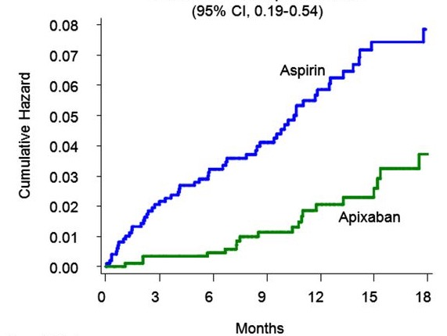
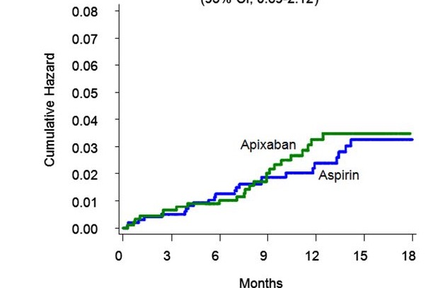
AVERROES: Apixaban in the elderly, compared to aspirin
(1898 patients ≥ 75 years; 82% of those got 5 mg bid)
Age ≥75 years
Age ≥75 years
HR with apixaban, 0.33
(95% CI: 0.19–0.54)
HR with apixaban, 1.21
(95% CI: 0.69–2.12)
ICH 6 V 8
Stroke/SE
Major Bleeding

Slide 23
Should patients with or at risk of falls receive anticoagulation?

Slide 24
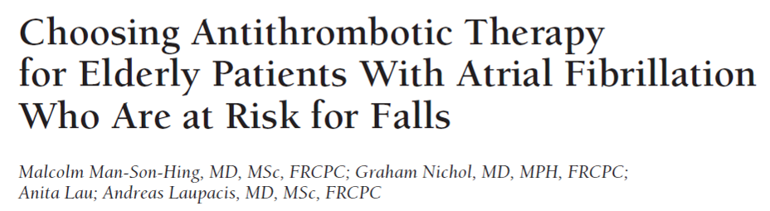
Among older patients, falling is common (about 30% fall at least once a year), and subdural hematomas are uncommon
“… persons taking warfarin must fall about 295 times in 1 year for warfarin to not be the optimal therapy.”
In ARISTOTLE, among patients with history of falls, there was an 80% lower rate of ICH with apixaban vs warfarin
  Of 375 patients with falling on apixaban, 0 had subdural hematoma

Slide 25
What do the guidelines say about who should (and who should not) be treated?

Slide 26
(*and female sex is not a risk factor and should be removed from CHADS VASc)

Slide 27
Treat: CHADS VASc*2 or greater with NOAC
Do not treat: CHADS VASc* 0
Do not use: aspirin for stroke prevention for AF
(*and female sex is not a risk factor and should be removed from CHADS VASc)

Slide 28
NT-proBNP is a powerful predictor of stroke and can be used as a “tie breaker” for patients with CHADS-VASc = 1

Slide 29
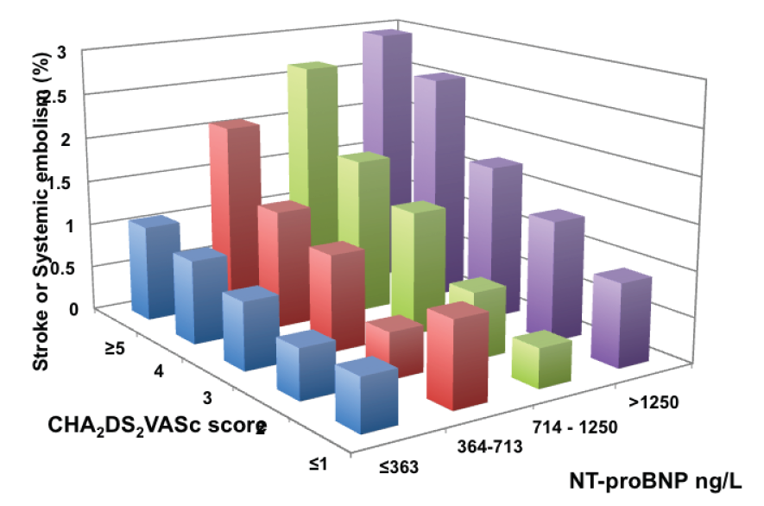
Biomarkers and Risk in AF
By Quartiles of NT-proBNP and CHADS-VASc

Slide 30
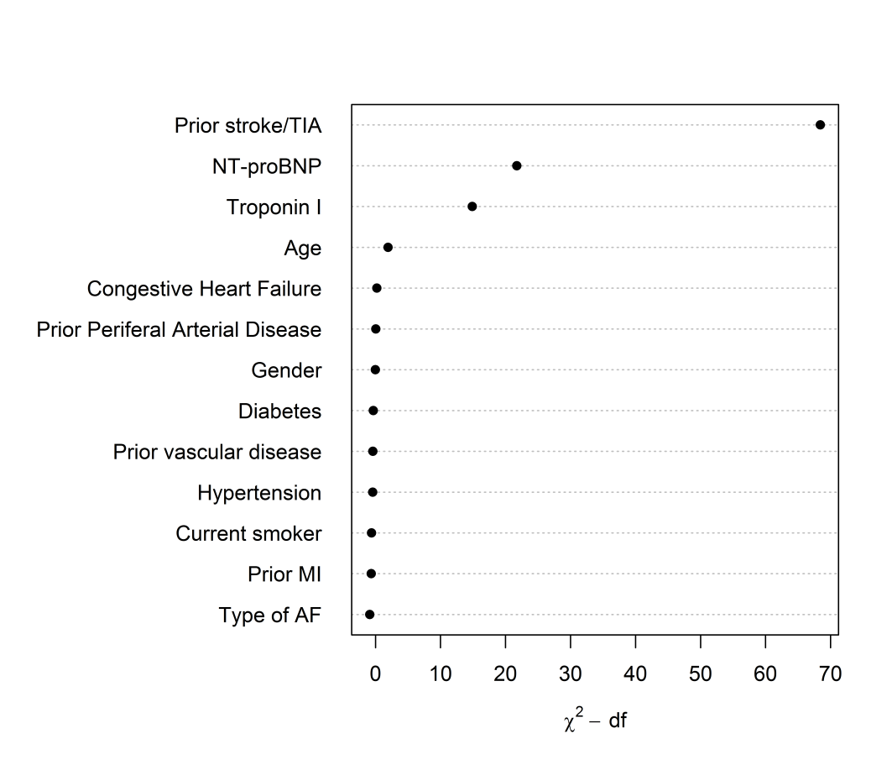
ABC Risk Score
ABC, age, biomarker, clinical factor.
Based on 391 stroke or systemic embolism during 27,929 person years of follow-up in patients from the ARISTOTLE trial
(ᵡ²-df)

Slide 31
When can you safely start a DOAC after an ischemic stroke?

Slide 32
2013 patients at 103 sites in 15 countries
early anticoag (within 48 h after minor/moderate stroke or day 6-7 after a major stroke)
or later anticoag (day 3-4 after minor stroke, day 6-7 after mod stroke, or day 12-14 after major stroke)

Slide 33
Chronic Kidney Disease

Slide 34
Renal function and novel drugs
RE-LY, ROCKET, ARISTOTLE excluded patients with eGFR less than 25 to 30
Dabigatran is 80% renally eliminated, edoxaban 50%, rivaroxaban and apixaban are around 30%
Renal impairment is independent risk factor for stroke, for bleeding, for death
150 mg bid of dabigatran should generally not be used in the elderly (>80 y/o) and with renal impairment (<∼40 ml/min)
Rivaroxaban should be used at 15 mg/d with CrCl less than 50
Apixaban should be used at 2.5 mg bid with 2 of 3: age 80 and older, weight 60 kg or less, creatinine 1.5 or greater
Edoxaban should be used at 30 mg/d with CrCl 50 or less

Slide 35
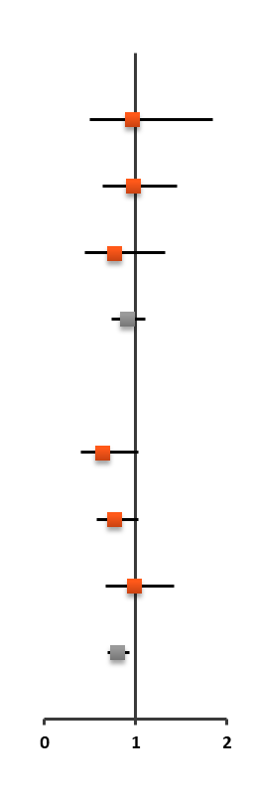
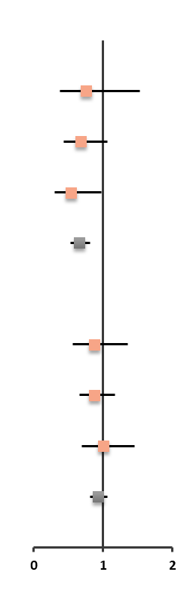
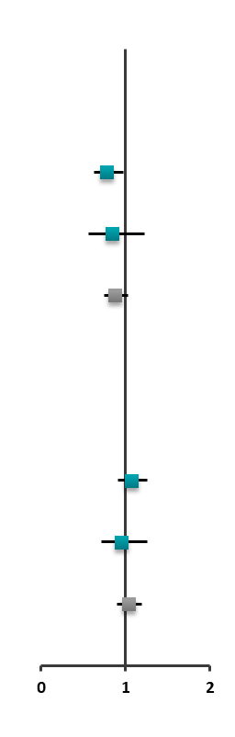
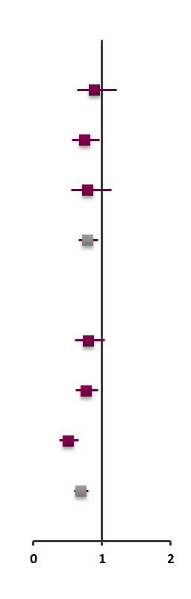
NOACs Efficacy and Safety Profiles in Patients with or without Renal Impairment
Apixaban
Dabigatran 110 mg
Dabigatran 150 mg
Rivaroxaban
HR (95% CI)
HR (95% CI)
HR (95% CI)
HR (95% CI)
eGFR (mL/min)
>80
No data
Stroke
or SE
>50–80
≤50
Overall²⁻⁴
>80
No data
Major
bleeding
>50–80
≤50
Overall²⁻⁴
Favors
Apixaban
Favors
Warfarin
Favors
Dabigatran
Favors
Warfarin
Favors
Dabigatran
Favors
Warfarin
Favors
Rivaroxaban
Favors
Warfarin
Notes:
Capranzano 2013/
p963/Figure 2
Granger 2011/
p988/Figure 2a;
p989/Figure 2b
Connolly 2009/ p1144/table2; p1146/table3; p1149/figure
Patel/2011/p890/
Table 3 (‘Any’)
Giugliano 2013/p2098/table2; p2101/table3
Edoxaban PI 2015/ p4/c1/fig6.1; p7/c2/fig14.2

Slide 36

What does two hours of Afib on an implantable device mean?

Slide 37

Stopped early (184 of 220 planned events)
N= 2536
AHRE 2.8 hours
Median f/u 21 months
HR 0.81; 95% CI, 0.6 to 1.08; p = 0.15
83 v 101
HR 1.31; 95% CI, 1.02 to 1.67;
P = 0.03
Primary Outcome: Stroke, SE, CV Death
Major Bleeding or Death
Ischemic stroke 1% per year, 22 versus 27, 0.79 (0.45 to 1.39)
Major bleeding 53 versus 25, 2.10 (1.30 to 3.38)
Kirchhof P, et al. N Engl J Med. 2023. 28;389(13):1167-1179.

Slide 38
ARTESiA Study Design
SCAF 6 min to 24 hrs (pacemaker, ICD, ICM)
Risk factors for stroke (age ≥ 75, prior stroke/ TIA/ SE or multiple risk factors)
No clinical AF/not on OAC, no contraindication
4000 patients
3 times the number of strokes, twice the duration of follow-up (3.5 v 1.8 y) as NOAH
Double-blind, double-dummy design
RANDOMIZE
Apixaban
5 mg or 2.5 mg bid
Aspirin
81 mg OD
Stay tuned for tomorrow 8 AM!
Primary efficacy outcome: stroke or SE
Primary safety outcome: Major bleeding

Slide 39
intrinsic
Milvexian: Axiomic/Librexia
Asundexian: Pacific/Oceanic
Abelacimab: LILAC

Slide 40
Summary
Since August 2009, DOACs have become standard of care to prevent stroke in Afib for most patients
DOACs are more effective at preventing stroke, mainly due to reducing ICH
They have less serious bleeding and lower mortality than warfarin
They provide consistent benefit in nearly all subgroups, including the elderly, frail, and CKD
But they do not have lower GI bleeding
And they are still substantially underused, mainly related to concern over bleeding

Slide 41



Looking for more resources
on this topic?
CME/CE in minutes
Congress highlights
Late-breaking data
Quizzes
Webinars
In-person events
Slides & resources
www.MedEdOTG.com

