Slide 1
Incorporating Data Into Practice: Late-Breaking Highlights on G/GEJ Cancers From the 2024 GI Congress
Yelena Y. Janjigian, MD
Chief
Gastrointestinal Oncology Service
Memorial Sloan Kettering Cancer Center
New York, NY

Slide 2



Resource Information
About This Resource
These slides are one component of a continuing education program available online at MedEd On The Go titled Navigating Challenges in Metastatic Gastric/GEJ Cancer Management: Advancements in Biomarker-Directed Therapies
Program Learning Objectives:
Describe relevant molecular biomarkers and how they relate to clinical characteristics of G/GEJ cancers
Discuss the impact molecular biomarkers have on treatment selection in metastatic G/GEJ cancers
Evaluate clinical data with current and investigational combination regimens for the first-line treatment of advanced G/GEJ cancers
Identify adverse effects associated with individual components of combination regimens and their prophylactic and management strategies in the setting of advanced or metastatic G/GEJ cancers
Implement strategies to provide holistic, multidisciplinary care for patients with advanced or metastatic G/GEJ cancers
Evaluate recent practice-changing data to inform treatment strategies for patients with G/GEJ cancers
MedEd On The Go®
www.mededonthego.com
This content or portions thereof may not be published, posted online or used in presentations without permission.
This content can be saved for personal use (non-commercial use only) with credit given to the resource authors.
To contact us regarding inaccuracies, omissions or permissions please email us at support@MedEdOTG.com

Slide 3
Disclaimer
The views and opinions expressed in this educational activity are those of the faculty and do not necessarily represent the views of Total CME, LLC, the CME providers, or the companies providing educational grants. This presentation is not intended to define an exclusive course of patient management; the participant should use their clinical judgment, knowledge, experience, and diagnostic skills in applying or adopting for professional use any of the information provided herein. Any procedures, medications, or other courses of diagnosis or treatment discussed or suggested in this activity should not be used by clinicians without evaluation of their patient's conditions and possible contraindications or dangers in use, review of any applicable manufacturer’s product information, and comparison with recommendations of other authorities. Links to other sites may be provided as additional sources of information.

Slide 4
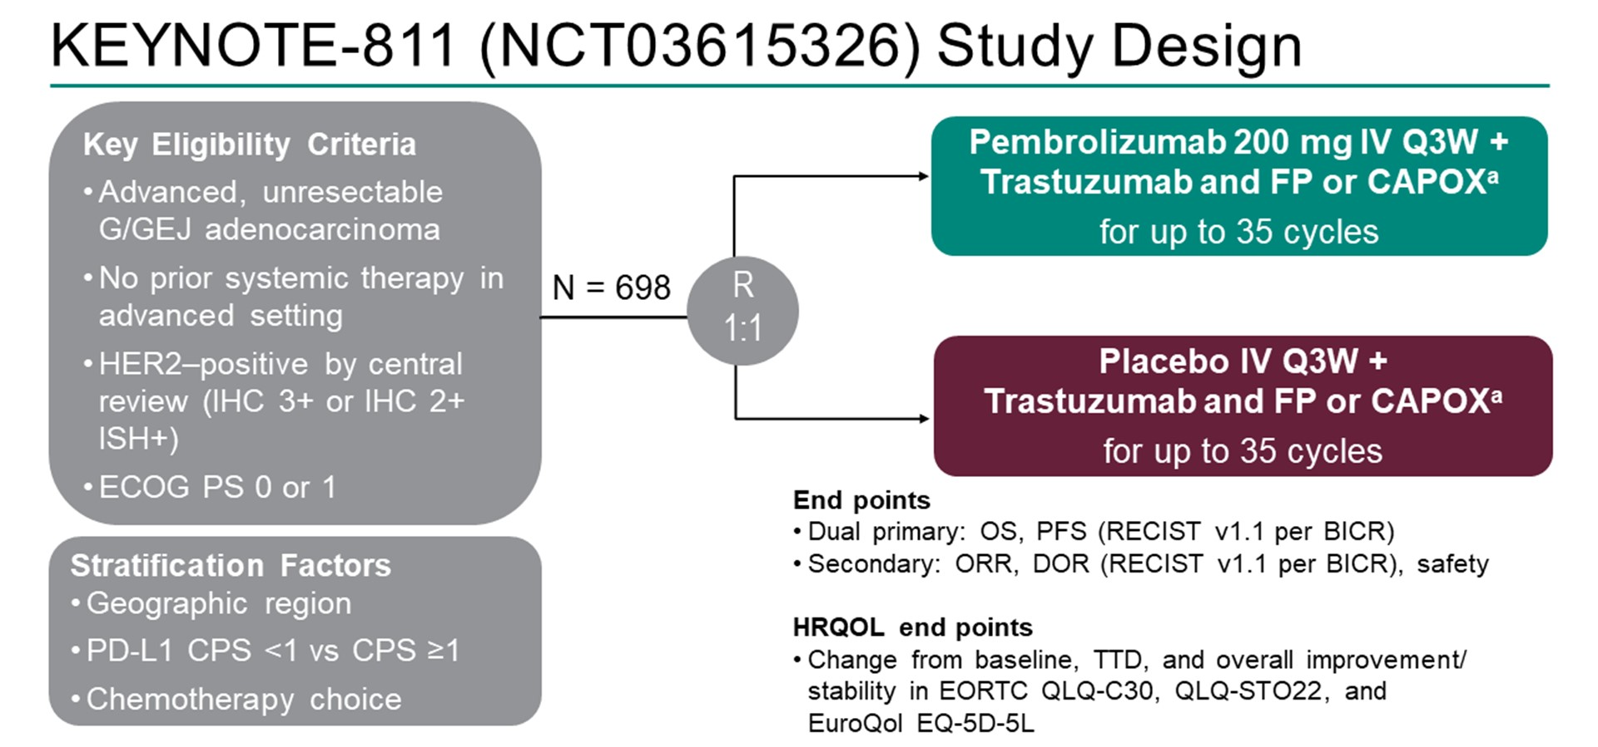
Abstract 286: Health-Related Quality of Life with Pembrolizumab Plus Trastuzumab/Chemotherapy in First-Line HER2+ Advanced Gastric Cancer

Slide 5
Abstract 286: Health-Related Quality of Life with Pembrolizumab Plus Trastuzumab/Chemotherapy in First-Line HER2+ Advanced Gastric Cancer
The addition of pembrolizumab to standard of care trastuzumab/chemotherapy did not have a negative impact on HRQOL during treatment
Improvement in cancer related symptoms with treatment
Immune related adverse effects did not worsen QOL
Together with safety and efficacy data, these results support the use of pembrolizumab with trastuzumab/chemotherapy for first-line treatment of HER2+ advanced gastric cancer

Slide 6
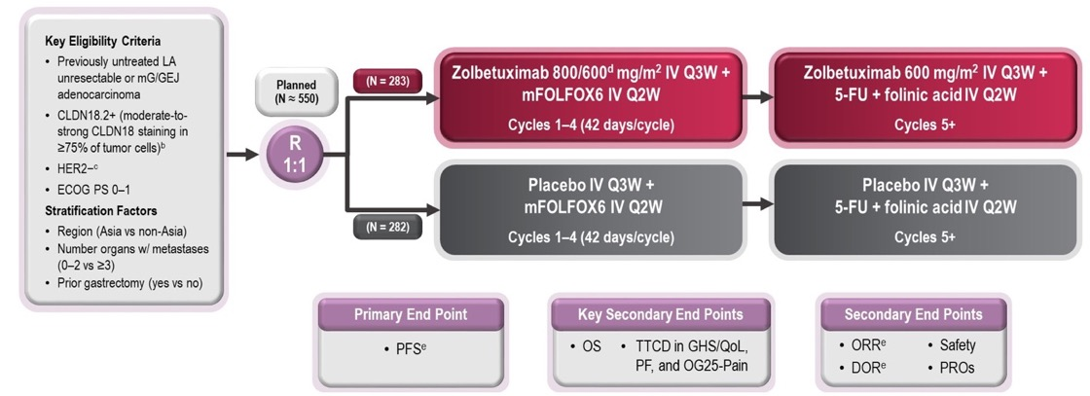
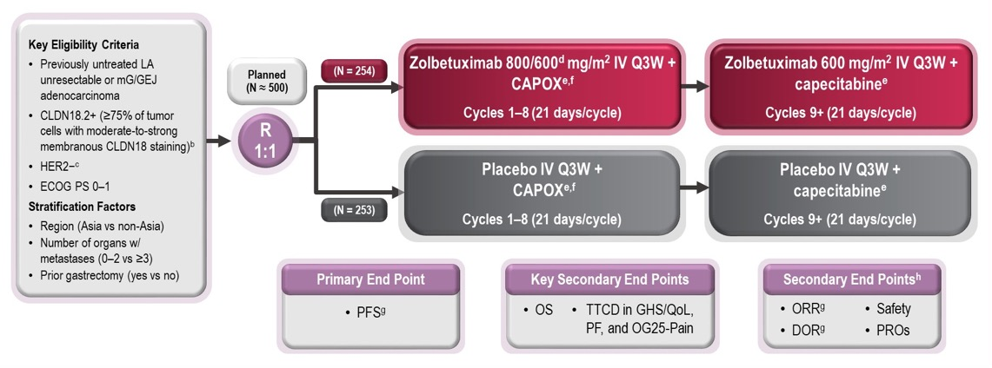
Zolbetuximab: SPOTLIGHT and GLOW Trials
SPOTLIGHT
Claudin18.2 inhibitor
Parallel phase III trials, differing by chemotherapy backbone
PFS = Primary endpoint
OS = Secondary endpoint
GLOW

Slide 7
Abstract 372: Management of Nausea and Vomiting Following First-Line Zolbetuximab + Chemotherapy Treatment in Claudin-18.2+, HER2−, Locally Advanced Unresectable or Metastatic Gastric or Gastroesophageal Junction Adenocarcinoma: Analysis from the Phase 3 SPOTLIGHT and GLOW Studies
SPOTLIGHT: zolbetuximab + FOLFOX
GLOW: zolbetuximab + CAPOX
Infusion guidelines amended to reduce the initial infusion rate of the first zolbetuximab/placebo dose
Prophylactic antiemetics recommended prior to each treatment

Slide 8
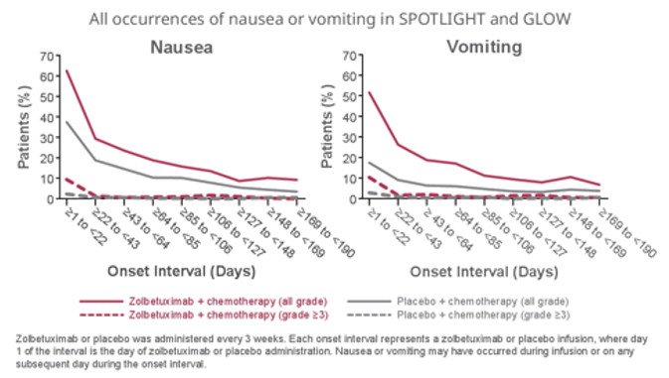
Abstract 372: Management of Nausea and Vomiting Following First-Line Zolbetuximab + Chemotherapy Treatment in Claudin-18.2+, HER2−, Locally Advanced Unresectable or Metastatic Gastric or Gastroesophageal Junction Adenocarcinoma: Analysis from the Phase 3 SPOTLIGHT and GLOW Studies
Effective strategies for mitigating nausea/vomiting:
Slowing the rate of zolbetuximab infusion
Optimization of prophylactic antiemetics
Nausea/vomiting lessens with subsequent cycles
The addition of zolbetuximab to chemotherapy:
Did not negatively impact overall quality of life despite nausea/vomiting
Improved PFS and OS compared to chemotherapy alone

Slide 9
Key Takeaway Points
Targeted agents are improving outcomes for patients with G/GEJ cancers
Emphasis on quality of life in addition to survival outcomes
The addition of agents like pembrolizumab and zolbetuximab improve survival outcomes without significantly affecting overall quality of life

Slide 10



Looking for more resources on this topic?
CME/CE in minutes
Congress highlights
Late-breaking data
Quizzes
Webinars
In-person events
Slides & resources
www.MedEdOTG.com

