Slide 1
Claudin18.2: An Emerging Biomarker and Its Significance as a Therapeutic Target in G/GEJ Cancers
Samuel J. Klempner, MD
Gastrointestinal Oncology
Massachusetts General Hospital Cancer Center
Harvard Medical School
Boston, MA

Slide 2



Resource Information
About This Resource
These slides are one component of a continuing education program available online at MedEd On The Go titled Navigating Challenges in Metastatic Gastric/GEJ Cancer Management: Advancements in Biomarker-Directed Therapies
Program Learning Objectives:
Describe relevant molecular biomarkers and how they relate to clinical characteristics of G/GEJ cancers
Discuss the impact molecular biomarkers have on treatment selection in metastatic G/GEJ cancers
Evaluate clinical data with current and investigational combination regimens for the first-line treatment of advanced G/GEJ cancers
Identify adverse effects associated with individual components of combination regimens and their prophylactic and management strategies in the setting of advanced or metastatic G/GEJ cancers
Implement strategies to provide holistic, multidisciplinary care for patients with advanced or metastatic G/GEJ cancers
Evaluate recent practice-changing data to inform treatment strategies for patients with G/GEJ cancers
MedEd On The Go®
www.mededonthego.com
This content or portions thereof may not be published, posted online or used in presentations without permission.
This content can be saved for personal use (non-commercial use only) with credit given to the resource authors.
To contact us regarding inaccuracies, omissions or permissions please email us at support@MedEdOTG.com

Slide 3
Disclaimer
The views and opinions expressed in this educational activity are those of the faculty and do not necessarily represent the views of Total CME, LLC, the CME providers, or the companies providing educational grants. This presentation is not intended to define an exclusive course of patient management; the participant should use their clinical judgment, knowledge, experience, and diagnostic skills in applying or adopting for professional use any of the information provided herein. Any procedures, medications, or other courses of diagnosis or treatment discussed or suggested in this activity should not be used by clinicians without evaluation of their patient's conditions and possible contraindications or dangers in use, review of any applicable manufacturer’s product information, and comparison with recommendations of other authorities. Links to other sites may be provided as additional sources of information.

Slide 4
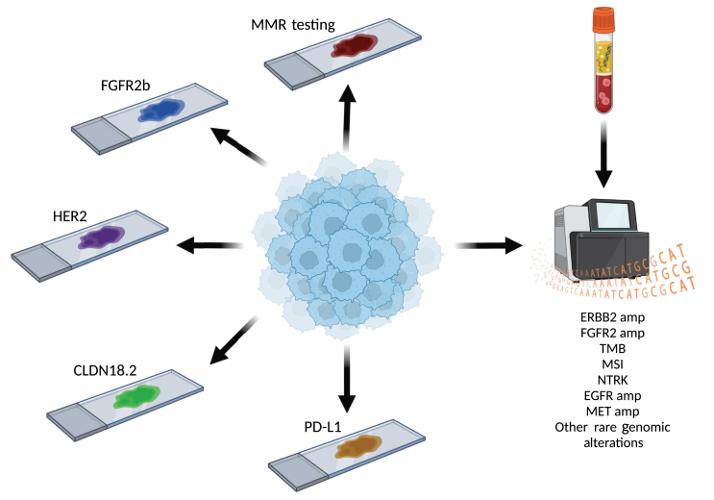
Broad Overview of Biomarkers in G/GEJ Cancer

Slide 5
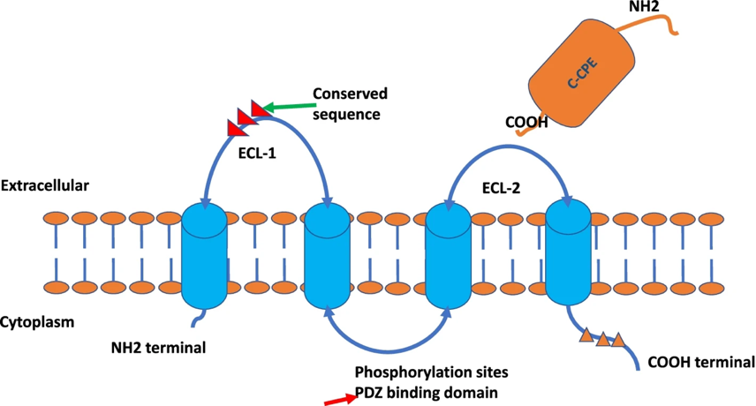
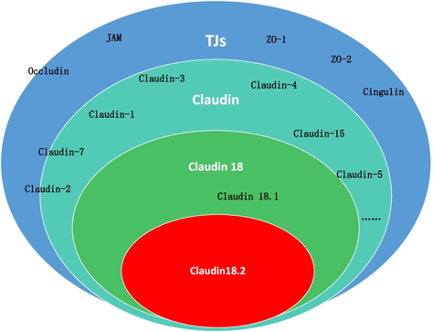
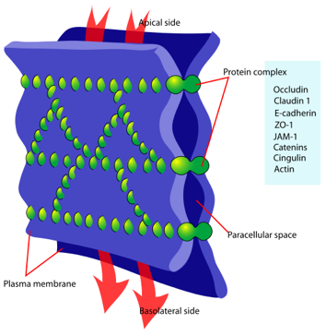
Claudin 18.2: Biology
Zolbetuximab
Member of TJ protein superfamily
CLDN18 highly conserved across species
CLDN18.2 expression normally restricted to differentiated gastric epithelium
Regulates paracellular permeability to Na+ and H+
CLDN18 knockout mice can develop lung and stomach tumors (CLDN18.2 only do not)

Slide 6
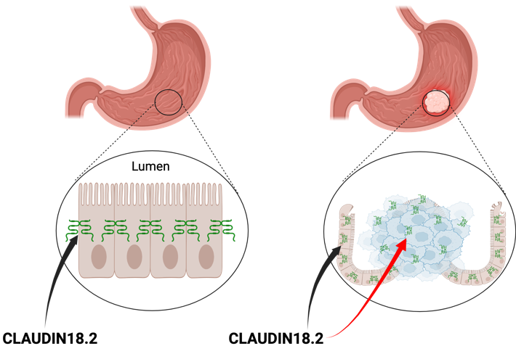
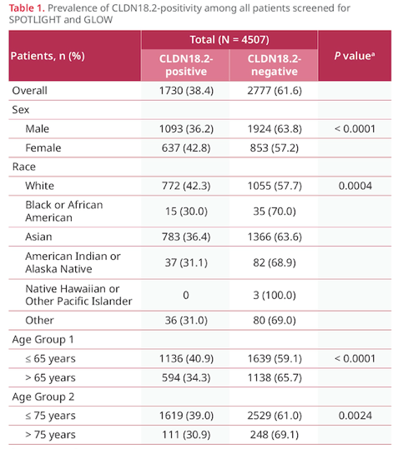
Claudin 18.2: Location, Location, Location
Created on biorender.com

Slide 7
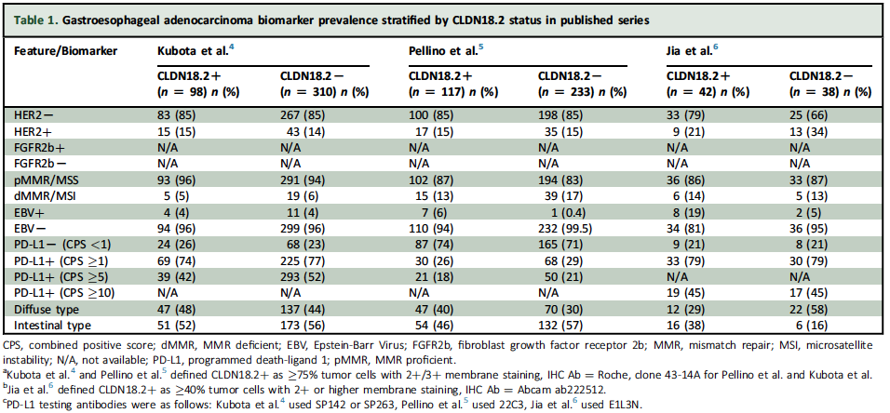
Claudin18.2: Could be Anyone with GC/GEJ
~35-40% of all GC/GEJ Adenocarcinomas
No clear enrichment among other biomarker subgroups

Slide 8
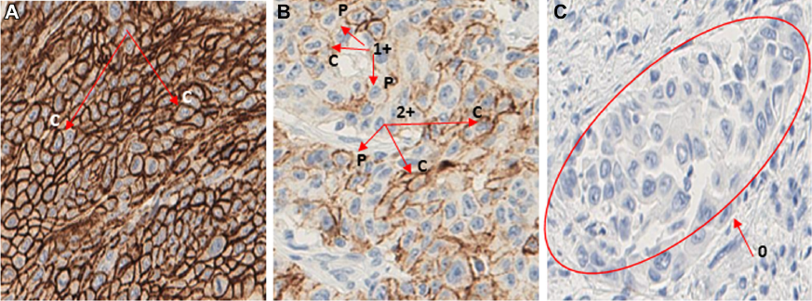
Claudin18.2 Testing
Claudin18.2 is detected by immunohistochemistry (IHC), like PD-L1 and HER2
Claudin18.2+ is defined as > 75% of tumor cells showing moderate to strong (2+/3+) membranous staining

Slide 9
Key Takeaways for Clinic Tomorrow
Claudin18.2 is a new biomarker in gastroesophageal cancers
Over 1/3 of all gastric and GEJ adenocarcinomas are positive for CLDN18.2
CLDN18.2+ patients occur in all existing biomarker categories (HER2, MMR, PD-L1)
CLDN18.2 testing is done by IHC and is required to identify CLDN18.2+ patients for potential therapy

Slide 10



Looking for more resources on this topic?
CME/CE in minutes
Congress highlights
Late-breaking data
Quizzes
Webinars
In-person events
Slides & resources
www.MedEdOTG.com

