Slide 1
Advancements in MRI Technology: Improved Diagnosis and Monitoring of MS
Bianca Weinstock-Guttman, MD
Professor of Neurology
Jacobs School of Medicine and Biomedical Sciences
The State University of New York
Director Jacobs MS center for Treatment and Research
Buffalo, NY

Slide 2



Resource Information
About This Resource
These slides are one component of a continuing education program available online at MedEd On The Go titled Multiple Sclerosis: Using S1P Receptor Modulators to Slow Disease Progression
Program Learning Objectives:
Identify metrics and barriers that exclude multiple sclerosis mimics and facilitate early diagnosis and treatment initiation
Provide clinical knowledge regarding the role and impact of the most current S1P modulators for multiple sclerosis symptom management
Examine the evolution of the treatment landscape of the past 30 years and outline best practices to enhance decision-making focusing on long- and short-term disease-modifying therapies
MedEd On The Go®
www.mededonthego.com
This content or portions thereof may not be published, posted online or used in presentations without permission.
This content can be saved for personal use (non-commercial use only) with credit given to the resource authors.
To contact us regarding inaccuracies, omissions or permissions please email us at support@MedEdOTG.com

Slide 3
Disclaimer
The views and opinions expressed in this educational activity are those of the faculty and do not necessarily represent the views of Total CME, LLC, the CME providers, or the companies providing educational grants. This presentation is not intended to define an exclusive course of patient management; the participant should use their clinical judgment, knowledge, experience, and diagnostic skills in applying or adopting for professional use any of the information provided herein. Any procedures, medications, or other courses of diagnosis or treatment discussed or suggested in this activity should not be used by clinicians without evaluation of their patient's conditions and possible contraindications or dangers in use, review of any applicable manufacturer’s product information, and comparison with recommendations of other authorities. Links to other sites may be provided as additional sources of information.

Slide 4
MRI: Essential Impact in Early, Accurate MS Diagnosis
The diagnosis of MS relies on multiple clinical, imaging, and fluid indicators that are evaluated in the context of the latest 2017 McDonald diagnostic criteria which provides improved accuracy compared to previous iterations
Joint neurological and radiological expertise are necessary in determining key diagnostic aspects supporting the dissemination in space (DIS) and dissemination in time (DIT) of the underlying pathology
The definite MS diagnosis remains dependent on the neurological and radiological expertise in excluding alternative diagnosis

Slide 5
MRI Guidelines for Dx and Monitoring MS
In 2021, a consensus report by three major MS organizations (Magnetic Resonance Imaging in MS, MAGNIMS; Consortium of MS Centers, CMSC; and North American Imaging in MS, NAIMS) consolidated earlier MRI guidelines and provided updated recommendations on how and when to use MRI for:
  MS diagnosis,
  Prognosis, and
  Treatment monitoring

Slide 6
Standardized MRI for Dx of MS
Standardized initial brain protocol:
At least 1·5 T; 3 T if available
Core sequences are: T2-weighted 3D-fluid-attenuated inversion recovery, axial T2-weighted, and T1-weighted with gadolinium
Standardized initial spinal cord protocol:
  1·5 T or 3 T
  Sagittal: 2D TSE T2-weighted , 2D TSE proton density-weighted* , 2D short tau inversion recovery* 2D contrast-enhanced T1-weighted, axial 2D TSE T2-weighted
Follow up imaging to establish multiple sclerosis diagnosis when the first MRI does not fulfill the criteria
Brain MRI is recommended every 6–12 months in CIS and subclinical multiple sclerosis RIS with risk factors for conversion to MS and paraclinical features of multiple sclerosis
Showing DIT on a follow-up MRI does not require the detection of gadolinium-enhancing lesions, because DIT can be based exclusively on the detection of new T2 lesions

Slide 7
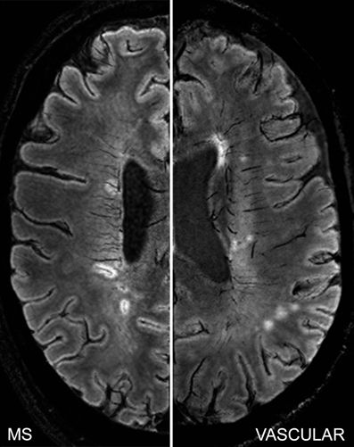
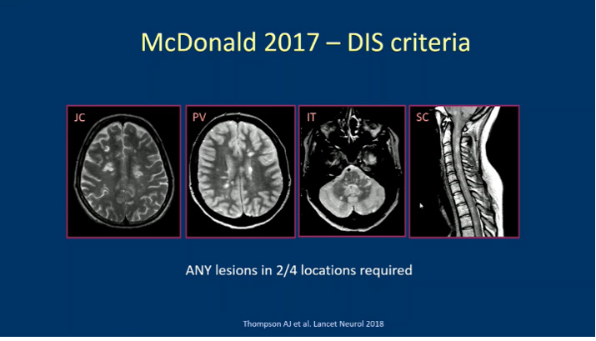
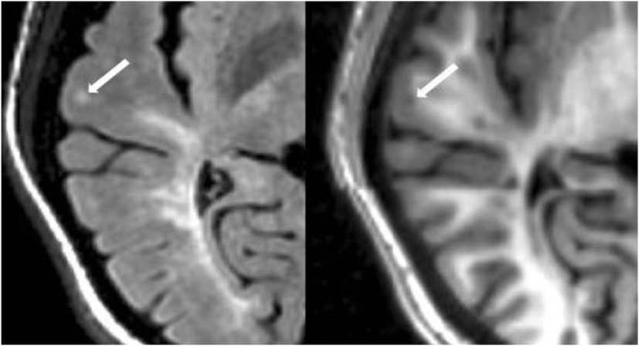
Image Interpretation:
Standardized image interpretation and reporting is recommended (number of lesions and location)
Knowledge about definition of lesion
types is crucial and warning signs against a diagnosis of multiple sclerosis should
be recognized
Separate identification of cortical lesions (together with juxtacortical lesions) based
on standard images is recommended
(eg, fluid-attenuated inversion recovery; double inversion recovery or phase-sensitive inversion recovery sequences are optional)
McDonald Criteria 2017, DIS
Central vein
Any lesion in 2/4 locations
Cortical Lesions
in MS

Slide 8
Monitoring of Treatment Effectiveness and Prediction of Treatment Response
MRI timing
Obtain a baseline brain MRI (with gadolinium-GAD- if required by drug label) before starting or switching disease-modifying treatment
Obtain a new baseline brain MRI usually at 3–6 months after treatment onset to avoid misinterpretation of lesions that developed before therapeutic onset
  Longer intervals are to be considered in patients who are treated with disease-modifying therapies that are slow acting
Obtain yearly brain MRI while the patient is on the disease-modifying treatment;
  Consider longer intervals in clinically stable patients after the first few years of treatment, particularly if safety monitoring is not required
In patients who show MRI disease activity that is not associated with clinical activity on a follow-up scan, consider a new MRI scan without GAD 6 months later
Use of GAD-based contrast agents is optional and not recommended for all clinical situations (ie, consider new or enlarging T2 lesions as the only measure when a recent
[ie, ≤1 year] reference scan is available); use GAD judiciously; minimize repeated gadolinium imaging when possible and use a single dose

Slide 9

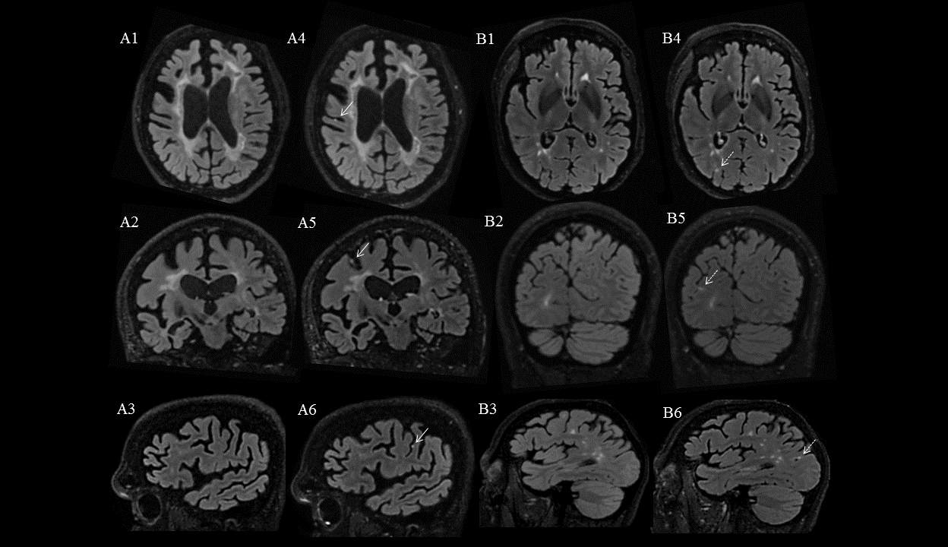
Additional MRI Methods and Imaging Findings for Multiple Sclerosis Diagnosis and Monitoring
Novel MRI approaches are being incorporated in diagnostic setting, conduct of clinical trials and research studies, including assessment of central vein sign
Chronic active lesions (CALs) have recently garnered attention and might represent the imaging correlate of smoldering inflammation. CALs can be detected as slowly-expanding lesions (SELs) by conventional T2 and T1-WI sequences using serial MRI or as paramagnetic rim lesions (PRLs)
The PRLs are usually detected on susceptibility-based MRI sequences such as: phase-imaging, susceptibility-weighted imaging (SWI) and quantitative susceptibility mapping (QSM). These lesions reflect ongoing tissue loss, and their presence has been proposed as an MRI marker of chronic inflammatory activity
However, their identification
is not yet standardized,
lasting long time and
thus, cannot be routinely
recommended
Foci of leptomeningeal GAD
enhancement are more
frequent in patients with
SPMS than in patients with
other types of MS. However,
once apparent, the foci are
generally constant over a long
period of time, and no effect of
disease-modifying treatments
has been shown on the size
or number of foci

Slide 10



Looking for more resources
on this topic?
CME/CE in minutes
Congress highlights
Late-breaking data
Quizzes
Webinars
In-person events
Slides & resources
www.MedEdOTG.com

