Slide 1
Navigating the Diagnostic Maze
Strategies for Excluding MS Disease Mimics
Dr. Mark S. Freedman, MSc, MD, FANA, FAAN, CSPQ, FRCPC
Professor of Neurology
University of Ottawa
Sr. Scientist
Ottawa Hospital Research Institute
Ottawa, Canada

Slide 2



Resource Information
About This Resource
These slides are one component of a continuing education program available online at MedEd On The Go titled Multiple Sclerosis: Using S1P Receptor Modulators to Slow Disease Progression
Program Learning Objectives:
Identify metrics and barriers that exclude multiple sclerosis mimics and facilitate early diagnosis and treatment initiation
Provide clinical knowledge regarding the role and impact of the most current S1P modulators for multiple sclerosis symptom management
Examine the evolution of the treatment landscape of the past 30 years and outline best practices to enhance decision-making focusing on long- and short-term disease-modifying therapies
MedEd On The Go®
www.mededonthego.com
This content or portions thereof may not be published, posted online or used in presentations without permission.
This content can be saved for personal use (non-commercial use only) with credit given to the resource authors.
To contact us regarding inaccuracies, omissions or permissions please email us at support@MedEdOTG.com

Slide 3
Disclaimer
The views and opinions expressed in this educational activity are those of the faculty and do not necessarily represent the views of Total CME, LLC, the CME providers, or the companies providing educational grants. This presentation is not intended to define an exclusive course of patient management; the participant should use their clinical judgment, knowledge, experience, and diagnostic skills in applying or adopting for professional use any of the information provided herein. Any procedures, medications, or other courses of diagnosis or treatment discussed or suggested in this activity should not be used by clinicians without evaluation of their patient's conditions and possible contraindications or dangers in use, review of any applicable manufacturer’s product information, and comparison with recommendations of other authorities. Links to other sites may be provided as additional sources of information.

Slide 4
Use of McDonald Criteria to Avoid Misdiagnosis
Criteria not developed to differentiate MS from other conditions, but to identify MS or a high likelihood of the disease in patients with a typical clinically isolated syndrome once other diagnoses have been deemed unlikely
Integration of the history, examination, imaging, and laboratory evidence by a clinician with MS-related expertise remains fundamental in making a reliable diagnosis of MS or alternative diagnosis
Need to confirm DIS and DIT
In the absence of a clear-cut typical clinically isolated syndrome consistent with CNS demyelination, caution should be exercised in making the diagnosis of MS, and the diagnosis should be confirmed by further clinical and radiological follow-up
  In such cases, clinician should consider postponing making a definitive diagnosis and initiation of long-term disease-modifying therapies, pending longer follow-up to accumulate additional evidence supporting the diagnosis

Slide 5
Use of McDonald Criteria to Avoid Misdiagnosis
Caution in accepting a historical event as an attack in the absence of contemporaneous or current objective evidence providing corroboration
The threshold for additional testing should be low, including for spinal cord MRI or CSF examination in the following situations:
  When clinical and brain MRI evidence supporting MS is insufficient, particularly if initiation of long-term disease-modifying therapies are being considered
  When there is a presentation other than a typical clinically isolated syndrome, including patients with a progressive course at onset (PPMS)
  When there are clinical, imaging, or laboratory features atypical of MS
  In populations in which MS is less common (e.g. children, older individuals, or non-white populations)

Slide 6
MRI in MS Diagnosis
Differentiation from mimics of disease
  Shape
  Distribution
  Central vein sign
  Asymmetry of spinal cord lesions
  Open “C” type of demyelination
McD criteria
Importance in reports “not” corroborating, confirming or suggesting a clinical diagnosis of MS!

Slide 7
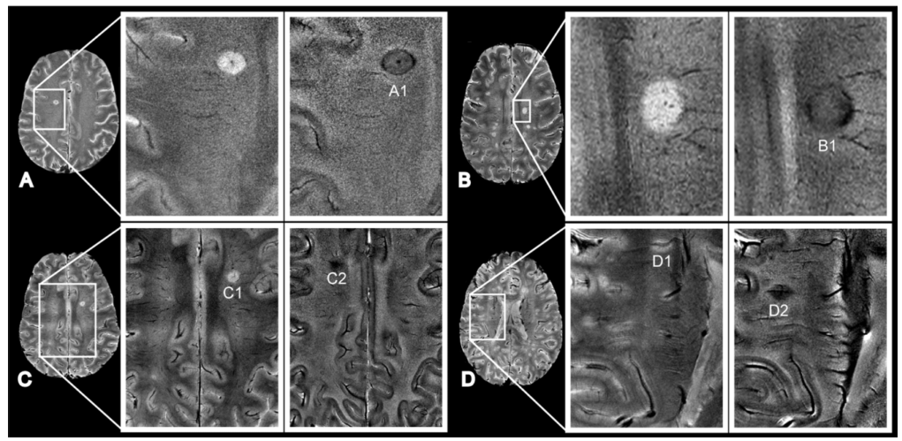
The Central Vein (CV) Sign in MS

Slide 8
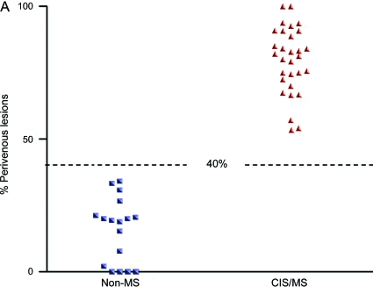
The CV Sign: A Diagnostic Biomarker for MS?

Slide 9
The CV Sign:
Diagnostic Value
List of CV articles using the 40-50% rule
Numerous studies showing diagnostic utility in differentiating MS versus other WMD (NMOSD, SLE, migraines, SVD, HCs with and without co-morbidities)
Also observed in high proportions in RIS
90% RIS met > 40% threshold

Slide 10
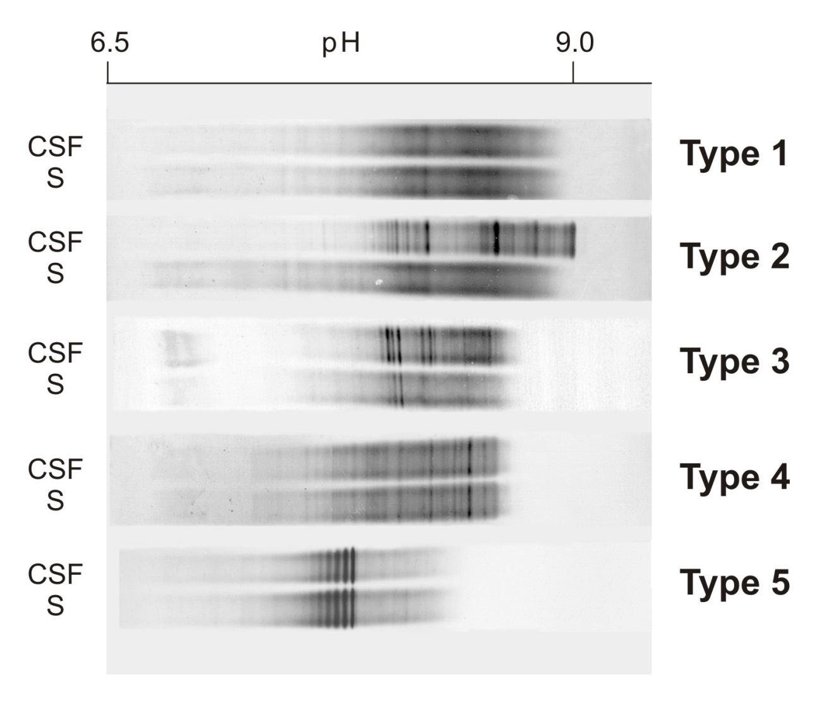
CSF in MS Diagnosis: Typical of MS
Cellular make-up
  Typically, in MS cell counts are <5/hpf; the majority are lymphocytes, all T
  (Too many RBC = traumatic tap)
Biochemistry
  Protein N or only minimally increased
  Albumin Index N
  N glucose
Immunology
  IgG Index is raised (>0.7)
  Presence of CSF-specific OCB
MS

Slide 11
CSF in MS Diagnosis: Atypical Findings in MS
Cellular make-up
  Any non-lymphocyte (e.g. neutrophil or eosinophil)
Biochemistry
  Protein elevated
  Albumin Index raised
  Glucose low
Immunology
  IgG Index is N
  No CSF-specific OCB or mirror pattern (same in serum and CSF)
Mirror Pattern

Slide 12



Looking for more resources
on this topic?
CME/CE in minutes
Congress highlights
Late-breaking data
Quizzes
Webinars
In-person events
Slides & resources
www.MedEdOTG.com

