Slide 1
Saturday, October 14, 2023 9:00am – 2:45pm CT
InterContinental Chicago Magnificent Mile Hotel | Chicago, IL
This activity is supported by independent educational grants from Actelion Pharmaceuticals US, Division of Janssen Pharmaceuticals and United Therapeutics Corporation. Jointly provided by the Global Learning Collaborative (GLC) and Total CME, LLC.

Slide 2
Resource Information
About This Resource
These slides are one component of a continuing education program available online at MedEd On The Go titled Midwest Regional PH Summit – Management of Pulmonary Hypertension with Comorbidities
Program Learning Objectives:
Explain the ERS/ERC guideline updates
Evaluate available evidence-based data and patient management strategies for PH
Identify opportunities to apply effective management strategies to improve patient outcomes
MedEd On The Go®
www.mededonthego.com
This content or portions thereof may not be published, posted online or used in presentations without permission.
This content can be saved for personal use (non-commercial use only) with credit given to the resource authors.
To contact us regarding inaccuracies, omissions or permissions please email us at support@MedEdOTG.com

Slide 3
Disclaimer
The views and opinions expressed in this educational activity are those of the faculty and do not necessarily represent the views of Total CME, LLC, the CME providers, or the companies providing educational grants. This presentation is not intended to define an exclusive course of patient management; the participant should use their clinical judgment, knowledge, experience, and diagnostic skills in applying or adopting for professional use any of the information provided herein. Any procedures, medications, or other courses of diagnosis or treatment discussed or suggested in this activity should not be used by clinicians without evaluation of their patient's conditions and possible contraindications or dangers in use, review of any applicable manufacturer’s product information, and comparison with recommendations of other authorities. Links to other sites may be provided as additional sources of information.

Slide 4
Case 3 & Panel Discussion: Right Heart Diagnostics in PAH
Ravi B. Patel, MD, MSc
Assistant Professor of Medicine and Preventive Medicine
Division of Cardiology
Northwestern University Feinberg School of Medicine
Chicago, IL

Slide 5
Case Presentation
62-year-old female with history of sickle cell anemia and pulmonary hypertension hospitalized with dyspnea and lower extremity swelling
Marked reduction in functional capacity over 2 years
Episodes of near syncope with walking

Slide 6
Case Presentation
Past Medical History
Physical Exam
Sickle cell anemia
Monthly exchange transfusions
Pulmonary hypertension
On riociguat
Atrial fibrillation
Hypertension
Elevated JVP with prominent C-V wave
Irregular rhythm
Abdominal distension
2-3+ pitting edema of lower extremities

Slide 7
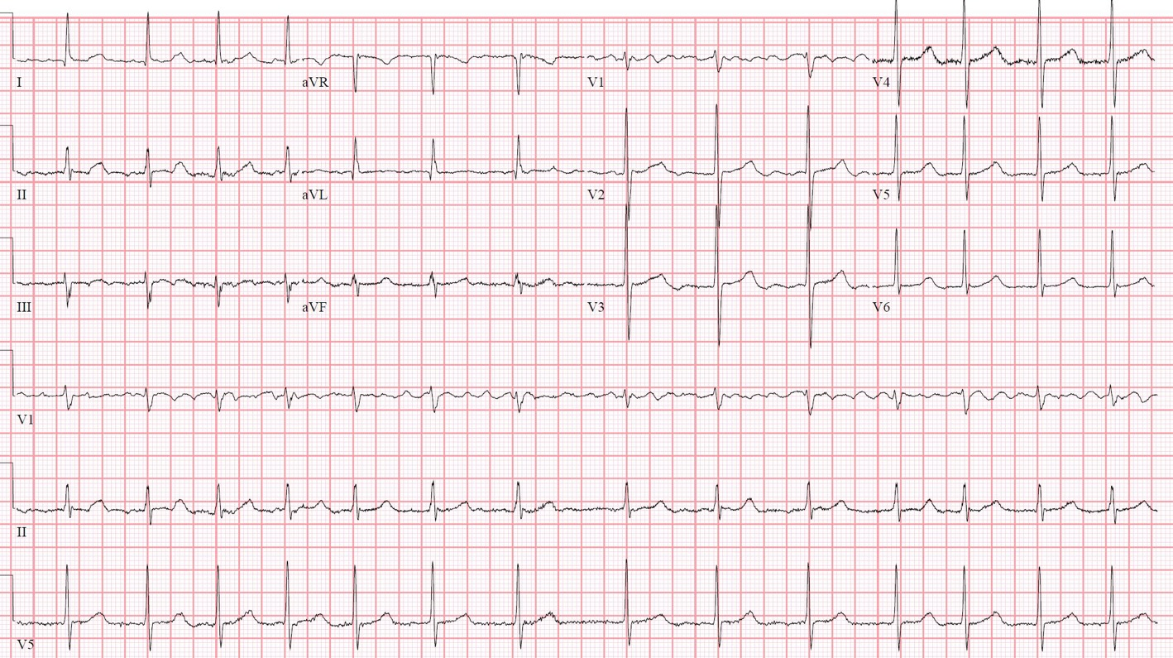
ECG

Slide 8
Echocardiogram

Slide 9
Echocardiogram

Slide 10
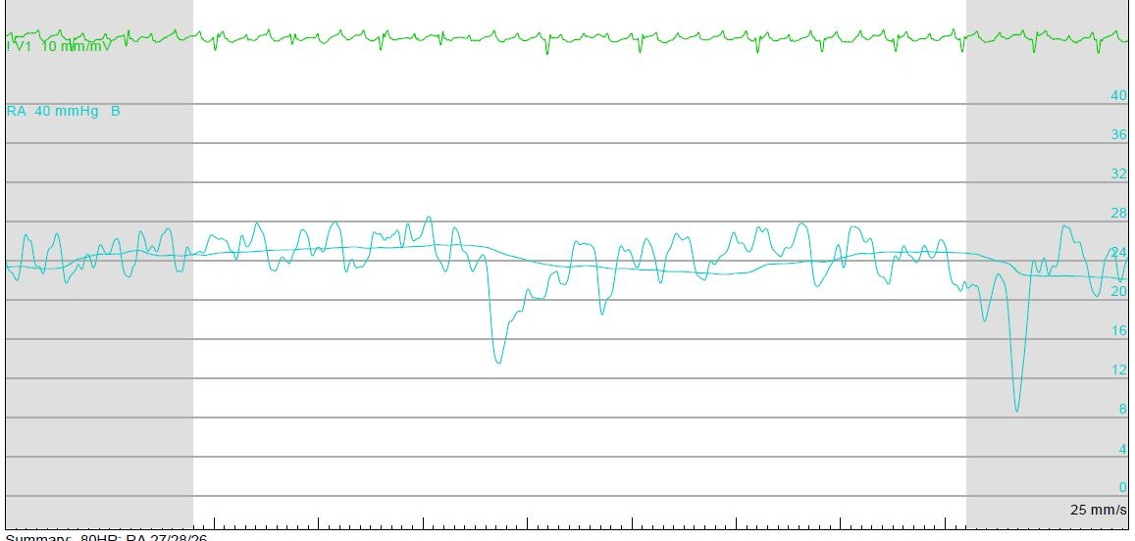
Right Heart Catheterization

Slide 11
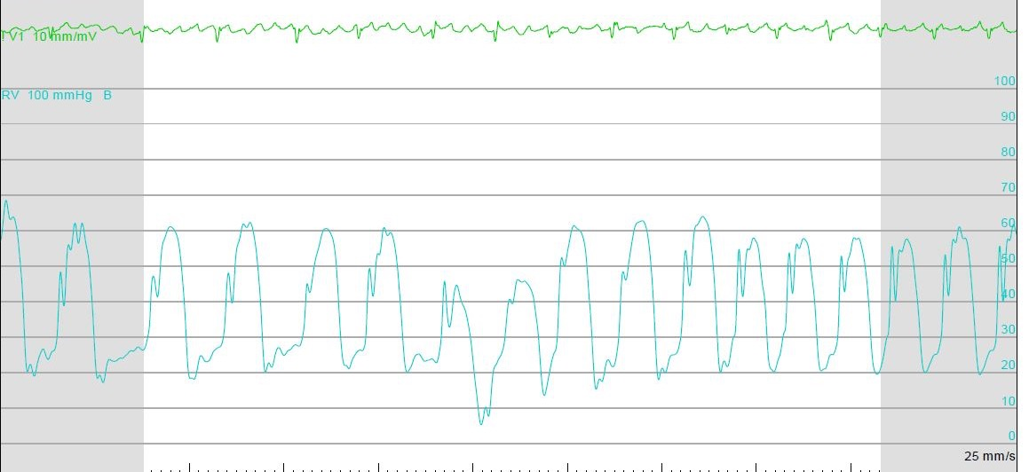
Right Heart Catheterization

Slide 12
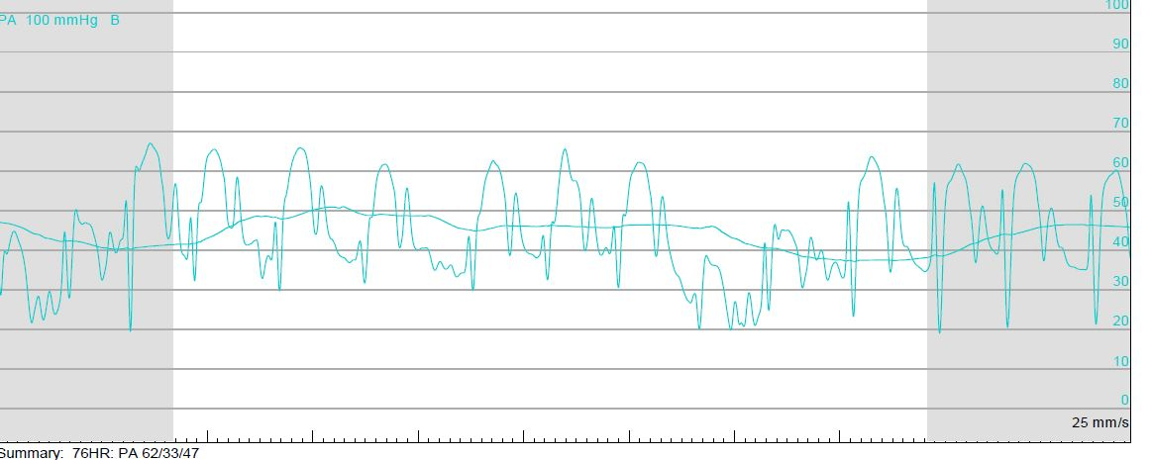
Right Heart Catheterization

Slide 13
Right Heart Catheterization

Slide 14
RHC
TD CO 6.5
TD CI 3.1
TPG 10 mmHg
PVR 1.5 WU

Slide 15
Hospital Course
Riociguat stopped
Continued IV diuresis, but progressive AKI
Required milrinone to support diuresis
Robust diuretic response after milrinone, discharged on loop diuretic, SGLT2 inhibitor

Slide 16
Clinical Course
Rehospitalized 3 years later for HF
Repeat RHC:
RA: 18
PA: 63/30, mean 44
PCWP: 26
TD CO/CI: 4.6/2.3
PVR: 3.9 WU

Slide 17
Next Steps
Initiated sacubitril-valsartan and spironolactone
Evaluation for clinical trials for combined pre and post capillary PH
PA denervation?
Levosimendan?

Slide 18
Looking for more resources on this topic?
CME/CE in minutes
Congress highlights
Late-breaking data
Quizzes
Webinars
In-person events
Slides & resources
www.MedEdOTG.com

