Slide 1






Saturday, October 14, 2023
9:00am – 2:45pm CT
InterContinental Chicago Magnificent Mile Hotel | Chicago, IL
This activity is supported by independent educational grants from Actelion Pharmaceuticals US, Division of Janssen Pharmaceuticals and United Therapeutics Corporation.
Jointly provided by the Global Learning Collaborative (GLC) and Total CME, LLC.

Slide 2



Resource Information
About This Resource
These slides are one component of a continuing education program available online at MedEd On The Go titled Midwest Regional PH Summit – Management of Pulmonary Hypertension with Comorbidities
Program Learning Objectives:
Explain the ERS/ERC guideline updates
Evaluate available evidence-based data and patient management strategies for PH
Identify opportunities to apply effective management strategies to improve patient outcomes
MedEd On The Go®
www.mededonthego.com
This content or portions thereof may not be published, posted online or used in presentations without permission.
This content can be saved for personal use (non-commercial use only) with credit given to the resource authors.
To contact us regarding inaccuracies, omissions or permissions please email us at support@MedEdOTG.com

Slide 3
Disclaimer
The views and opinions expressed in this educational activity are those of the faculty and do not necessarily represent the views of Total CME, LLC, the CME providers, or the companies providing educational grants. This presentation is not intended to define an exclusive course of patient management; the participant should use their clinical judgment, knowledge, experience, and diagnostic skills in applying or adopting for professional use any of the information provided herein. Any procedures, medications, or other courses of diagnosis or treatment discussed or suggested in this activity should not be used by clinicians without evaluation of their patient's conditions and possible contraindications or dangers in use, review of any applicable manufacturer’s product information, and comparison with recommendations of other authorities. Links to other sites may be provided as additional sources of information.

Slide 4
Case 2 & Panel Discussion:
CTEPH and PH
Victor M. Moles, MD
Clinical Assistant Professor
Associate Director, Pulmonary Hypertension Program
University of Michigan
Ann Arbor, MI

Slide 5
Case Presentation
21 year-old female without significant medical history presented to outside emergency department due to worsening dyspnea and hemoptysis
2 years prior she developed pneumonia after which she had persistent dyspnea of unclear etiology
Previous work up was unremarkable and exertional dyspnea was attributed to anxiety
No personal of family history of venous thromboembolic events
  CT angiogram of the chest concerning for pulmonary embolism
  Echocardiogram with severe pulmonary hypertension

Slide 6
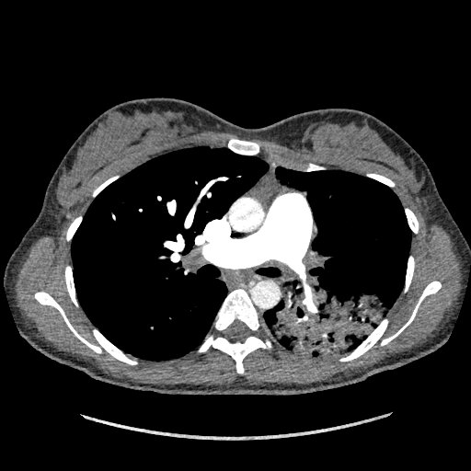
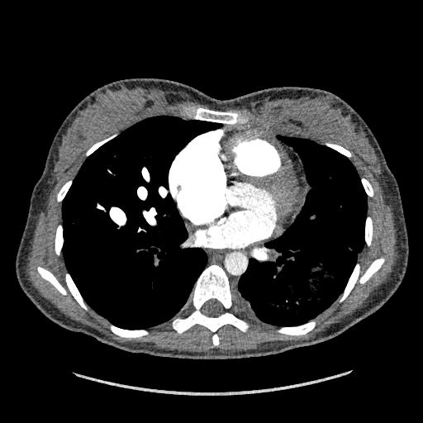
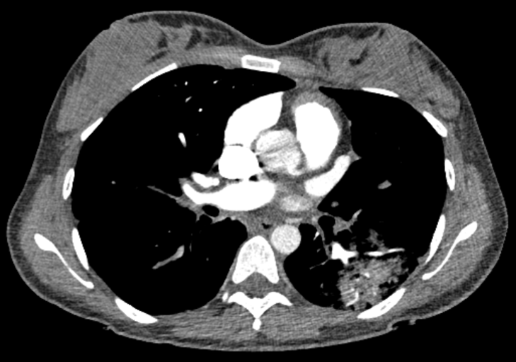
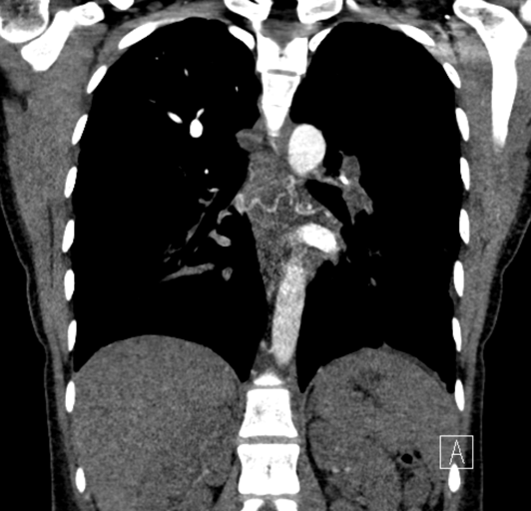
Computed Tomography
Stenosis
Hypo vasculature
Stenosis
Collaterals
Severe narrowing and abrupt obstruction
of pulmonary arteries (left>right), hypo
vascularity and presence of collaterals.

Slide 7
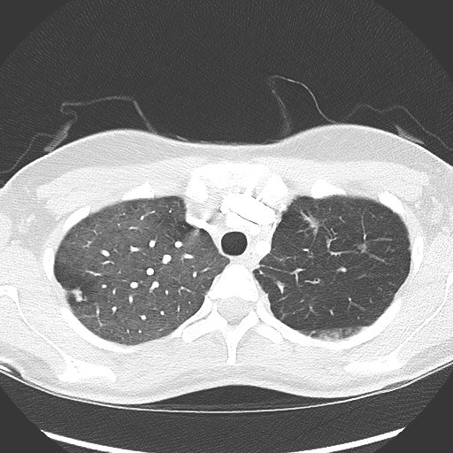
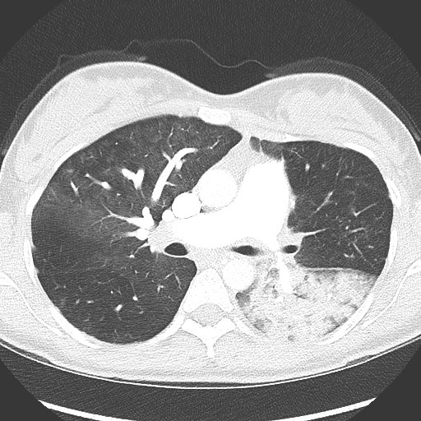
Computed Tomography
Hypo vasculature
Infarct

Slide 8
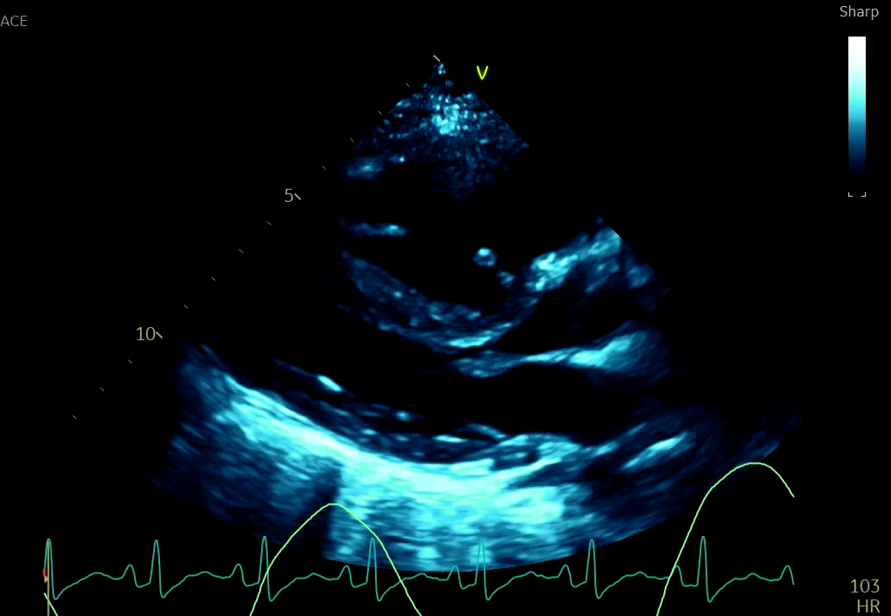
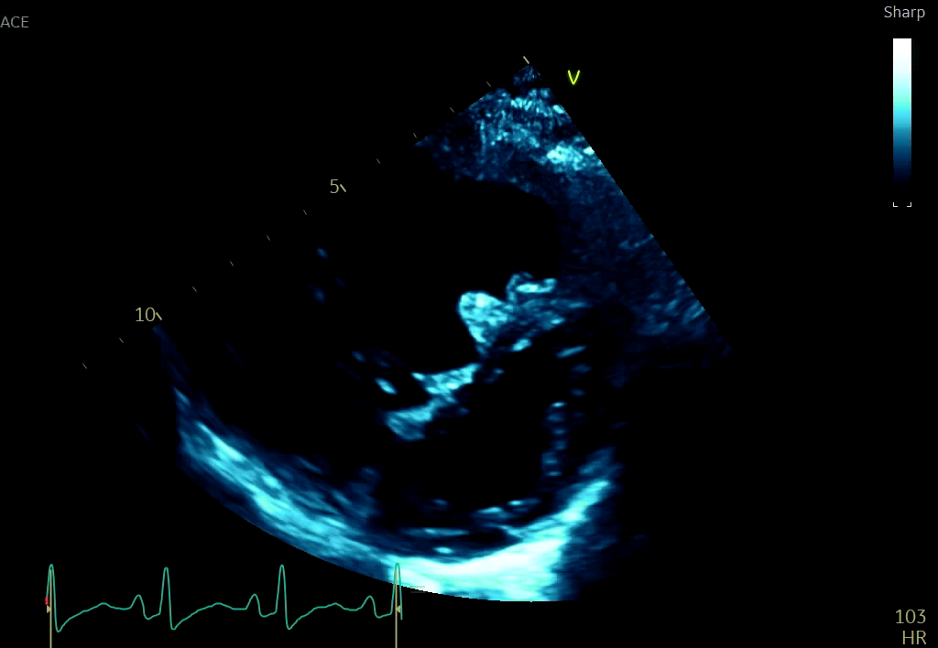
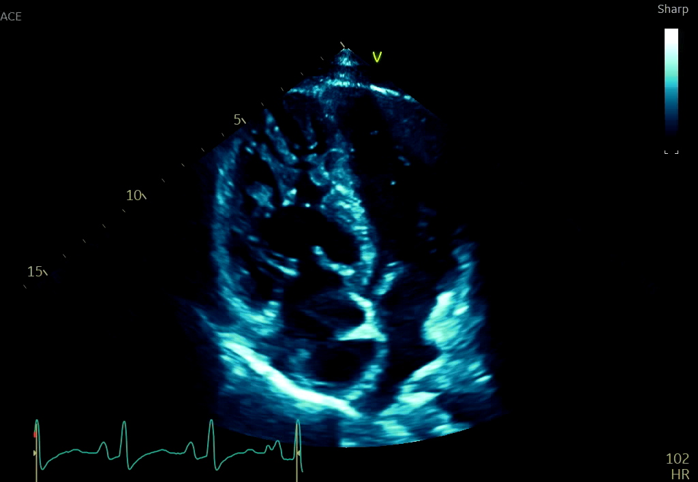
Echocardiogram
Parasternal long axis
RVOT pulse wave Doppler
TR peak jet velocity
Parasternal short axis
Inferior vena cava
Inferior vena cava
Consistent with severe pulmonary hypertension, likely precapillary.

Slide 9
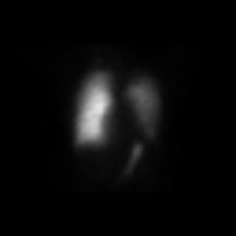
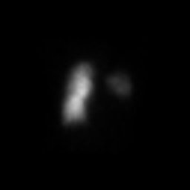
Ventilation Perfusion Scan
Ventilation
Perfusion

Slide 10
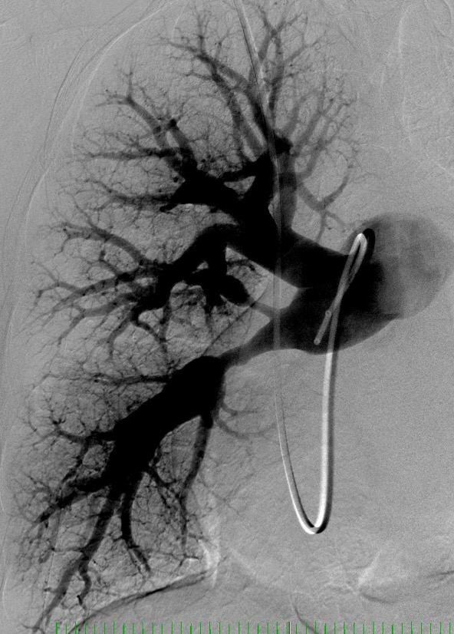
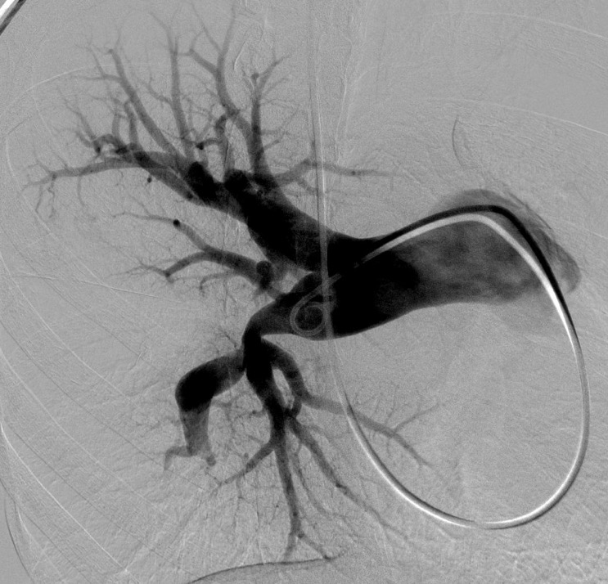
Pulmonary Angiogram - Right
Left anterior oblique 60º
Right anterior oblique 30º
Severe stenosis
Severe stenosis
Occlusion

Slide 11
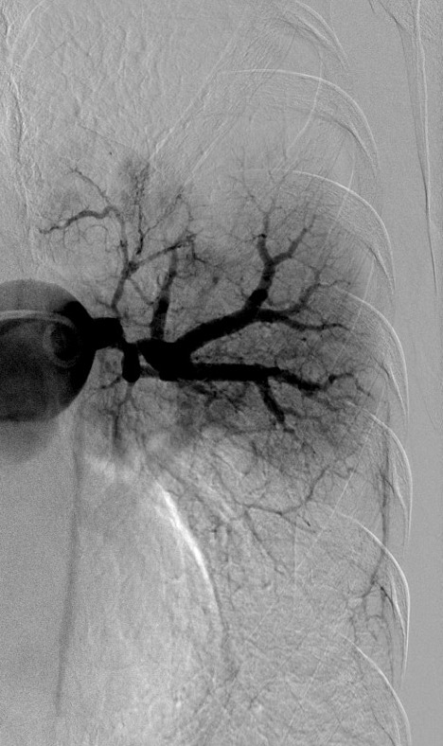
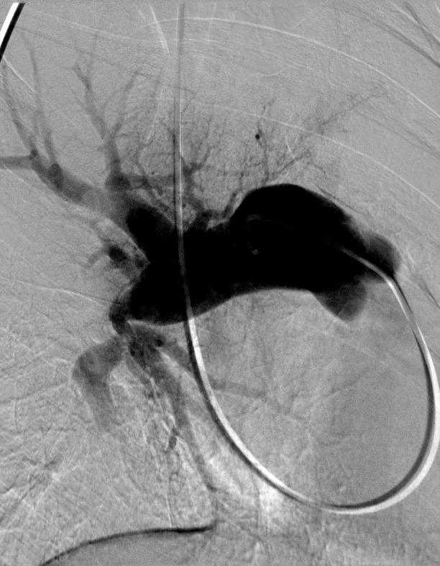
Pulmonary Angiogram - Left
Left anterior oblique 30º
Right anterior oblique 60º
Severe stenosis
Severe stenosis
Occlusion
Occlusion
Lack of perfusion
Lack of perfusion

Slide 12
Right heart catheterization
RA (mmHg) | RV (mmHg) | PA (mmHg) | PCW (mmHg) | TD CO (L/min) | TD CI (L/min/m²) | PVR (WU)
16 | 110/11/20 | 111/47/71 | 12 | 2 | 1.3 | 30
=

Slide 13
Medical Decision Making
Severe precapillary pulmonary hypertension
Severe pulmonary vascular obstructions “matching” the pulmonary hypertension severity
No history of thromboembolic event
Reviewed the CT angiogram and pulmonary angiogram among the CTEPH team
  Large vessel vasculitis was considered but there was no other major artery involvement
Pulmonary vascular obstructions were proximal and surgically accessible
Pulmonary endarterectomy

Slide 14


Clinical Course
Pulmonary endarterectomy under hypothermic circulatory arrest.
No thrombus is identified. Multiple stenosis and occlusion noted that appeared to be constriction. Fibrotic appearance of arteries.
Sample obtained for pathology.

Slide 15
Clinical Course
Transferred to flood on post op day #4.
CT neck, chest, abdomen and pelvis with IV contrast is performed and confirms no other systemic artery involvement
Biopsy results:
  Granulomatous vasculitis consistent with isolated pulmonary artery Takayasu arteritis
High dose IV steroids + infliximab in hospital
Oral steroids + methotrexate as outpatient

Slide 16
Takayasu arteritis (TA)
TA is a large vessel vasculitis which disproportionately affects young women in their second and third decades and in Asian populations
There is no gold standard test to diagnosis TA. Clinical assessment and labs correlate poorly with disease activity
Pulmonary artery involvement is common in patients with TA, occurring in 20-56% of patients
TA with isolated pulmonary artery involvement is rare
Immunosuppression is the mainstream treatment
Pulmonary angioplasty has been described in small series to improve hemodynamics and functional capacity with a high rate of complications (up to 32%)

Slide 17
Clinical Course
Repeat right heart catheterization and pulmonary angiogram after 4 month of immunosuppression
  Unchanged hemodynamics
  Unchanged pulmonary anatomy
Optimization hemodynamics
  started on tadalafil and macitentan improvement in RV Fx
  Planning on parenteral prostacyclin initiation
Discussion with multiple colleagues around the globe
  No clear consensus on management
Considering balloon pulmonary angioplasty once hemodynamics are optimized

Slide 18
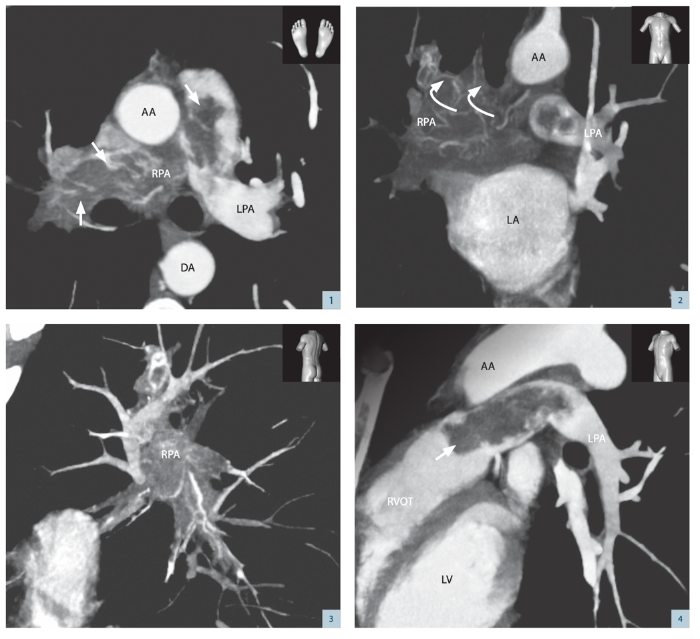
Differential Diagnosis: Pulmonary artery sarcoma

Slide 19
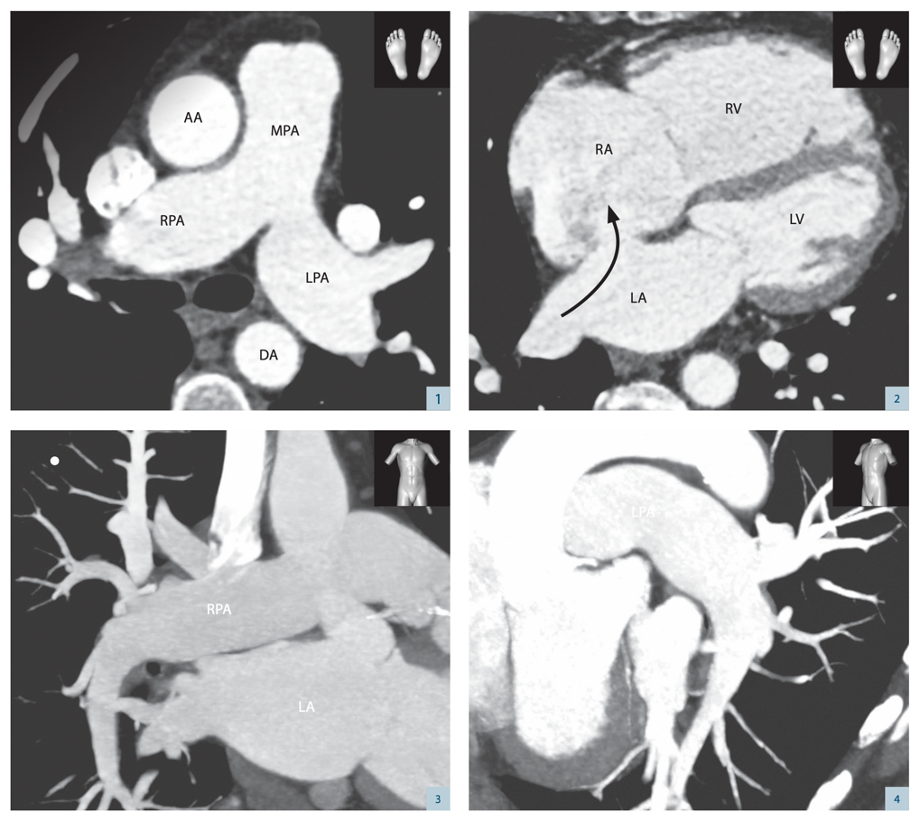
Differential Diagnosis: Atrial septal defect & layering thrombus

Slide 20
Conclusions
CTEPH is a complex medical condition characterized by chronic emboli causing mechanical obstruction to pulmonary blood flow
Thrombus characterization is difficult
Not every pulmonary obstruction is thrombus! Keep an open mind
Takayasu arteritis can affect the pulmonary arteries
  Systemic arteries are commonly affected too
  Isolated pulmonary artery involvement is very rare
A multidisciplinary approach to management of CTEPH is crucial

Slide 21



Looking for more resources
on this topic?
CME/CE in minutes
Congress highlights
Late-breaking data
Quizzes
Webinars
In-person events
Slides & resources
www.MedEdOTG.com

