Slide 1
Saturday, October 14, 2023 9:00am – 2:45pm CT
InterContinental Chicago Magnificent Mile Hotel | Chicago, IL
This activity is supported by independent educational grants from Actelion Pharmaceuticals US, Division of Janssen Pharmaceuticals and United Therapeutics Corporation. Jointly provided by the Global Learning Collaborative (GLC) and Total CME, LLC.

Slide 2
Resource Information
About This Resource
These slides are one component of a continuing education program available online at MedEd On The Go titled Midwest Regional PH Summit – Management of Pulmonary Hypertension with Comorbidities
Program Learning Objectives:
Explain the ERS/ERC guideline updates
Evaluate available evidence-based data and patient management strategies for PH
Identify opportunities to apply effective management strategies to improve patient outcomes
MedEd On The Go®
www.mededonthego.com
This content or portions thereof may not be published, posted online or used in presentations without permission.
This content can be saved for personal use (non-commercial use only) with credit given to the resource authors.
To contact us regarding inaccuracies, omissions or permissions please email us at support@MedEdOTG.com

Slide 3
Disclaimer
The views and opinions expressed in this educational activity are those of the faculty and do not necessarily represent the views of Total CME, LLC, the CME providers, or the companies providing educational grants. This presentation is not intended to define an exclusive course of patient management; the participant should use their clinical judgment, knowledge, experience, and diagnostic skills in applying or adopting for professional use any of the information provided herein. Any procedures, medications, or other courses of diagnosis or treatment discussed or suggested in this activity should not be used by clinicians without evaluation of their patient's conditions and possible contraindications or dangers in use, review of any applicable manufacturer’s product information, and comparison with recommendations of other authorities. Links to other sites may be provided as additional sources of information.

Slide 4
Epidemiology & Management of Left Heart Disease Associated PH
Thomas Cascino, MD, MSc, FACC, FHFSA
Clinical Instructor
Division of Cardiovascular Medicine
University of Michigan
Ann Arbor, MI

Slide 5
Overview
Review the classification and epidemiology of PH-LHD
Discuss treatment strategies for PH-LHD in 2023
PH-LHD, pulmonary hypertension associated with left heart disease.

Slide 6
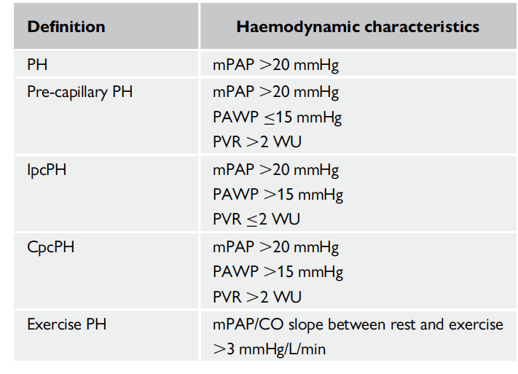
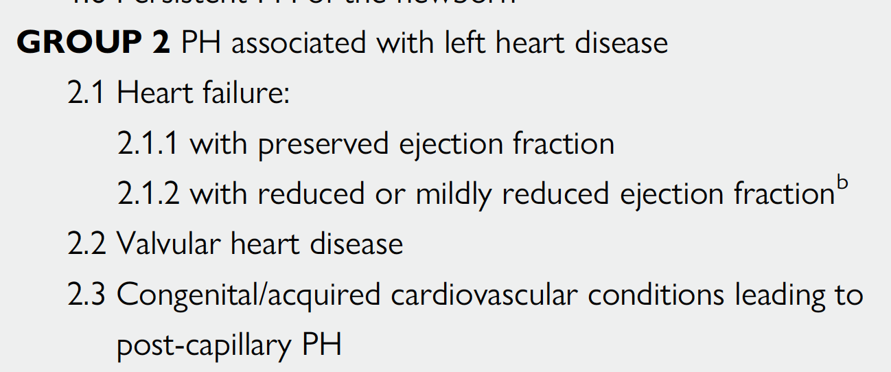
PH Definitions and Classifications
Hemodynamic Definitions
Clinical Classification

Slide 7
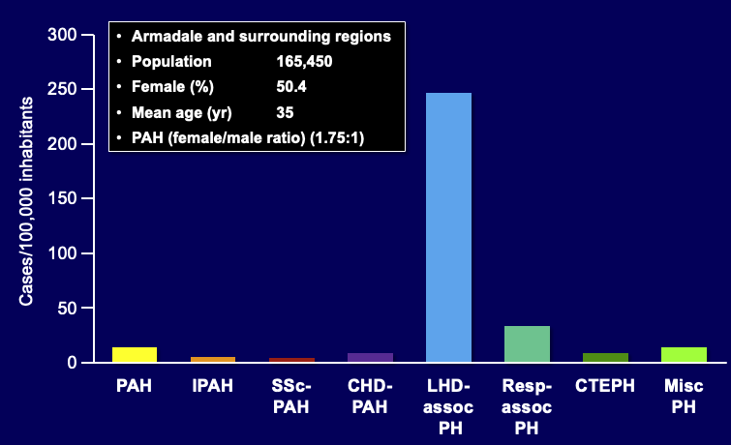
PH Associated with Left Heart Disease is an Epidemic
10,314 patients with echocardiogram between 2003 and 2009
9.1% had RVSP greater than 40 mmHG
326 cases/100,000
68% of elevated RVSP associated with LHD
250 cases/100,000
RVSP, right ventricular systolic pressure.

Slide 8
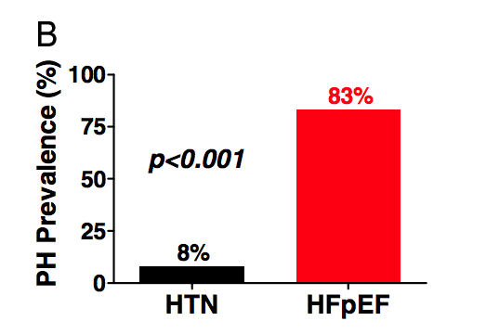
PH Associated with Left Heart Disease is an Epidemic
244 HFpEF patients from Olmsted County, MN
83% HFpEF patients with PH defined as PASP greater than 35 mmHg on echo
HFpEF, heart failure with preserved ejection fraction; PASP, pulmonary artery systolic pressure.

Slide 9
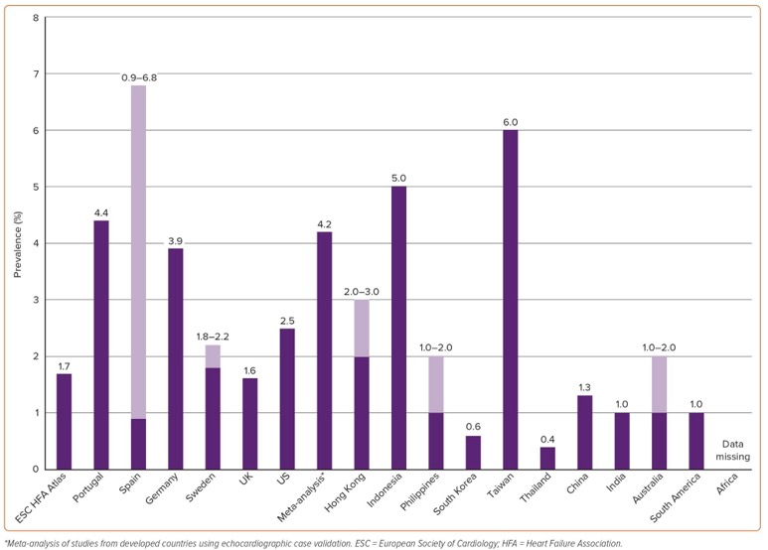
PH Associated with Left Heart Disease is an Epidemic
Prevalence of HF Worldwide:
64 million
Estimated over 30 million people worldwide with PH-LHD!!

Slide 10
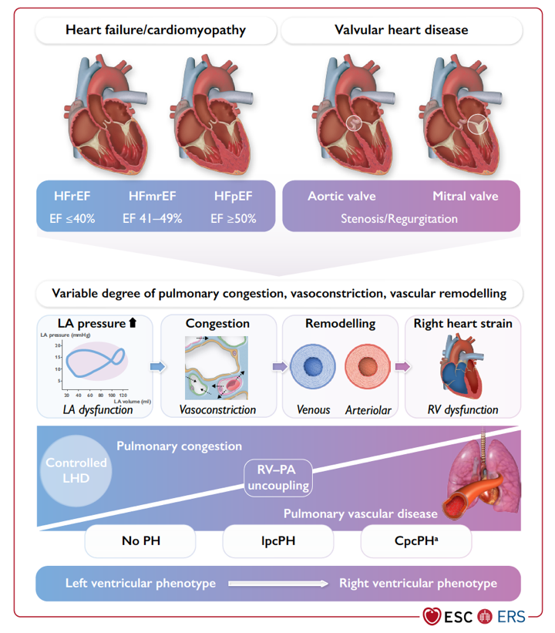
PH Associated with Left Heart Disease is a Spectrum

Slide 11
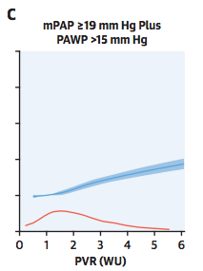
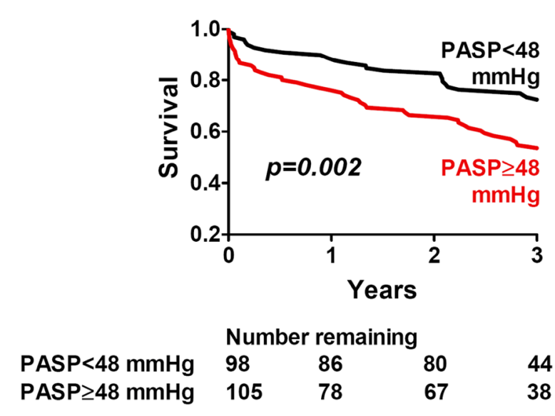
PH Impacts Mortality in Patients with LHD
40,082 VA patients
244 HFpEF patients

Slide 12
Overview
Review the classification and epidemiology of PH associated with left heart disease (PH-LHD)
PH-LHD is common and associated with increased mortality
Discuss treatment strategies for PH-LHD in 2023

Slide 13
No FDA-Approved PAH-Specific Medications for Patients with Group II-Associated PH!
Isolated post-capillary pulmonary hypertension
Combined post- and pre-capillary pulmonary hypertension
Theoretical risk of of increasing PCWP resulting in pulmonary edema

Slide 14
No FDA-Approved PAH-Specific Medications for Patients with Group II-Associated PH!
PDE5 inhibitors:
Most promising; trials = mixed results
Endothelin receptor antagonists:
Multiple studies have failed to show benefit
Prostacyclins:
FIRST trial in HF w/reduced LVEF: ↑mortality

Slide 15
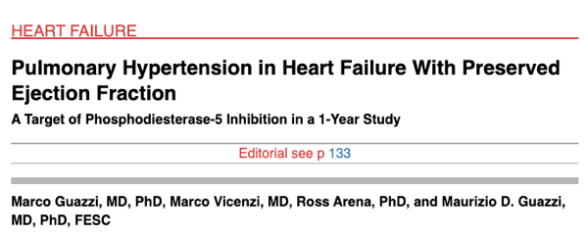
Sildenafil in HFpEF
Evidence of PH required | Evidence of PH not required
N=44 | N=216
PASP 53mmHg | PASP 41mmHg
Mean PADP-PCWP: 9 mm Hg | Hemodynamic testing not done
12-month follow-up | 6-month follow-up
Primary outcome: hemodynamics, RV performance, QoL | Primary outcome: peak VO₂
Positive trial | Negative trial

Slide 16
No Large, Multicenter Trials That Show Benefit
TABLE 4: Recently completed randomized controlled trials targeting the phosphodiesterase type 5 inhibitor/nitric oxide and endothelin pathways in pulmonary hypertension due to left heart disease
First author or study [ref.] | Study drug | Dose | Subjects n | Duration | Population | Primary outcome | Result
GUAZZI [74] | Sildenafil | 50 mg 3 times a day | 44 | 12 months | HFpEF | PVR, RV performance, CPET | Improvement
LEPHT [75] | Riociguat | 0.5. 1 or 2 mg 3 times a day | 201 | 16 weeks | HFrEF | mPAP versus placebo | No change
HOENDERMIS [73] | Sildenafil | 60 mg 3 times a day | 52 | 12 weeks | HFpEF | mPAP versus placebo | No change
SIOVAC [77] | Sildenafil | 40 mg 3 times a day | 231 | 24 weeks | VHD | Composite clinical score# | Worsening in active group
MELODY-1 [76] | Macitentan | 10 mg once daily | 48 | 12 weeks | HF (EF >30%): 75% HFpEF | Safety and tolerability | +10% fluid retention in active group
HF: heart failure; pEF: preserved ejection fraction; PVR: pulmonary vaunter resistance: RV: right ventricular; CPET: cardiopulmonary exercise testing; rEF: reduced ejection fraction: rnPAP: mean pulmonary arterial pressure; VHEI: valvular hear disease. #: combination of death, hospitalization for HF, change in New York Heart Association Functional Class and patient global self-assessment.

Slide 17
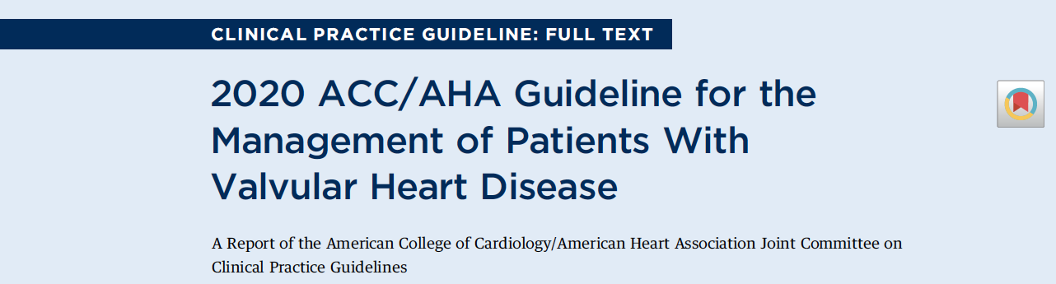
Treatment of LH Disease-Associated PH
Step 1: Accurate diagnosis of etiology
Make sure not dealing with a “zebra”
Step 2: Treat the underlying etiology of left heart disease

Slide 18
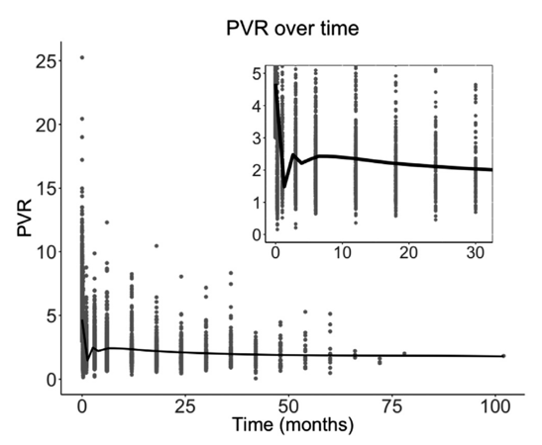
Treatment of LH Disease-Associated PH
Step 1: Accurate diagnosis of etiology
Make sure not dealing with a “zebra”
Step 2: Treat the underlying etiology of left heart disease
Step 3: Diuretics to optimize volume status and lower left atrial pressure
1581 LVAD patients in Intermacs Registry with PVR>3 WU

Slide 19
Treatment of LH Disease-Associated PH
Step 1: Accurate diagnosis of etiology
Make sure not dealing with a “zebra”
Step 2: Treat the underlying etiology of left heart disease
Step 3: Diuretics to optimize volume status and lower left atrial pressure
Step 4: Treat comorbidities aggressively
Step 5: Exercise training, HF education, chronic disease management programs
Step 6: Enroll in clinical trials

Slide 20
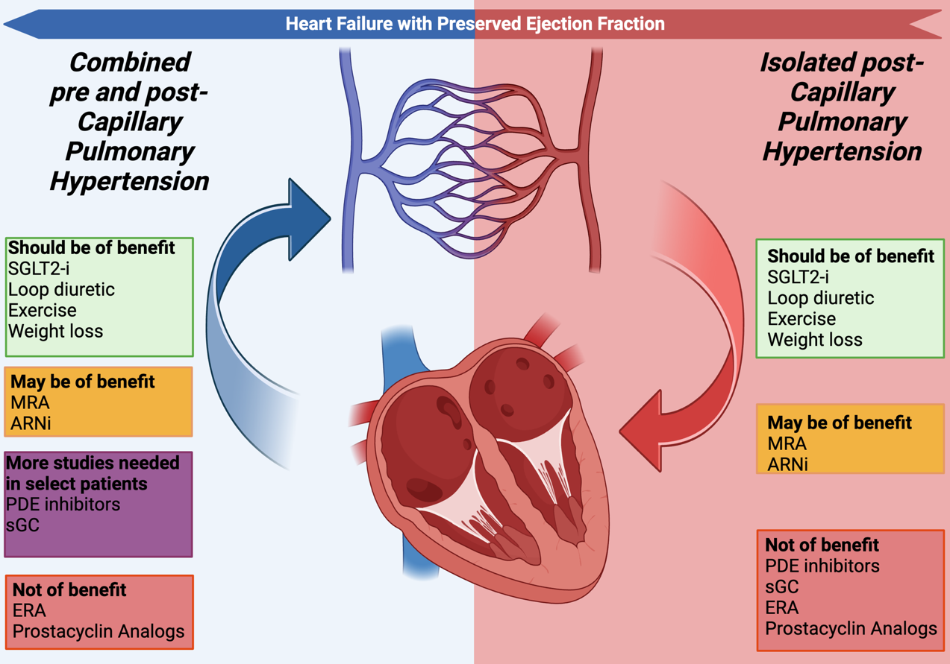
Summary

Slide 21
Conclusions
Review the classification and epidemiology of PH-LHD
PH-LHD is common and associated with increased mortality
Discuss treatment strategies for PH-LHD in 2023
Treat the underlying cause, optimize right atrial pressure, and enroll in clinical trials

Slide 22
Looking for more resources on this topic?
CME/CE in minutes
Congress highlights
Late-breaking data
Quizzes
Webinars
In-person events
Slides & resources
www.MedEdOTG.com

