Slide 1






Saturday, October 14, 2023
9:00am – 2:45pm CT
InterContinental Chicago Magnificent Mile Hotel | Chicago, IL
This activity is supported by independent educational grants from Actelion Pharmaceuticals US, Division of Janssen Pharmaceuticals and United Therapeutics Corporation.
Jointly provided by the Global Learning Collaborative (GLC) and Total CME, LLC.

Slide 2



Resource Information
About This Resource
These slides are one component of a continuing education program available online at MedEd On The Go titled Midwest Regional PH Summit – Management of Pulmonary Hypertension with Comorbidities
Program Learning Objectives:
Explain the ERS/ERC guideline updates
Evaluate available evidence-based data and patient management strategies for PH
Identify opportunities to apply effective management strategies to improve patient outcomes
MedEd On The Go®
www.mededonthego.com
This content or portions thereof may not be published, posted online or used in presentations without permission.
This content can be saved for personal use (non-commercial use only) with credit given to the resource authors.
To contact us regarding inaccuracies, omissions or permissions please email us at support@MedEdOTG.com

Slide 3
Disclaimer
The views and opinions expressed in this educational activity are those of the faculty and do not necessarily represent the views of Total CME, LLC, the CME providers, or the companies providing educational grants. This presentation is not intended to define an exclusive course of patient management; the participant should use their clinical judgment, knowledge, experience, and diagnostic skills in applying or adopting for professional use any of the information provided herein. Any procedures, medications, or other courses of diagnosis or treatment discussed or suggested in this activity should not be used by clinicians without evaluation of their patient's conditions and possible contraindications or dangers in use, review of any applicable manufacturer’s product information, and comparison with recommendations of other authorities. Links to other sites may be provided as additional sources of information.

Slide 4
Clinical Trials in HFpEF: What Have They Taught Us?
Ravi B. Patel, MD, MSc
Assistant Professor of Medicine and Preventive Medicine
Division of Cardiology
Northwestern University Feinberg School of Medicine
Chicago, IL

Slide 5
Goal
Discuss recent HFpEF clinical trials and their relevance to pulmonary hypertension

Slide 6
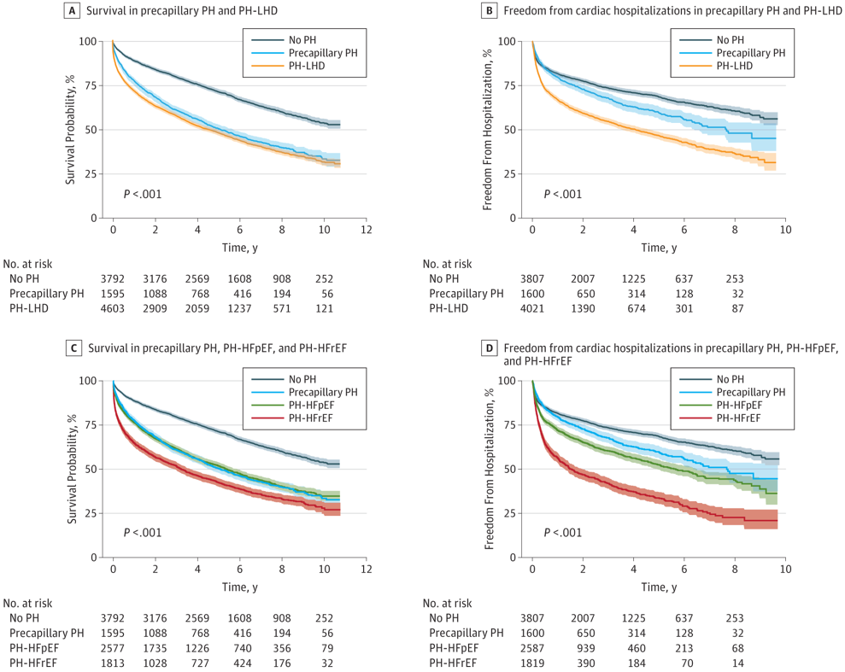
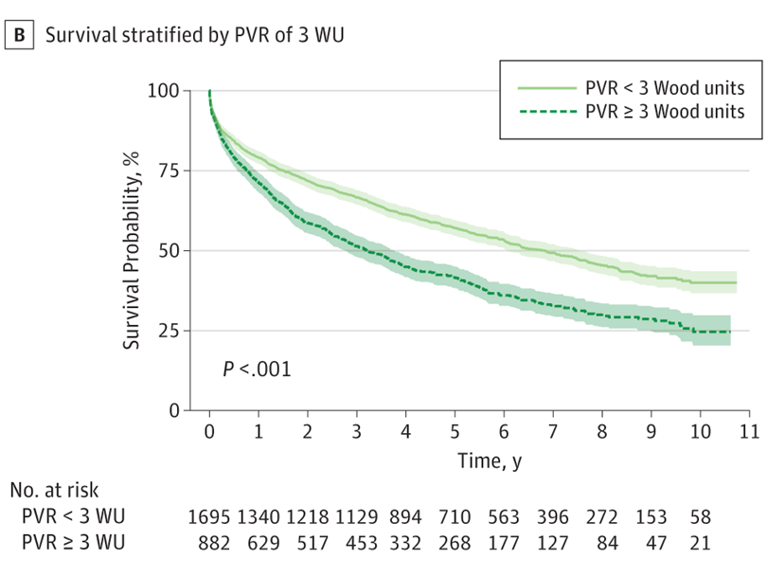
PH in HFpEF: Common and Morbid

Slide 7
SGLT2i: The First Disease-Modifying Therapies Across the LVEF Spectrum
HR 0.86 (95% CI 0.76-0.97) P=0.01
Placebo better
Dapagliflozin better
P for interaction=0.94

Slide 8
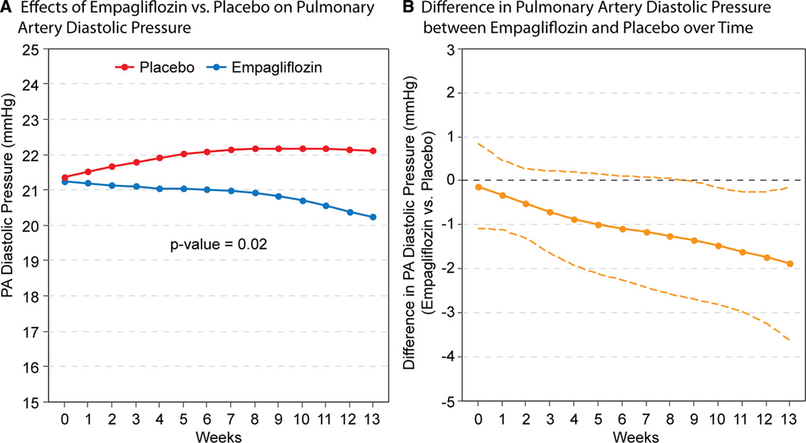
SGLT2i Reduce PA Pressure

Slide 9
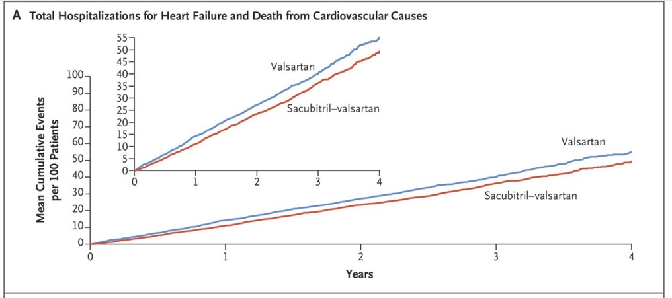
Sacubitril-Valsartan in HFpEF: PARAGON-HF
Rate ratio: 0.87 (0.75-1.01) P=0.06.

Slide 10


Prespecified Participant-Level Pooled Analyses
Pooled analysis of all 5,262 participants

Slide 11
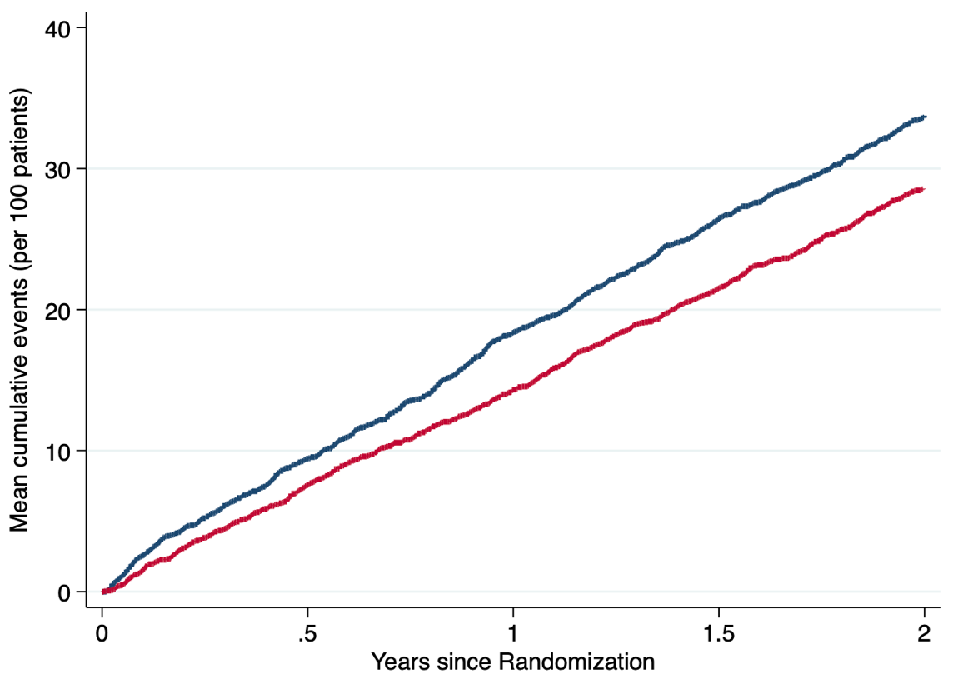
Pooled Analysis of All Participants (n=5,262)
Primary Endpoint: Total Worsening HF Events and CV Death
Rate ratio 0.86 (0.75-0.98)
P=0.027
Valsartan
16.8 (15.2-18.5) per 100 py
Sacubitril/Valsartan
14.5 (13.1-16.0)
per 100 py

Slide 12
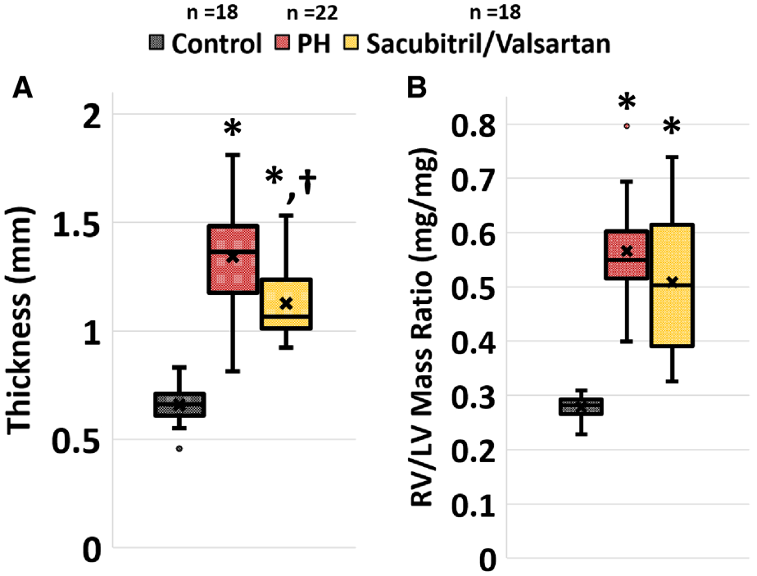
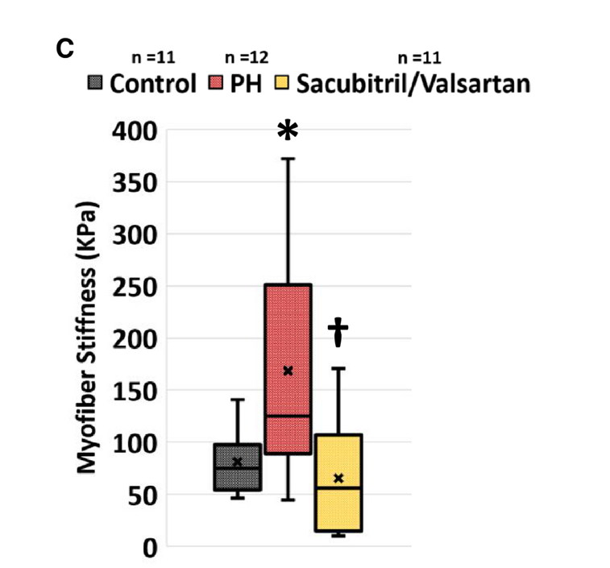
Sacubitril-Valsartan in PH

Slide 13
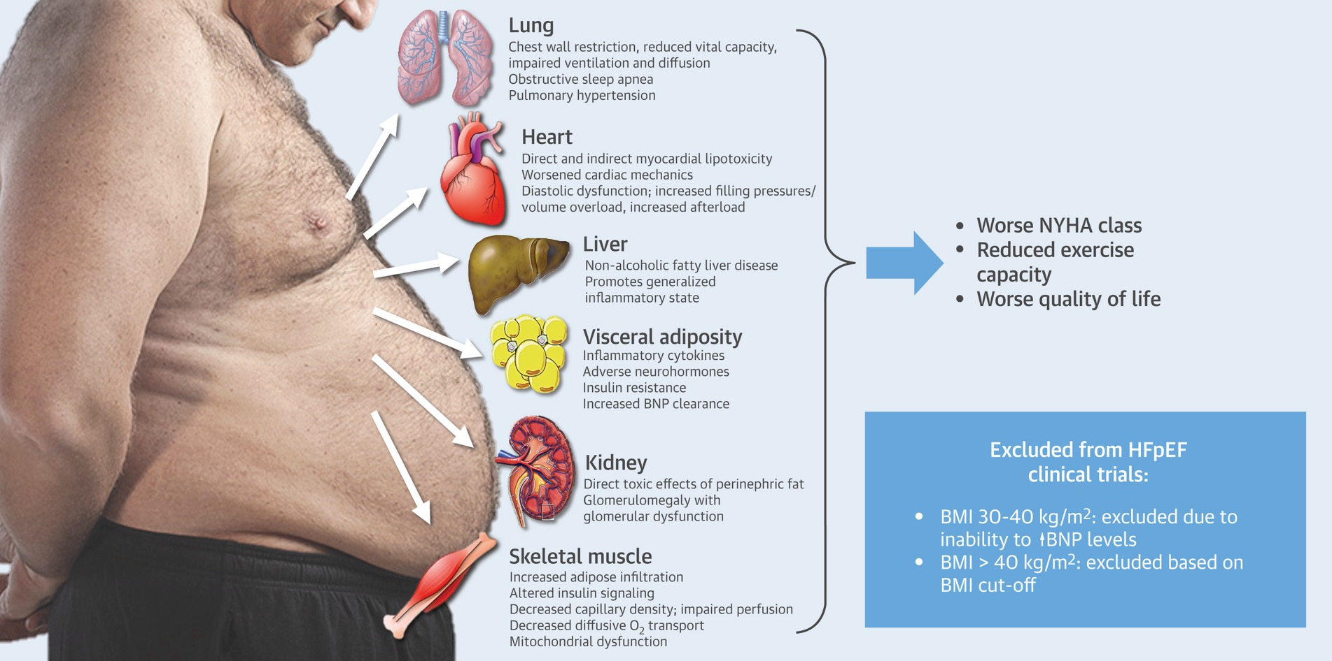
HFpEF: The Obesity Conundrum

Slide 14
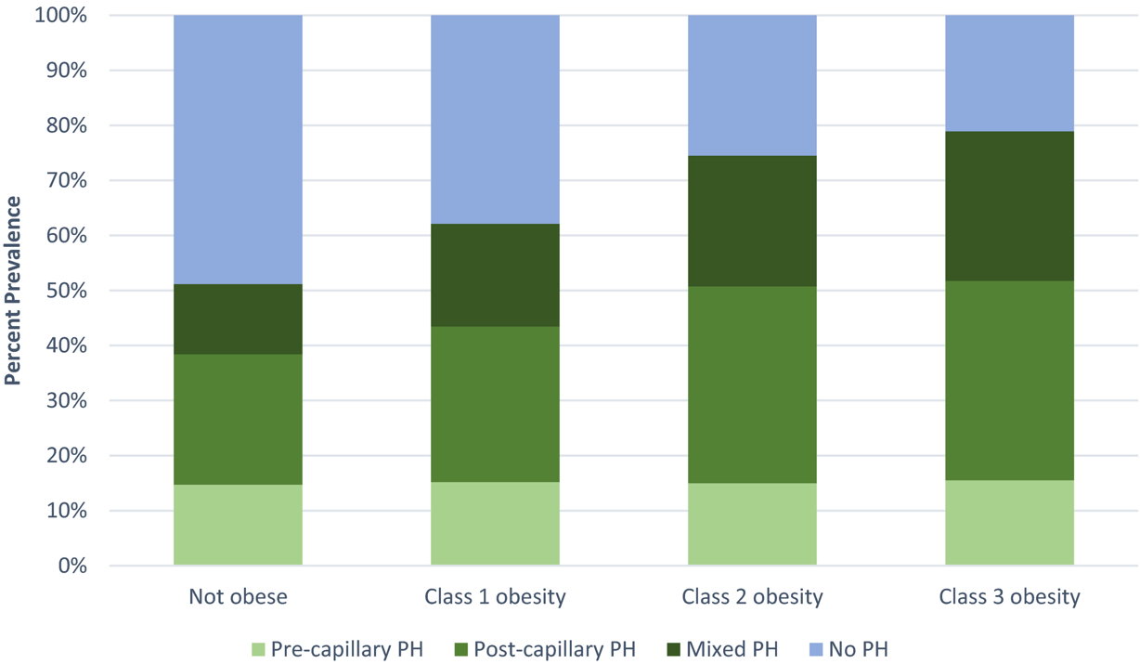
PH Commonly Exists in Obesity

Slide 15
STEP-HFpEF Trial
529 patients with obesity and HFpEF
Randomized to semaglutide 2.4 mg versus placebo
52 weeks of therapy
Dual primary endpoints: Change in KCCQ and body weight
KCCQ, Kansas City Cardiomyopathy Questionnaire.

Slide 16
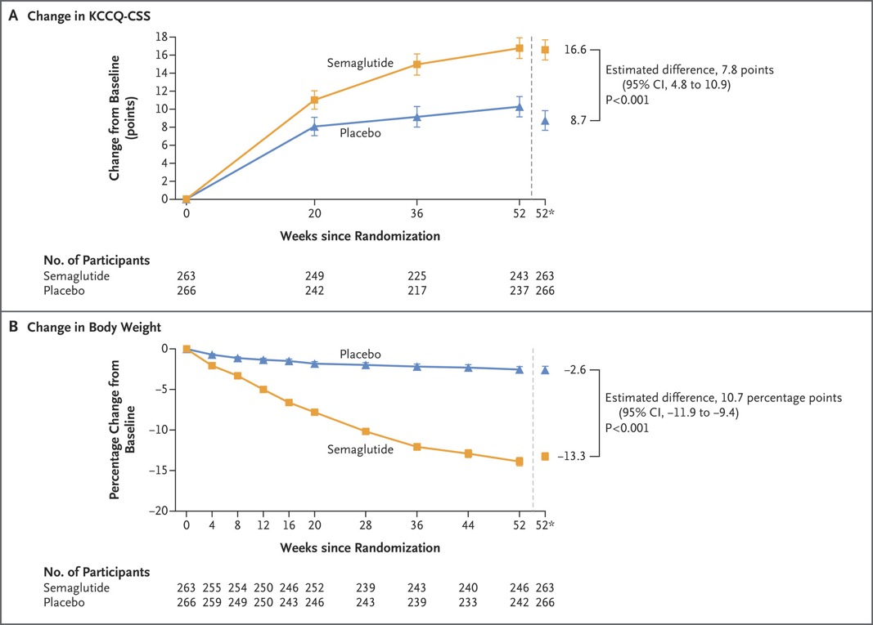
STEP-HFpEF: Meets Both Primary Endpoints

Slide 17
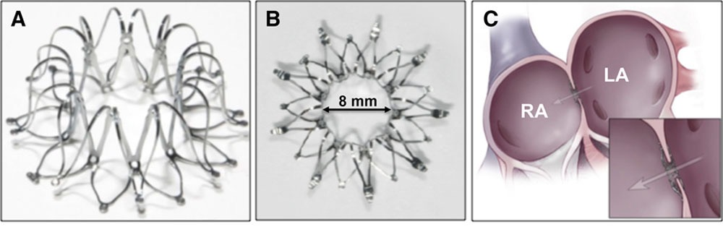
Methods to Decongest in HFpEF:
Interatrial Shunting for HFpEF Treatment

Slide 18
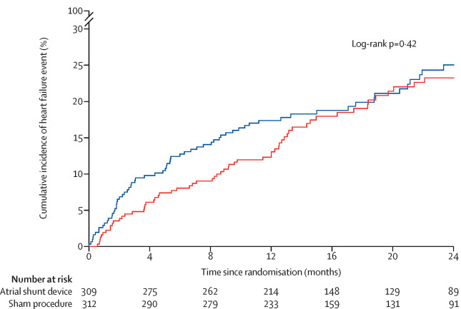
Interatrial Shunting for HFpEF Treatment
626 participants
Required to have elevated PCWP with exercise (PCWP >25 mmHg)
Randomized to IASD versus sham procedure

Slide 19
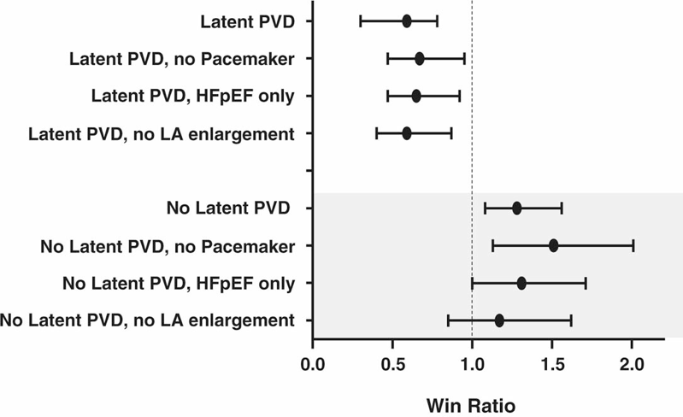
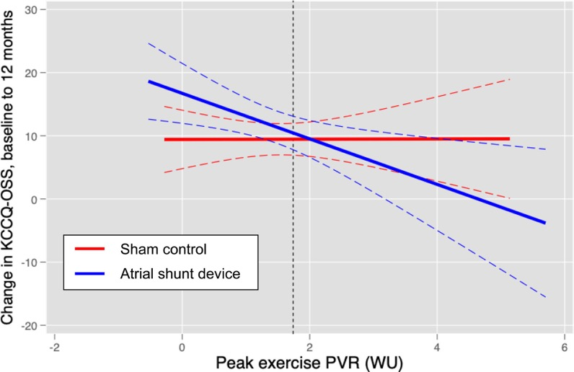
Latent PVD Differentiates Response to IASD in HFpEF
1.74 WU

Slide 20
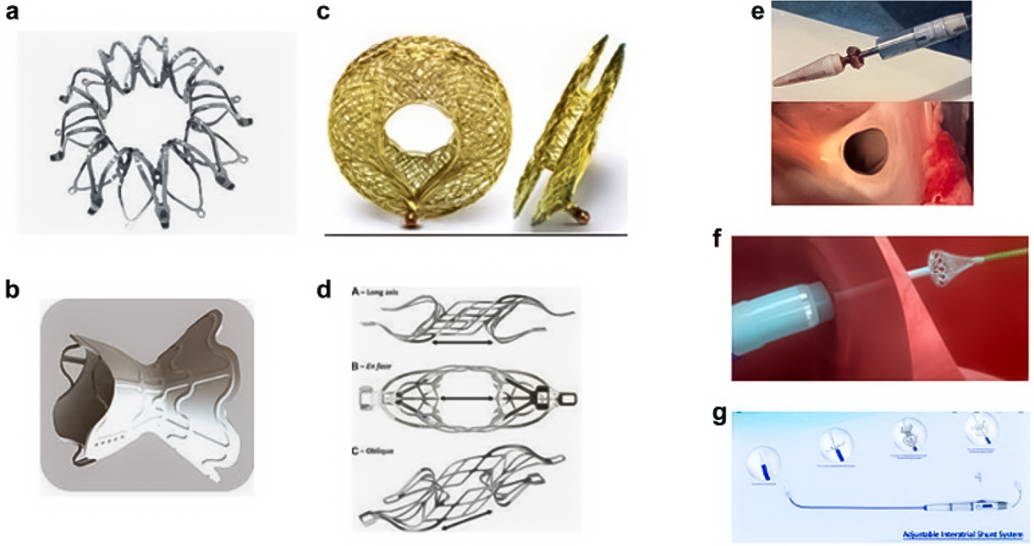
IASD Therapies in HFpEF

Slide 21
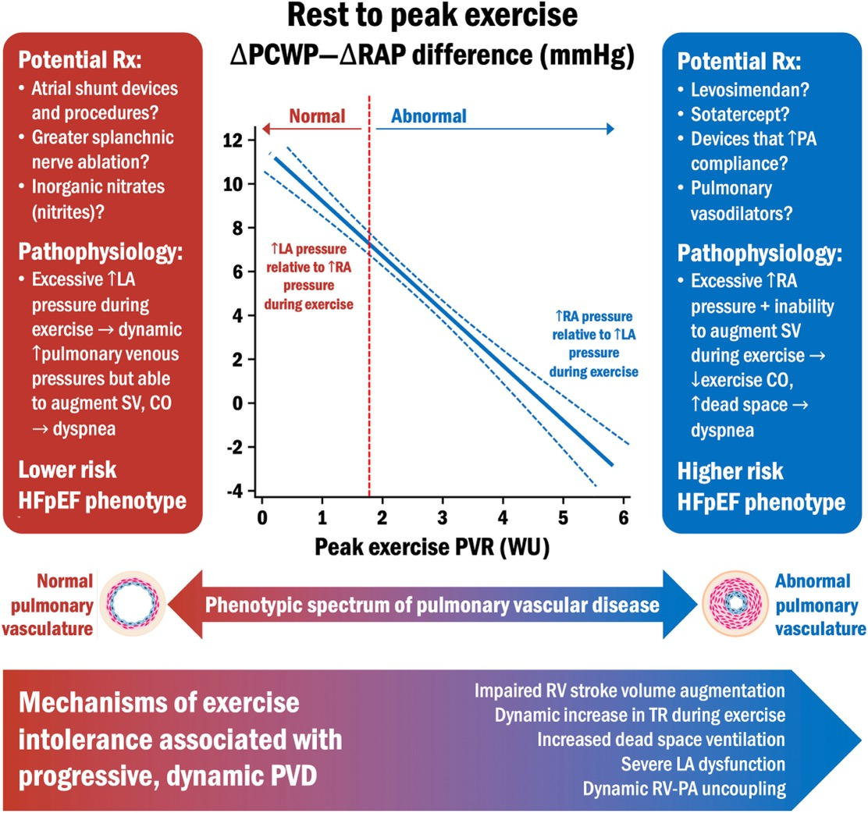
HFpEF and PH: The Therapeutic Spectrum

Slide 22
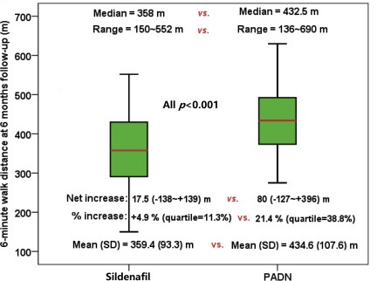
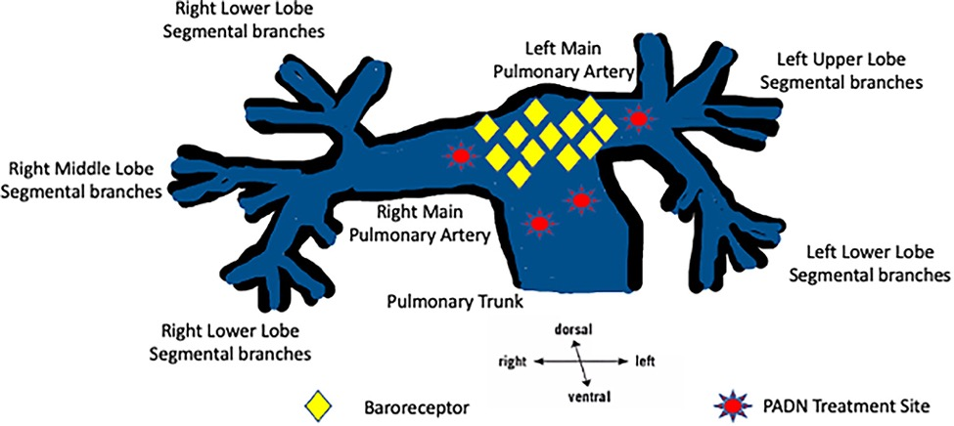
Pulmonary Artery Denervation in Cpc-PH Group II PH

Slide 23
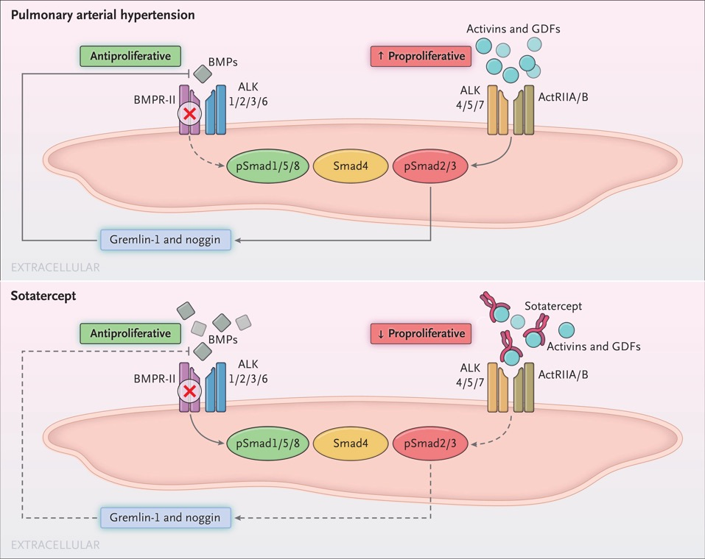
Sotatercept in Cpc-PH Due to HFpEF
CADENCE trial
Phase 2
Placebo controlled
N~150
Primary endpoint: Change in PVR at 24 months

Slide 24
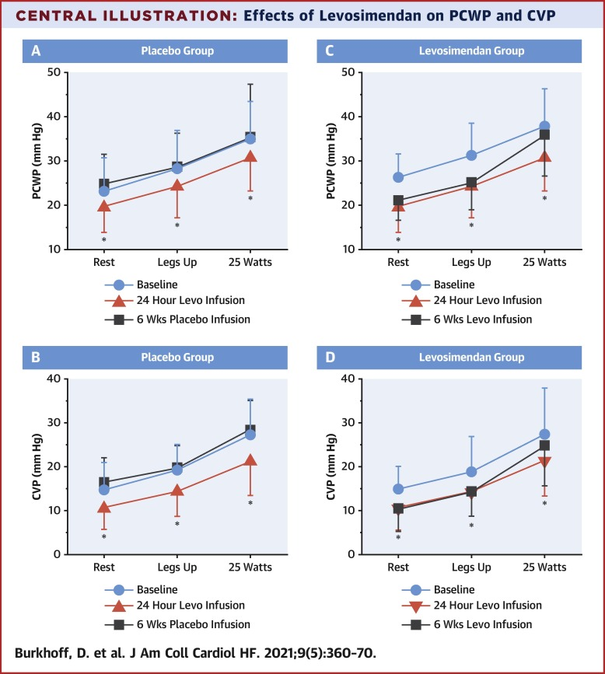
Levosimendan in PH-HFpEF

Slide 25



Looking for more resources
on this topic?
CME/CE in minutes
Congress highlights
Late-breaking data
Quizzes
Webinars
In-person events
Slides & resources
www.MedEdOTG.com

