Slide 1






Saturday, October 14, 2023
9:00am – 2:45pm CT
InterContinental Chicago Magnificent Mile Hotel | Chicago, IL
This activity is supported by independent educational grants from Actelion Pharmaceuticals US, Division of Janssen Pharmaceuticals and United Therapeutics Corporation.
Jointly provided by the Global Learning Collaborative (GLC) and Total CME, LLC.

Slide 2



Resource Information
About This Resource
These slides are one component of a continuing education program available online at MedEd On The Go titled Midwest Regional PH Summit – Management of Pulmonary Hypertension with Comorbidities
Program Learning Objectives:
Explain the ERS/ERC guideline updates
Evaluate available evidence-based data and patient management strategies for PH
Identify opportunities to apply effective management strategies to improve patient outcomes
MedEd On The Go®
www.mededonthego.com
This content or portions thereof may not be published, posted online or used in presentations without permission.
This content can be saved for personal use (non-commercial use only) with credit given to the resource authors.
To contact us regarding inaccuracies, omissions or permissions please email us at support@MedEdOTG.com

Slide 3
Disclaimer
The views and opinions expressed in this educational activity are those of the faculty and do not necessarily represent the views of Total CME, LLC, the CME providers, or the companies providing educational grants. This presentation is not intended to define an exclusive course of patient management; the participant should use their clinical judgment, knowledge, experience, and diagnostic skills in applying or adopting for professional use any of the information provided herein. Any procedures, medications, or other courses of diagnosis or treatment discussed or suggested in this activity should not be used by clinicians without evaluation of their patient's conditions and possible contraindications or dangers in use, review of any applicable manufacturer’s product information, and comparison with recommendations of other authorities. Links to other sites may be provided as additional sources of information.

Slide 4
HFpEF – Diagnostic Approach Through Case Review
Yasmin Raza, MD
Assistant Professor of Medicine, Cardiology
Northwestern University Feinberg School of Medicine
Chicago, IL

Slide 5
Case Overview
A 58-year-old female PMH:
  PE and DVT (2019)
  OSA on CPAP
  Obesity
  Hypertension
  ? Lupus (stable off medical therapy, serologies negative)
Diagnosed with “pulmonary hypertension”
  Based on TTE (12/2019): Normal LV and RV size and systolic function, estimated PASP 71 mmHg
  Initiated on treatment with sildenafil in 2019

Slide 6
Case Overview
Subsequently, RHC (2/2020)
  Per report: PAP 64/16/37 mmHg, PAWP 15 mmHg, but LVEDP reported to be 26 mmHg, with CI/CO 2.9/6.4
3/2021
  Continues on sildenafil. Persistent DOE, and is presenting for a second opinion regarding pulmonary hypertension
Exam:
  BMI 39, JVP 6cm of water, negative HJR, normal S1, S2, no LE edema

Slide 7
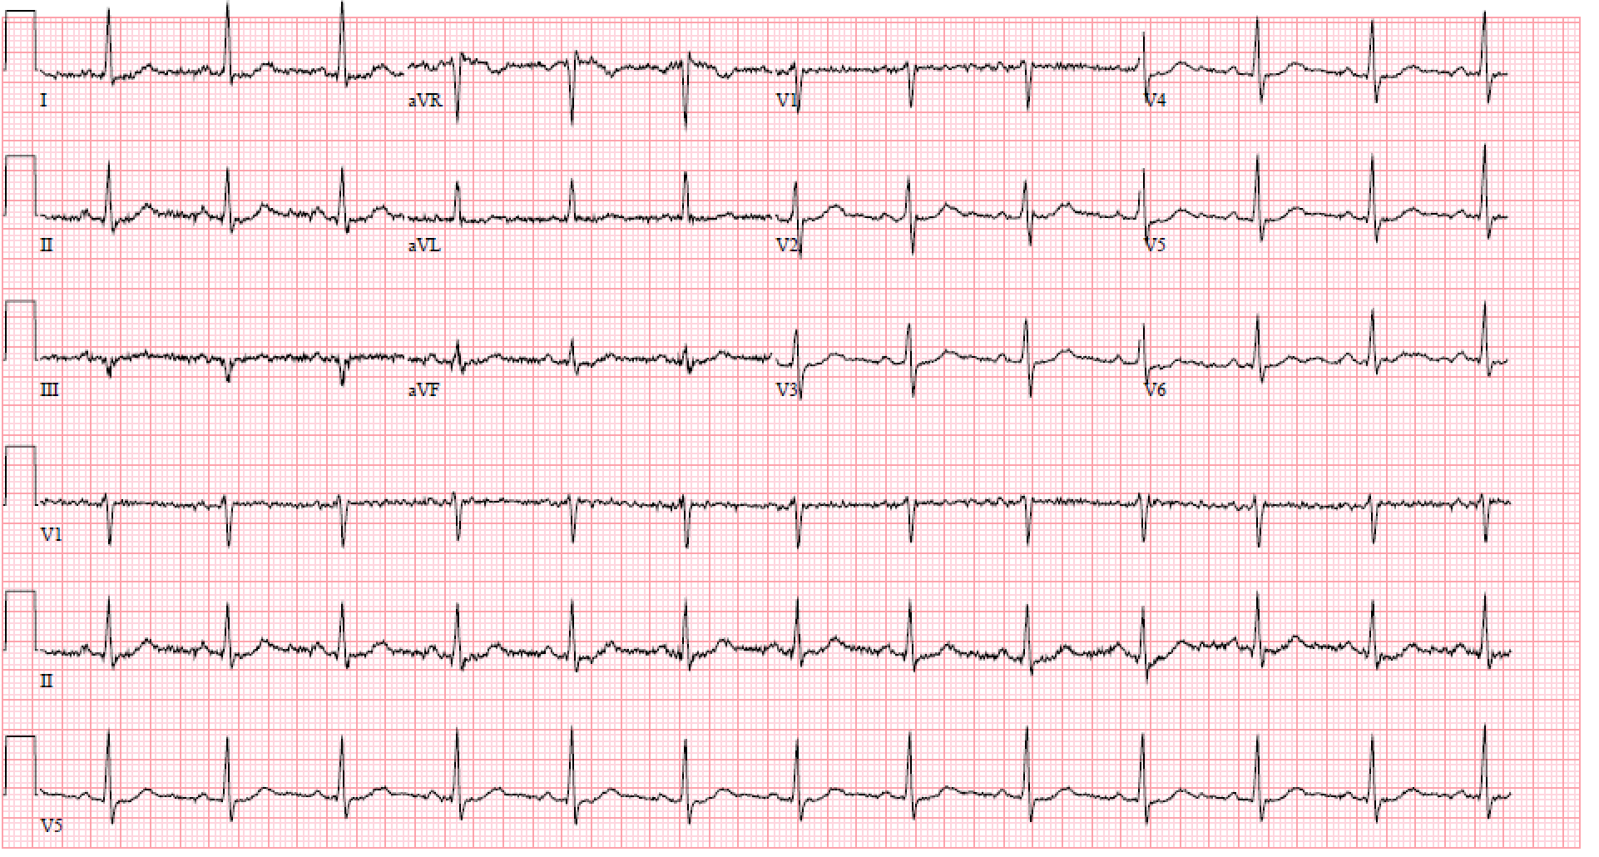
ECG

Slide 8
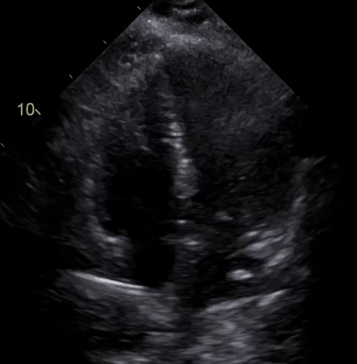
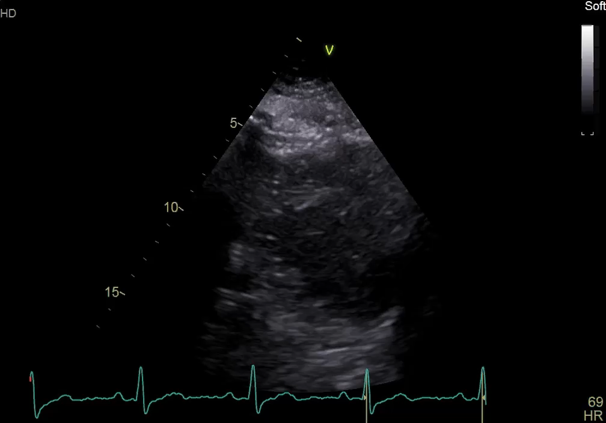
TTE

Slide 9
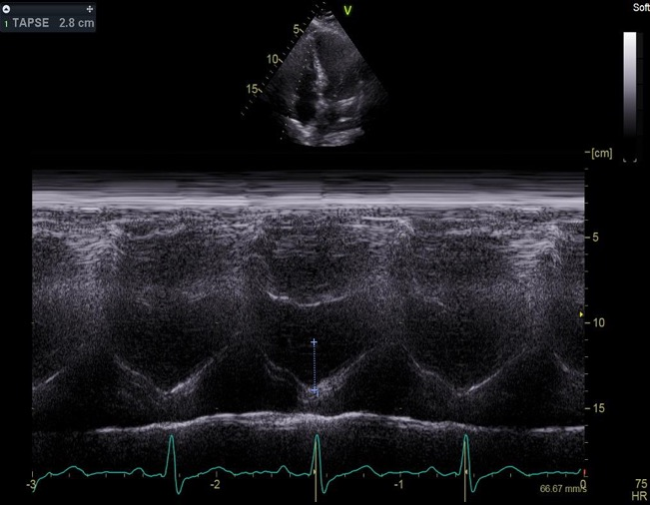
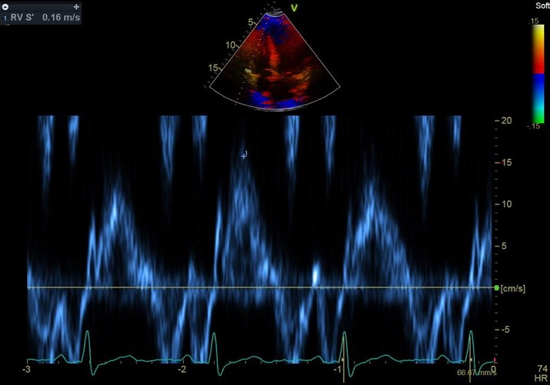
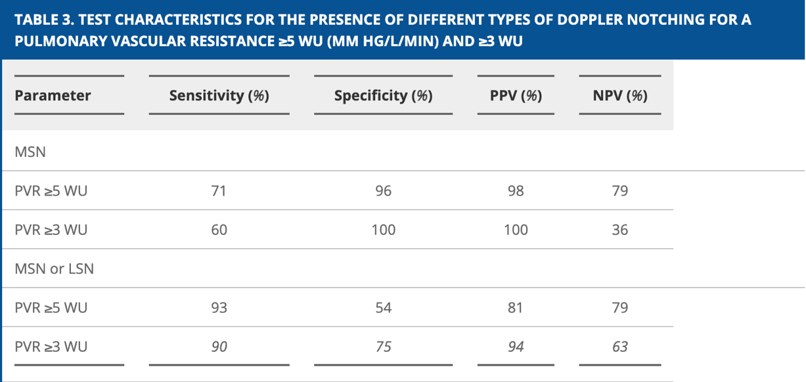
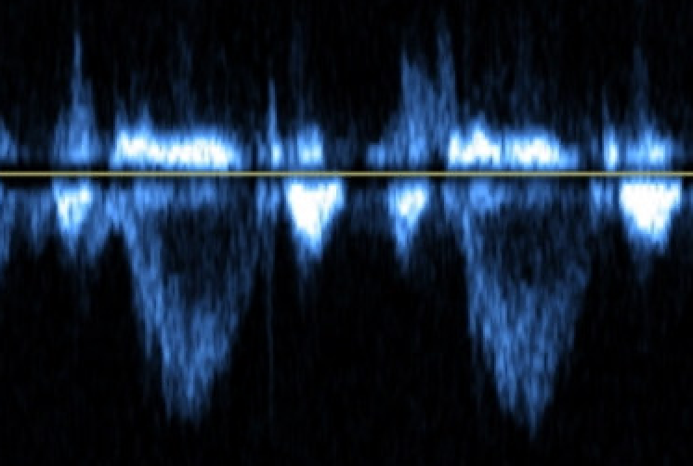
TTE

Slide 10
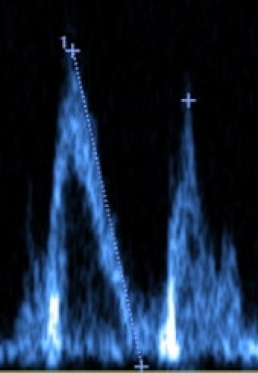
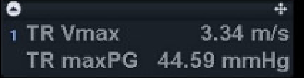
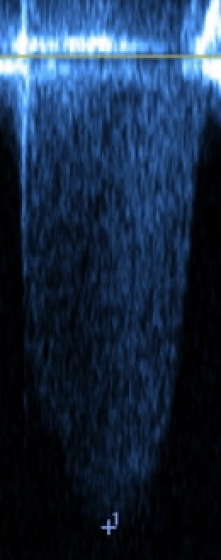
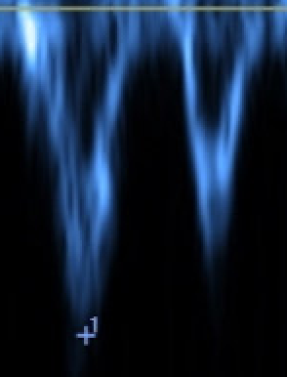
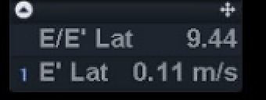
TTE

Slide 11
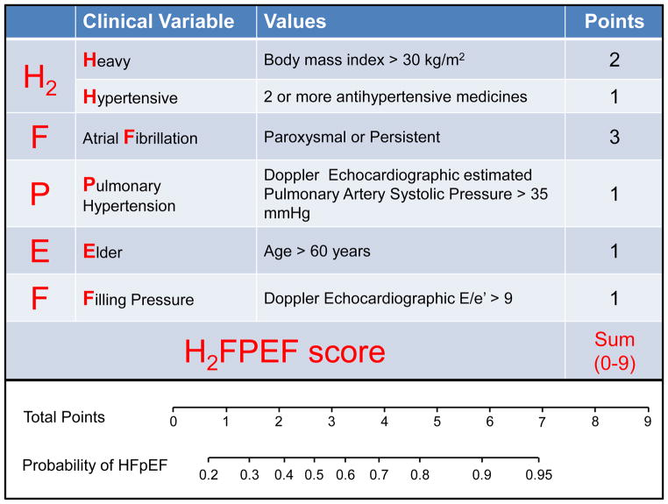
H2FPEF Score

Slide 12
Hemodynamics
Right heart catheterization:
  RA 9 mm Hg
  PA 50/15/27 mm Hg
  PAWP 18, V wave to 30 mm Hg
  PA Sat 74%
  CI 3 L/min/m2, CO 7 L/min by TD
  PVR ~ 1.3WU

Slide 13
Hemodynamics
Diagnosis: HFpEF

Slide 14
Case Overview
Referred to HFpEF clinic
  Continued spironolactone
  Started empagliflozin
  Screening for inclusion in HFpEF clinical trial

Slide 15
Take Home Points
TTE
Right heart catheterization
Powerful tool in assessment of patients with pulmonary hypertension, including HFpEF-PH
  Peak TR Velocity
  RV and RA morphology, RV function
  RVOT PW Doppler
  IVS contour
Remains gold standard
  Not always necessary if clear group 2 PH
  If unsure, it is a must!
  Pulmonary vasodilator therapy generally lacks benefit, may lead to clinical worsening in group 2 PH patients

Slide 16



Looking for more resources
on this topic?
CME/CE in minutes
Congress highlights
Late-breaking data
Quizzes
Webinars
In-person events
Slides & resources
www.MedEdOTG.com

