Slide 1






Saturday, October 14, 2023
9:00am – 2:45pm CT
InterContinental Chicago Magnificent Mile Hotel | Chicago, IL
This activity is supported by independent educational grants from Actelion Pharmaceuticals US, Division of Janssen Pharmaceuticals and United Therapeutics Corporation.
Jointly provided by the Global Learning Collaborative (GLC) and Total CME, LLC.

Slide 2



Resource Information
About This Resource
These slides are one component of a continuing education program available online at MedEd On The Go titled Midwest Regional PH Summit – Management of Pulmonary Hypertension with Comorbidities
Program Learning Objectives:
Explain the ERS/ERC guideline updates
Evaluate available evidence-based data and patient management strategies for PH
Identify opportunities to apply effective management strategies to improve patient outcomes
MedEd On The Go®
www.mededonthego.com
This content or portions thereof may not be published, posted online or used in presentations without permission.
This content can be saved for personal use (non-commercial use only) with credit given to the resource authors.
To contact us regarding inaccuracies, omissions or permissions please email us at support@MedEdOTG.com

Slide 3
Disclaimer
The views and opinions expressed in this educational activity are those of the faculty and do not necessarily represent the views of Total CME, LLC, the CME providers, or the companies providing educational grants. This presentation is not intended to define an exclusive course of patient management; the participant should use their clinical judgment, knowledge, experience, and diagnostic skills in applying or adopting for professional use any of the information provided herein. Any procedures, medications, or other courses of diagnosis or treatment discussed or suggested in this activity should not be used by clinicians without evaluation of their patient's conditions and possible contraindications or dangers in use, review of any applicable manufacturer’s product information, and comparison with recommendations of other authorities. Links to other sites may be provided as additional sources of information.

Slide 4
Screening, Diagnosis, and Treatment of PH-ILD
Victor M. Moles, MD
Clinical Assistant Professor
Associate Director, Pulmonary Hypertension Program
University of Michigan
Ann Arbor, MI

Slide 5
Introduction
Pulmonary hypertension (PH) is a common and underrecognized complication of interstitial lung disease (ILD).
  The prevalence of PH associated with ILD (PH-ILD) can range from 8% to >60% and is associated with disease severity
The mechanisms leading to PH and those driving ILD are incompletely understood.
  Molecular and genetic pathways
  Destruction of lung parenchyma
  Hypoxia leading to vasoconstriction
PH-ILD is associated with reduced functional capacity, impaired quality of life, greater oxygen requirements and an increased risk of mortality.
  Until recently, no PH specific medical therapy had demonstrated to be effective in treating this condition

Slide 6
Screening: Noninvasive Testing
Pulmonary function testing (PFT)
Computed tomography (CT) of the chest
Mild lung disease |  | Severe lung disease
Obstructive FEV1>60% Restrictive FVC>70% | Physiological severity | Obstructive FEV1<60% Restrictive FVC<70%
Minimal parenchymal changes in CT | Morphological severity | Extensive parenchymal changes in CT
Mismatch between degree of ILD and symptoms…?
Consider PH

Slide 7
Screening: Noninvasive Testing
Plasma levels of brain natriuretic peptide (BNP) or N-terminal pro-BNP…
Are elevated in significant PH-ILD
  176 patients with chronic lung disease
  BNP levels predicted presence of significant PH (mean PA > 35 mmHg) as well as 1-year survival
May have less sensitivity and specificity for milder PH
May be confounded by left heart abnormalities (e.g. heart failure)

Slide 8
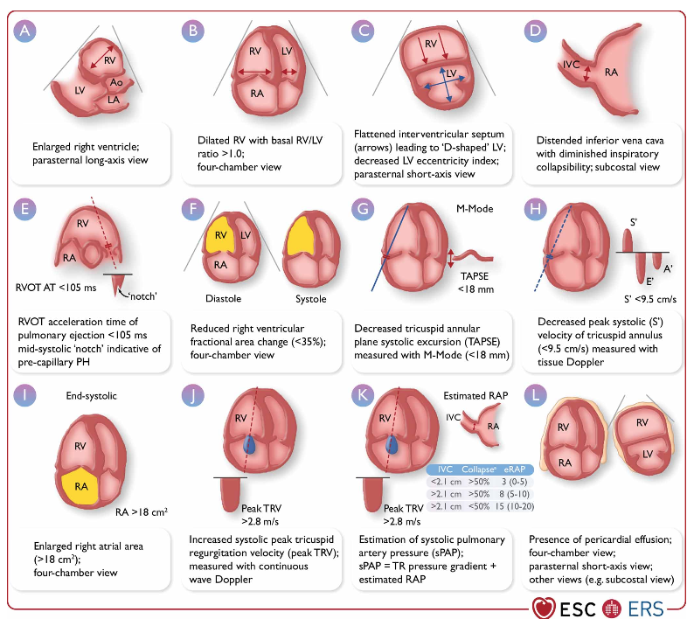
Screening: Noninvasive Testing
Echocardiography

Slide 9
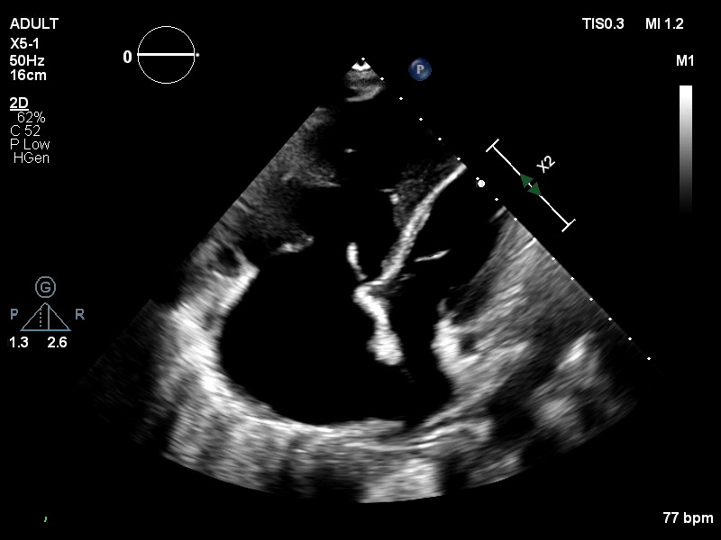
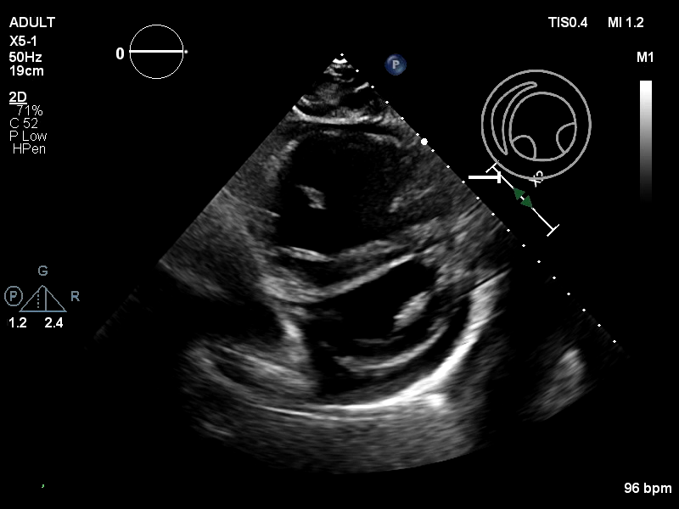
Screening: Noninvasive Testing
Examples of Echocardiogram

Slide 10
Diagnosis: Right Heart Catheterization
Zeroing is essential to an accurate diagnosis
A floating average over several breaths (without a breath hold) is suggested for measurement of mean pressure due to exaggerated changes in intrathoracic pressures during beathing cycle
Suggested definitions per 6th World Symposium in PH:
  ILD without PH (mPAP<21 mmHg, or mPAP 21-24 mmHg with PVR <3 WU
  ILD with PH (mPAP 21-24 mmHg with PVR⩾3WU, or mPAP 25-34 mmHg)
  ILD with severe PH (mPAP⩾35 mmHg, or mPAP⩾25 mmHg with CI <2.0 L/min/m²)
  or PVR⩾5 WU

Slide 11
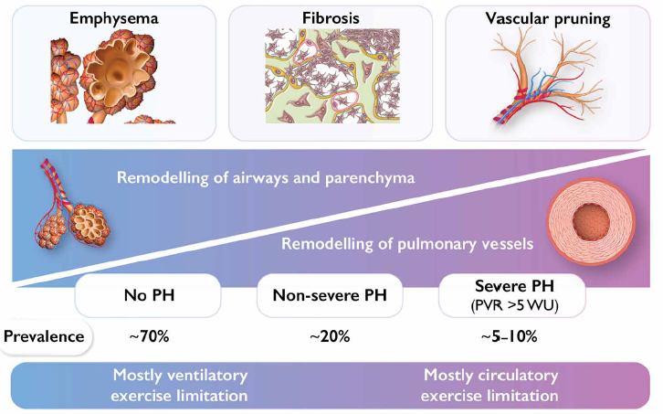
Parenchymal Lung Changes and Vasculopathy May Exist Across a Multidimensional Spectrum

Slide 12
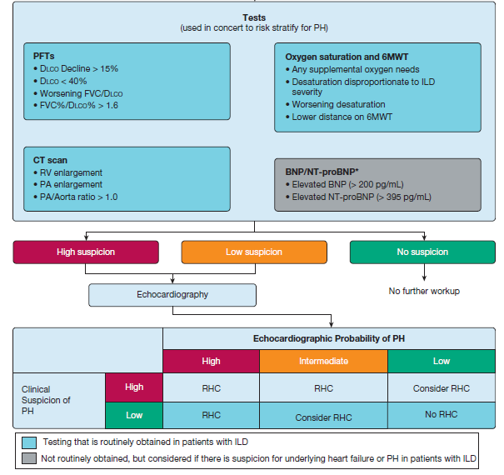
Consensus approach to screening pH in ILD patients

Slide 13
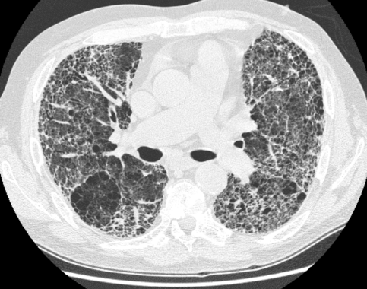
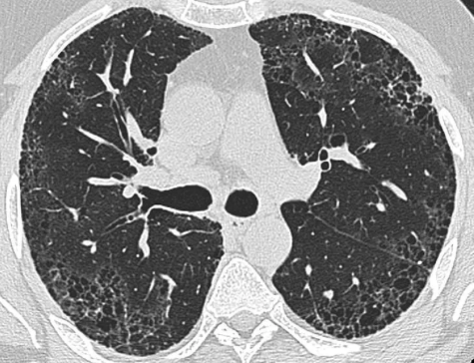
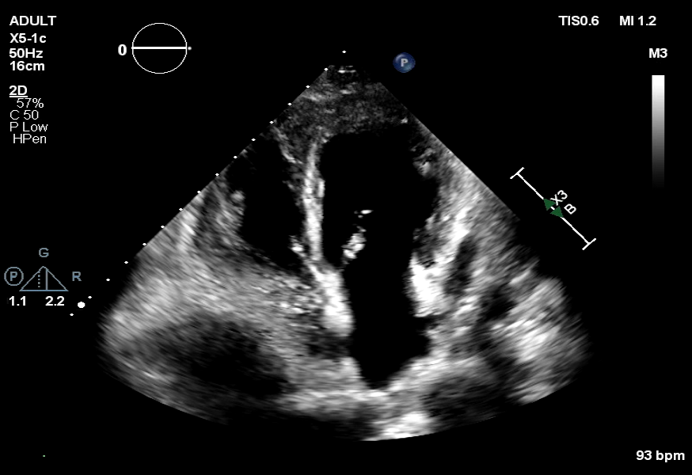
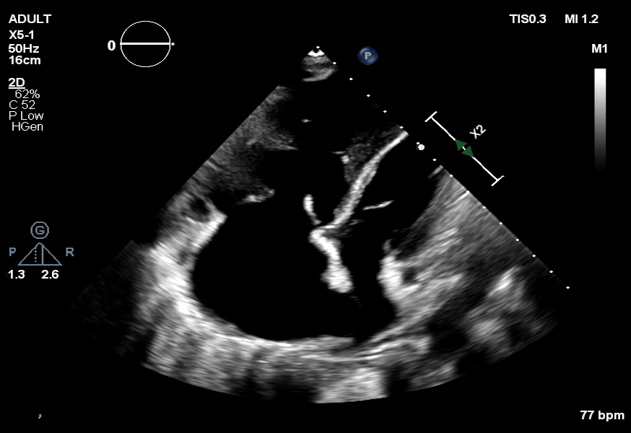
Patient A
Patient B
WHO functional class III
WHO functional class III
FVC 30%
FVC 75%
mPAP 30 mmHg
PVR 4 WU
CI 2.6 L/min/m²
mPAP 45 mmHg
PVR 9 WU
CI 1.9 L/min/m²
PH-ILD
PAH

Slide 14
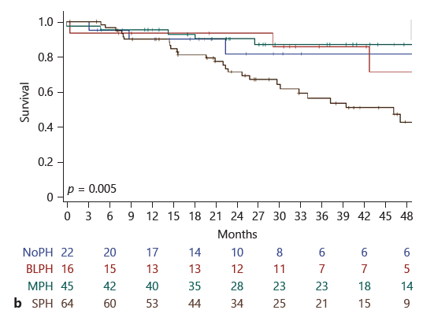
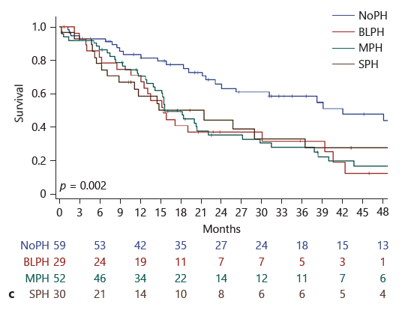
Any Level of PH Portends Worse Survival in Patients with ILD
Retrospective analysis of 317 patients from 12 centers (Italy, Spain, and UK)
NoPH
Borderline PH
Mild-moderate PH
Severe PH
COPD
ILD

Slide 15
Treatment of PH-ILD
Treat ILD
The approach should always begin with optimization of the underlying lung disease:
  Assessment and correction of low oxygenation
  Use of non-invasive ventilation if needed
  Enrollment in pulmonary rehabilitation
Treat PH
Consider use of PH specific medications in the appropriate clinical setting:
  Inhaled Treprostinil
  Consider use of phosphodiesterase inhibitors

Slide 16
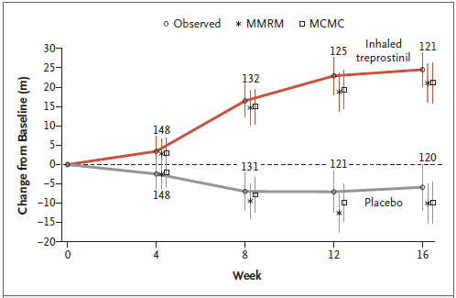
Inhaled Treprostinil INCREASEs Functional Capacity in PH-ILD
INCREASE clinical trial: 16-week randomized clinical trial of inhaled treprostinil (IT) versus placebo in PH-ILD
Primary end point: Change in 6-minute walk distance (6MWD)
Secondary end point: Change in NT-proBNP

Slide 17
Inhaled treprostinil decreases NTproBNP and occurrence of clinical worsening event
Change in NTproBNP levels from baseline to 16 weeks
Occurrence of clinical worsening event
End Point | Inhaled Treprostinil (N=163) | Placebo (N=163) | Treatment Effect (95% CI) | P Value
Change in plasma concentration of NT-proBNP from baseline to wk 16
Mean (±SD) change – pg/ml | -396.35±1904.90 | 1453.95±7296.20
Median – pg/ml | -22.65 | 20.65
Range – pg/ml | -11,433.0 to 5373.1 | -5483.3 to 87,148.3
Ratio to baseline | 0.85±0.06 | 1.46±0.11 | 0.58±0.06 (0.47 to 0.72) | <0.001
Occurrence of clinical worsening - no. (%) |  |  | 0.61 (0.4 to 0.92)** | 0.04
Any event | 37 (22.7) | 54 (33.1)
Hospitalization for cardiopulmonary indication | 18 (11.0) | 24 (14.7)
Decrease in 6-minute walk distance of >15% from baseline | 13 (8.0) | 26 (16.0)
Death from any cause | 4 (2.5) | 4 (2.5)
Lung transplantation | 2 (1.2) | 0

Slide 18
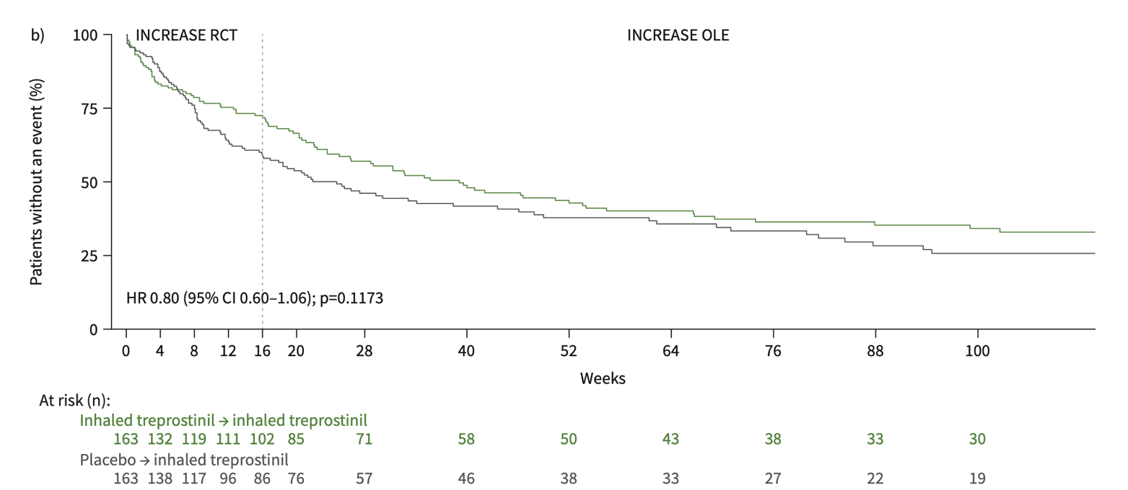
Long term data for inhaled treprostinil in PH-ILD is available: INCREASE OLE
6MWD is sustained long term in those originally in IT group who remained on IT.
6MWD improves in those transitioning from placebo to IT.

Slide 19
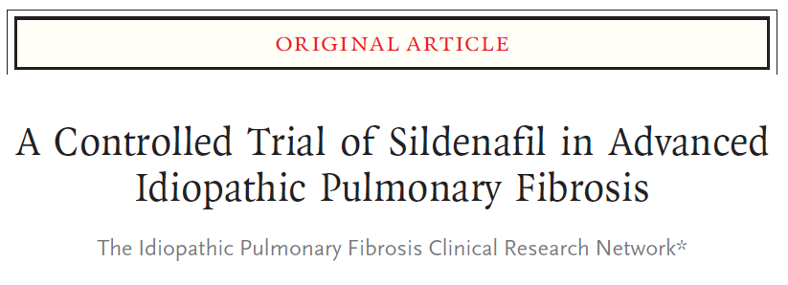
Sildenafil… or no sildenafil…?
STEP-IPF: randomized, double-blinded, placebo-controlled trial.
180 patient with idiopathic pulmonary fibrosis (IPF) and DLCO < 35% (PH not an inclusion criteria).
Results:
  No difference in increase in 20% or more of 6MWD between placebo and sildenafil
  Improvement in secondary endpoint such as dyspnea and QoL
  No signal of harm with use of sildenafil

Slide 20
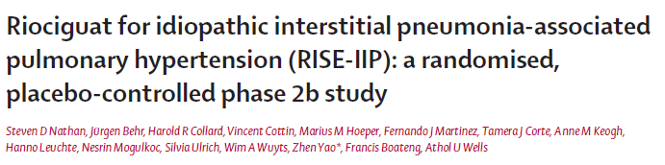
Riociguat Should Be Avoided in PH-ILD
Randomized controlled trial of 147 patients with PH-ILD, riociguat versus placebo
Study was terminated early due to increased serious adverse events and mortality in the riociguat group

Slide 21
Conclusions
PH is a serious comorbidity complicating ILD and is associated with worsen prognosis.
Screening of PH in patients with ILD is reasonable:
  PFTs
  CT scan
  Oxygenation and 6MWD
  BNP/NTproBNP
  Echocardiogram
A right heart catheterization is needed for the diagnosis and stratification.
Inhaled treprostinil is the only current FDA approved medication to treat PH-ILD.
Methodical follow up is crucial.

Slide 22



Looking for more resources
on this topic?
CME/CE in minutes
Congress highlights
Late-breaking data
Quizzes
Webinars
In-person events
Slides & resources
www.MedEdOTG.com

