Slide 1






Saturday, October 14, 2023
9:00am – 2:45pm CT
InterContinental Chicago Magnificent Mile Hotel | Chicago, IL
This activity is supported by independent educational grants from Actelion Pharmaceuticals US, Division of Janssen Pharmaceuticals and United Therapeutics Corporation.
Jointly provided by the Global Learning Collaborative (GLC) and Total CME, LLC.

Slide 2



Resource Information
About This Resource
These slides are one component of a continuing education program available online at MedEd On The Go titled Midwest Regional PH Summit – Management of Pulmonary Hypertension with Comorbidities
Program Learning Objectives:
Explain the ERS/ERC guideline updates
Evaluate available evidence-based data and patient management strategies for PH
Identify opportunities to apply effective management strategies to improve patient outcomes
MedEd On The Go®
www.mededonthego.com
This content or portions thereof may not be published, posted online or used in presentations without permission.
This content can be saved for personal use (non-commercial use only) with credit given to the resource authors.
To contact us regarding inaccuracies, omissions or permissions please email us at support@MedEdOTG.com

Slide 3
Disclaimer
The views and opinions expressed in this educational activity are those of the faculty and do not necessarily represent the views of Total CME, LLC, the CME providers, or the companies providing educational grants. This presentation is not intended to define an exclusive course of patient management; the participant should use their clinical judgment, knowledge, experience, and diagnostic skills in applying or adopting for professional use any of the information provided herein. Any procedures, medications, or other courses of diagnosis or treatment discussed or suggested in this activity should not be used by clinicians without evaluation of their patient's conditions and possible contraindications or dangers in use, review of any applicable manufacturer’s product information, and comparison with recommendations of other authorities. Links to other sites may be provided as additional sources of information.

Slide 4
Pulmonary Arterial Hypertension and Connective Tissue Disease
Michael J. Cuttica MD, MS
Associate Professor of Medicine
Director, Northwestern Pulmonary Vascular Disease Program
Northwestern Medicine
Chicago, IL

Slide 5
Learning Objectives
Review the current knowledge of pulmonary vascular disease in patients with connective tissue disease
Focus on screening, diagnosis and treatment of CTD-PAH

Slide 6
Pulmonary Hypertension (PH)
PH is a progressive and debilitating disease, associated with significant morbidity and mortality, as well as poor quality of life
PH eventually leads to right heart failure and death

Slide 7
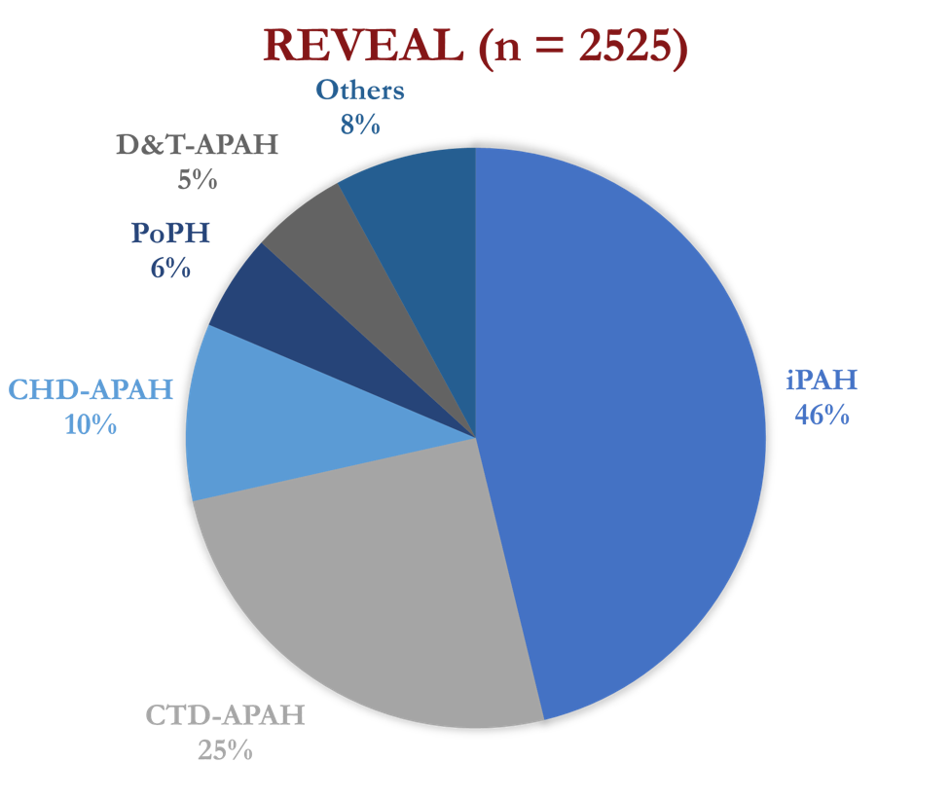
Pulmonary Arterial Hypertension
REVEAL (n=2525)
Others
8%
D&T-APAH
5%
The prevalence of PAH is 0.66 to 2.6 per 100,000 adults in the developed world
PoPH
6%
CHD-APAH
10%
IPAH
46%
CTD-APAH
25%

Slide 8
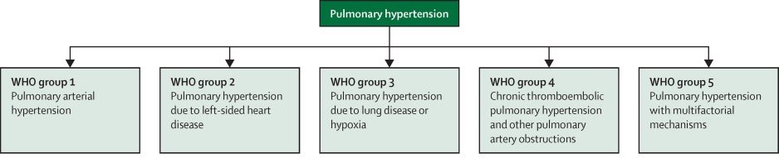
Primary pulmonary
arterial vasculopathy
Chronic pulmonary
venous congestion
Left atrial dysfunction
Left atrial hypertension
Abnormal LV relaxation
Destruction of
pulmonary parenchyma
Loss of capillaries
Pre-capillary disease
Chronic intraluminal
occlusion of pulmonary
vasculature
Pre- or post-capillary disease
Miscellaneous
Sickle cell disease
Sarcoidosis

Slide 9
Primary pulmonary
arterial vasculopathy
SSc
SLE
MCTD
RA
Sjogren
Chronic pulmonary
venous congestion
Abnormal LV relaxation
SSc
SLE
Destruction of
pulmonary parenchyma
Loss of capillaries
SSc
MCTD
Sjogren
RA
SLE
Anti-synthetase
Chronic intraluminal
occlusion of pulmonary
vasculature
SLE
APS

Slide 10
PH and Connective Tissue Disease
Immune dysfunction is a common contributor in the pathogenesis of PAH
Vascular lesions in CTD-APAH are indistinguishable from those in IPAH
Survival and clinical outcomes are significantly worse for CTD-APAH (especially SSc)

Slide 11
PAH and SSc
Prevalence 8-12%
Disturbances in angiogenesis (increased VGEF)
Presence auto-antibodies (U3 RNP)
Similar hemodynamic profile, less hemodynamic impairment

Slide 12
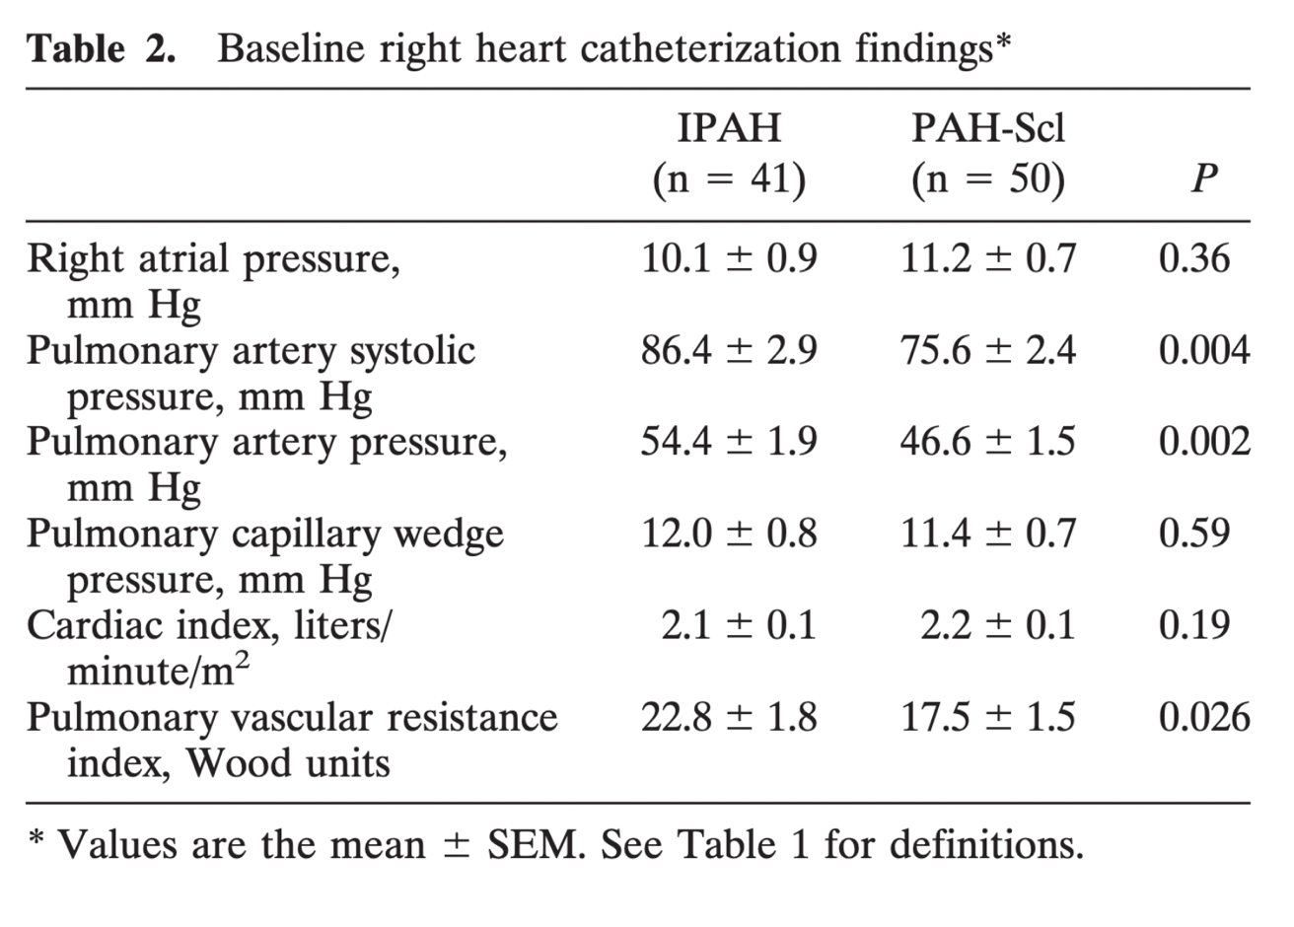

Slide 13
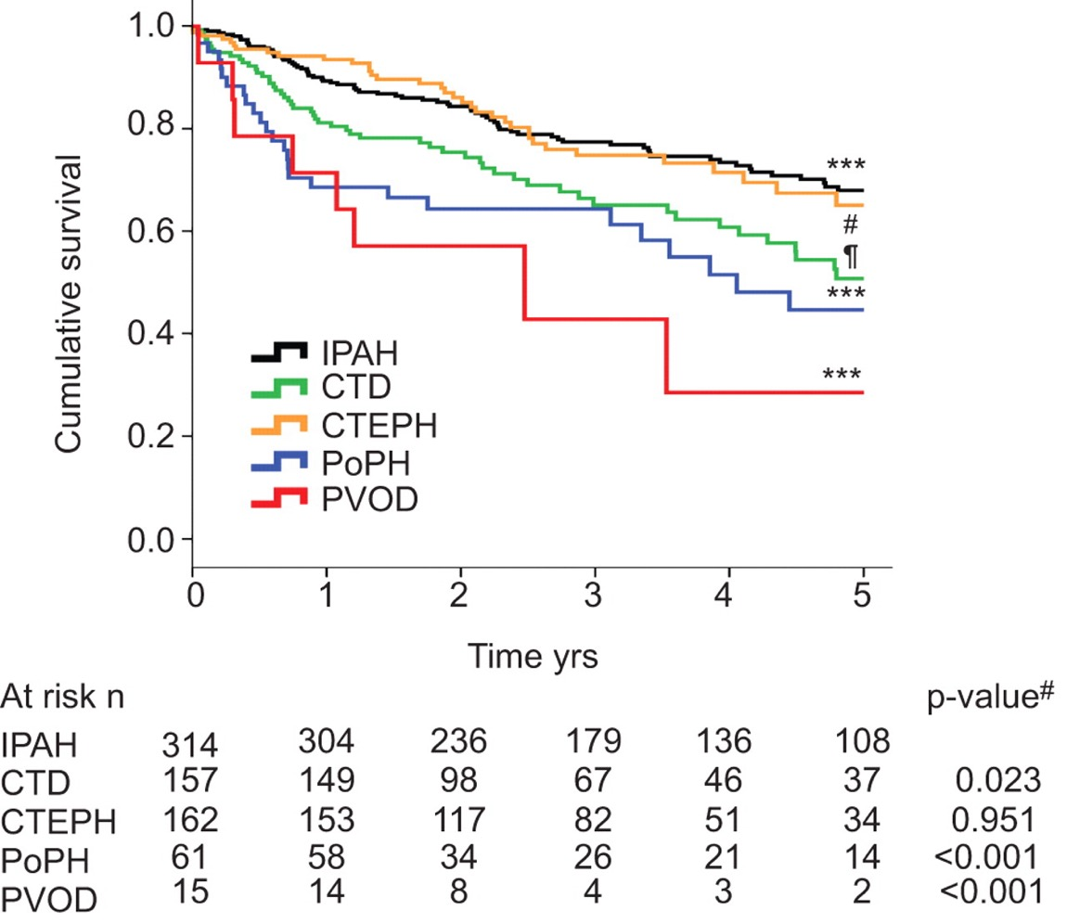
Survival
Comparison

Slide 14
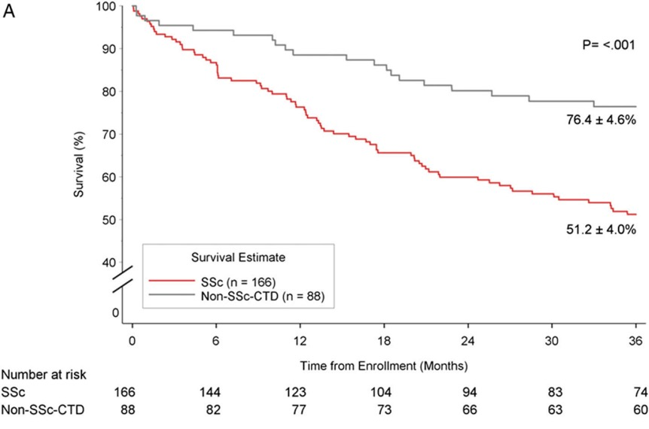
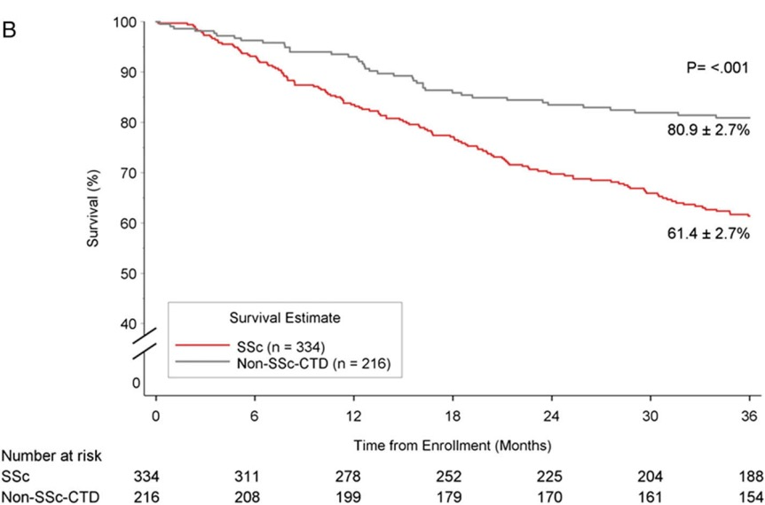

Slide 15
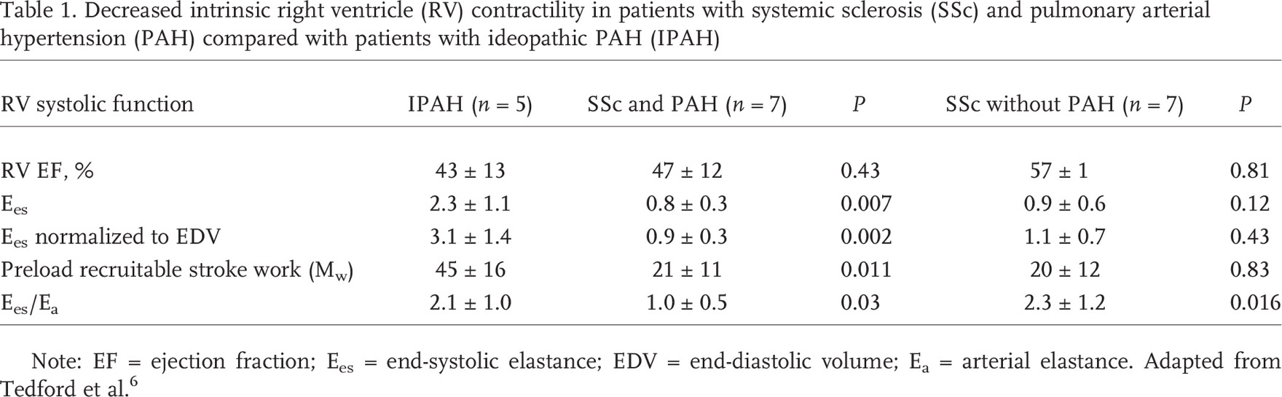
RV Adaptation in SSc

Slide 16
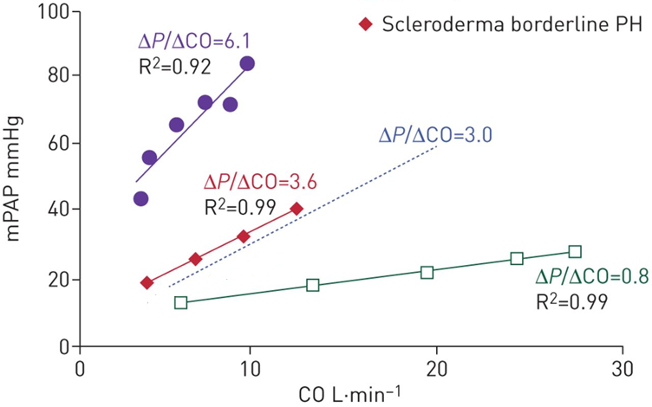

Slide 17
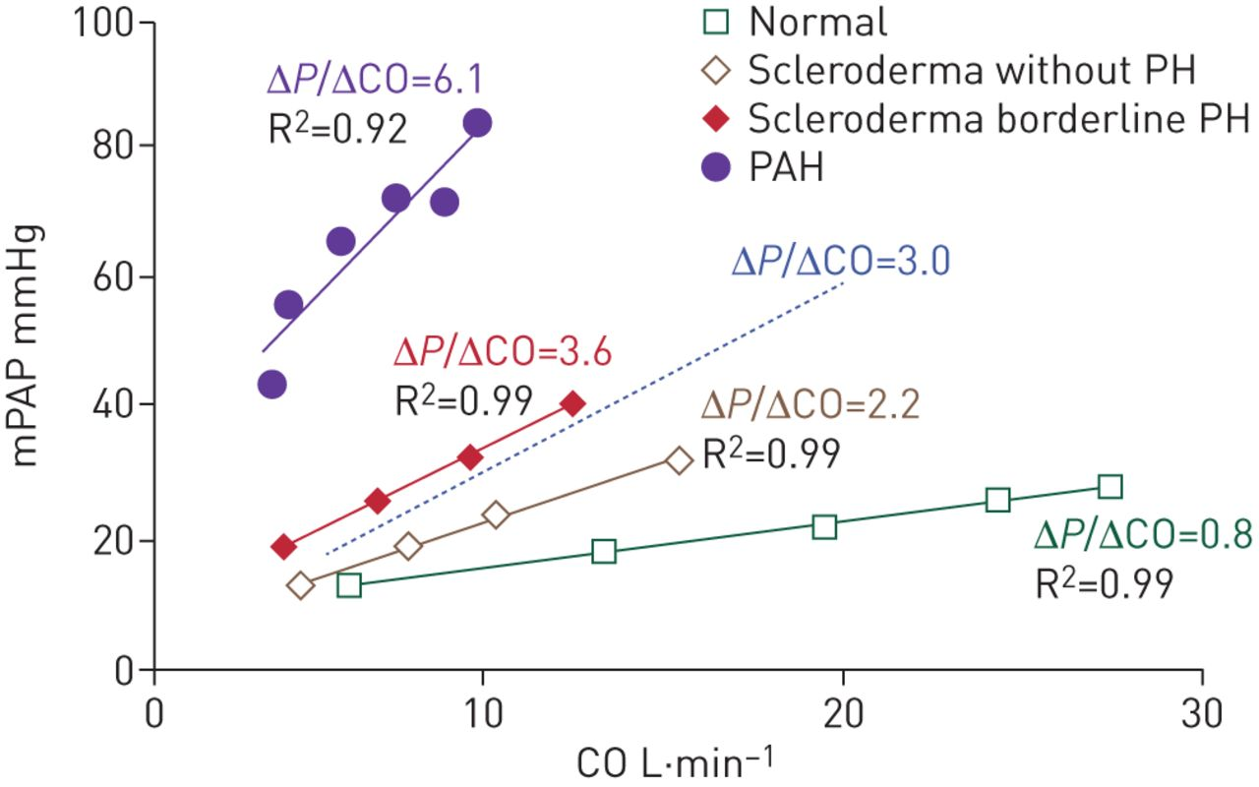

Slide 18
Risk Factors
Limited SSc
Late age of onset
Duration of SSc
Raynaud
Digital ulcers
Number of telangiectasia
Decreased DLCO-FVC/ DLCO >1.6
Increased BNP
Presence auto-antibodies

Slide 19
Screening for PAH: DETECT
Step 1
FVC% predicted / DLCO% predicted
Telangiectasias present yes/no
Anti-centromere antibody (ACA) present yes/no
NTproBNP
Serum urate
Right axis deviation on ECG present yes/no
  Calculate on www.detect-pah.com
  Total risk score 220-300: no echo recommended
  Total risk score 300-400: echo recommended
Step 2 Echocardiography
Step 1 total risk score
Right atrium area in cm²
TRJ velocity in m/s
  Calculate on www.detect-pah.com
  Total risk score 10-35: no right heart catheterization recommended
  Total risk score 35-90: right heart catheterization recommended

Slide 20
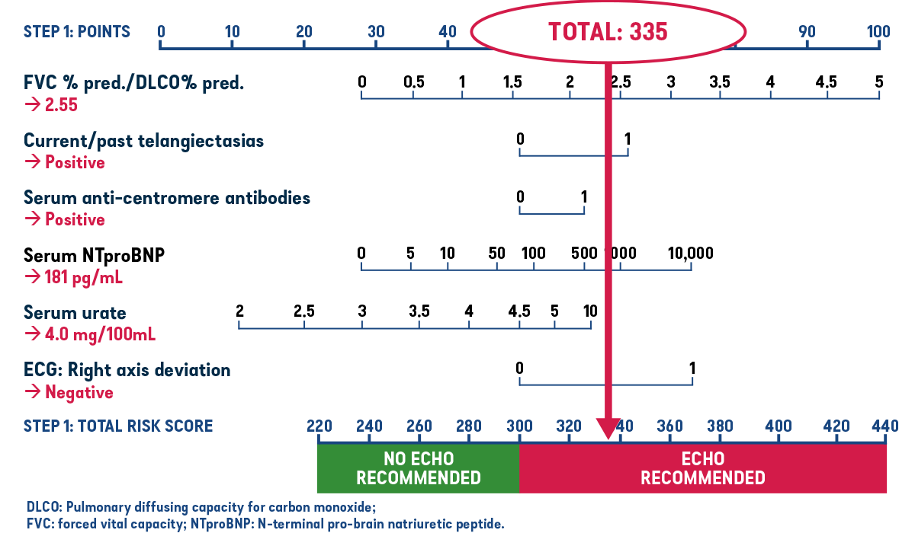
DETECT Algorithm Nomogram Step 1: Example Patient Total Risk Score

Slide 21
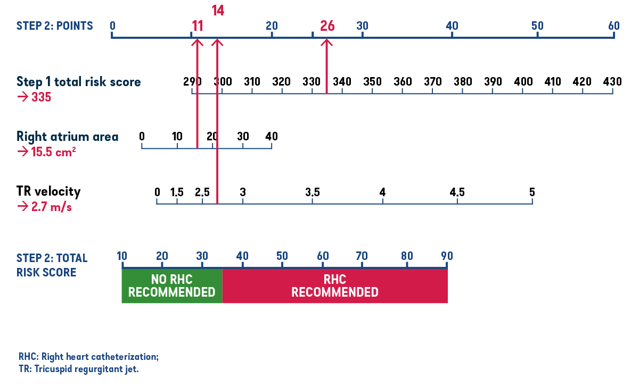
DETECT Algorithm Nomogram Step 2: Example Patient Points

Slide 22

detectionofpah.com

Slide 23
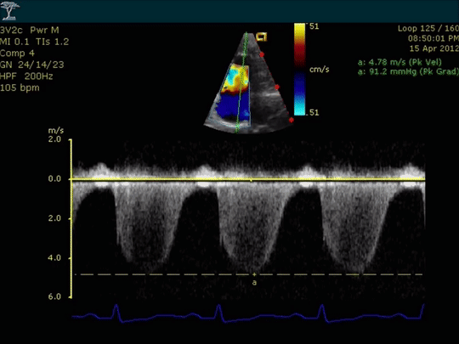
Screening for PH: Echo
Echo allows for estimation of pulmonary pressures

Slide 24
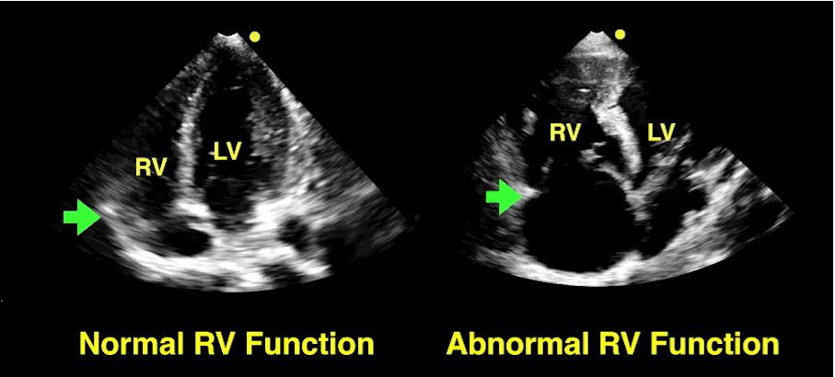
Screening for PH: Echo
Echo allows for estimation of pulmonary pressures
Echo provides information about RV performance

Slide 25
Right Ventricular Clinical Imaging Metrics

Slide 26
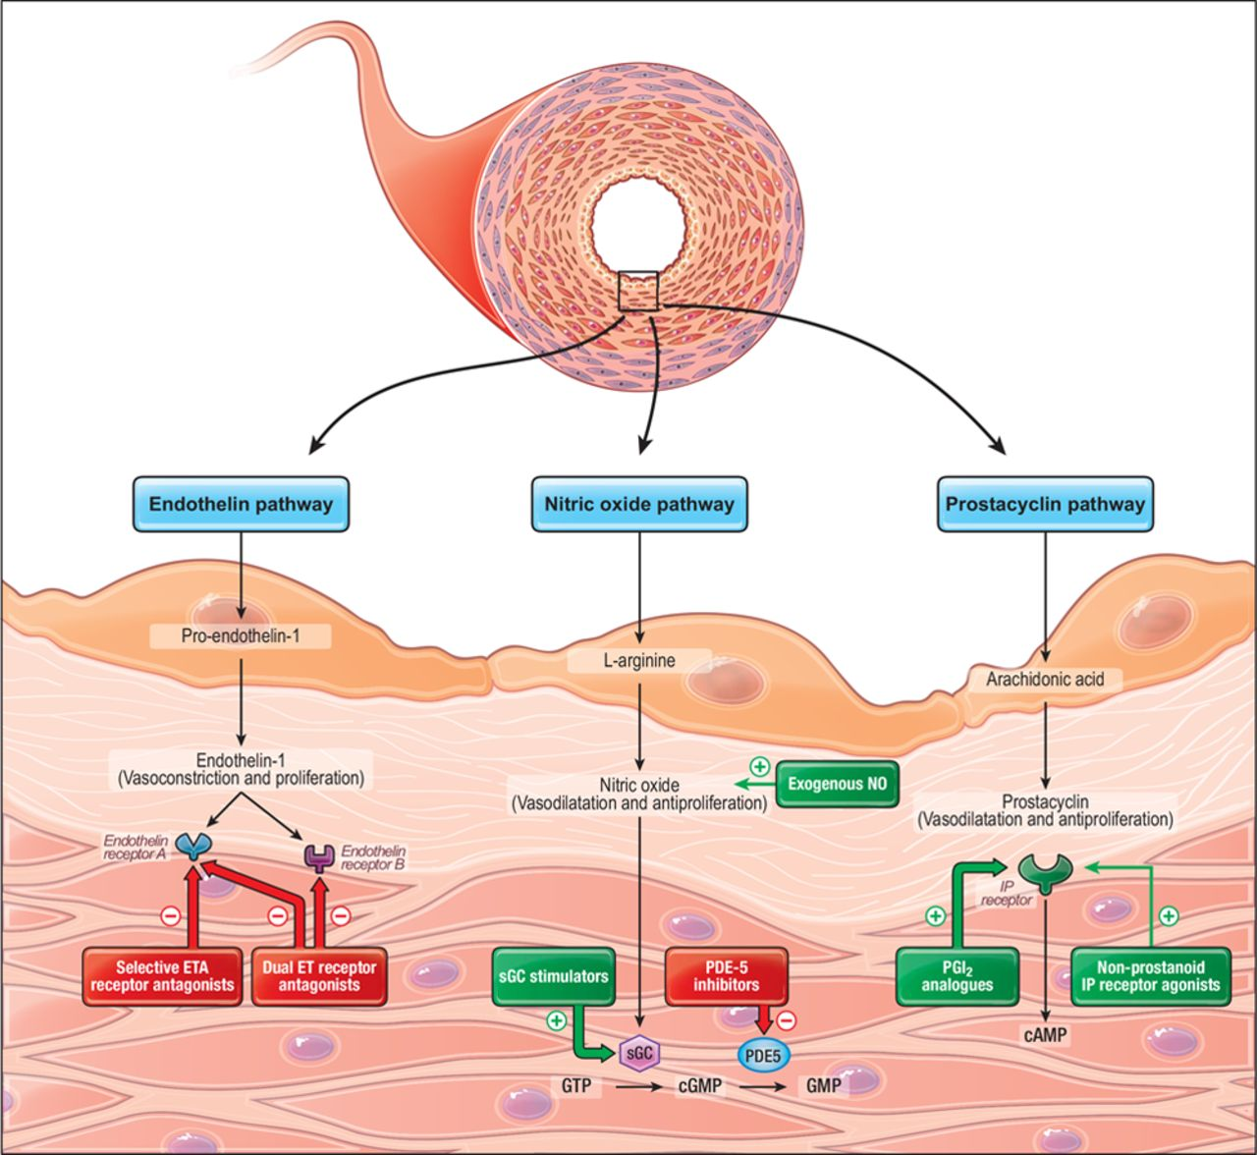

Slide 27
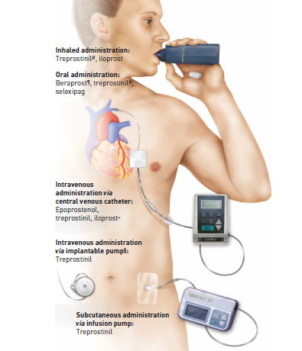
Drugs That Target the Prostacyclin Pathway and Their Routes of Administration

Slide 28
Role of Immunosuppression in CTD-PH
SLE
  Systemic lupus erythematosus
SSc
  Systemic
  sclerosis

Slide 29
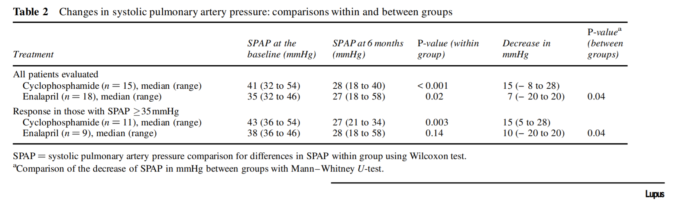

Slide 30
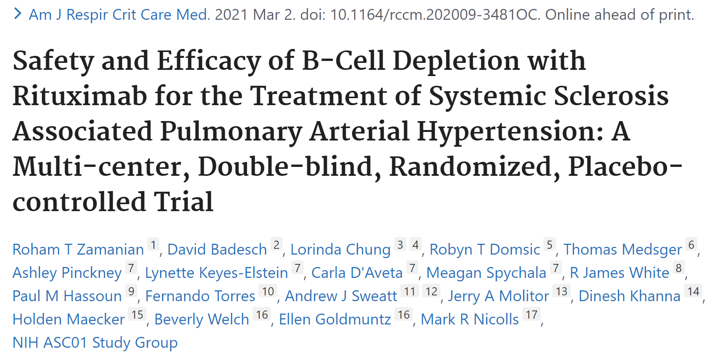

Slide 31
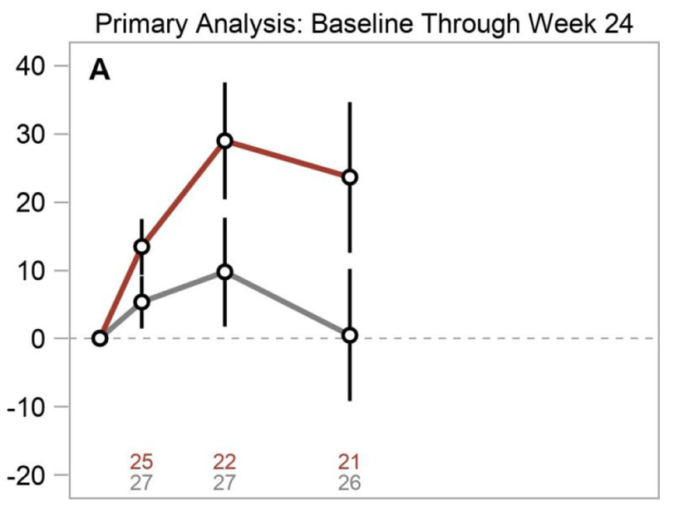
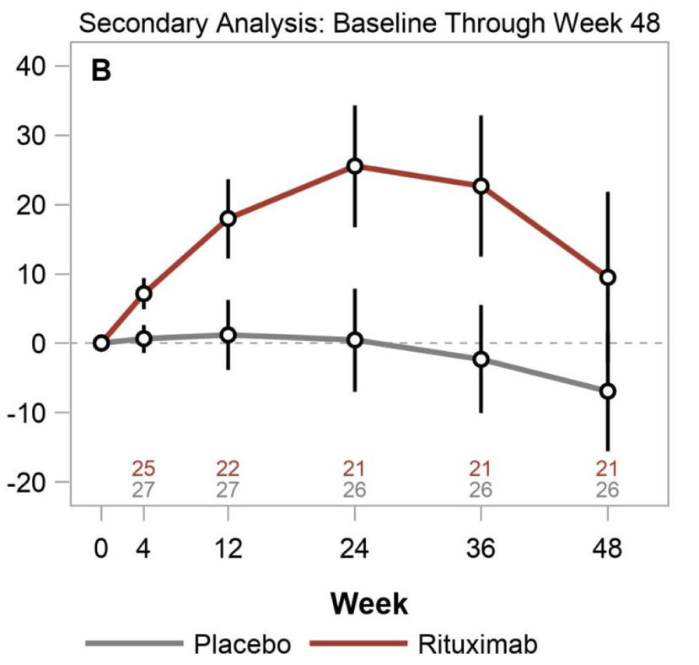
Change from Baseline in 6-Minute Walk Distance (m)

Slide 32
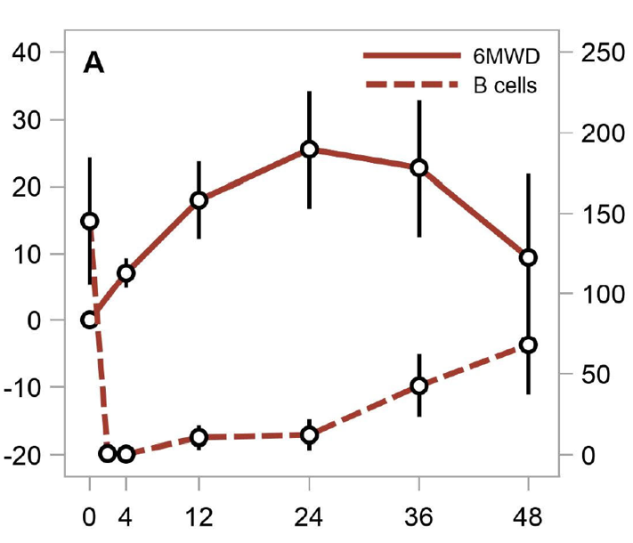
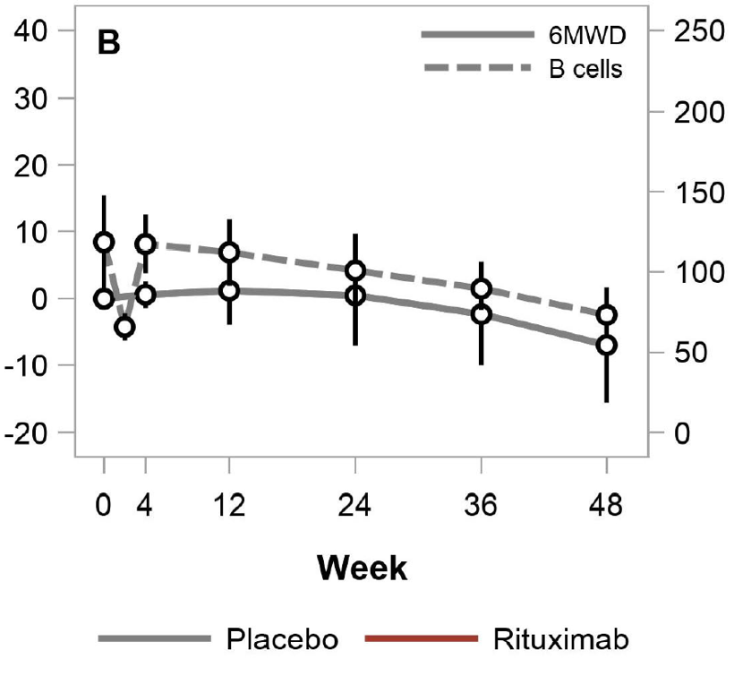
Change from Baseline in 6-Minute Walk Distance (m)
B Cells (cells/uL
B Cells (cells/uL

Slide 33
Summary
PH in patients with CTD is associated with impaired clinical outcomes despite similar hemodynamic profile
Early recognition is key

Slide 34



Looking for more resources
on this topic?
CME/CE in minutes
Congress highlights
Late-breaking data
Quizzes
Webinars
In-person events
Slides & resources
www.MedEdOTG.com

