Slide 1
Saturday, October 14, 2023 9:00am – 2:45pm CT
InterContinental Chicago Magnificent Mile Hotel | Chicago, IL
This activity is supported by independent educational grants from Actelion Pharmaceuticals US, Division of Janssen Pharmaceuticals and United Therapeutics Corporation. Jointly provided by the Global Learning Collaborative (GLC) and Total CME, LLC.

Slide 2
Resource Information
About This Resource
These slides are one component of a continuing education program available online at MedEd On The Go titled Midwest Regional PH Summit – Management of Pulmonary Hypertension with Comorbidities
Program Learning Objectives:
Explain the ERS/ERC guideline updates
Evaluate available evidence-based data and patient management strategies for PH
Identify opportunities to apply effective management strategies to improve patient outcomes
MedEd On The Go®
www.mededonthego.com
This content or portions thereof may not be published, posted online or used in presentations without permission.
This content can be saved for personal use (non-commercial use only) with credit given to the resource authors.
To contact us regarding inaccuracies, omissions or permissions please email us at support@MedEdOTG.com

Slide 3
Disclaimer
The views and opinions expressed in this educational activity are those of the faculty and do not necessarily represent the views of Total CME, LLC, the CME providers, or the companies providing educational grants. This presentation is not intended to define an exclusive course of patient management; the participant should use their clinical judgment, knowledge, experience, and diagnostic skills in applying or adopting for professional use any of the information provided herein. Any procedures, medications, or other courses of diagnosis or treatment discussed or suggested in this activity should not be used by clinicians without evaluation of their patient's conditions and possible contraindications or dangers in use, review of any applicable manufacturer’s product information, and comparison with recommendations of other authorities. Links to other sites may be provided as additional sources of information.

Slide 4
PH-ILD: Diagnosis and Management
Sydney Schacht, DO
Pulmonary/Critical Care Fellow
Indiana University School of Medicine
Indianapolis, IN

Slide 5
Initial Presentation
64-year-old female with PMHx chronic cough, recurrent pneumonia, HTN, Hashimoto thyroiditis s/p thyroidectomy, and bronchiectasis who presented for evaluation of DOE.
4 years prior: Persistent cough after her thyroidectomy
2 years prior: Hospitalized for pneumonia two times, one of which required mechanical ventilation
Last 6 months: Significant functional decline with DOE. She previously walked 3 miles per day and now must rest after ADLs. Exertional chest pain but no syncope or pre-syncope. + lower extremity edema and weight gain of an unknown amount. Symptoms worse during the day and with activity. Cough not productive
She has mild GERD with improved symptoms when on esomeprazole. Inhaled bronchodilators do not seem to help. No joint tenderness, no rashes
Denies: tobacco use, drugs, alcohol use. Environmental changes: none. Pets: none

Slide 6
Exam
Vitals: Temp 36.7 deg C, HR 107, RR 18, BP 134/91, SpO2 94%
General: Well-appearing, no distress
Eyes: anicteric
ENT: moist mucus membranes, scattered telangiectasias on forehead
Neck: supple, no lymphadenopathy, +JVD
Cardiac: normal rate, regular rhythm, S3+, no murmurs, no edema
Pulmonary: basilar crackles, not labored, no wheezing
Abdomen: soft, non-tender
Extremities: no deformities
Skin: no cyanosis or clubbing, no rashes on exposed skin. Some skin tightening and periungual erythema
Neuro: alert, oriented, no focal deficits

Slide 7
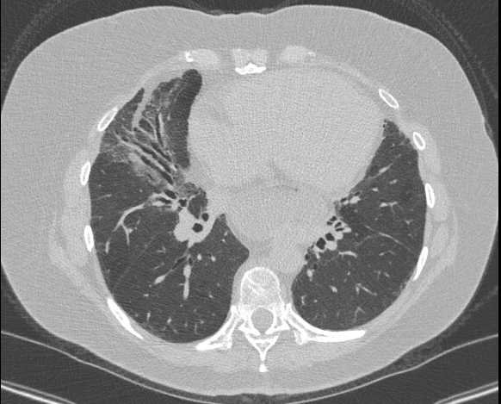
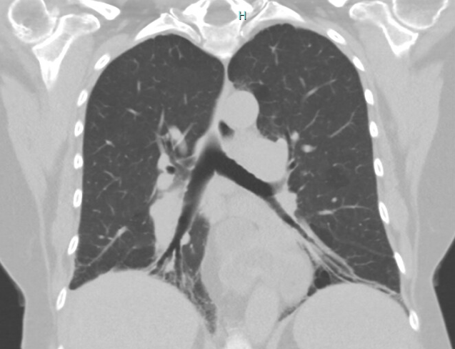
Initial Diagnostics
PFTs 3/2021:
FVC 2.58 (80%), FEV1 1.87 (76%), FEV1/FVC 73, no bronchodilator response.
TLC 4.06 (77%) DLCO 8.4 (40%)

Slide 8
Laboratory Data
CBC: WBC 15.3, Hgb 14.8, Plt 413
BMP: Na 139, K 3.8, Cl 103, HCO3 21, BUN 33, Cr 1.17, Gluc 150
Serologies: ANA 1:160, homogeneous anti-centromere ab negative SCL 70 Ab 51 (positive) SS-A and SS-B negative, Smith/RNP Ab negative, Anti Jo Ab negative, Anti-dsDNA negative, RF negative, anti-CCP Ab negative
HIV and hepatitis serologies negative
C3 133, C4 28
Immunoglobulins within normal limits
NT-proBNP: 2797, BNP: 405

Slide 9
Other Diagnostics
Home O2 4/2021: 93% on RA with rest, 86% on RA with exertion, 1L prescribed with exertion
VQ scan 4/2021: Negative for pulmonary embolism
Bronchoscopy with bronchial washing 5/2021: airways normal, EDAC noted. Microbiology negative
PSG 7/2021: AHI 6.8
6MWT 9/2021: 243.84 m on 3L

Slide 11
Right Heart Catheterization
RAP 17 mmHg
RV 92/6/22 mmHg
PAP 92/42 (63) mmHg
PCWP 7 mmHg
LVEDP 9 mmHg
PVR 14.9 WU
CO (TD) 2.68, CI 1.5
CO (indirect Fick) 3/71, CI 2.1
No response to nitric oxide

Slide 12
Treatment
Patient was started on triple therapy with subcutaneous treprostinil. Additionally, a diuretic regimen was initiated with improved weights and lower extremity edema.
She was evaluated by rheumatology, diagnosed formally with scleroderma, and started on mycophenolate.
She was referred to pulmonary rehab.

Slide 13
Follow-Up
Since initiation of PAH therapy and immunosuppression for scleroderma, she has improved symptomatically. Functional class has improved from class III to class II. She remains in pulmonary rehab and finds it beneficial. Her high-risk features are now considered low-risk.
RHC 12/2022: RA 3, RV 64/8, PA 66/23 (41), PCWP 9, Fick CO 4.92, TD CO 5.37 – all improved.
Echo 6/2023: RV mildly dilated, RA pressure low-normal, improved RV systolic function, development of stage 2 diastolic dysfunction
PFTs 12/2022: FVC 2.92 (96%), FEV1 1.99 (86%), DLCO 2.39 (12%) – all improved
Home O2 needs have increased to 1 L with rest and 6L with exertion.
6MWT has improved from 243 m to 444 m.

Slide 14
Looking for more resources on this topic?
CME/CE in minutes
Congress highlights
Late-breaking data
Quizzes
Webinars
In-person events
Slides & resources
www.MedEdOTG.com

