Slide 1






Saturday, October 14, 2023
9:00am – 2:45pm CT
InterContinental Chicago Magnificent Mile Hotel | Chicago, IL
This activity is supported by independent educational grants from Actelion Pharmaceuticals US, Division of Janssen Pharmaceuticals and United Therapeutics Corporation.
Jointly provided by the Global Learning Collaborative (GLC) and Total CME, LLC.

Slide 2



Resource Information
About This Resource
These slides are one component of a continuing education program available online at MedEd On The Go titled Midwest Regional PH Summit – Management of Pulmonary Hypertension with Comorbidities
Program Learning Objectives:
Explain the ERS/ERC guideline updates
Evaluate available evidence-based data and patient management strategies for PH
Identify opportunities to apply effective management strategies to improve patient outcomes
MedEd On The Go®
www.mededonthego.com
This content or portions thereof may not be published, posted online or used in presentations without permission.
This content can be saved for personal use (non-commercial use only) with credit given to the resource authors.
To contact us regarding inaccuracies, omissions or permissions please email us at support@MedEdOTG.com

Slide 3
Disclaimer
The views and opinions expressed in this educational activity are those of the faculty and do not necessarily represent the views of Total CME, LLC, the CME providers, or the companies providing educational grants. This presentation is not intended to define an exclusive course of patient management; the participant should use their clinical judgment, knowledge, experience, and diagnostic skills in applying or adopting for professional use any of the information provided herein. Any procedures, medications, or other courses of diagnosis or treatment discussed or suggested in this activity should not be used by clinicians without evaluation of their patient's conditions and possible contraindications or dangers in use, review of any applicable manufacturer’s product information, and comparison with recommendations of other authorities. Links to other sites may be provided as additional sources of information.

Slide 4
Panel Discussion: Simulated CTEPH Case Conference

Slide 5
First BPA Session – 1/5/2023
PRESSURES
SITE | PRESSURES | END | A-WAVE | V-WAVE | MEAN
RA |  |  | 17 | 14 | 11
RV | 60/8 | 12
PCW |  |  | 18 | 19 | 13
PA | 54/20 |  |  |  | 33
CARDIAC OUTPUT
TDCO: 7.3 | Fick CO: 4.87
TDCI: 2.87 | Fick CI: 1.91
RESISTANCE
PVR: 328.79 dynes (4.11 WU)

Slide 6
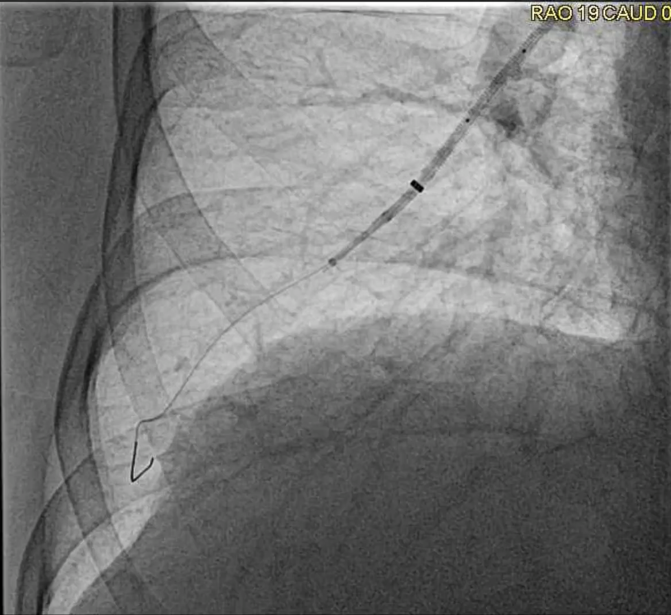

Slide 7
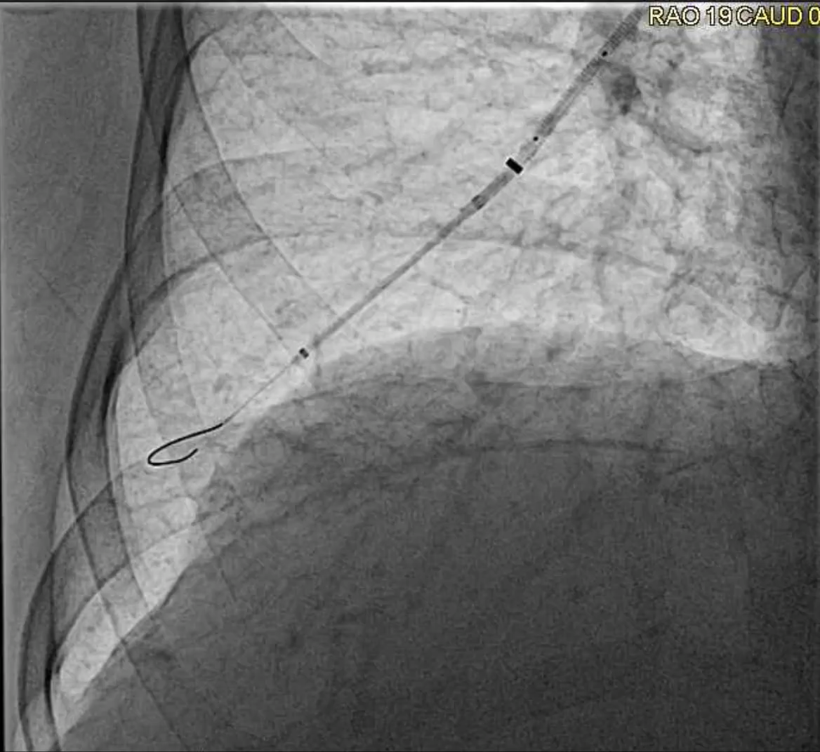

Slide 8
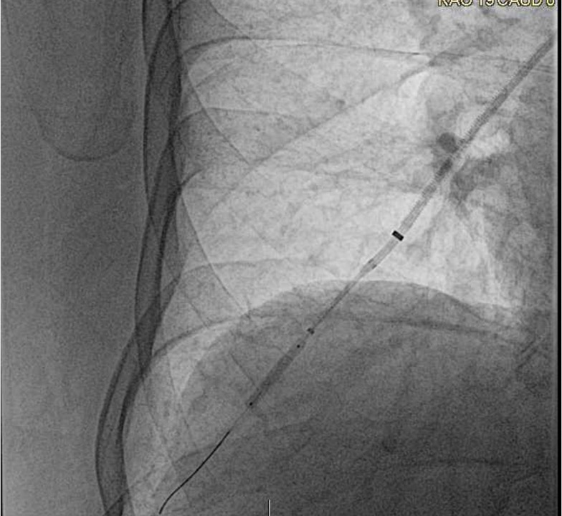

Slide 9
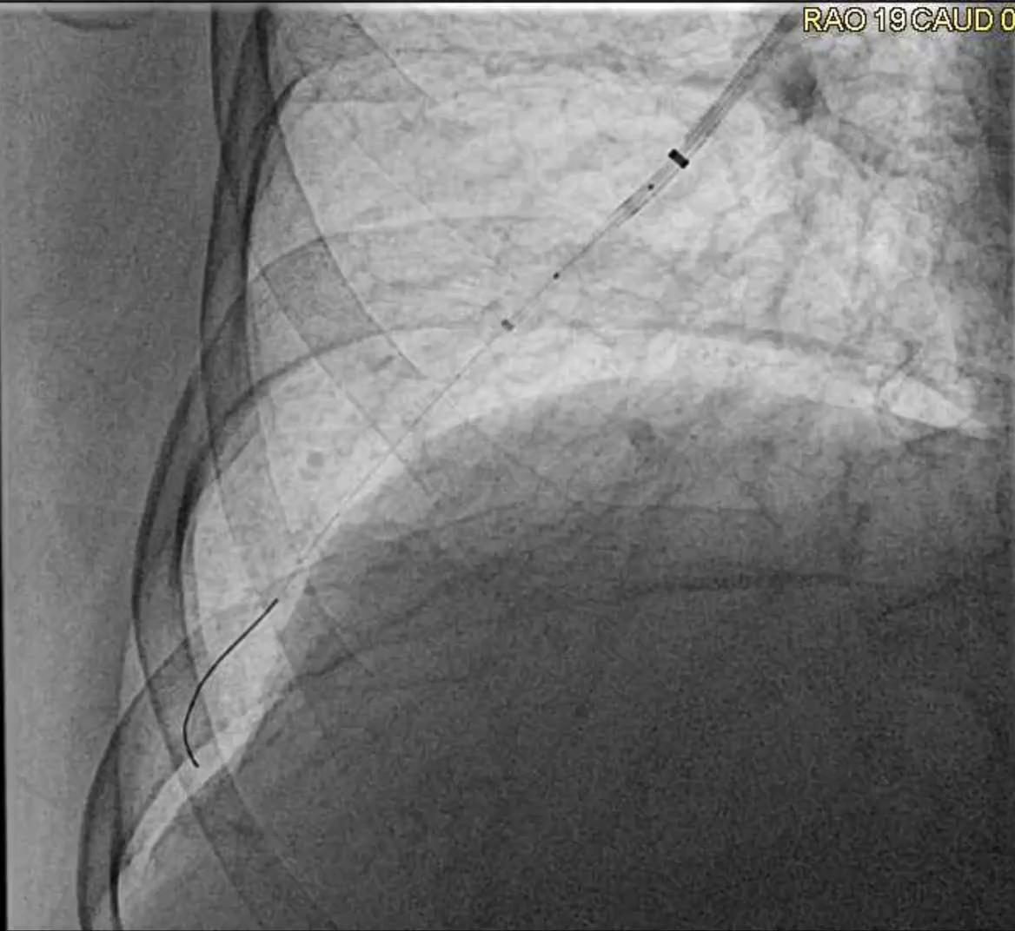

Slide 10
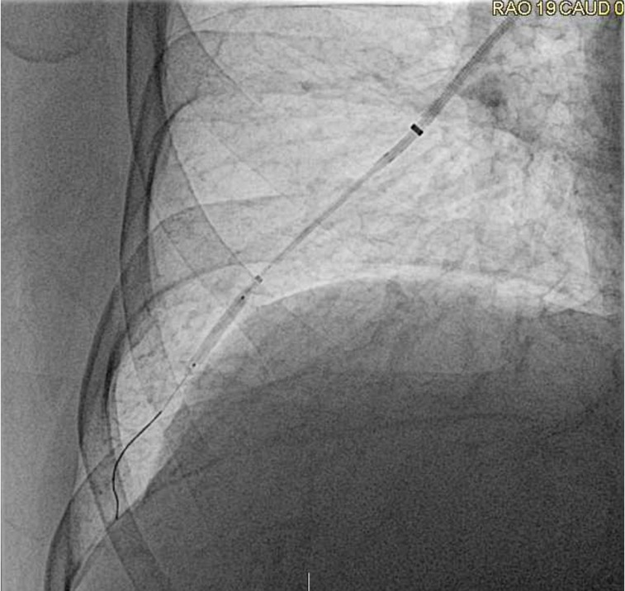

Slide 11
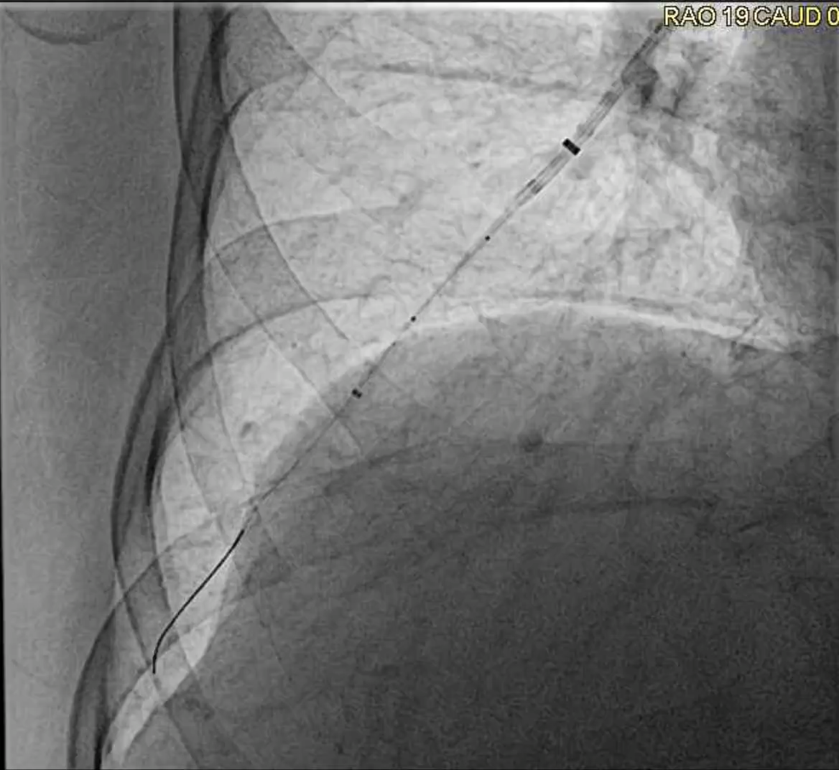

Slide 12
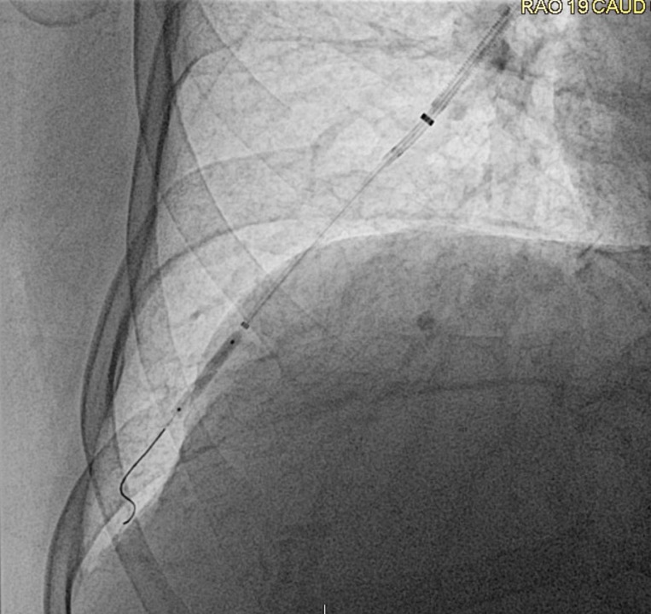

Slide 13
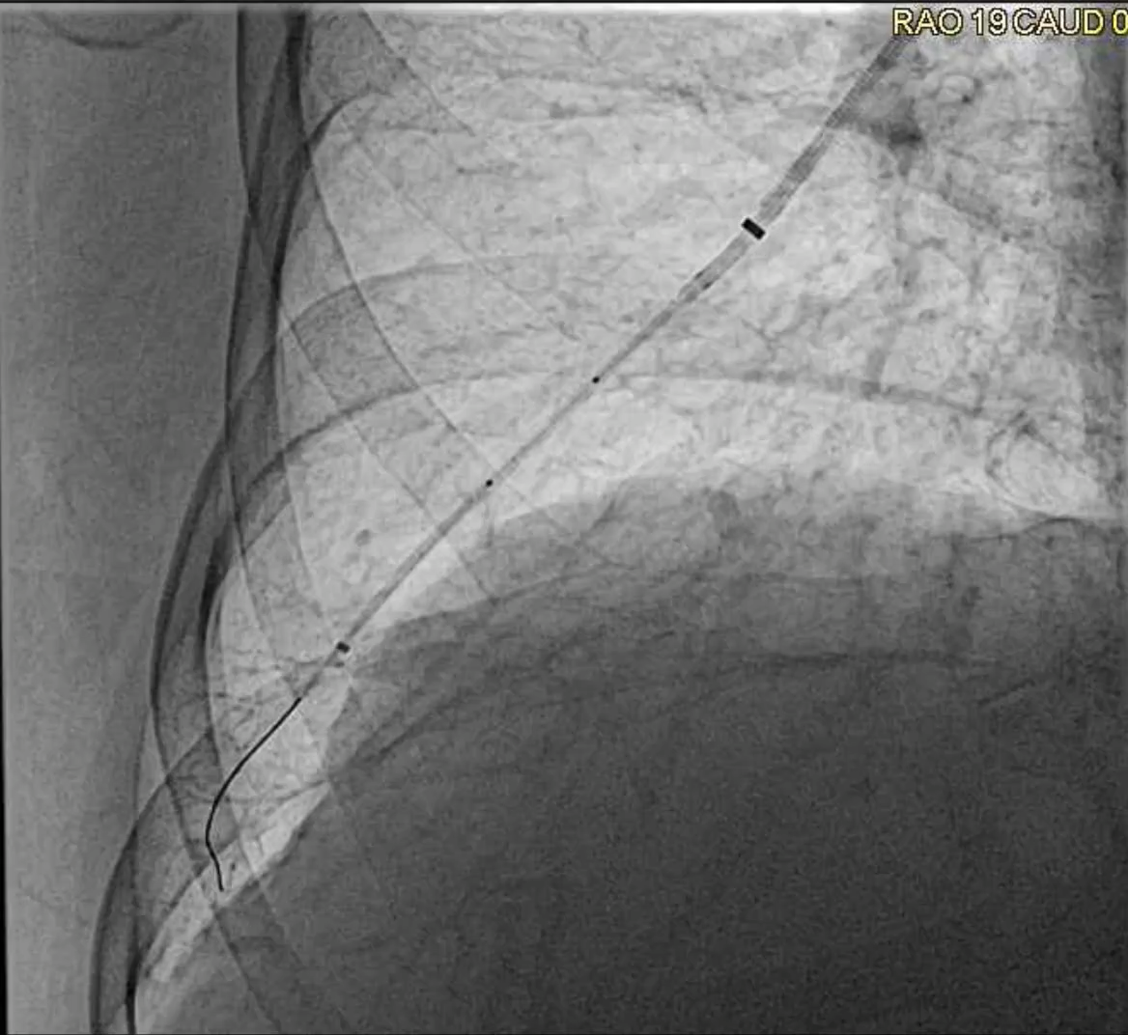

Slide 14
RHC Trend
DATE | RA | PA | PCWP | PVR | CO/CI
10/19/22 | 13 | 55/22/34 | 14 | 4.24 | 5.33/4.71
2/9/23 | 7 | 44/15/24 | 9 | 2.28 | 5.47/6.57

Slide 15
6-MWT Trend
DATE | DISTANCE
6/29/22 | 314 (52%)
10/3/22 | 378 (63%)
12/27/22 | 367 (61%)
2/22/23 | 491/603 (81%)
6/19/2023 | 542/603 (90%)

Slide 16
Follow-Up 6/19/2023
He reports very little dyspnea in his everyday life
Able to climb 2 flight of stairs without shortness of breath. Rides a bicycle around 6 miles and recently went on a biking event and biked almost 17 miles throughout the day
Classified World Health Organization Functional Class 1

Slide 17



Looking for more resources
on this topic?
CME/CE in minutes
Congress highlights
Late-breaking data
Quizzes
Webinars
In-person events
Slides & resources
www.MedEdOTG.com

