Slide 1






Saturday, October 14, 2023
9:00am – 2:45pm CT
InterContinental Chicago Magnificent Mile Hotel | Chicago, IL
This activity is supported by independent educational grants from Actelion Pharmaceuticals US, Division of Janssen Pharmaceuticals and United Therapeutics Corporation.
Jointly provided by the Global Learning Collaborative (GLC) and Total CME, LLC.

Slide 2



Resource Information
About This Resource
These slides are one component of a continuing education program available online at MedEd On The Go titled Midwest Regional PH Summit – Management of Pulmonary Hypertension with Comorbidities
Program Learning Objectives:
Explain the ERS/ERC guideline updates
Evaluate available evidence-based data and patient management strategies for PH
Identify opportunities to apply effective management strategies to improve patient outcomes
MedEd On The Go®
www.mededonthego.com
This content or portions thereof may not be published, posted online or used in presentations without permission.
This content can be saved for personal use (non-commercial use only) with credit given to the resource authors.
To contact us regarding inaccuracies, omissions or permissions please email us at support@MedEdOTG.com

Slide 3
Disclaimer
The views and opinions expressed in this educational activity are those of the faculty and do not necessarily represent the views of Total CME, LLC, the CME providers, or the companies providing educational grants. This presentation is not intended to define an exclusive course of patient management; the participant should use their clinical judgment, knowledge, experience, and diagnostic skills in applying or adopting for professional use any of the information provided herein. Any procedures, medications, or other courses of diagnosis or treatment discussed or suggested in this activity should not be used by clinicians without evaluation of their patient's conditions and possible contraindications or dangers in use, review of any applicable manufacturer’s product information, and comparison with recommendations of other authorities. Links to other sites may be provided as additional sources of information.

Slide 4
Pulmonary Thrombo-endarterectomy for CTEPH
Jonathan Haft, MD
Robert H. Bartlett Professor of Cardiac Surgery
Department of Cardiac Surgery
Frankel Cardiovascular Center
University of Michigan
Ann Arbor, MI

Slide 5

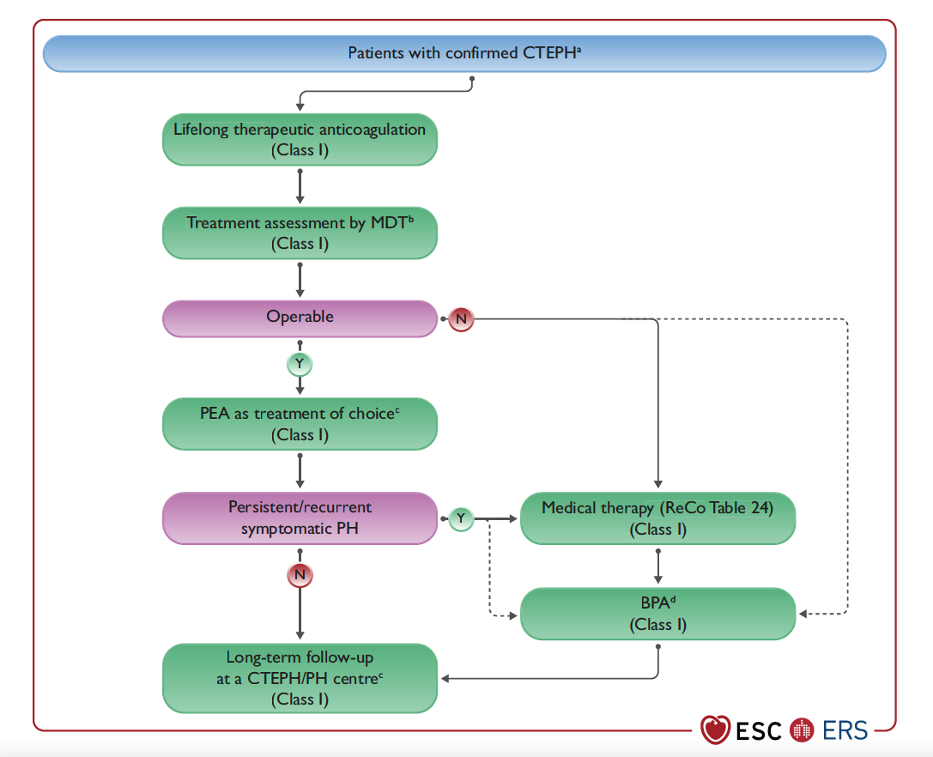
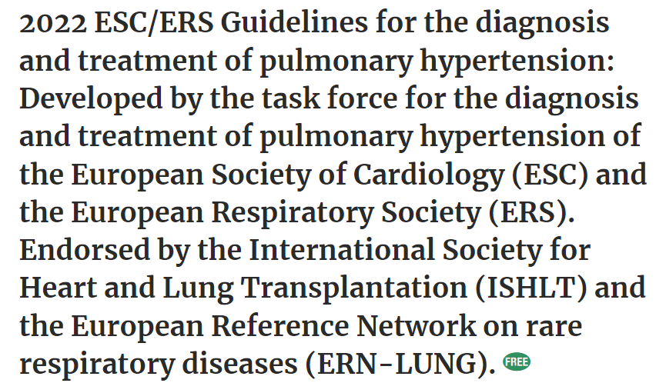
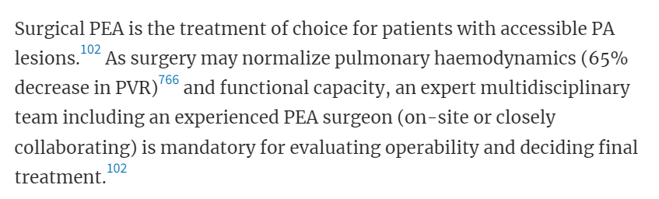

Slide 6
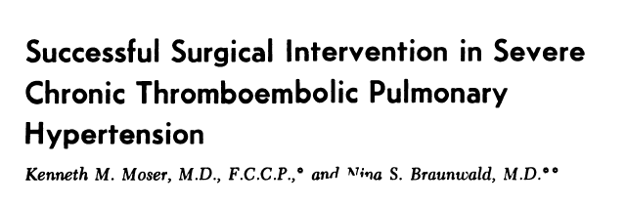
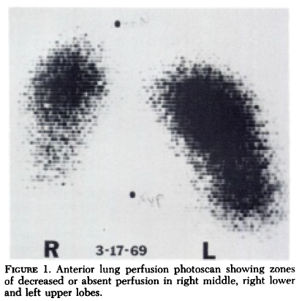
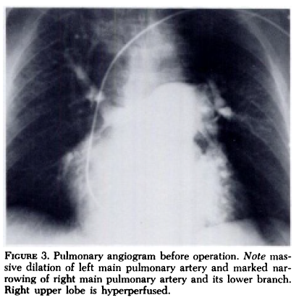
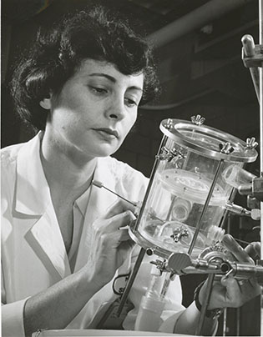
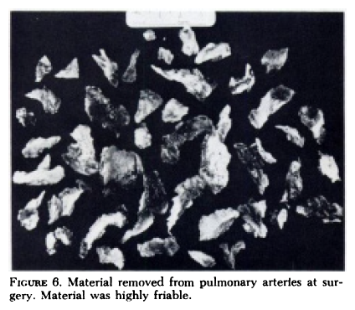
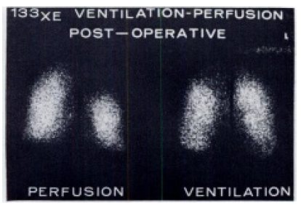


Slide 7
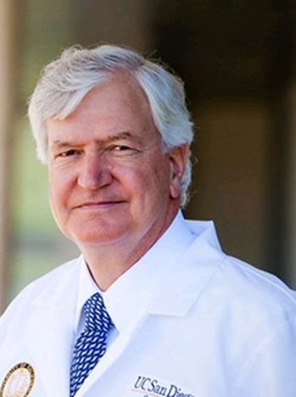
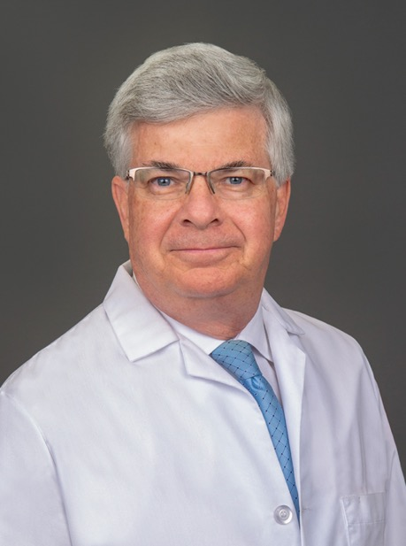
William Auger
Stuart Jamieson

Slide 8
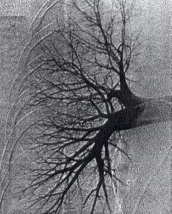
PEA Surgical Accessibility
1) Established diagnosis
  Mismatched defects on V/Q or anatomic obstructions on CT
  Significant functional limitations or symptoms
2) Is the disease surgically accessible?
  Jamieson classification
    I: Branch PA
    II: Lobar
    III: Segmental
    IV: Subsegmental
3) Balancing risks versus benefits?
  Comorbid conditions
  Functional status
1
2
4
3

Slide 9
Surgical Guiding Principles
Bilateral access
  Median sternotomy
  Avoids bloody pleural adhesions with collateral vessels
Cardiopulmonary bypass
  Deep hypothermic circulatory arrest
    18°
Endarterectomy to the tail in subsegmental branches

Slide 10
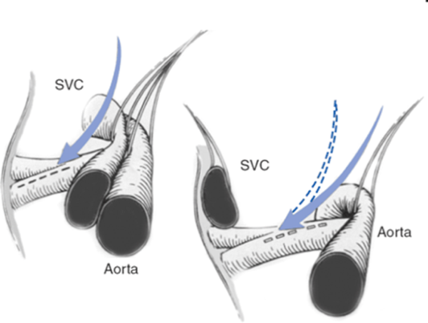
Surgical Techniques
Standard CPB cannulation
  Bicaval venous drainage
  Ascending aortic infusion
  Left ventricular vent
Systemic cooling to 18 degrees
  45-90 minutes
Mobilization of the right pulmonary artery from the ascending aorta and superior vena cava
Aortic cross clamp
Cold blood cardioplegia
Incision in the right pulmonary artery beyond the upper lobe branch
Circulatory arrest for the dissection

Slide 11
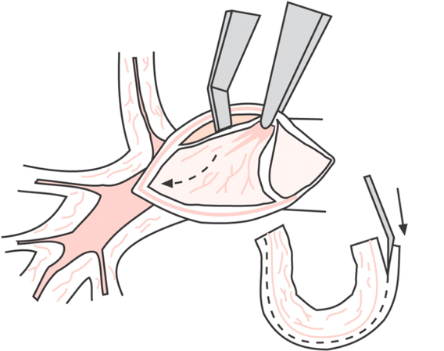
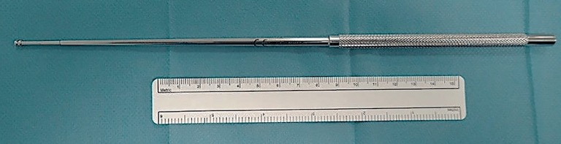
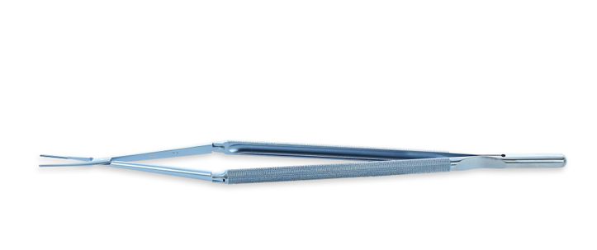
Surgical Techniques
Identification of correct dissection plane
  Jamieson suction device
  Long fine double action forceps
  “Pearly white”
  Pink color suggest too deep, entering adventitial plane
  Begin where it's easy
    At the level of the incision
    More distally where there is clearly mural organized thrombus

Slide 12
Surgical Techniques
Continue dissection distally into each subsegmental branch
  Eversion technique
  “Feathered tail”
Transection = trouble!
  No benefit if cannot retrieve residual specimen
Tearing = BIG TROUBLE!
  Pulmonary hemorrhage
Hypothermic circulatory arrest essential
  Robust bronchial circulation
  20 minutes/10 minute reperfusion
Slow rewarming
  <10 degree gradient between blood and body
  90-120 minutes

Slide 13
Results

Slide 14
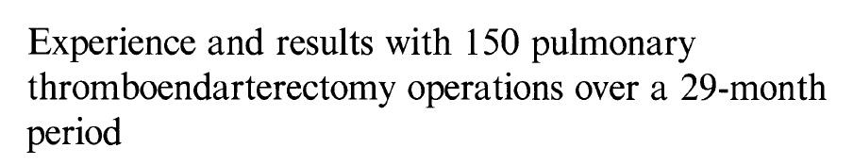
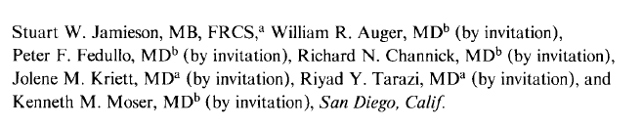
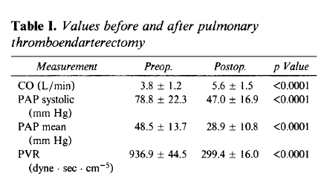
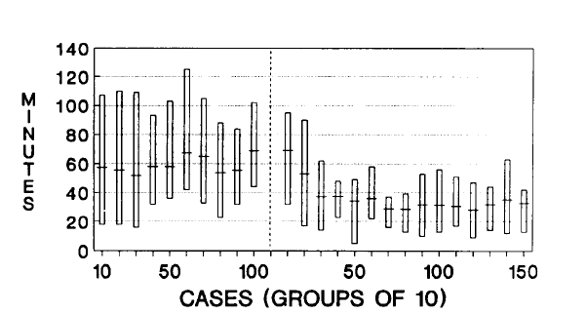

Operative mortality of 8.7%

Slide 15
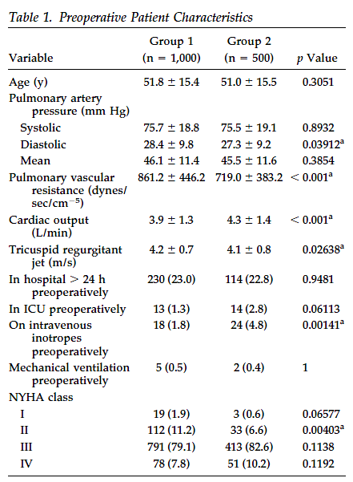
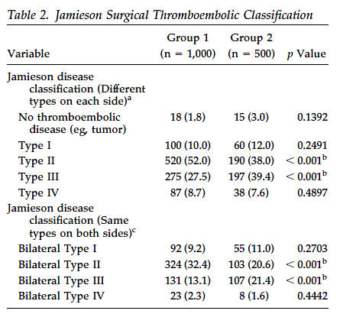
Pulmonary Endarterectomy: Recent Changes in a Single Institution's Experience of More Than 2,700 Patients
Michael M. Madani, MD, William R. Auger, MD, Victor Pretorius, MD, Naohide Sakakibara, MD, Kim M. Kerr, MD, Nick H. Kim, MD, Peter F. Fedullo, MD, and Stuart W. Jamieson, MD
Divisions of Cardiovascular and Thoracic Surgery and Pulmonary and Critical Care Medicine, University of California San Diego Health Center, San Diego, California

Slide 16
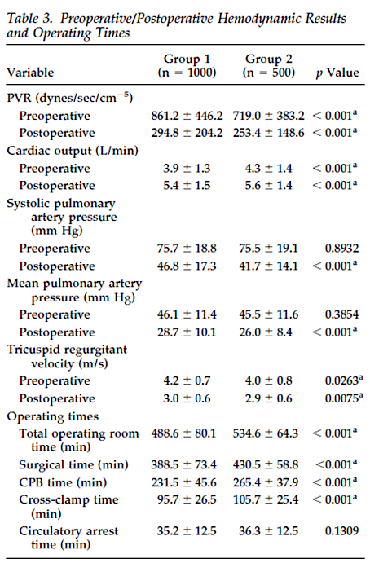
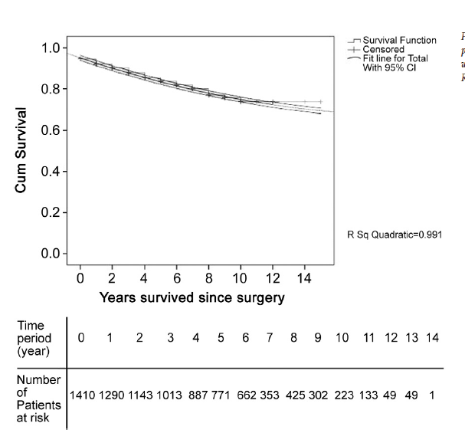
Pulmonary Endarterectomy: Recent Changes in a Single Institution's Experience of More Than 2,700 Patients
Michael M. Madani, MD, William R. Auger, MD, Victor Pretorius, MD, Naohide Sakakibara, MD, Kim M. Kerr, MD, Nick H. Kim, MD, Peter F. Fedullo, MD, and Stuart W. Jamieson, MD
Divisions of Cardiovascular and Thoracic Surgery and Pulmonary and Critical Care Medicine, University of California San Diego Health Center, San Diego, California
Operative mortality ~2%

Slide 17
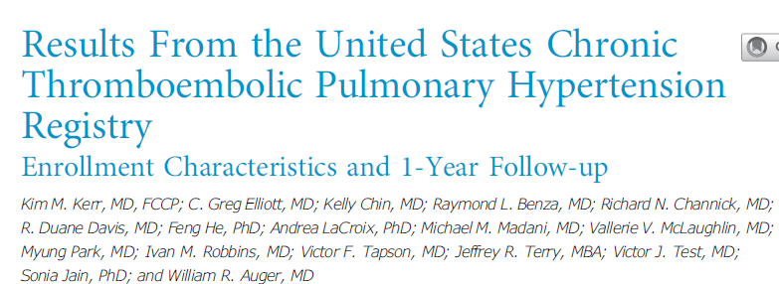
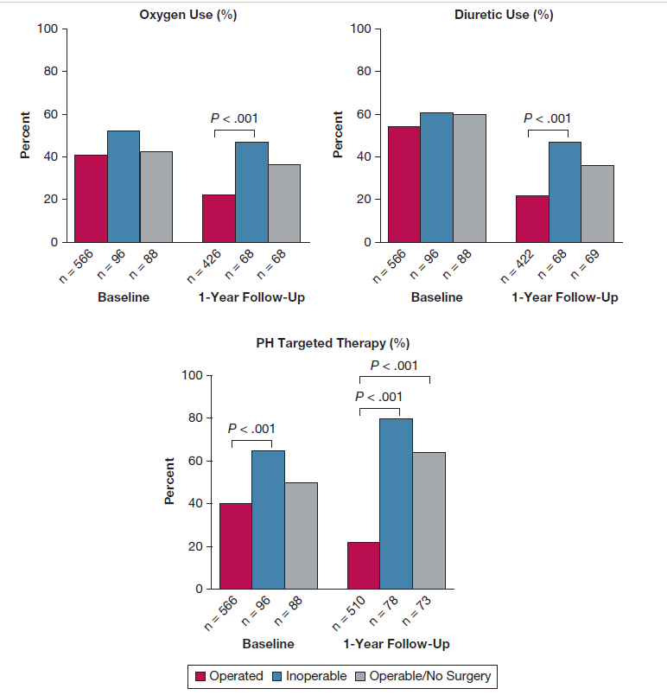
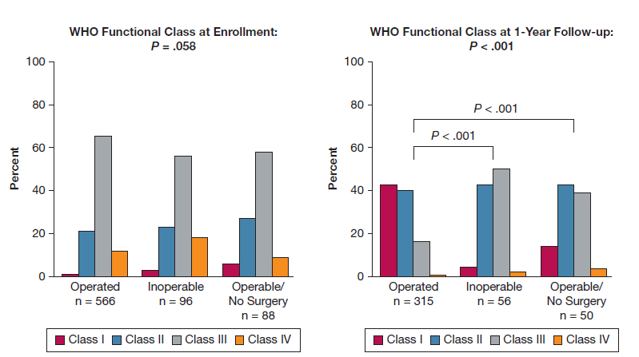
Surgical mortality 3.9%

Slide 18
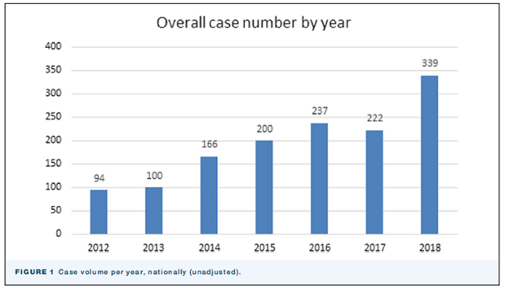
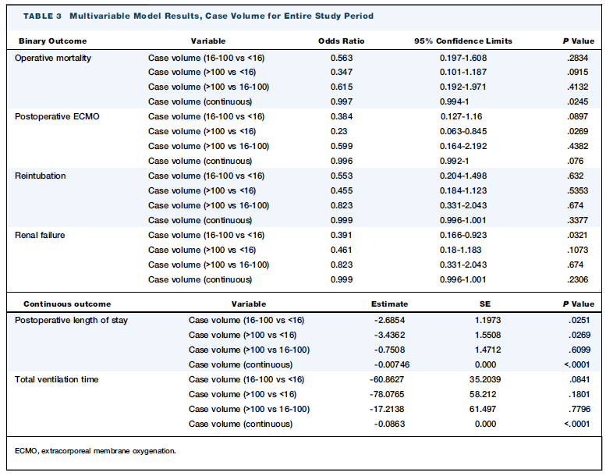
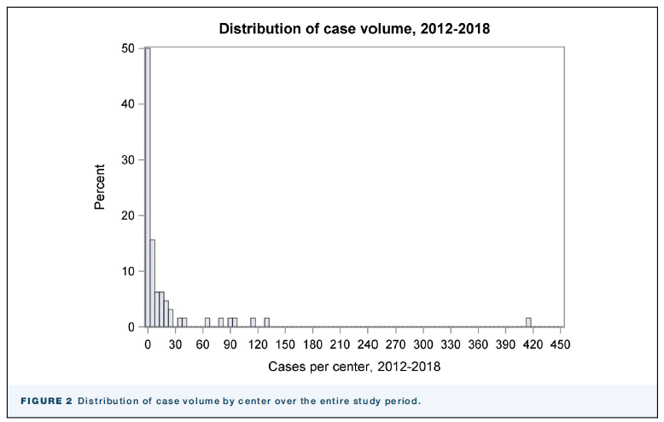
Pulmonary Endarterectomy for Chronic Thromboembolic Pulmonary Hypertension:
An STS Database Analysis
Curtis S. Bergquist, MD, Xiaoting Wu, PhD, Vallerie V. McLaughlin, MD, Carlo M. Rosati, MD, Victor Pretorius, MBChB, Donald S. Likosky, PhD, and Jonathan W. Haft, MD
Department of Cardiac Surgery, Michigan Medicine, University of Michigan, Ann Arbor, Michigan; Division of Cardiovascular Medicine, Department of Internal Medicine, Michigan Medicine, University of Michigan, Ann Arbor, Michigan; and Sulpizio Cardiovascular Center, University of California San Diego, La Jolla, California

Slide 19
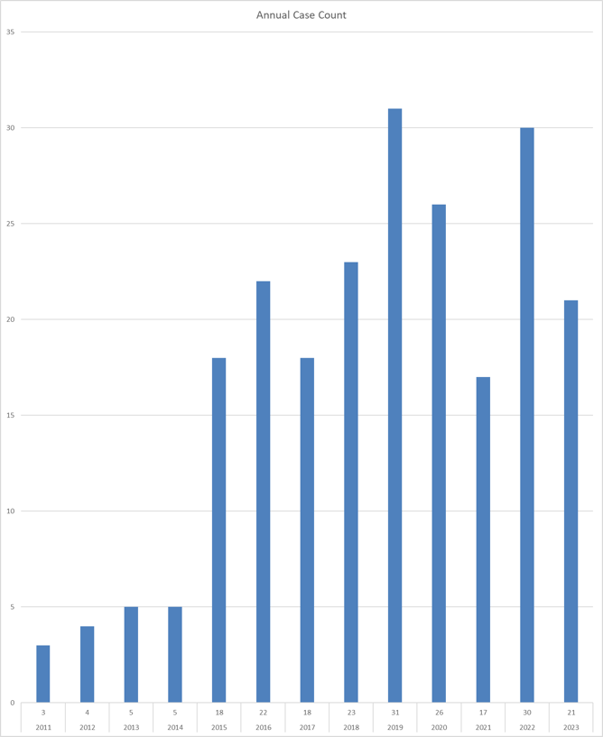
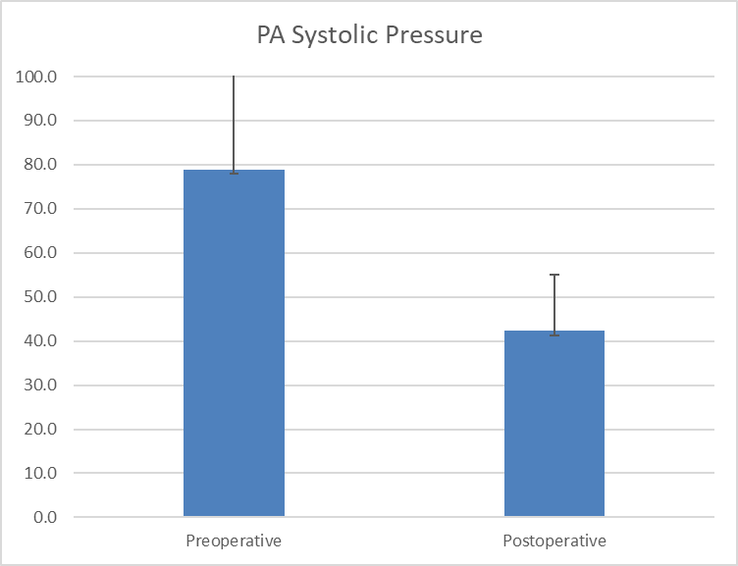
UM CTEPH PEA Program
223 Cases
Operative mortality 4.1%

Slide 20


Slide 21
6-Month Follow Up
6-minute hall walk
Echocardiogram
Right heart cath
V/Q scan

Slide 22
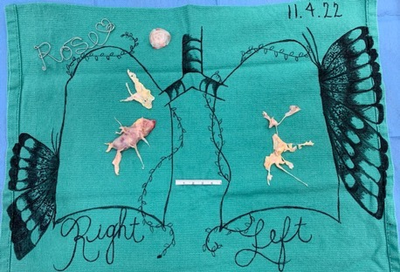
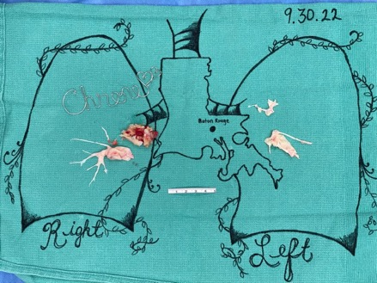
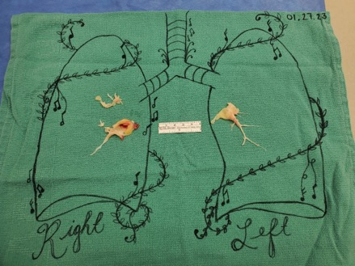
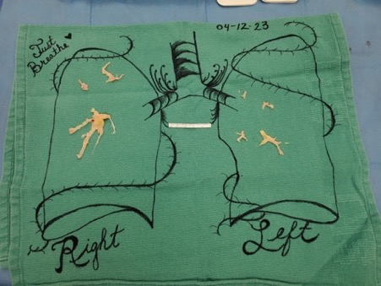
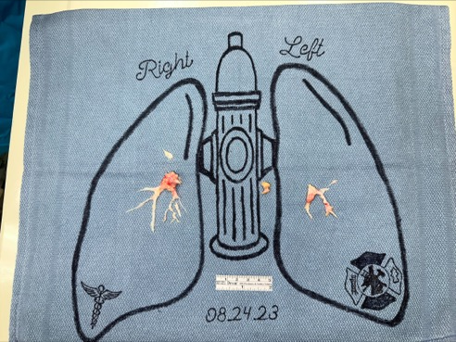
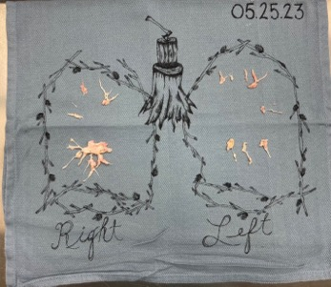
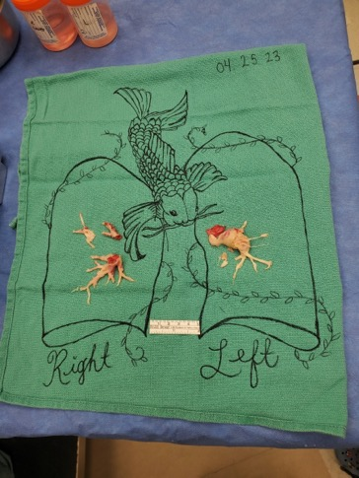
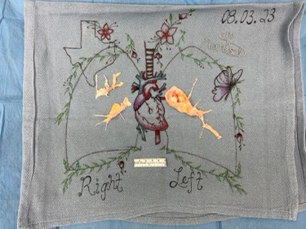
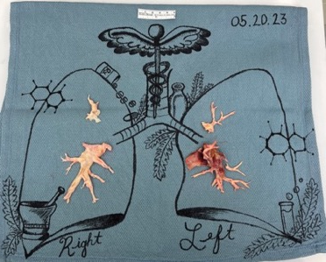

Slide 23



Looking for more resources
on this topic?
CME/CE in minutes
Congress highlights
Late-breaking data
Quizzes
Webinars
In-person events
Slides & resources
www.MedEdOTG.com

