Slide 1
Saturday, October 14, 2023 9:00am – 2:45pm CT
InterContinental Chicago Magnificent Mile Hotel | Chicago, IL
This activity is supported by independent educational grants from Actelion Pharmaceuticals US, Division of Janssen Pharmaceuticals and United Therapeutics Corporation. Jointly provided by the Global Learning Collaborative (GLC) and Total CME, LLC.

Slide 2
Resource Information
About This Resource
These slides are one component of a continuing education program available online at MedEd On The Go titled Midwest Regional PH Summit – Management of Pulmonary Hypertension with Comorbidities
Program Learning Objectives:
Explain the ERS/ERC guideline updates
Evaluate available evidence-based data and patient management strategies for PH
Identify opportunities to apply effective management strategies to improve patient outcomes
MedEd On The Go®
www.mededonthego.com
This content or portions thereof may not be published, posted online or used in presentations without permission.
This content can be saved for personal use (non-commercial use only) with credit given to the resource authors.
To contact us regarding inaccuracies, omissions or permissions please email us at support@MedEdOTG.com

Slide 3
Disclaimer
The views and opinions expressed in this educational activity are those of the faculty and do not necessarily represent the views of Total CME, LLC, the CME providers, or the companies providing educational grants. This presentation is not intended to define an exclusive course of patient management; the participant should use their clinical judgment, knowledge, experience, and diagnostic skills in applying or adopting for professional use any of the information provided herein. Any procedures, medications, or other courses of diagnosis or treatment discussed or suggested in this activity should not be used by clinicians without evaluation of their patient's conditions and possible contraindications or dangers in use, review of any applicable manufacturer’s product information, and comparison with recommendations of other authorities. Links to other sites may be provided as additional sources of information.

Slide 4
Balloon Pulmonary Angioplasty: Issues and Perspectives
Dan Schimmel, MD, MS, FACC, FSCAI
Associate Professor of Medicine
Director, Cardiac Catheterization Laboratory
Bluhm Cardiovascular Institute
Northwestern University
Chicago, IL

Slide 5
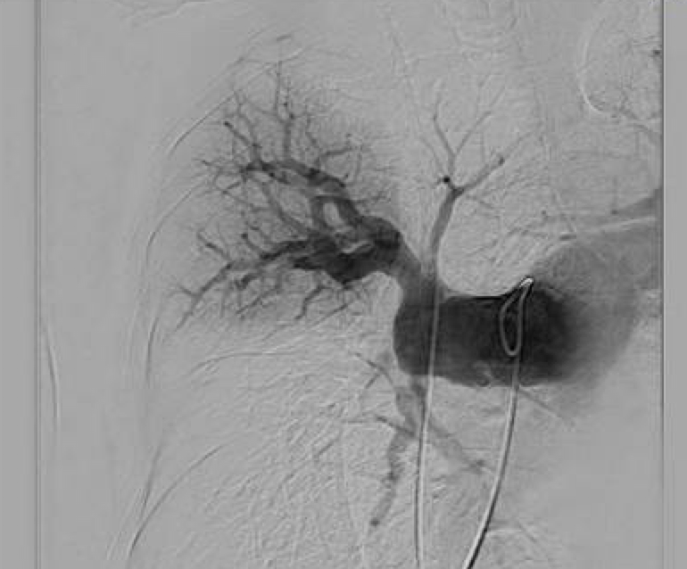
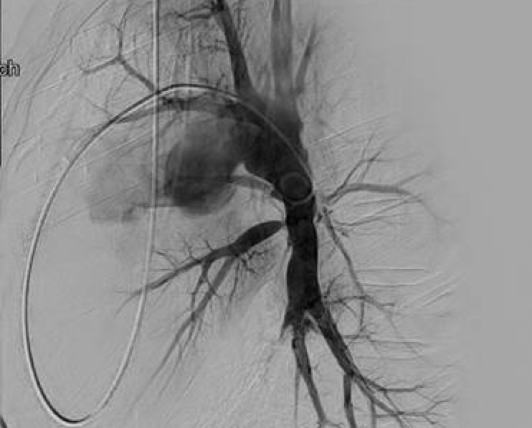
Chronic Thromboembolic Pulmonary Hypertension Surgical therapy is considered curative
Proximal Disease
Proximal and Segmental Disease

Slide 6
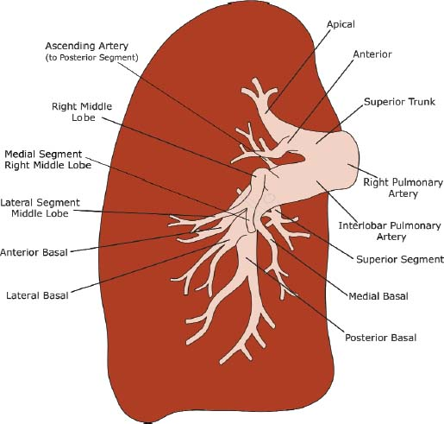
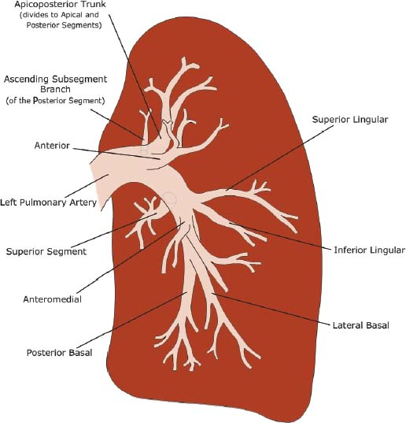
Defining Operable Disease Anatomically… AN INEXACT SCIENCE
The success of PTE is dependent on the location of the thromboemboli
Extraction can be achieved in the main pulmonary, lobar, or segmental arteries
Dependent on surgeon, center expertise

Slide 7
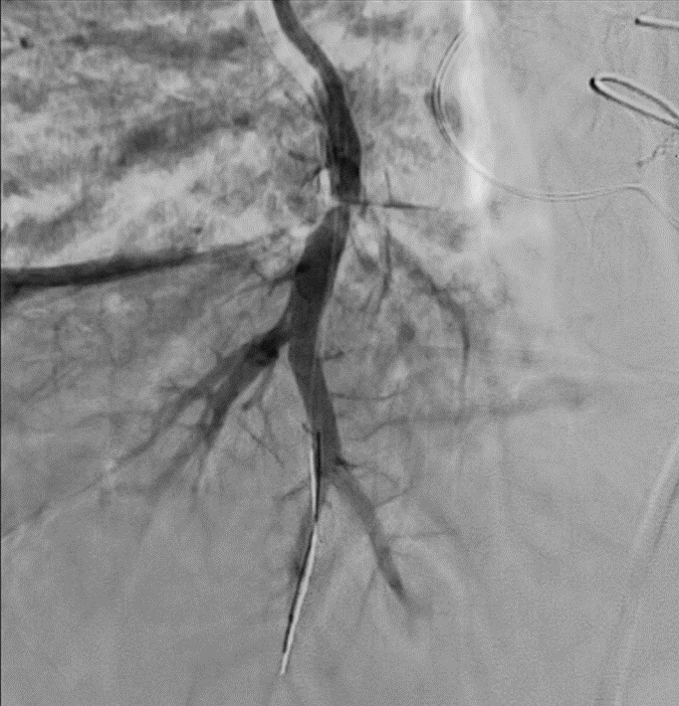
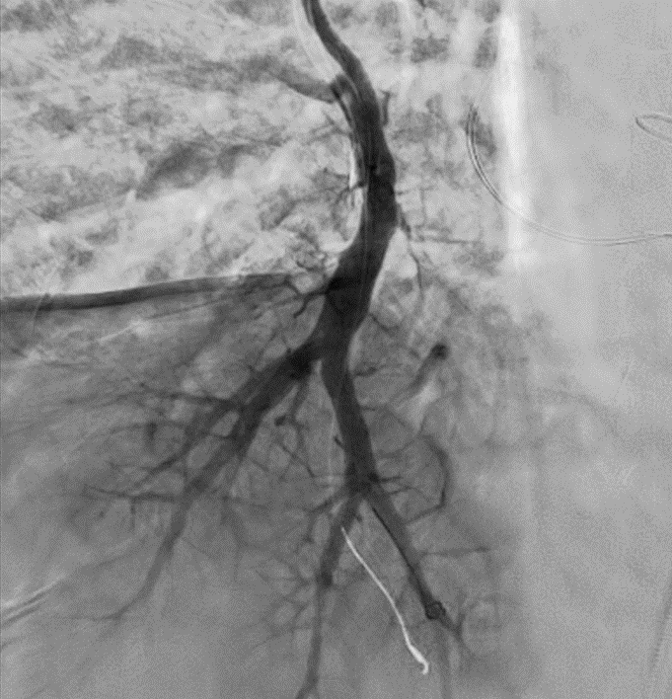
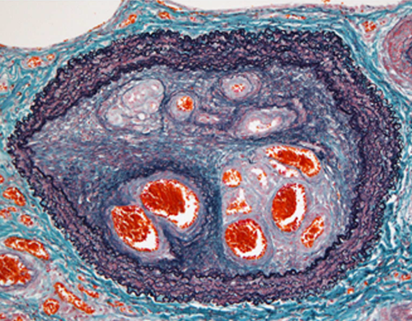
Balloon Pulmonary Angioplasty
Before BPA
After BPA

Slide 9
Chronic Thromboembolic Pulmonary Hypertension Pressure wire assessment for treatment guide

Slide 10
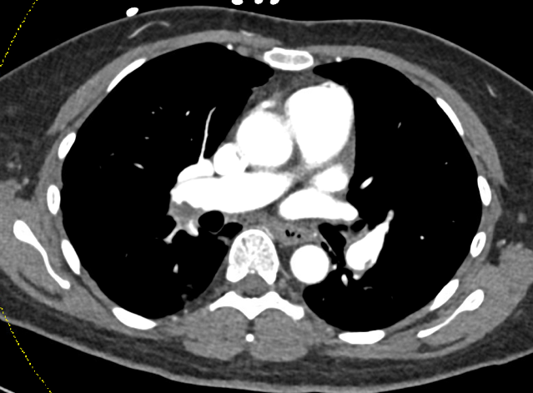
Case 1
44 year old waoman with multiple schlerosis and history of remote DVT/PE admitted for acute on chronic dyspnea and newly discovered hypoxia
Failed catheter thrombolysis and suction embolectomy, performed for tachycardia and hypoxia in setting of severe right ventricular dilation and dysfunction
Persistent tachycardia and hypoxia transferred to Northwestern for CTEPH evaluation

Slide 11
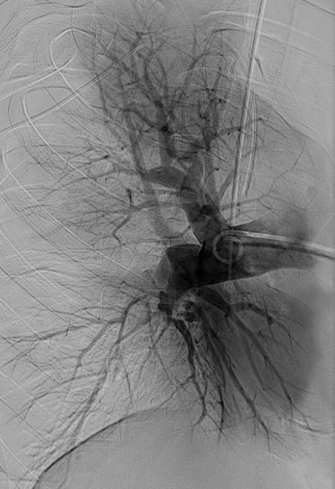
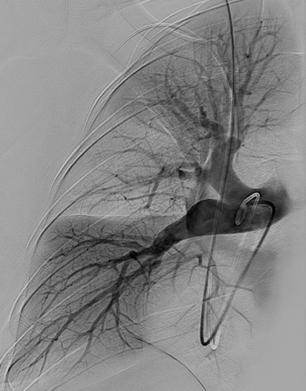
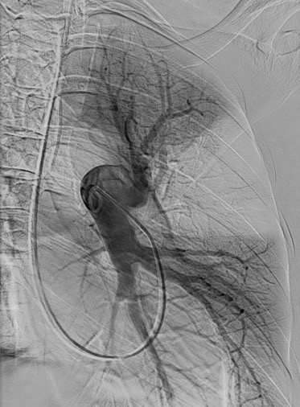
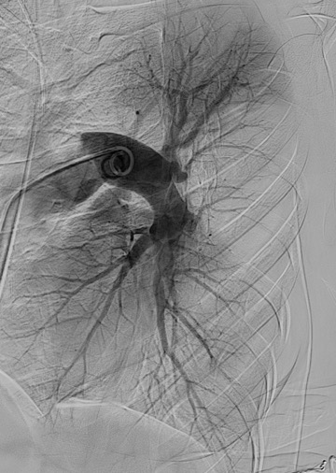
Case 1
Young patient, central disease with large perfusion defects
Right lung RAO
Right lung LAO
Left lung RAO
Right lung RAO

Slide 12
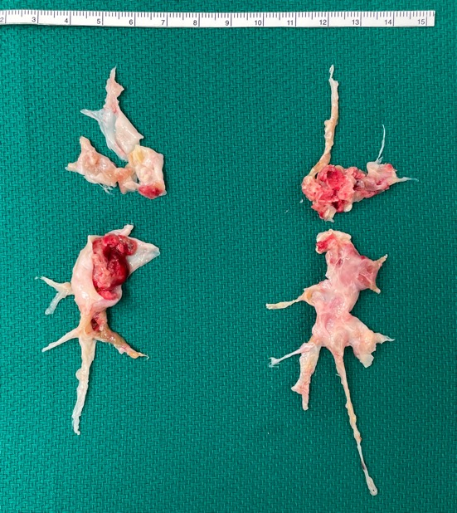
Case 1
Extubated post-operative day 1
Post-operative day 3 working with PT/OT and wonders if her symptoms were ever due to multiple sclerosis
PVR 480 dyn-s-cm5 – 216 dyn-s-cm5
Discharged

Slide 13
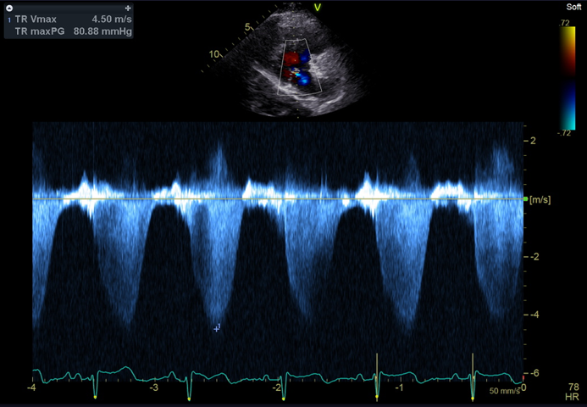
Case 2
80-year-old woman with history of remote PE presents with dizziness and recurrent syncope
Echo: RV dilation; estimated PASP 89 mmHg
Right heart catheterization:
RA 20
PA 110/40 (65)
Wedge 12
Cardiac output/index (thermo) 2.13 / 1.3
PVR 1990 dyn-s-cm⁵

Slide 14
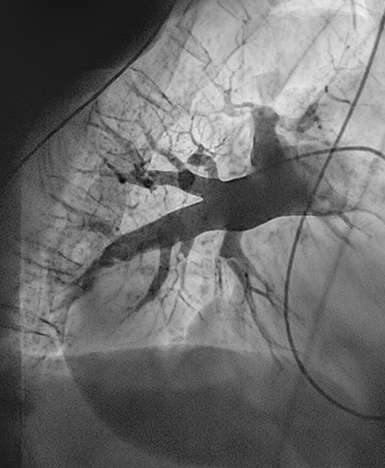
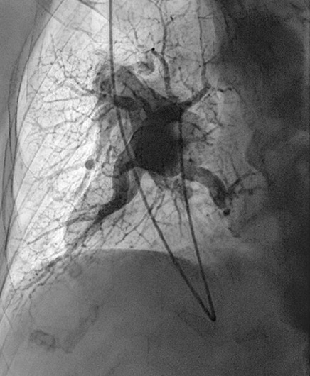
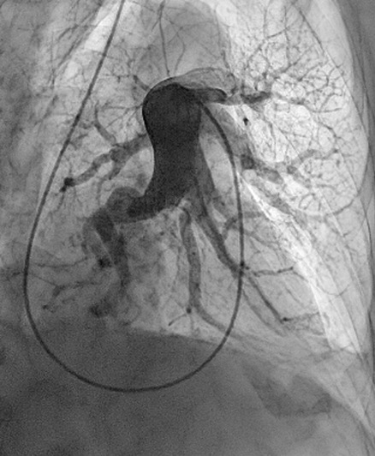
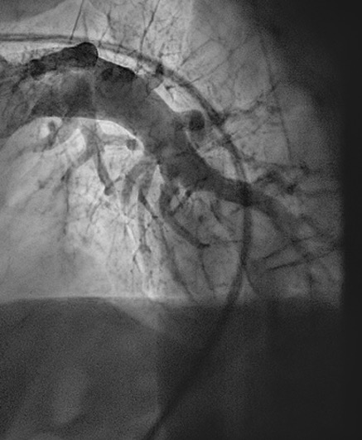
Case 2
Young patient, central disease with large perfusion defects
Right lung RAO
Right lung LAO
Left lung RAO
Right lung RAO

Slide 15
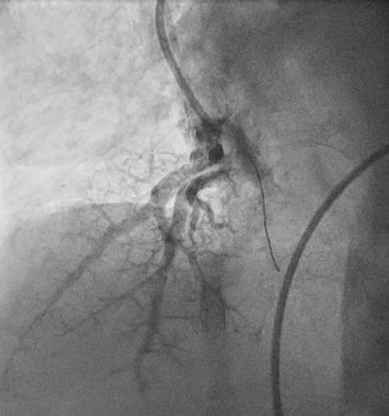
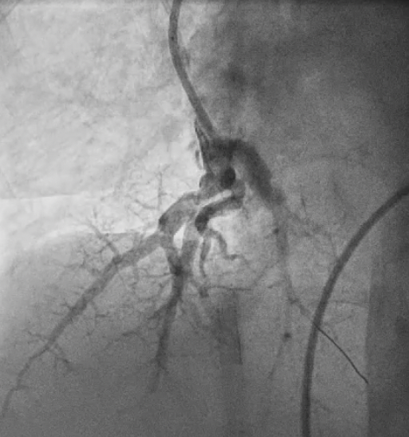
Case 2

Slide 16
Case 2
4 Sessions
Right heart catheterization:
RA 20
PA 110/40 (65)
Wedge 12
Cardiac output/index (thermo)
2.13 / 1.3
PVR 1990 dyn-s-cm⁵
Right heart catheterization:
RA 10
PA 90/35 (57)
Wedge 11
Cardiac output/index (thermo)
2.67 / 1.87
PVR 1378 dyn-s-cm⁵

Slide 17
BPA and PTE Papers by Year

Slide 18
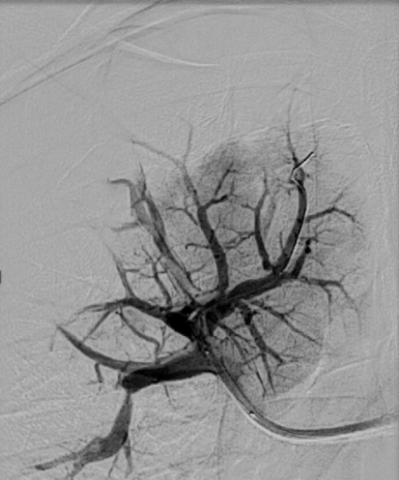
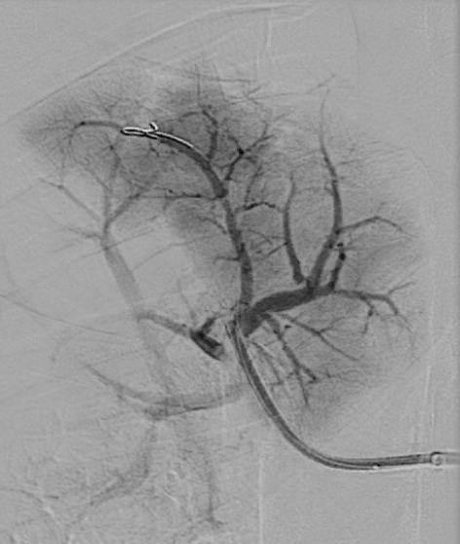
Case 3
Very distal disease not accessible to the surgeon

Slide 19
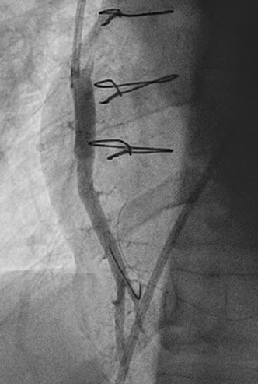
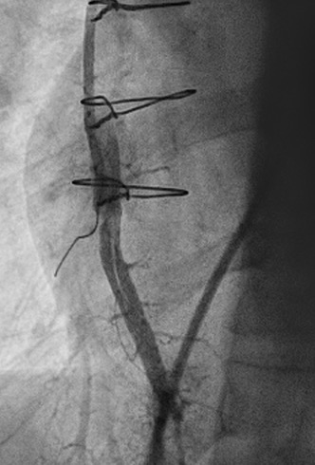
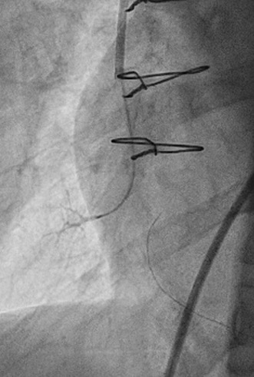
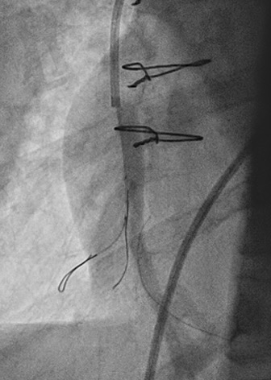
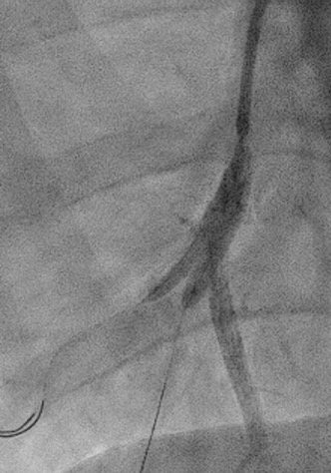
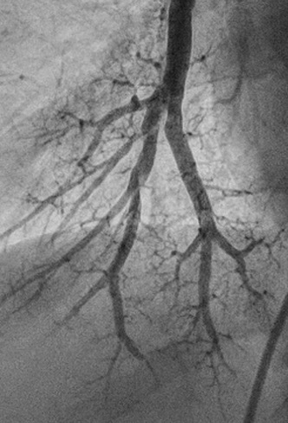
Case 4
Complete Total Occlusions

Slide 20
Mechanics of Balloon Pulmonary Angioplasty (BPA)
6F-9F short sheath
Angled pigtail catheter
70cm sheath
MP, JR4, AL1 Guide
DSA thorax 6fps versus fluoroscopy
Conscious sedation
Treat 1-2 segments in a session for 2-8 sessions
Possibly continued anticoagulation versus minimal time off for procedure
Observation with same day discharge or overnight
+/- CXR next morning

Slide 21
Balloon Pulmonary Angioplasty Outcomes (Single Center)
Median reduction
PVR 604 → 329 dyn-s-cm5
Significant reduction in heart failure symptoms
Median 6-minute walk increase 396 to 441 m
Mortality less than 4%

Slide 22
BPA After Pulmonary Thromboendarterectomy

Slide 23
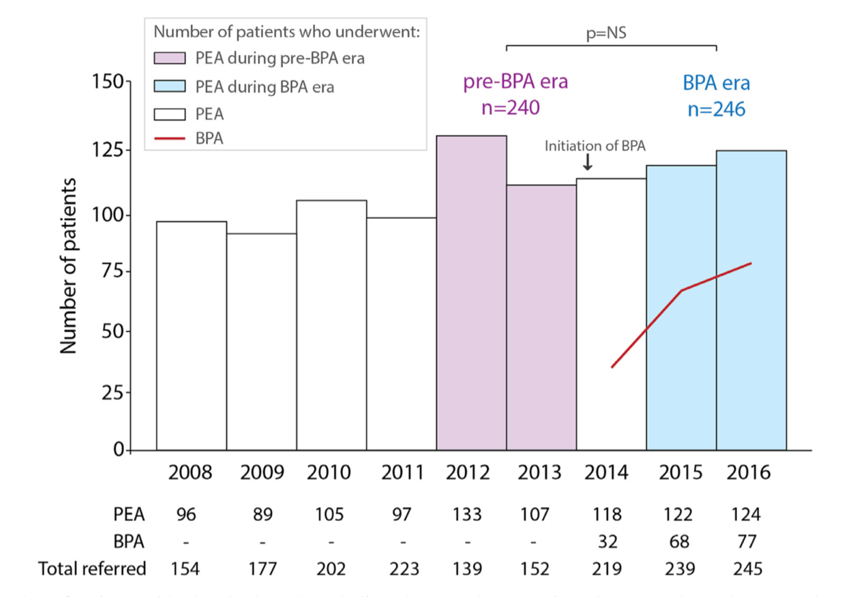
BPA Impact on PTE Surgical Volumes

Slide 24
Appropriate Candidates for Intervention
CTEPH/CTED
Diagnosis
Operability assessment
Technically operable
Technically inoperable
Unacceptable risk/benefit ratio
Targeted drug therapy
Balloon pulmonary angioplasty
Pulmonary endarterectomy
Persistent symptoms
Lung transplant
Wilkens, et al. IJC 272 2018: 69–7

Slide 25
Outstanding Questions
Is BPA a treatment pathway for patients with chronic thromboembolic disease who do not have pulmonary hypertension?
1-2 segmental disease with CPET proven vascular limitation?
Medicine before balloon pulmonary angioplasty versus initiation together
Balloon pulmonary angioplasty before pulmonary endarterectomy for distal disease - unlikely

Slide 26
Looking for more resources on this topic?
CME/CE in minutes
Congress highlights
Late-breaking data
Quizzes
Webinars
In-person events
Slides & resources
www.MedEdOTG.com

