Slide 1
Can You Use a Dual Checkpoint Inhibitor Regimen in an Unfit Patient With BRAF WT Metastatic Melanoma?
Jason J. Luke, MD, FACP
Interim Associate Director for Clinical Research
Director - Immunotherapy and Drug Development Center
Associate Professor of Medicine
UPMC Hillman Cancer Center and University of Pittsburgh
Pittsburgh, PA
Elizabeth Buchbinder, MD
Assistant Professor
Dana-Farber Cancer Institute
Harvard Medical School
Boston, MA

Slide 2



Resource Information
About This Resource
These slides are one component of a continuing education program available online at MedEd On The Go titled Metastatic Melanoma: Solving Clinical Dilemmas in Frontline ICI Treatment
Program Learning Objectives:
Review the risks and benefits of dual immune checkpoint inhibition and identify patient and disease characteristics that may impact the choice of therapy
Use data to determine optimal treatment sequencing for BRAF-mutated, metastatic melanoma
Review clinical challenges surrounding the use of immune checkpoint inhibitors in metastatic melanoma
MedEd On The Go®
www.mededonthego.com
This content or portions thereof may not be published, posted online or used in presentations without permission.
This content can be saved for personal use (non-commercial use only) with credit given to the resource authors.
To contact us regarding inaccuracies, omissions or permissions please email us at support@MedEdOTG.com

Slide 3
Disclaimer
The views and opinions expressed in this educational activity are those of the faculty and do not necessarily represent the views of Total CME, LLC, the CME providers, or the companies providing educational grants. This presentation is not intended to define an exclusive course of patient management; the participant should use their clinical judgment, knowledge, experience, and diagnostic skills in applying or adopting for professional use any of the information provided herein. Any procedures, medications, or other courses of diagnosis or treatment discussed or suggested in this activity should not be used by clinicians without evaluation of their patient's conditions and possible contraindications or dangers in use, review of any applicable manufacturer’s product information, and comparison with recommendations of other authorities. Links to other sites may be provided as additional sources of information.

Slide 4
An Unfit Patient With BRAF Wild-Type (WT) Metastatic Melanoma
72-year-old man with a previous medical history of deformative arthritis who lives alone and presents with back pain
Upon exam is found to have a T4b primary on the upper back
Imaging shows metastatic disease in multiple vertebrae as well as nodal chains
Biopsy of a node identifies BRAF WT, NRAS Q61K, PD-L1 negative
Patient is able to complete activities of daily living but not able to work in his tool garage as he used to do

Slide 5
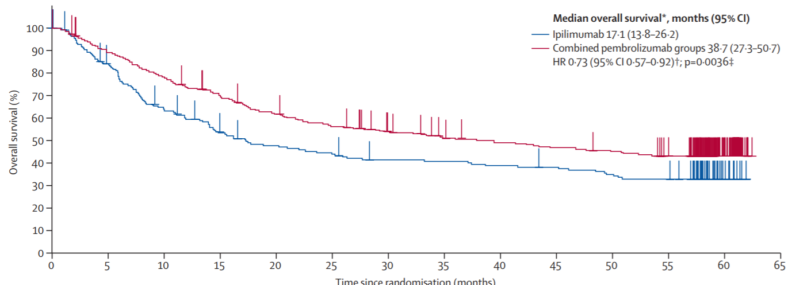
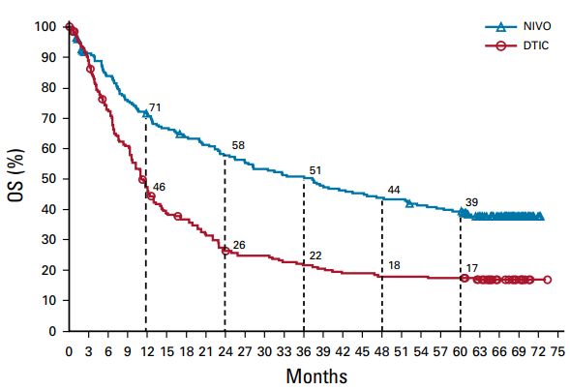
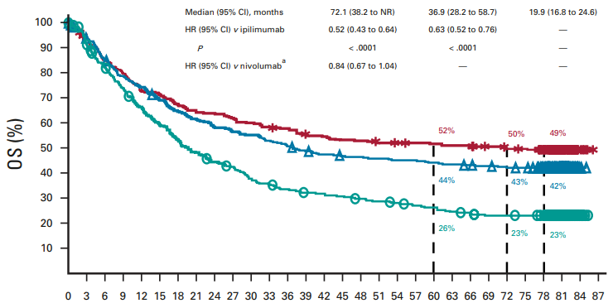
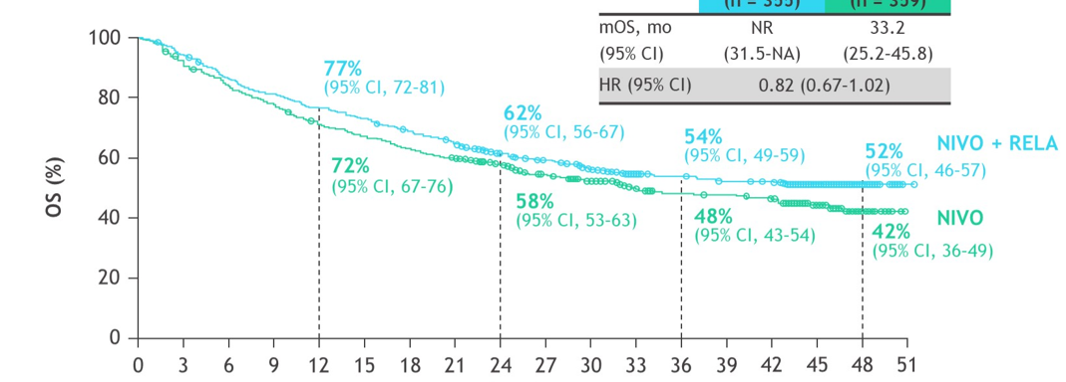
OS with Single Agent & Dual Agent Immune Checkpoint Inhibition
KEYNOTE-006
CheckMate-066
PEMBRO
IPI
Time since randomization (months)
CheckMate-067
RELATIVITY-047
NIVO/IPI
NIVO
IPI
Months

Slide 6
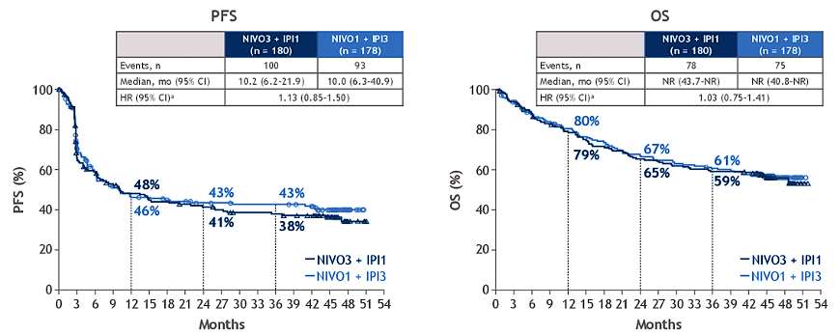
Checkmate 511: NIVO+IPI 1 mg/kg or IPI 3 mg/kg
*Flipped dose IPI1/NIVO3: Grade III/IV toxicity rate of 34% compared to 48% with NIVO1/IPI3

Slide 7
Checkmate 511: NIVO+IPI 1 mg/kg or IPI 3 mg/kg Safety Comparison Safety Summary
TRAE | NIVO3 + IPI1 (n = 180) | NIVO1 + IPI3 (n = 178)
Grade 3-5 TRAEs, n (%) | 61 (34) | 86 (48)
Difference (95% CI) P value (descriptive) | -14.4% (-24.5 to -4.3) 0.0059 | to -4.3)
TRAEs, n (%) Grade 3-4 Grade 5 | 60 (33) 1 (1)ª | 86 (48) 0
Treatment-related serious AEs, n (%) Grade 3-4 Grade 5 | 35 (19) 1 (1)ª | 60 (34) 0
TRAEs leading to discontinuation, n (%) Grade 3-4 Grade 5 | 43 (24) 30 (17) 1 (1)ª | 60 (34) 50 (28) 0
The most common TRAEs in both groups were diarrhea, fatigue, and pruitus

Slide 8
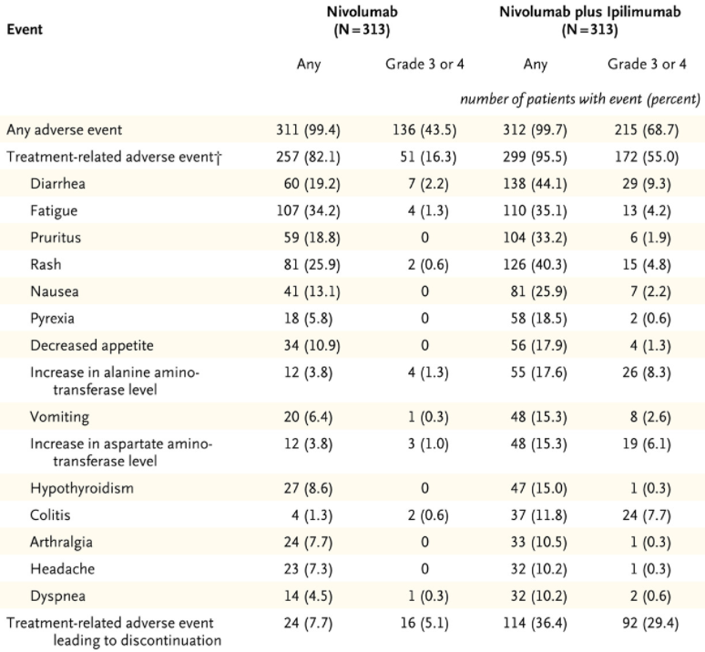
Toxicity of RELA+NIVO Similar to that Seen with NIVO in CheckMate-067
AE, n (%) | NIVO + RELA (n = 355) | (n = 355) | NIVO (n = 359) | 359)
AE, n (%) | Any grade | Grade 3-4 | Any grade | Grade 3-4
Any AE | 352 (99) | 161 (45) | 344 (96) | 139 (39)
TRAE | 301 (85) | 78 (22) | 262 (73) | 43 (12)
Leading to discontinuation | 61 (17) | 34 (10) | 31 (9) | 14 (4)
Treatment-related deaths | 4 (1) | (1) | 2 (1) | (1)

Slide 9
An Unfit Patient With BRAF Wild-Type (WT) Metastatic Melanoma
72-year-old man with a previous medical history of deformative arthritis who lives alone and presents with back pain
Upon exam is found to have a T4b primary on the upper back
Imaging shows metastatic disease in multiple vertebrae as well as nodal chains
Biopsy of a node identifies BRAF WT, NRAS Q61K, PD-L1 negative
Patient is able to complete activities of daily living but not able to work in his tool garage as he used to do

Slide 10



Looking for more resources on this topic?
CME/CE in minutes
Congress highlights
Late-breaking data
Quizzes
Webinars
In-person events
Slides & resources
www.MedEdOTG.com

