Slide 1
How Does Symptom Severity Influence Choice of Frontline Therapy for a Patient with BRAF-Mutated Metastatic Melanoma?
Jason J. Luke, MD, FACP
Interim Associate Director for Clinical Research
Director - Immunotherapy and Drug Development Center
Associate Professor of Medicine
UPMC Hillman Cancer Center and University of Pittsburgh
Pittsburgh, PA
Elizabeth Buchbinder, MD
Assistant Professor, Dana-Farber Cancer Institute
Harvard Medical School
Boston, MA

Slide 2
Resource Information
About This Resource
These slides are one component of a continuing education program available online at MedEd On The Go titled Metastatic Melanoma: Solving Clinical Dilemmas in Frontline ICI Treatment
Program Learning Objectives:
Review the risks and benefits of dual immune checkpoint inhibition and identify patient and disease characteristics that may impact the choice of therapy
Use data to determine optimal treatment sequencing for BRAF-mutated, metastatic melanoma
Review clinical challenges surrounding the use of immune checkpoint inhibitors in metastatic melanoma
MedEd On The Go®
www.mededonthego.com
This content or portions thereof may not be published, posted online or used in presentations without permission.
This content can be saved for personal use (non-commercial use only) with credit given to the resource authors.
To contact us regarding inaccuracies, omissions or permissions please email us at support@MedEdOTG.com

Slide 3
Disclaimer
The views and opinions expressed in this educational activity are those of the faculty and do not necessarily represent the views of Total CME, LLC, the CME providers, or the companies providing educational grants. This presentation is not intended to define an exclusive course of patient management; the participant should use their clinical judgment, knowledge, experience, and diagnostic skills in applying or adopting for professional use any of the information provided herein. Any procedures, medications, or other courses of diagnosis or treatment discussed or suggested in this activity should not be used by clinicians without evaluation of their patient's conditions and possible contraindications or dangers in use, review of any applicable manufacturer’s product information, and comparison with recommendations of other authorities. Links to other sites may be provided as additional sources of information.

Slide 4
A Patient with BRAF-Mutated Metastatic Melanoma
58-year-old man admitted with confusion and observed on MRI to have a parietal mass
Resection shows melanoma, BRAFV600E
Systemic imaging showing metastases in multiple nodes, liver, and bone
LDH is 2x ULN
Patient follows up as an outpatient and is observed to have lost 20 lbs. in past two months but still plans to return to work full time

Slide 5
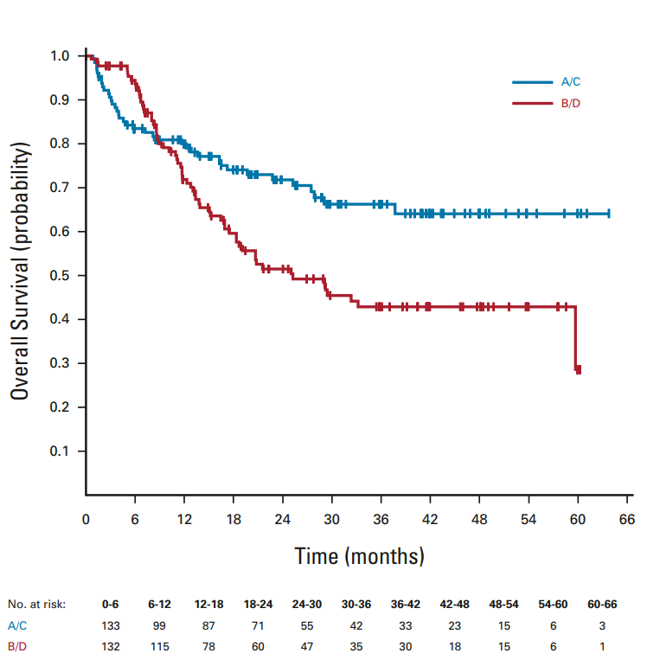
PD-1 + CTLA4 Superior to BRAF-MEK in Frontline Melanoma

Slide 6
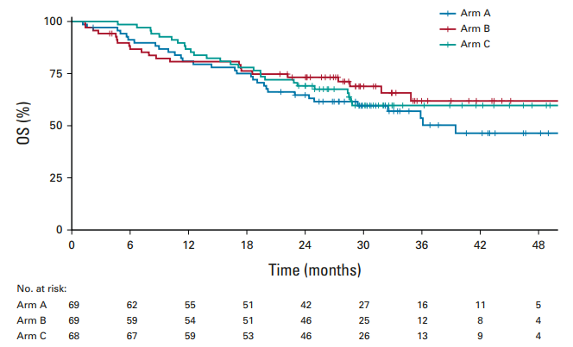
Sequential Combo Immuno- and Targeted Therapy (SECOMBIT)
ARM A: Enco/Bini PD → Ipi/Nivo
ARM B: Ipi/Nivo PD → Enco/Bini
ARM C: Enco/Bini (8 weeks) → Ipi/Nivo PD → Enco/Bini

Slide 7
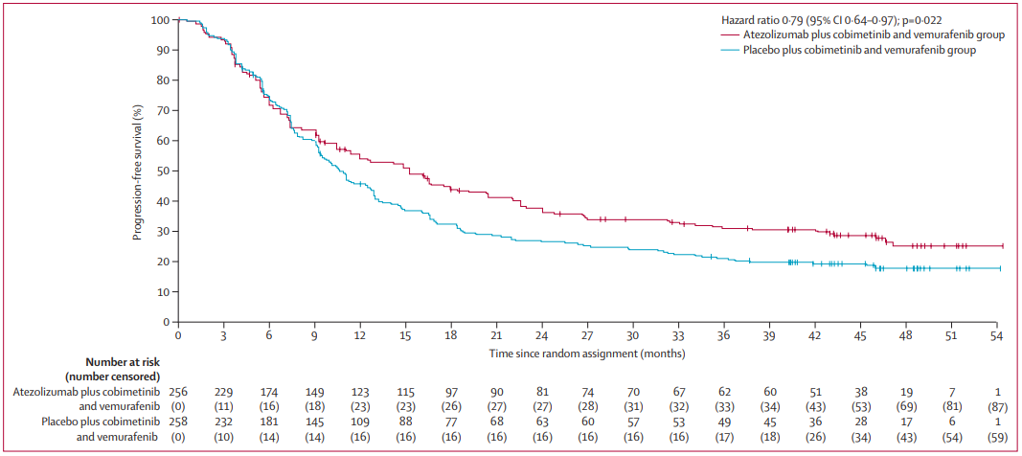
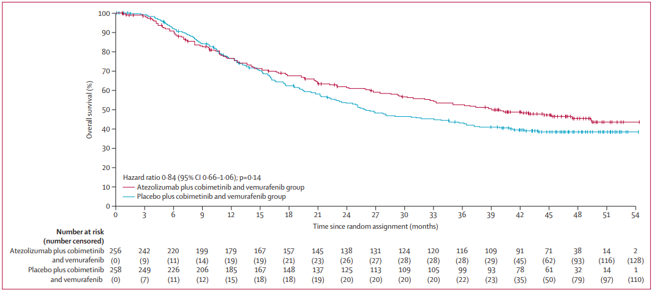
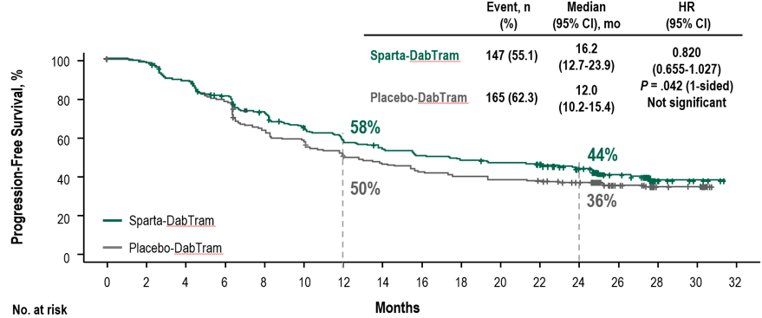
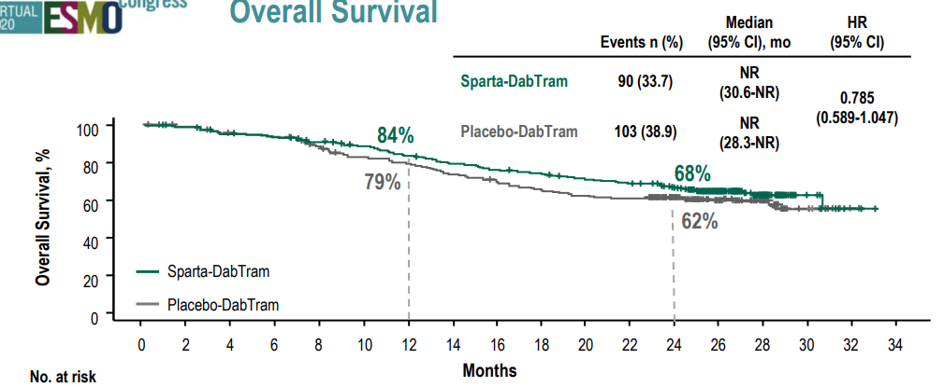
Triplet BRAF + MEK + PD-1/L1 Combos
IMspire150: Primary End Point: Investigator-Assessed PFS
IMspire150: Overall Survival
Assessed by investigator | Atezo+Cobi+ Vem | Pbo+Cobi+ Vem
PFS, median months (95% CI) | 15.1 (11.4-18.4) | 10.6 (9.3-12.7)
 | Atezo+Cobi+ Vem | Pbo+Cobi+ Vem
OS, median months (95% CI) | 39.0 (29.9-not estimable) | 25.8 (22.0-34.9)
COMBI-I

Slide 8
Start Directly with Immunotherapy?
Anti-PD-1 monotherapy?
Anti-PD-1 + low versus regular dose ipilimumab?
Anti-PD-1 + relatlimab?
Delivers most of the benefit of combination and least toxicity
Maximizes potential for long-term response but risks more toxicity
Appears to enhance response but less clear whether efficacy extends to higher risk disease and if responses will be as durable as PD-1 + CTLA4

Slide 9
Looking for more resources on this topic?
CME/CE in minutes
Congress highlights
Late-breaking data
Quizzes
Webinars
In-person events
Slides & resources
www.MedEdOTG.com

