Slide 1
How Does Real-World Evidence Expand Understanding of CDK4/6 Inhibitor Use in Special Populations With HR+/HER2- Metastatic Breast Cancer?
Adam Brufsky, MD, PhD
Professor of Medicine
Co-Director, Comprehensive Breast Cancer Center
University of Pittsburgh Cancer Institute
Pittsburgh, Pennsylvania

Slide 2
Disclaimer
The views and opinions expressed in this educational activity are those of the faculty and do not necessarily represent the views of TotalCME, Inc., the CME providers, or the companies providing educational grants. This presentation is not intended to define an exclusive course of patient management; the participant should use their clinical judgment, knowledge, experience, and diagnostic skills in applying or adopting for professional use any of the information provided herein. Any procedures, medications, or other courses of diagnosis or treatment discussed or suggested in this activity should not be used by clinicians without evaluation of their patient's conditions and possible contraindications or dangers in use, review of any applicable manufacturer’s product information, and comparison with recommendations of other authorities. Links to other sites may be provided as additional sources of information.

Slide 3
RWE to Address Populations Not Included in Clinical Trials
Male breast cancer patients
Asians
African Americans

Slide 4
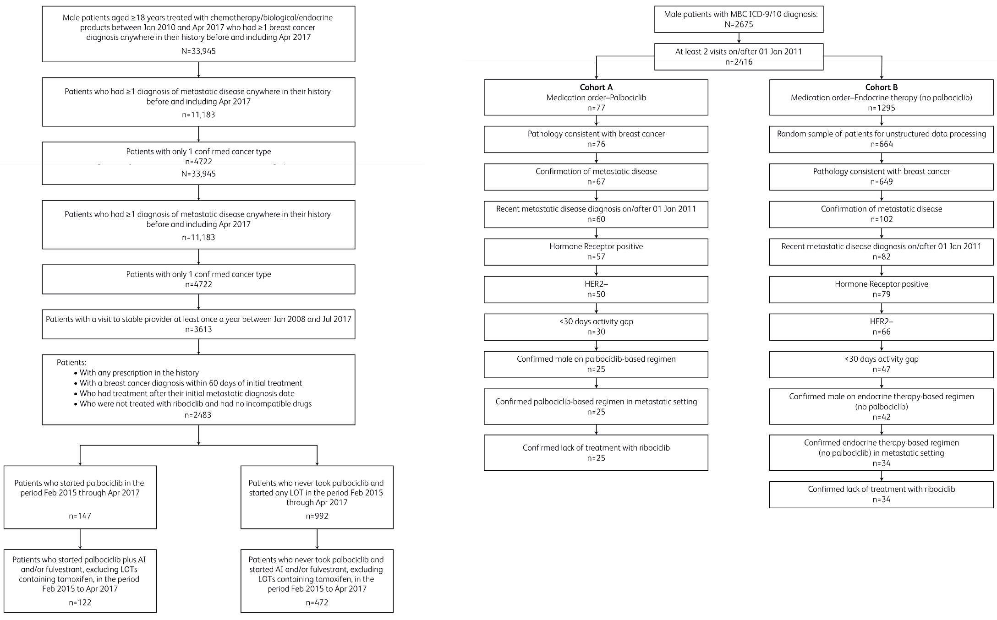
Real-World Data of Palbociclib in Combination with Endocrine Therapy for the Treatment of Metastatic Breast Cancer in Men: Cohort Selection
a)
b)

Slide 5
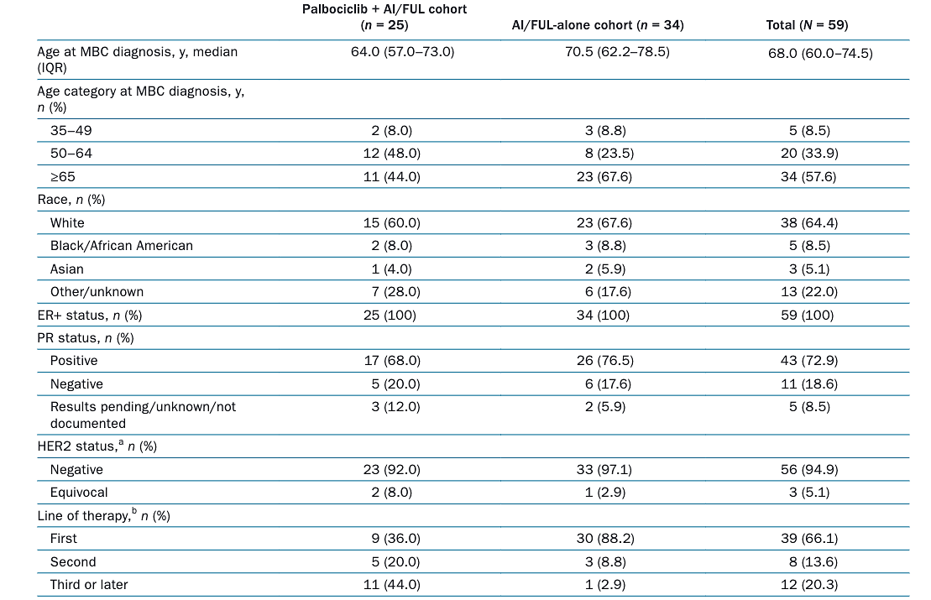
Baseline Demographics and Disease Characteristics of Patients in the EHR-Derived Database

Slide 6
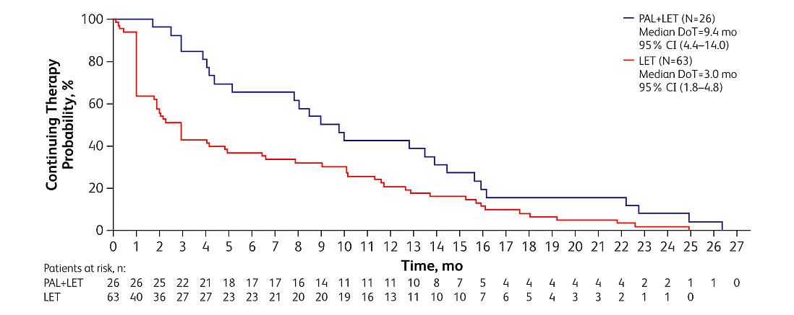
Duration of Therapy in the First-Line Setting
Pharmacy and medical records database.
Kaplan-Meier plot of duration of therapy in the first-line setting comparing PAL + LET with LET alone.

Slide 7
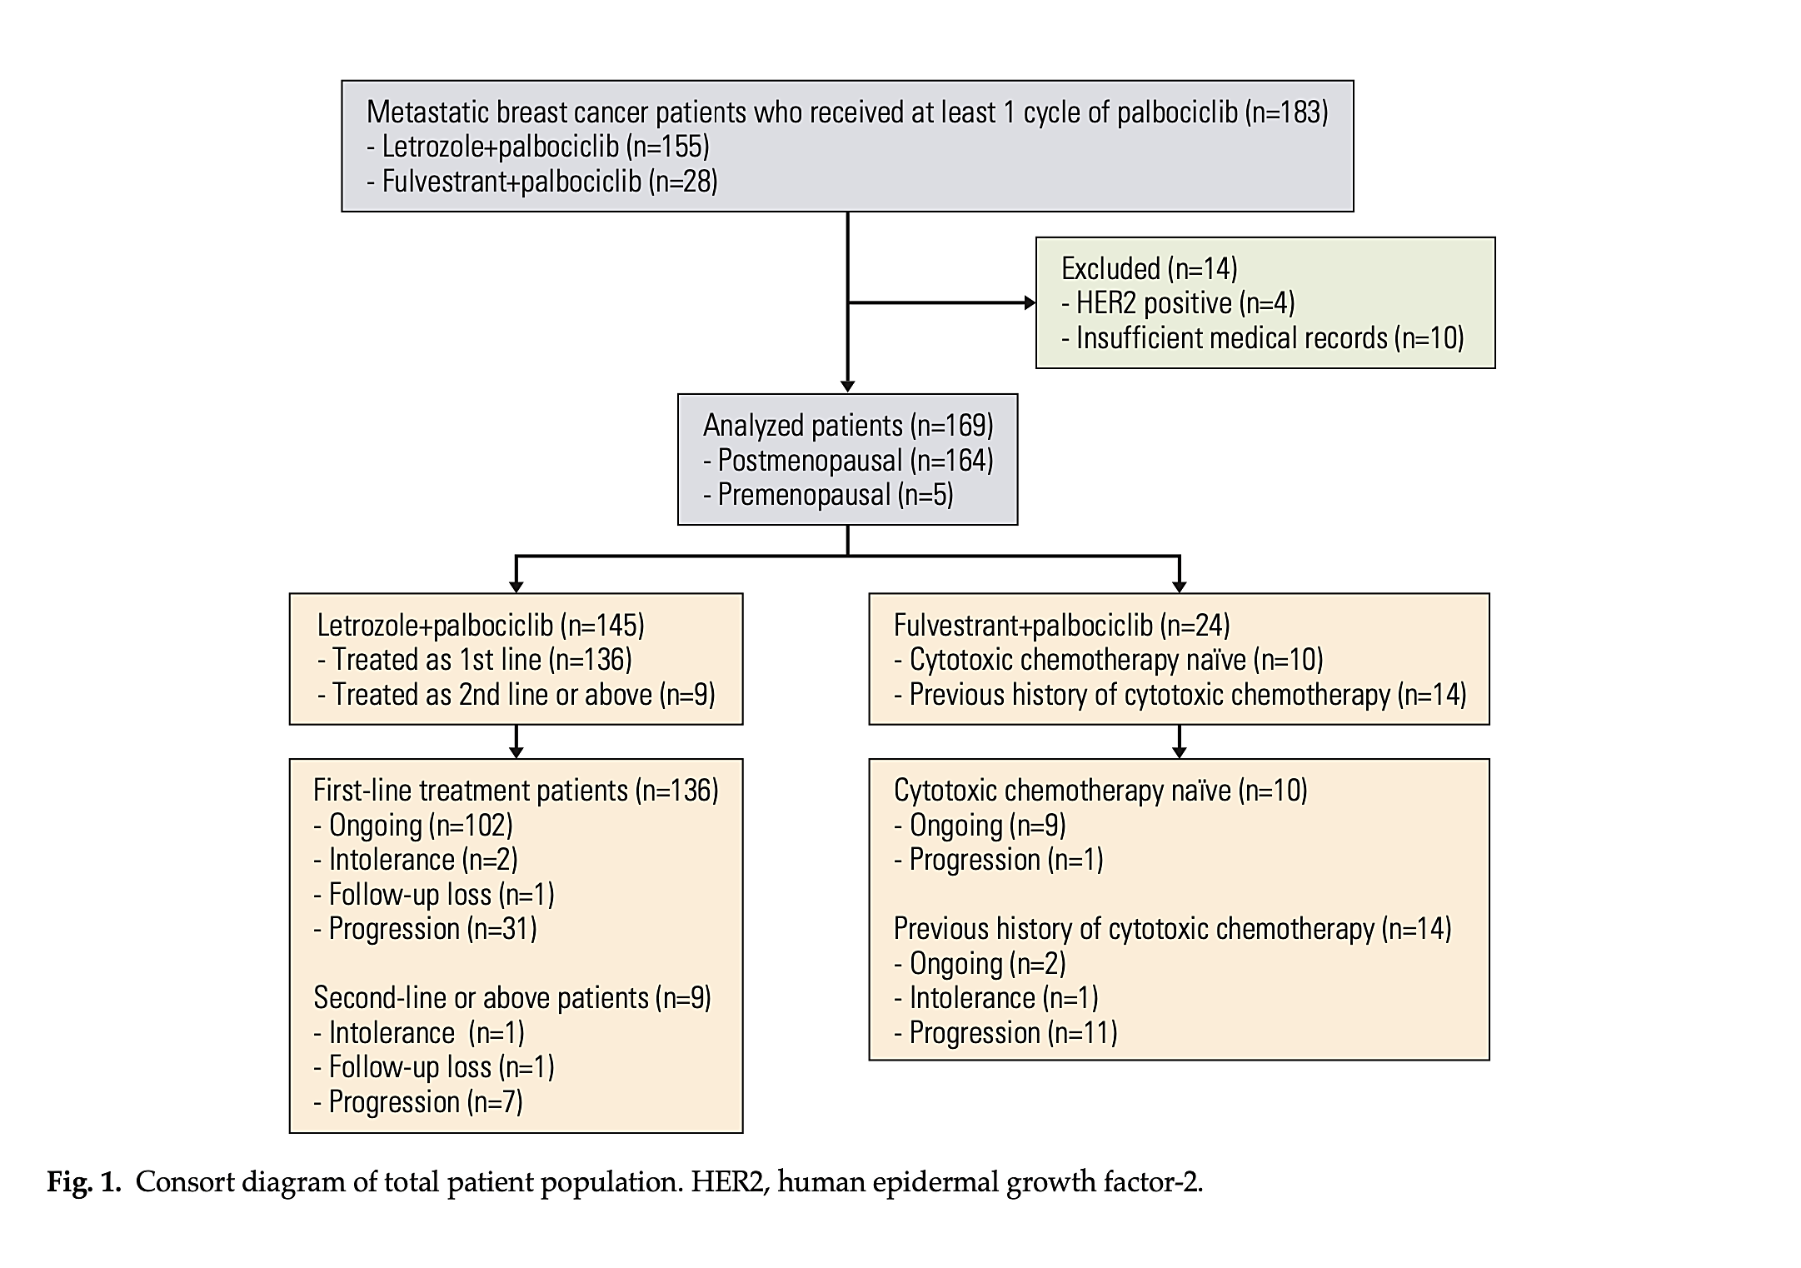
Real-World Clinical Data of Palbociclib in Asian MBC Patients: Experiences from Eight Institutions

Slide 8
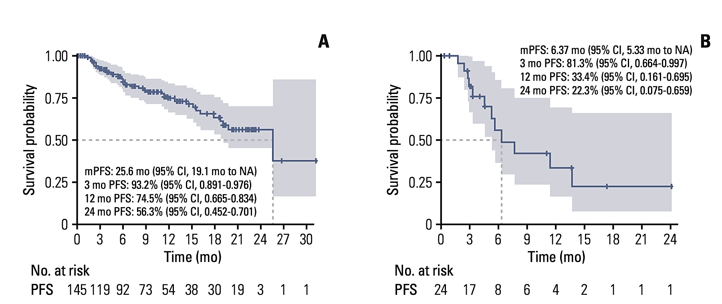
Progression-Free Survival

Slide 9
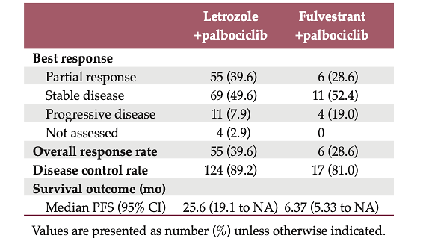
Best Overall Response In Patients with Measurable Disease

Slide 10
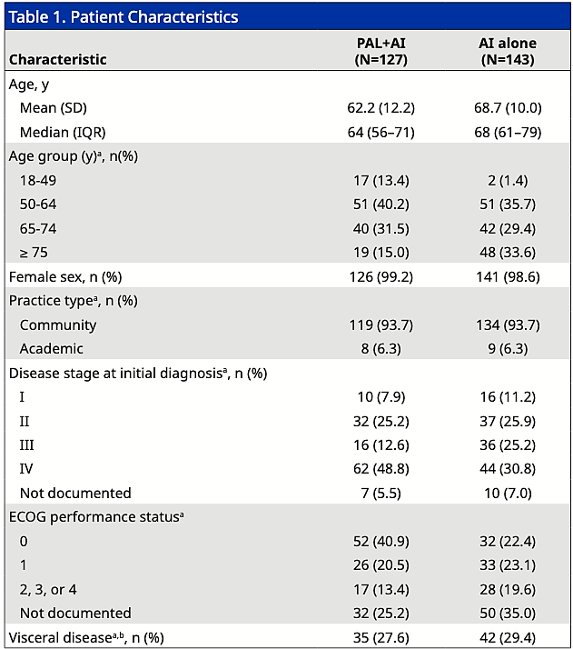
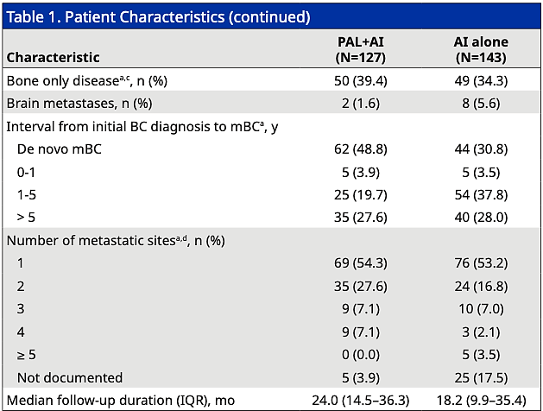
Real-World Effectiveness of Palbociclib Plus Aromatase Inhibitors in African American Patients with MBC

Slide 11
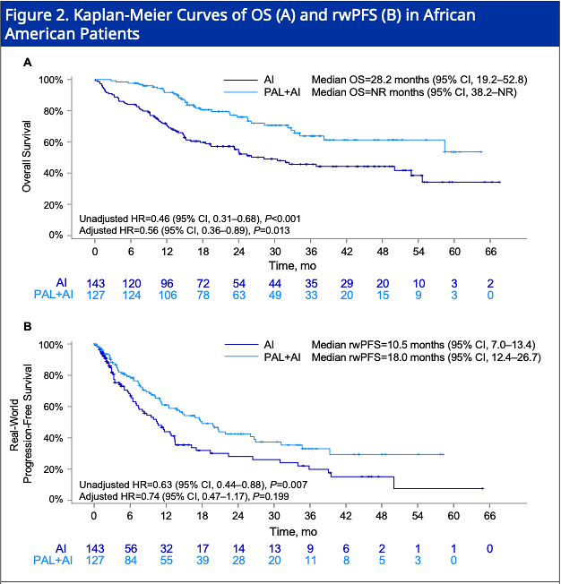
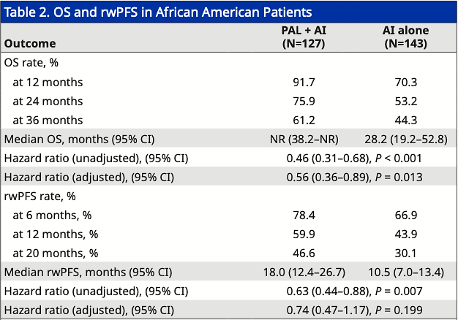
Survival Outcomes

Slide 12
Real-World Evidence in Special Populations
RWE helps with understanding CDK4/6 in special populations
HR consistent with RCTs in all scenarios
Absolute PFS consistent with RCT data for Asians and AAs
Data can be used for shared decision making

