Slide 1
What Is the Latest Real-World Evidence for CDK4/6 Inhibitors in Metastatic HR+ Breast Cancer?
Hope S. Rugo, MD
Professor of Medicine
Director, Breast Oncology and Clinical Trials Education
University of California San Francisco Comprehensive Cancer Center
San Francisco, California

Slide 2
Disclaimer
The views and opinions expressed in this educational activity are those of the faculty and do not necessarily represent the views of TotalCME, Inc., the CME providers, or the companies providing educational grants. This presentation is not intended to define an exclusive course of patient management; the participant should use their clinical judgment, knowledge, experience, and diagnostic skills in applying or adopting for professional use any of the information provided herein. Any procedures, medications, or other courses of diagnosis or treatment discussed or suggested in this activity should not be used by clinicians without evaluation of their patient's conditions and possible contraindications or dangers in use, review of any applicable manufacturer’s product information, and comparison with recommendations of other authorities. Links to other sites may be provided as additional sources of information.

Slide 3
Randomized Clinical Trials and Real-World Evidence Serve Different Purposes
RCT: Can the Drug Work?
RWE: Does the Drug Work?
Patient population selected by using strict inclusion and exclusion criteria
Protocol-driven treatment in an ‘ideal setting’ designed to meet the requirements of regulators and payers
Comparator and placebo may not reflect clinical practice
Intervention is strictly enforced and standardised
Diverse and nonselective populations with few to no exclusion criteria
Routine clinical practice
Comparator(s) of interest may reflect options used in clinical practice, not the comparators in clinical trials
Intervention is at the discretion of treating physician

Slide 4









Statistical Techniques to Address Inherent Bias in Non-Randomized Studies
The propensity score (PS) is the probability of a subject being assigned to a particular treatment given a set of observed key covariates (e.g., patient age or performance status) that may impact on this treatment decision
PS-based statistical approaches can be used to create balance between treatment groups in the absence of randomization
Inverse probability treatment weighting (IPTW)^{1–4}
Propensity score matching (PSM)¹
Aim: To adjust for differences in characteristics of study subjects by adjusting weighting assigned to variables
Goal: To create a pseudo-population that resembles a reference population
Advantages: Keep all eligible subjects​; can include more than two comparisons
Extreme weights: The use of stabilized weights can address extreme weight​ issues
Aim: To match patients across treatment
groups according to demographic and clinical characteristics
Goal: To compare patients with the same propensity score but who receive different treatments – similar to randomization in an RCT
Advantages: Treatment effects can be directly compared between matched patients

Slide 5
P-REALITY X: Palbociclib Real-World First-Line Comparative Effectiveness Study Extended
Objective
To evaluate the effectiveness of first-line PAL + AI, as compared with AI alone, in patients with HR+/HER2– MBC treated in real-world clinical practice in the United States
Method
  Retrospective, cohort analysis of electronic health records within the US Flatiron Health Analytic Database
Endpoints:
Primary - OS*
Secondary - rwPFS†
  KEY ELIGIBILITY CRITERIA
  Postmenopausal women and men aged ≥18 years with HR+/HER2‒ MBC (N = 2888)
  Index date i.e., start date of the first line MBC treatment (PAL plus AI or AI alone) from 03 February 2015 to 31 March 2020
  Follow up from index date to death, study end (data cut-off, 30 September 2020), or last visit, whichever occurred first
  Available for 6-month follow up
PAL+AI
(n=1,324)
  Statistical analyses:
  Unadjusted analyses were conducted first
  sIPTW, as the primary analysis, was performed to balance baseline demographic and clinical characteristics
  1:1 PSM was conducted in the sensitivity analysis
  Median survival times and 95% CIs for OS and rwPFS were estimated using the weighted Kaplan-Meier method
  Cox proportional hazards model was used to compute the HR and the corresponding 95% CI
AI
(n=1,564)

Slide 6
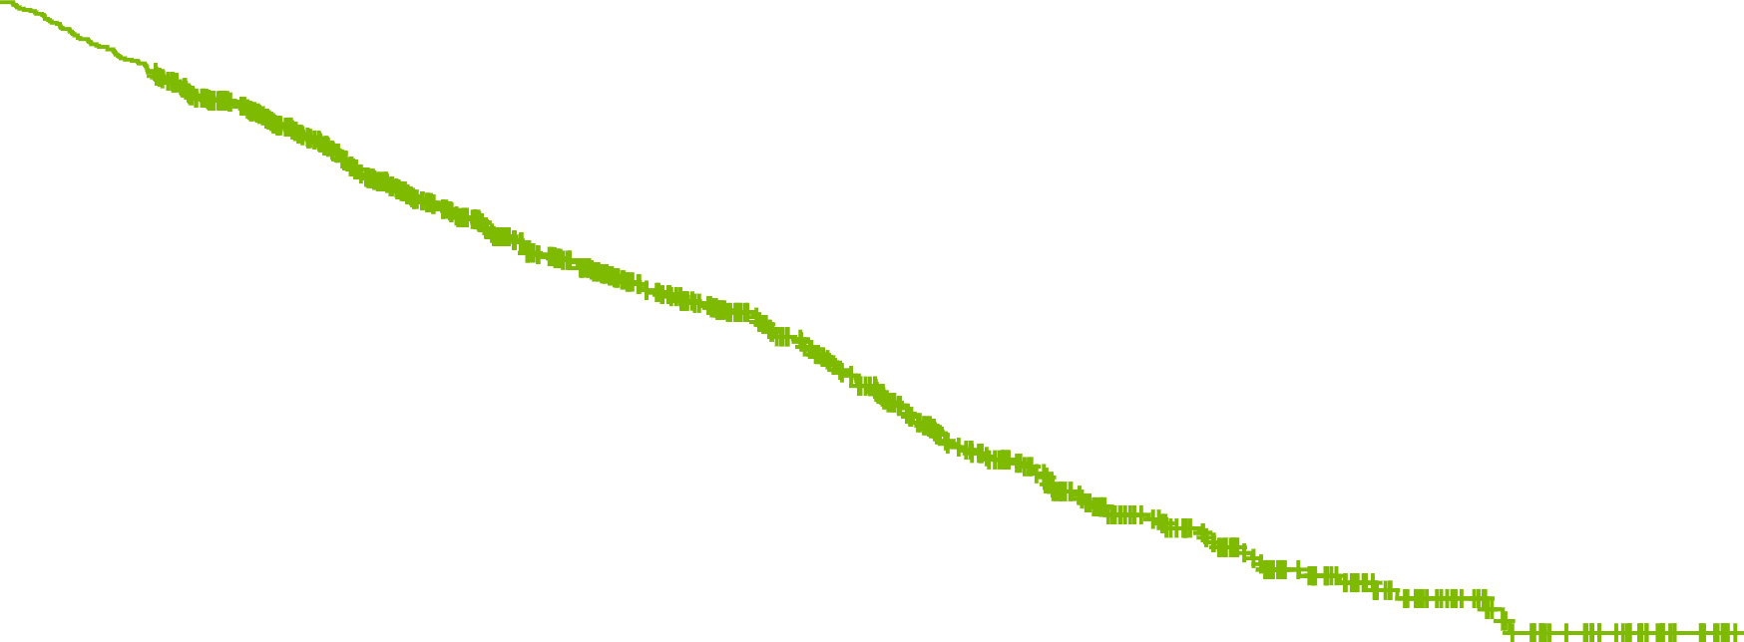
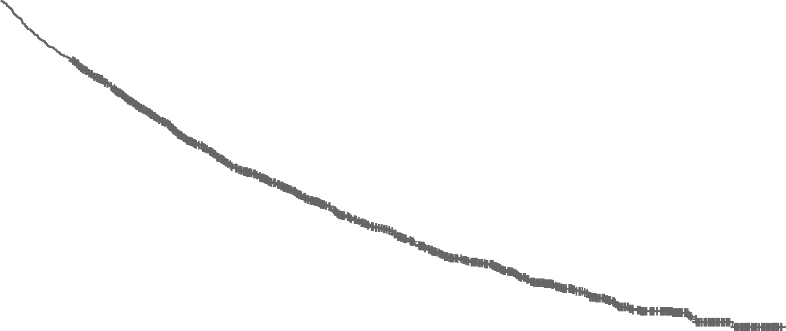
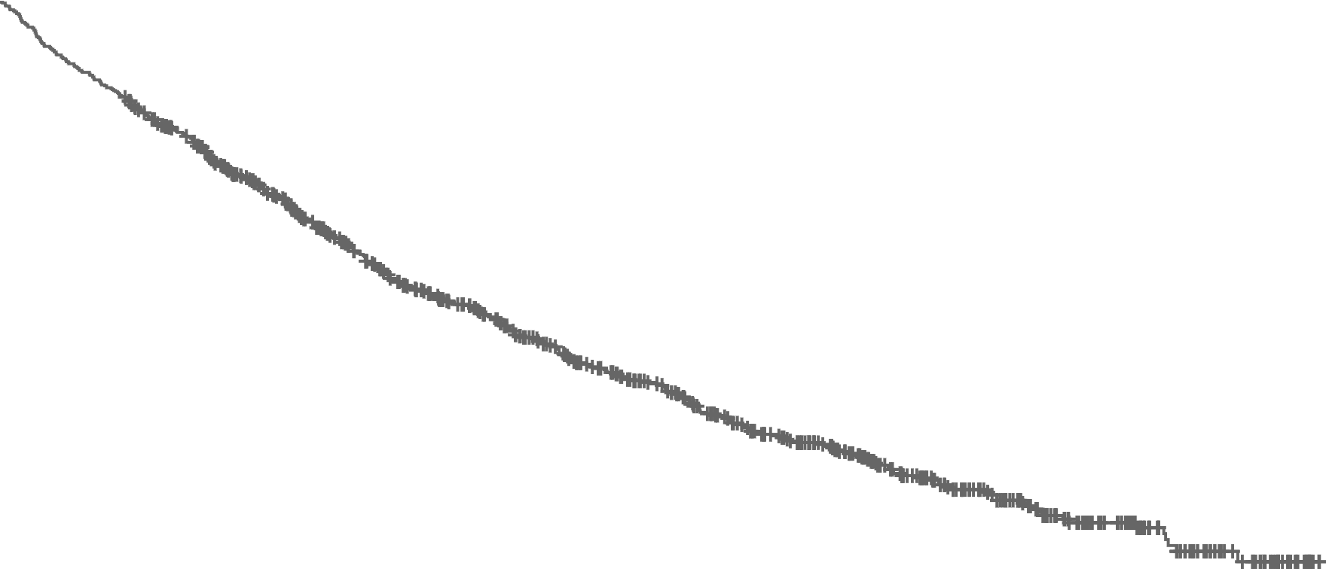
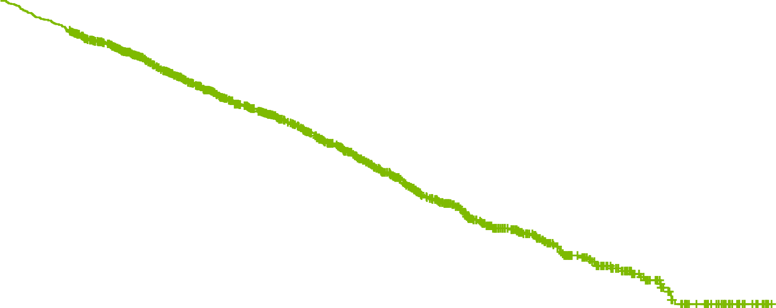

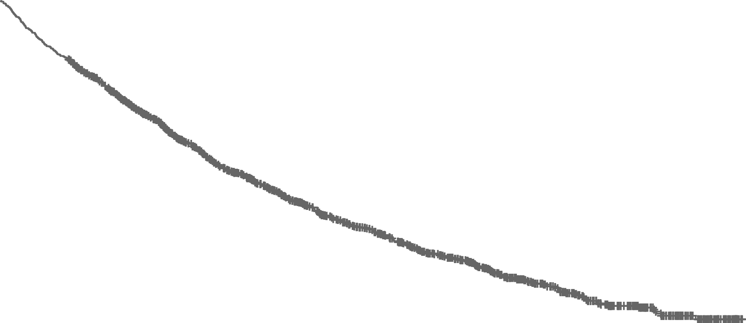
P-REALITY X:
Overall Survival Before and After sIPTW and PSM
Unadjusted analysis
Stabilized inverse probability of treatment weighting (sIPTW) analysis
Propensity score matching (PSM) analysis
100
100
100
80
80
80
60
60
60
Overall Survival (%)
Overall Survival (%)
Overall Survival (%)
40
 | PAL+ AI (N=1324) | AI (N=1564)
Median OS, months (95% CI) | 53.4 (48.7‒58.6) | 40.4 (36.3‒44.9)
HR=0.67 [95% CI: 0.60–0.76], P<0.0001 | HR=0.72 95% CI: 0.63–0.82 P<0.0001
40
 | PAL+ AI (N=1572) | AI (N=1137)
Median OS, months (95% CI) | 49.1 (45.2‒57.7) | 43.2 (37.6‒48.0)
HR=0.76 [95% CI: 0.65–0.87], P=0.0001 | HR=0.72 95% CI: 0.63–0.82 P<0.0001
40
 | PAL+ AI (N=939) | AI (N=939)
Median OS, months (95% CI) | 57.8 (47.2‒NE) | 43.5 (37.6‒48.9)
HR=0.72 [95% CI: 0.62–0.83], P<0.0001 | HR=0.72 95% CI: 0.63–0.82 P<0.0001
20
20
20
0
0
6
12
18
24
30
36
42
48
54
60
66
0
0
6
12
18
24
30
36
42
48
54
60
66
0
0
6
12
18
24
30
36
42
48
54
60
66
Time (months)
Time (months)
Time (months)
 | 1564 | 1390 | 1163 | 949 | 768 | 608 | 501 | 396 | 279 | 180 | 98 | 28
 | 1324 | 1251 | 1049 | 857 | 694 | 521 | 378 | 267 | 174 | 102 | 47 | 11
 | 1137 | 1014 | 852 | 697 | 577 | 463 | 380 | 299 | 210 | 135 | 73 | 21
 | 1572 | 1465 | 1214 | 988 | 775 | 588 | 435 | 296 | 192 | 112 | 53 | 14
 | 939 | 846 | 711 | 585 | 485 | 394 | 326 | 262 | 186 | 117 | 62 | 18
 | 939 | 884 | 731 | 579 | 450 | 349 | 261 | 184 | 122 | 76 | 40 | 11
 | PAL+ AI | AI
Median follow-up (IQR), months | 25.0 (13.8–38.3) | 23.3 (11.8–42.3)
 | PAL+ AI | AI
Median follow-up (IQR), months | 23.9 (12.8–38.0) | 24.5 (12.0–42.9)
 | PAL+ AI | AI
Median follow-up (IQR), months | 23.4 (13.1–37.8) | 24.9 (12.4–44.4)
Median OS* was significantly longer among patients who received PAL+ AI versus AI alone before and after sIPTW and PSM

Slide 7
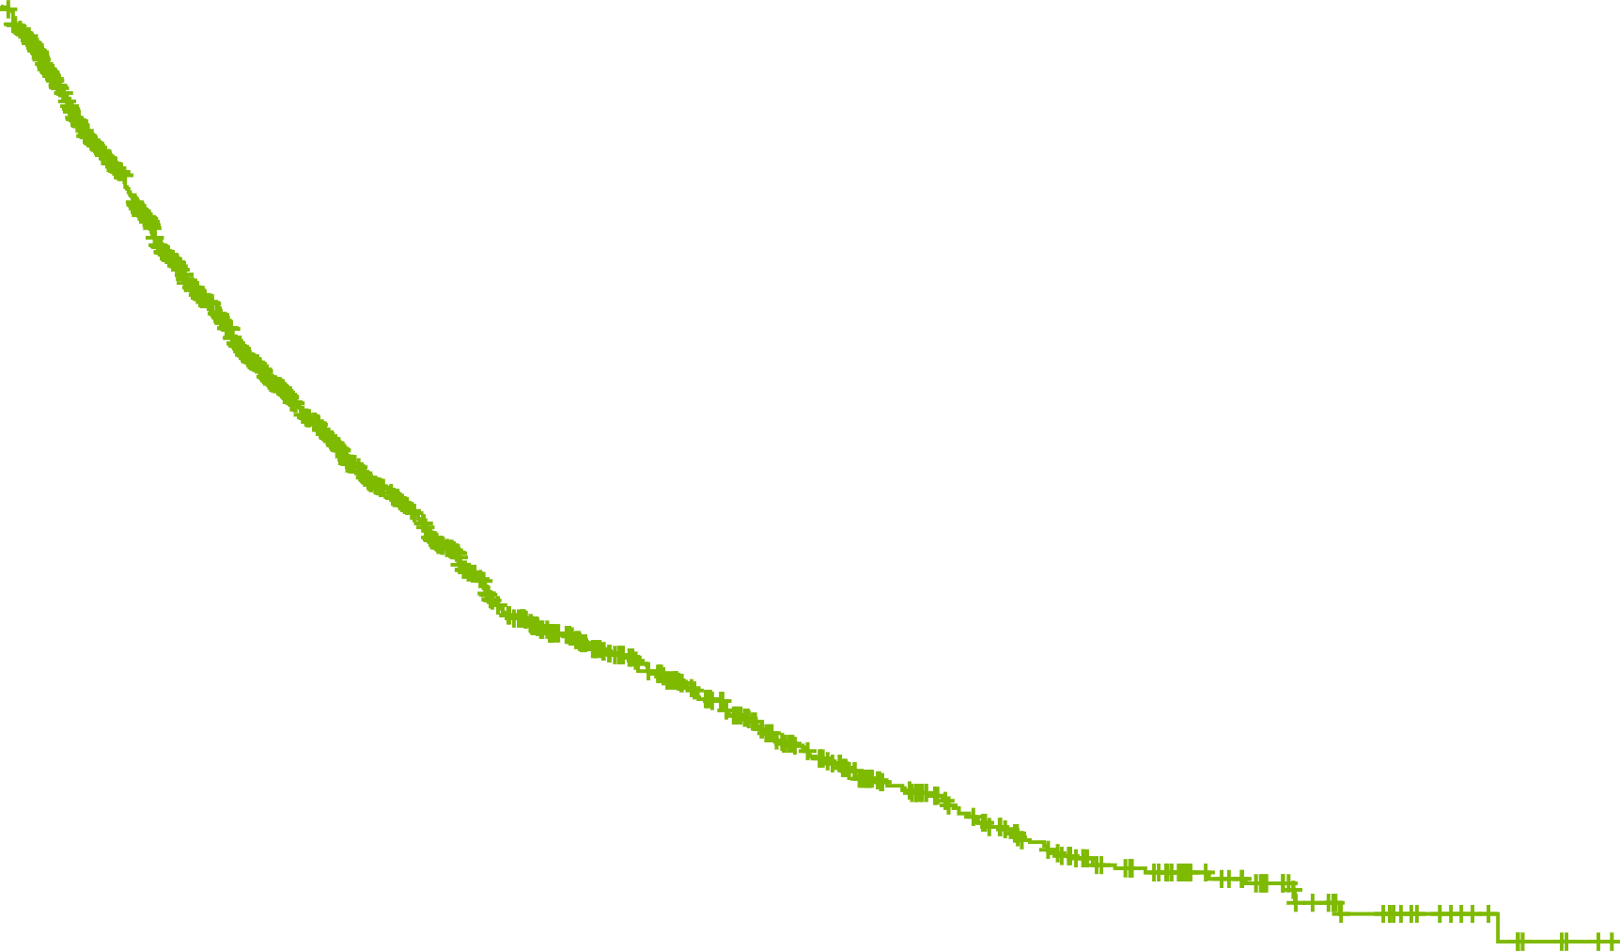
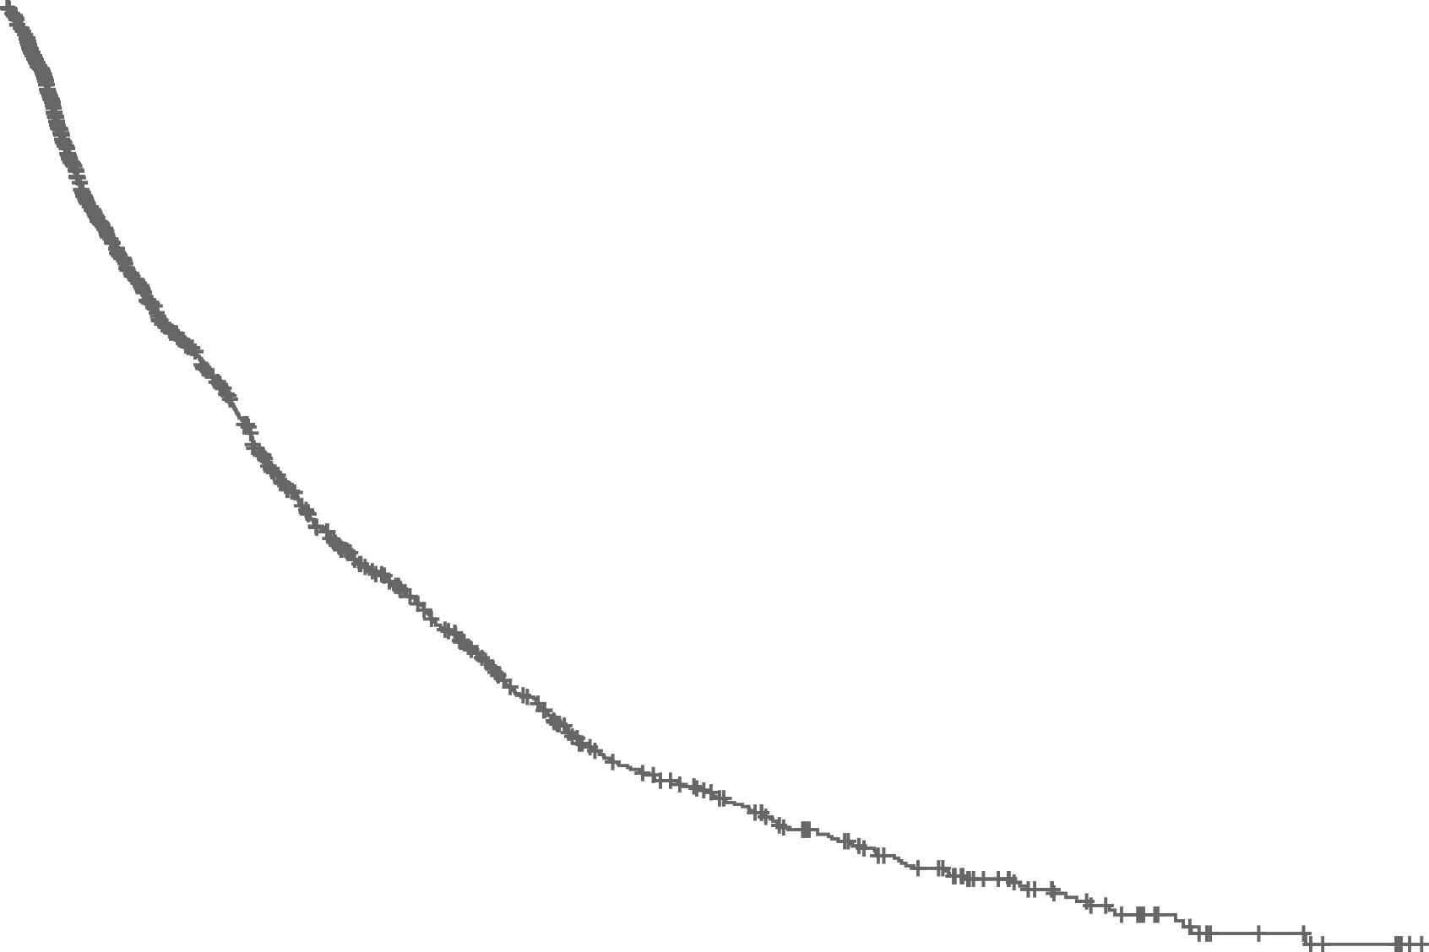
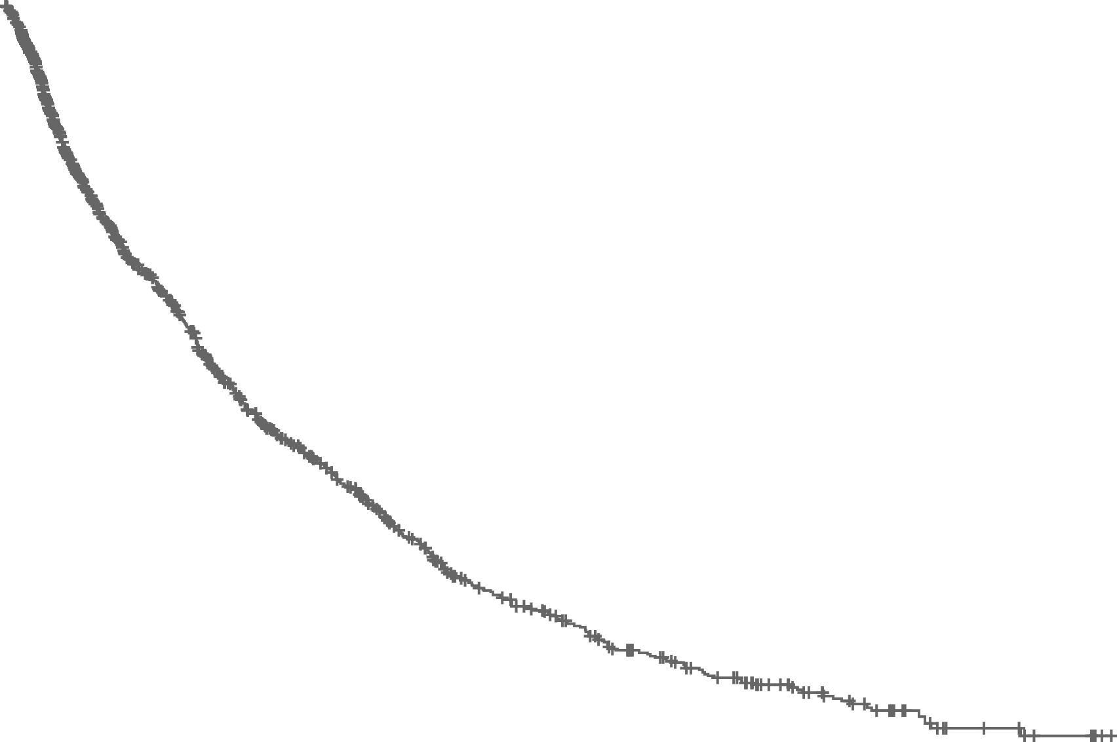
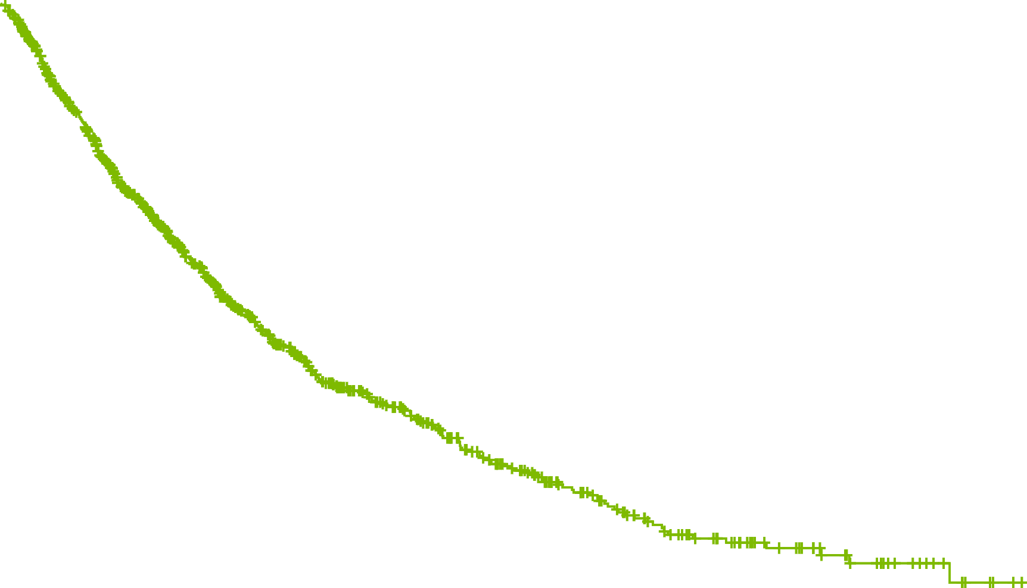
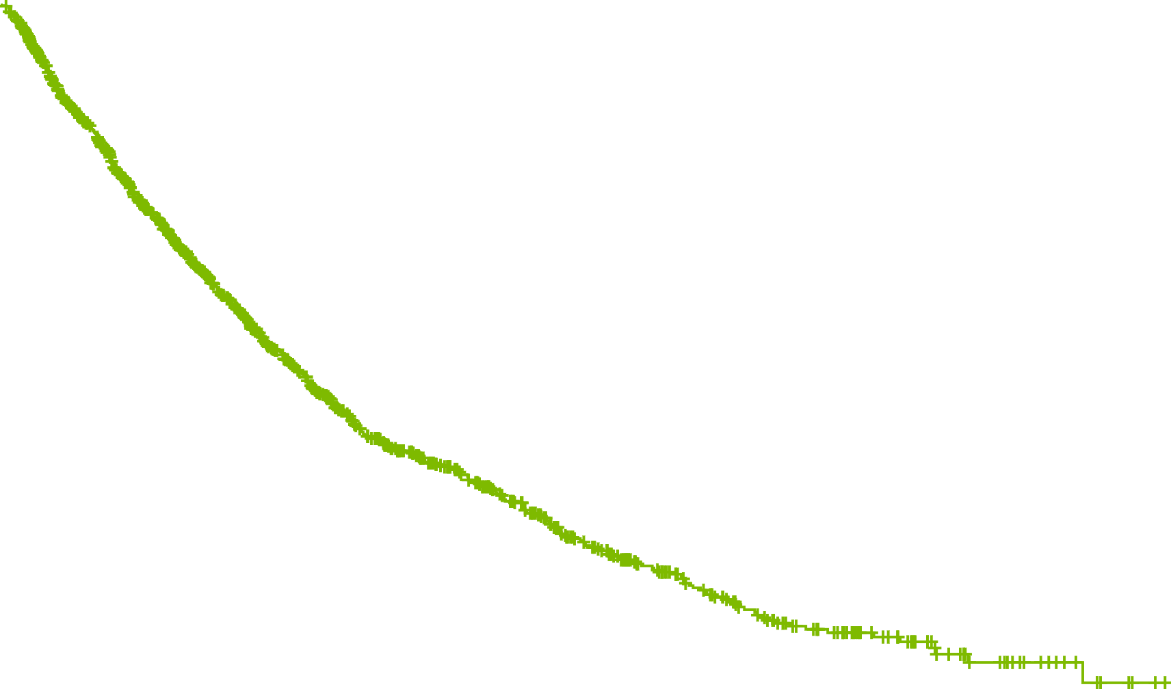
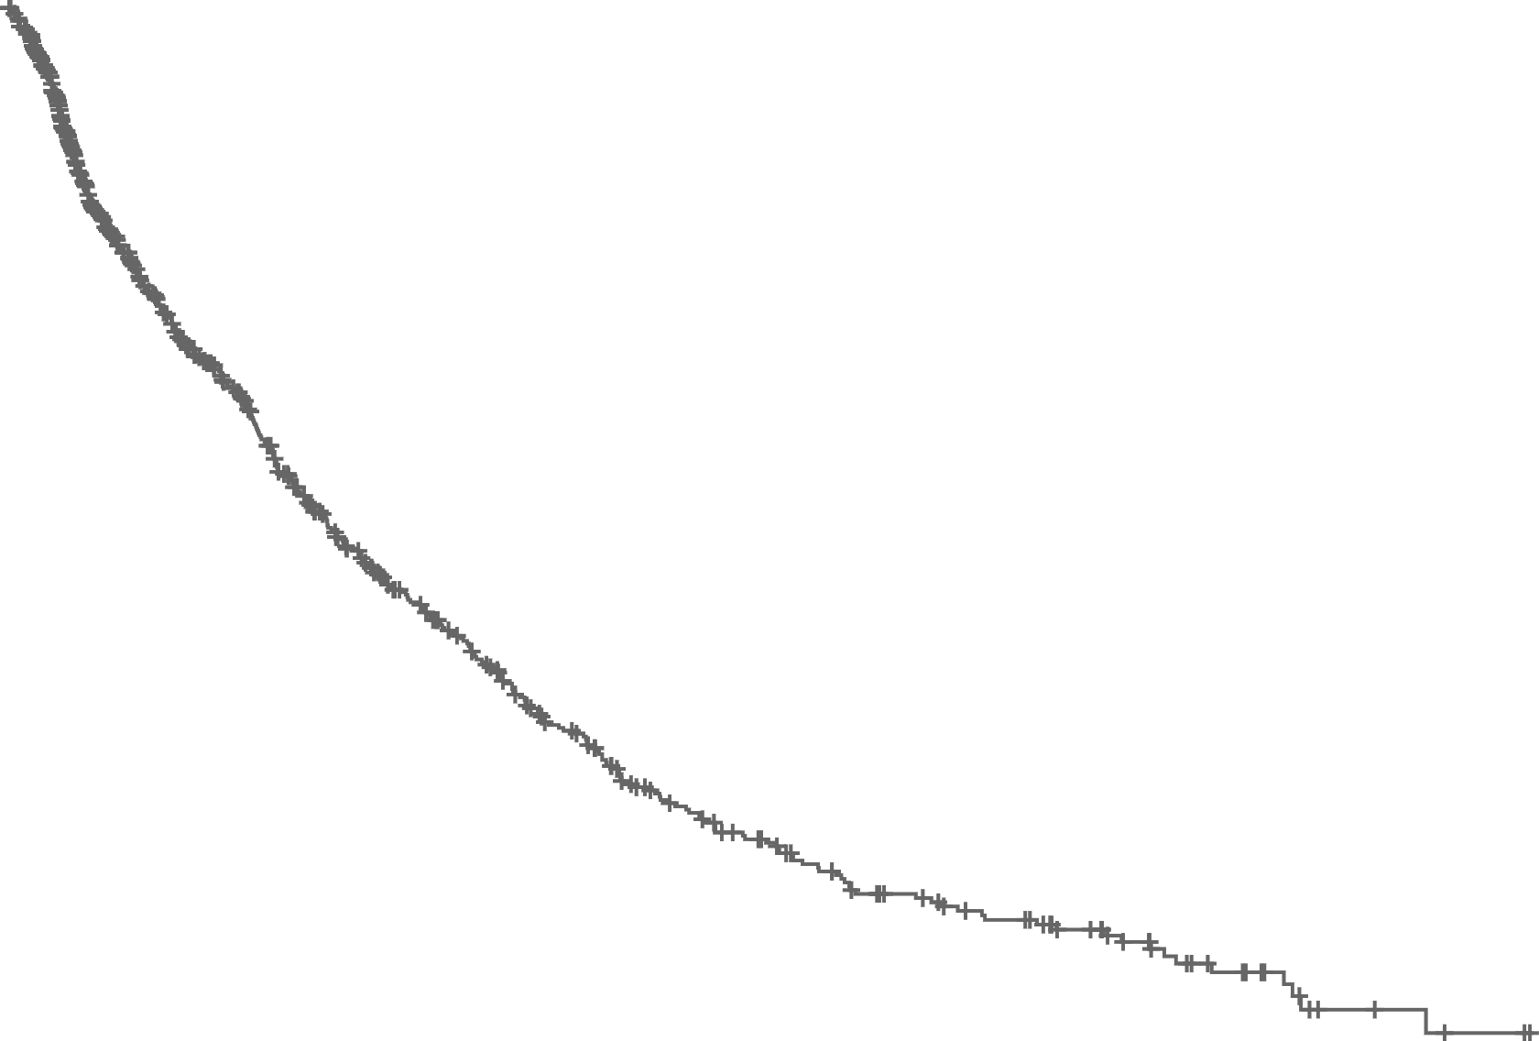
P-REALITY X: Real-World PFS
Secondary Endpoint
Unadjusted analysis
After sIPTW
After PSM
100
 | PAL+ AI (N=1324) | AI (N=1564)
Median rwPFS, months (95% CI) | 19.8 (17.9‒21.7) | 13.9 (12.7‒15.2)
HR=0.68 [95% CI: 0.62–0.76], P<0.0001 | HR=0.68 95% CI: 0.62–0.76 P<0.0001
100
 | PAL+ AI (N=1572) | AI (N=1137)
Median rwPFS, months (95% CI) | 19.3 (17.5‒20.7) | 13.9 (12.5‒15.2)
HR=0.70 [95% CI: 0.62–0.78], P<0.0001 | HR=0.70 95% CI: 0.62–0.78 P<0.0001
100
 | PAL+ AI (N=939) | AI (N=939)
Median rwPFS, months (95% CI) | 19.8 (17.3‒21.9) | 14.9 (12.9‒16.9)
HR=0.72 [95% CI: 0.63–0.82], P<0.0001 | HR=0.72 95% CI: 0.63–0.82 P<0.0001
80
80
80
60
60
60
Real-World PFS (%)
Real-World PFS (%)
Real-World PFS (%)
40
40
40
20
20
20
0
0
6
12
18
24
30
36
42
48
54
60
66
0
0
6
12
18
24
30
36
42
48
54
60
66
0
0
6
12
18
24
30
36
42
48
54
60
66
Time (months)
Time (months)
Time (months)
 | 1564 | 669 | 435 | 293 | 195 | 126 | 88 | 60 | 35 | 16 | 7 | 0
 | 1324 | 982 | 650 | 440 | 299 | 208 | 133 | 85 | 55 | 26 | 11 | 1
 | 1137 | 489 | 320 | 215 | 147 | 93 | 60 | 41 | 23 | 10 | 4 | 0
 | 1572 | 1129 | 729 | 489 | 316 | 223 | 145 | 94 | 62 | 29 | 12 | 1
 | 939 | 431 | 283 | 189 | 130 | 82 | 55 | 41 | 25 | 10 | 3 | 0
 | 939 | 682 | 439 | 288 | 196 | 137 | 93 | 61 | 40 | 22 | 11 | 1
 | PAL+ AI | AI
Median follow-up (IQR), months | 25.0 (13.8–38.3) | 23.3 (11.8–42.3)
 | PAL+ AI | AI
Median follow-up (IQR), months | 23.9 (12.8–38.0) | 24.5 (12.0–42.9)
 | PAL+ AI | AI
Median follow-up (IQR), months | 23.4 (13.1–37.8) | 24.9 (12.4–44.4)
Median rwPFS* was statistically significantly longer among patients who received PAL+ AI versus AI alone before and after sIPTW and PSM

Slide 8
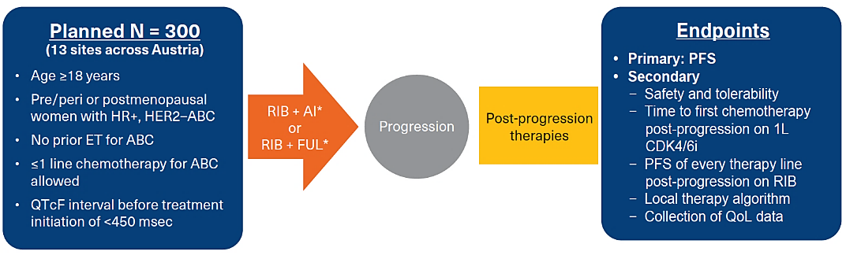
REACH AUT: RW Study of First-Line Ribociclib and ET in HR+, HER2– MBC
283 eligible

Slide 9
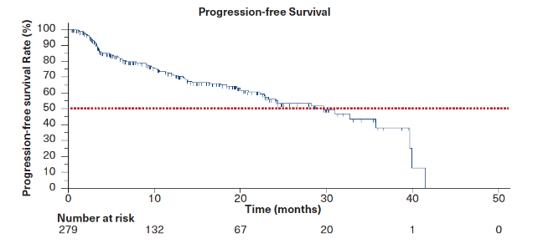
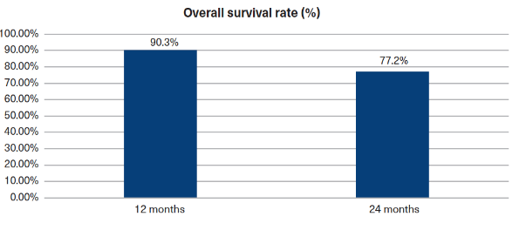
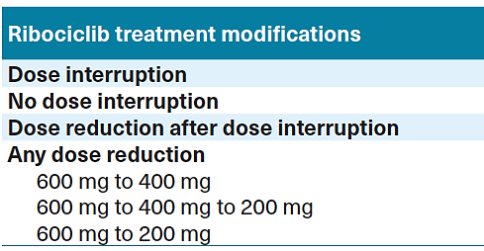
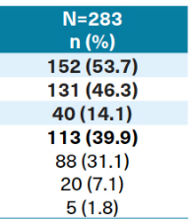
Kaplan-Meier Estimate of Median PFS of Overall Population mPFS=29.7 mo
Overall Survival Rate
QTc prolongation in 11.0% (gr 1: 8.5%; gr 2: 3.5%; gr 3: 0.4%)
61% co-meds causing QT prolongation
Managed with dose reduction or delay

Slide 10
Real-World Data: Abemaciclib
Retrospective study using the Flatiron Health electronic health record (EHR)-derived database
Inclusion: Female patients with HR+, HER2- MBC who initiated treatment with abemaciclib between 6/30/2016 and 8/31/2018: 1st 21 months of approval!
Abemaciclib given most commonly in the 2nd line setting with fulvestrant

Slide 11
rwPFS in the Overall Cohort
50% had visceral mets; 25% had prior CDKi treatment
Median rwPFS was not reached in the overall cohort (95% CI:9.02, NR)
1-year rwPFS rate was 61.7%

Slide 12
Summary
Real-world studies evaluating CDK4/6i in metastatic HR+ BC
  Several methodologies
    Retrospective database
      Largest vetted database is Flatiron; data collected prospectively
      Can be created by an institution or groups of institutions, but populations are smaller and data are not collected prospectively
      Limited by how long the drug was available to the studied population
    Prospective real-world studies
      Population is generally smaller; longer time to data maturity
Heterogeneous population
  More accurate representation of real-world patient populations
  Clarifies and confirms efficacy and safety data from phase III trials
  Advantageous for the evaluation of small populations

