Slide 1
Case Presentation: Management of a Patient with Anticoagulation and Severe Traumatic Injuries
Presenter:
Tobias Lindner, MD
Deputy Medical Director, Acute and Emergency Medicine
Campus Virchow Klinikum
Charité- University Medicine Berlin
Berlin, Germany
Expert Emergency Medicine Panel:
Richard Body, MBChB, PhD
University of Manchester
Manchester, United Kingdom
Martin Möckel, MD, PhD
Charité - Universitätsmedizin Hospital
Berlin, Germany
Susann Järhult, MD
Uppsala University Hospital
Uppsala, Sweden
Moderator:
W. Brian Gibler, MD, FACEP, FACC, FAHA
President, EMCREG-International
University of Cincinnati College of Medicine
Cincinnati, Ohio USA

Slide 2



Resource Information
About This Resource
These slides are one component of a continuing education program available online at MedEd On The Go titled Meet the Experts: Managing Life-Threatening Bleeding in Anticoagulated Patients in the Emergency Department
Program Learning Objectives:
Demonstrate the ability to delineate reversal from repletion for life-threatening bleeding in the anticoagulated patient
Demonstrate the ability to distinguish treatment implications for intracerebral, cerebellar, subdural, and subarachnoid hemorrhage in the anticoagulated patient
Distinguish between gastrointestinal bleeding in the anticoagulated patient, which requires observation in the ICU, versus life-threatening bleeding, which requires specific reversal therapy
Review specific reversal and repletion management by the emergency physician for anticoagulated patients with trivial to major trauma
MedEd On The Go®
www.mededonthego.com
This content or portions thereof may not be published, posted online or used in presentations without permission.
This content can be saved for personal use (non-commercial use only) with credit given to the resource authors.
To contact us regarding inaccuracies, omissions or permissions please email us at support@MedEdOTG.com

Slide 3
Disclaimer
The views and opinions expressed in this educational activity are those of the faculty and do not necessarily represent the views of Total CME, LLC, the CME providers, or the companies providing educational grants. This presentation is not intended to define an exclusive course of patient management; the participant should use their clinical judgment, knowledge, experience, and diagnostic skills in applying or adopting for professional use any of the information provided herein. Any procedures, medications, or other courses of diagnosis or treatment discussed or suggested in this activity should not be used by clinicians without evaluation of their patient's conditions and possible contraindications or dangers in use, review of any applicable manufacturer’s product information, and comparison with recommendations of other authorities. Links to other sites may be provided as additional sources of information.

Slide 4
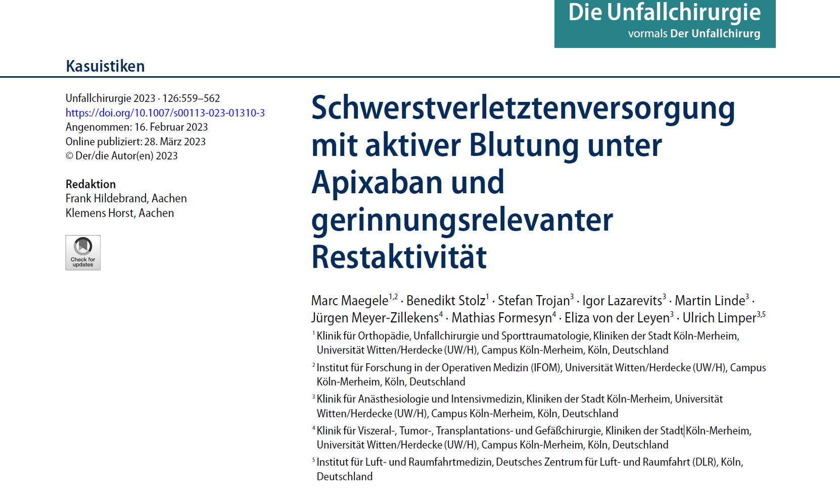
Trauma in the Anticoagulated Patient:
Decreasing Morbidity and Mortality in Severe Injuries
Case report (published 03/2023), Germany

Slide 5
Male, 54 years old. RTA
(C): No
A: Ok
B: Ok
C: Suspicion of pelvic fx, unstable femur L, free intra-abd fluid (US)
D: GCS 14
E: Lower limb fx R
SAMPLER: on Apixaban, 2/day 2,5 g (after PE), last intake this morning
Fluids, pelvic binder, immobilisation
Transport via helicopter to tertiary trauma center
(Cologne, Klinikum Merheim)

Slide 6
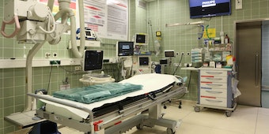
Shock Trauma Room
B: 20/min (10 l/min O₂)
C: f 125/min, MAP 100mmHg
D: GCS 11 (sedated)
Blood gases: Hb 15,6 g/dl, ph 7,269, lactate 4,4 mmol/l, BE – 1,1 mmol/l.
US: Increasing amount of free abdominal fluid
CT:
Multiple active bleedings from (meso)colon, 3 segmental fracture of L femur, fx lower R limb & lung contusions, dissection L art. iliaca comm.
1 g TXA
Emergency laparotomy as C- problem arises
Replacement: 2000 IE PPSB, 4 x FFP (as INR 2,75)

Slide 7
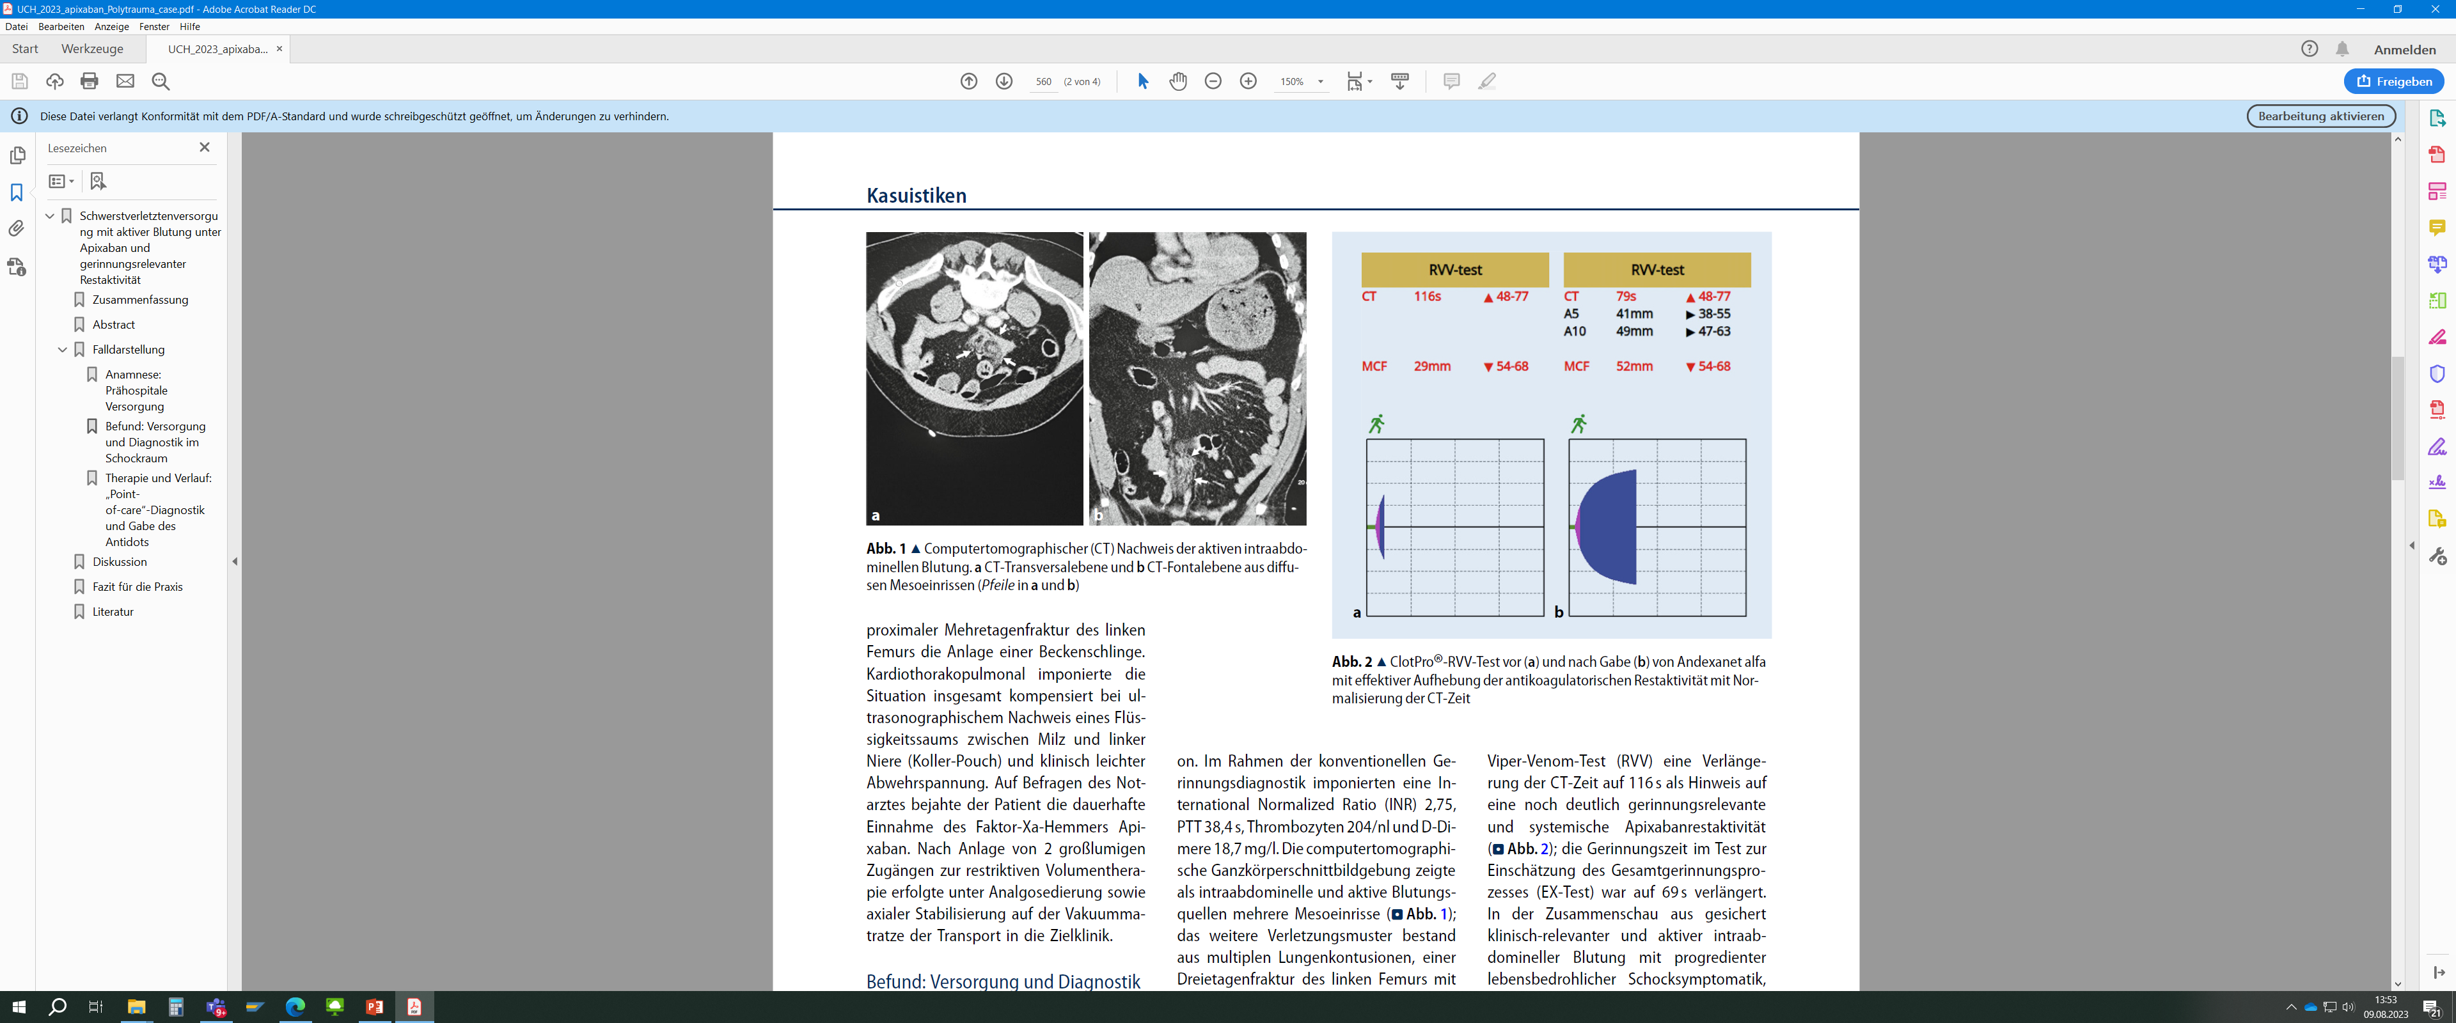
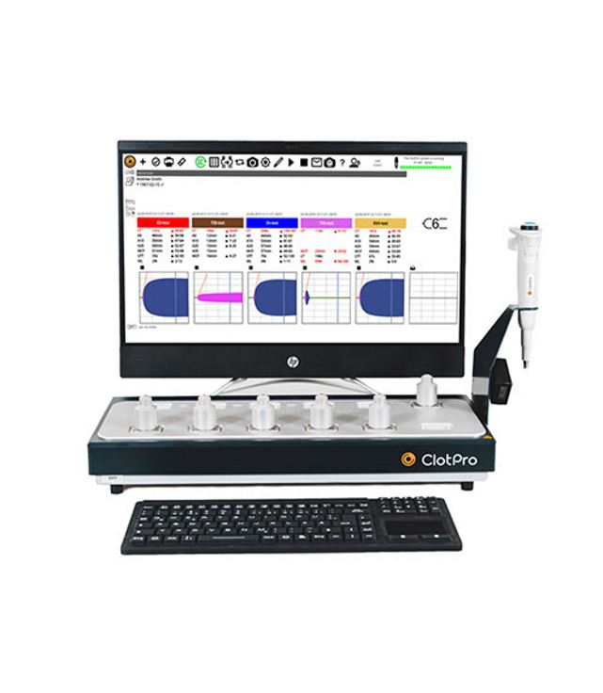
VEM- ClotPro® (TAT: 4 minutes!)
Russell – Viper Verum: CT 116 sec (normal 48-77 sec)
Interdisciplinary agreement to reverse apixaban:
Injury pattern, ongoing life-threatening bleeding, proven ongoing apixaban effect
Reversal:
400 mg andexanet/15 min. followed by 480 mg/120 min. (low dose as ≤ 5 mg, < 8 hrs.)
Re- VEM- ClotPro®:
  Russell – Viper Verum: CT 79 sec

Slide 8



Looking for more resources
on this topic?
CME/CE in minutes
Congress highlights
Late-breaking data
Quizzes
Webinars
In-person events
Slides & resources
www.MedEdOTG.com

