Slide 1
Severe Gastrointestinal Bleeding: Who Needs Reversal Or Repletion For Upper GI And Lower GI Bleeding?
Vinay Sehgal, MBChB, MRCP, PhD Consultant Gastroenterologist and Interventional Endoscopist University College London Hospital London, UK

Slide 2
Resource Information
About This Resource
These slides are one component of a continuing education program available online at MedEd On The Go titled Meet the Experts: Managing Life-Threatening Bleeding in Anticoagulated Patients in the Emergency Department
Program Learning Objectives:
Demonstrate the ability to delineate reversal from repletion for life-threatening bleeding in the anticoagulated patient
Demonstrate the ability to distinguish treatment implications for intracerebral, cerebellar, subdural, and subarachnoid hemorrhage in the anticoagulated patient
Distinguish between gastrointestinal bleeding in the anticoagulated patient, which requires observation in the ICU, versus life-threatening bleeding, which requires specific reversal therapy
Review specific reversal and repletion management by the emergency physician for anticoagulated patients with trivial to major trauma
MedEd On The Go®
www.mededonthego.com
This content or portions thereof may not be published, posted online or used in presentations without permission.
This content can be saved for personal use (non-commercial use only) with credit given to the resource authors.
To contact us regarding inaccuracies, omissions or permissions please email us at support@MedEdOTG.com

Slide 3
Disclaimer
The views and opinions expressed in this educational activity are those of the faculty and do not necessarily represent the views of Total CME, LLC, the CME providers, or the companies providing educational grants. This presentation is not intended to define an exclusive course of patient management; the participant should use their clinical judgment, knowledge, experience, and diagnostic skills in applying or adopting for professional use any of the information provided herein. Any procedures, medications, or other courses of diagnosis or treatment discussed or suggested in this activity should not be used by clinicians without evaluation of their patient's conditions and possible contraindications or dangers in use, review of any applicable manufacturer’s product information, and comparison with recommendations of other authorities. Links to other sites may be provided as additional sources of information.

Slide 4
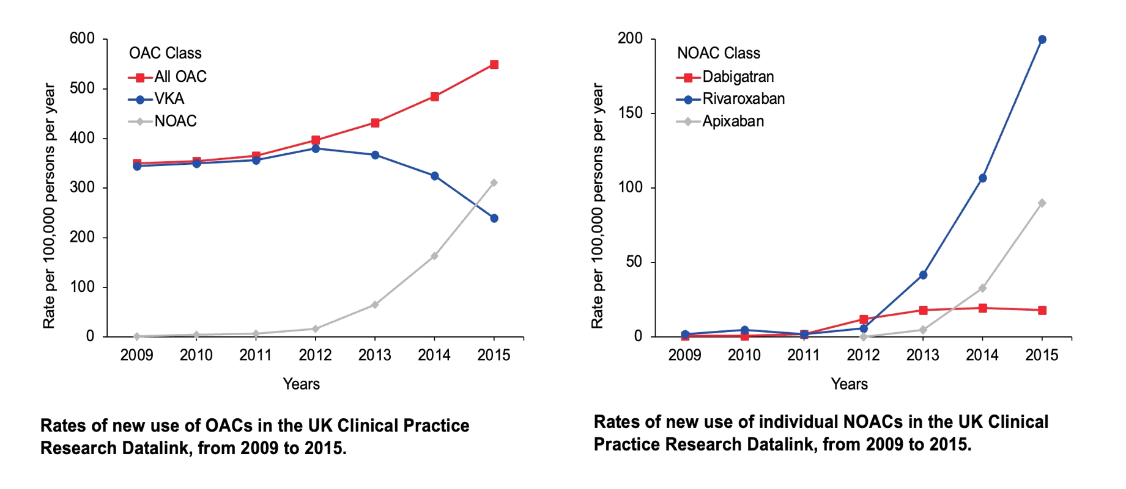
Increasing use of DOACs

Slide 5
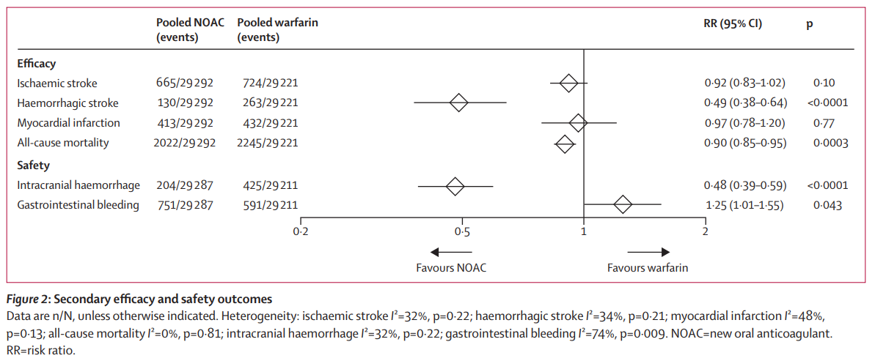
GI Bleeding and DOACs
Comparison of the efficacy and safety of oral anticoagulants with warfarin in patients with atrial fibrillation: a meta-analysis of randomized trials
Christian T Ruff, Robert P Giugliano, Eugene Braunwald, Elaine B Hoffman, Naveen Deenadayalu, Michael D Ezekowitz, A John Camm, Jeffrey I Weitz, Basil S Lewis, Alexander Parkhomenko, Takeshi Yamashita, Elliott M Antman
DOAC
DOAC = Direct oral anticoagulant

Slide 6
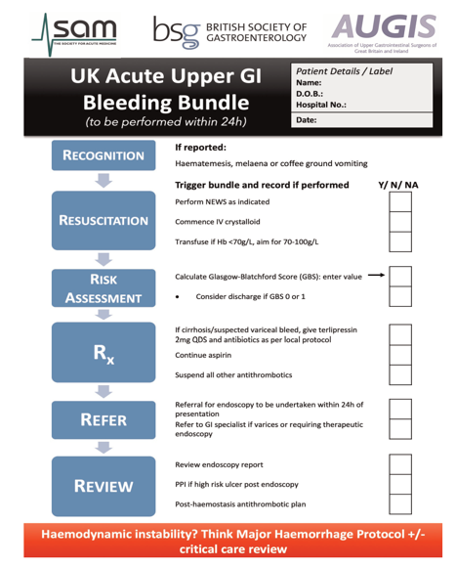
Upper GI Bleeding: Risk Stratification
Glasgow Blatchford Score
Rockall Score
Care Bundles
Rockall score and corresponding risk of Mortality and Re-bleeding ^{4,5}
Score | Mortality | Re-bleeding
Score 1 | Nil | 0-5%
Score 2 | Nil | 0-5%
Score 3 | 5% | 5-10%
Score 4 | 5-10% | 10-15%
Score 5 | 5-10% | 15-25%
Score 6 | 5-15% | 15-25%
Score 7 | 20-30% | 25-40%
Score 8 | 40-45% | 25-40%

Slide 7
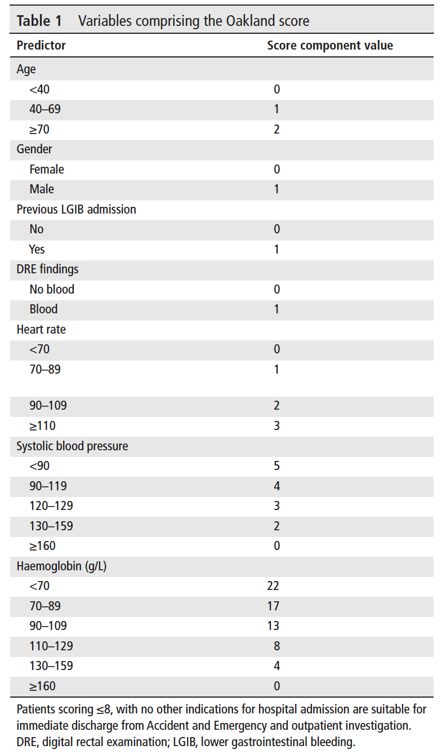
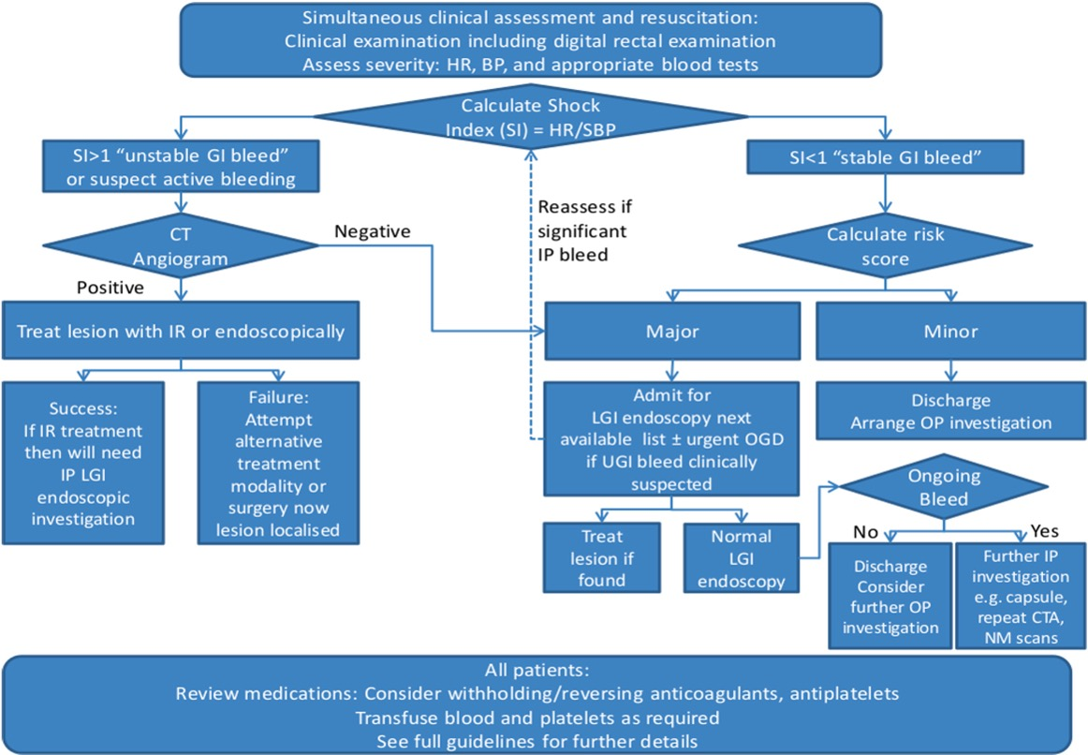
Lower GI Bleeding: Risk Stratification

Slide 8
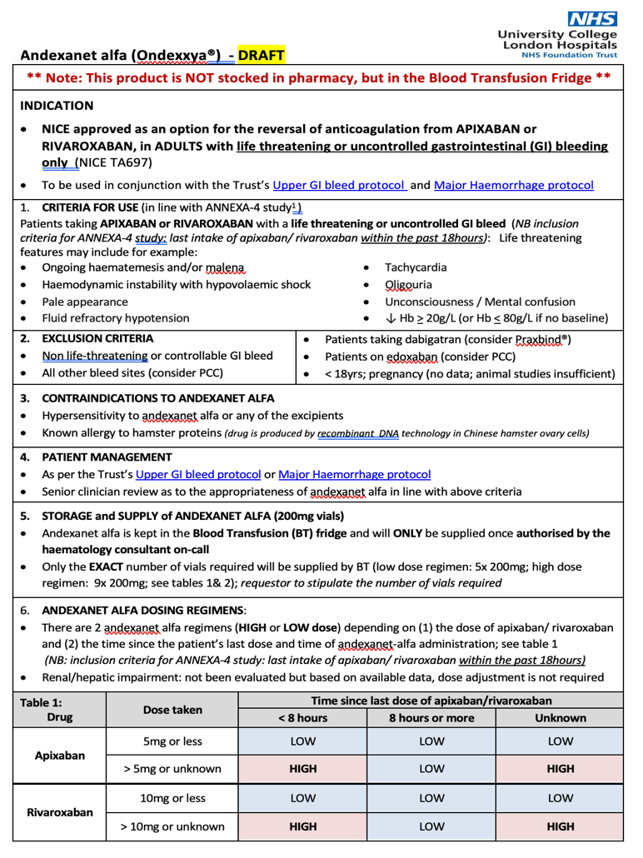
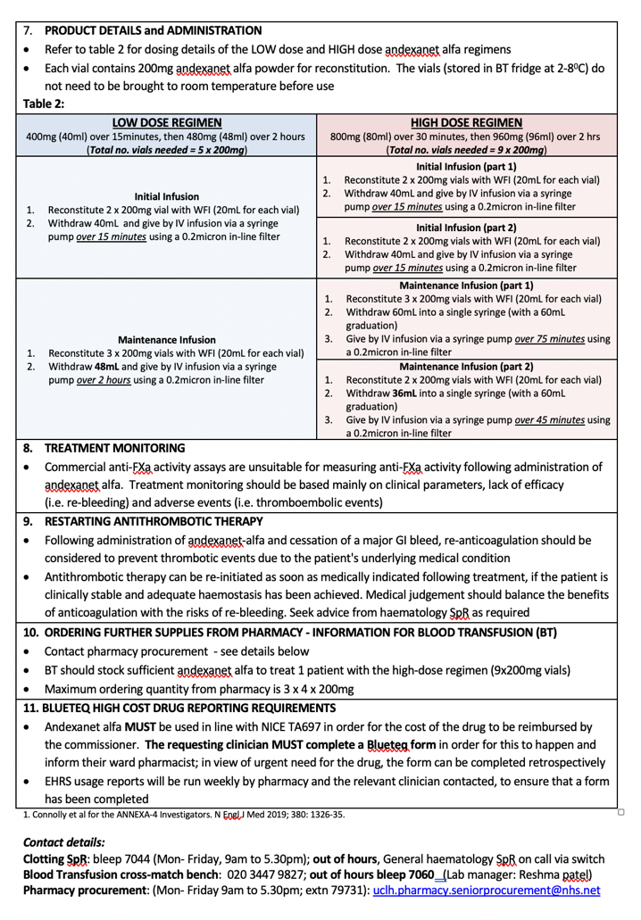

Slide 9
Looking for more resources on this topic?
CME/CE in minutes
Congress highlights
Late-breaking data
Quizzes
Webinars
In-person events
Slides & resources
www.MedEdOTG.com

