Slide 1
Delivery of an ICH Care Bundle: Illustrative Case
Presenter:
Adrian Parry-Jones, MD, PhD, FRCP
Consultant Neurologist, Northern Care Alliance NHS Foundation Trust
Geoffrey Jefferson Brain Research Centre
University of Manchester
Manchester, UK
Expert Emergency Medicine Panel:
Richard Body, MBChB, PhD
University of Manchester
Manchester, United Kingdom
Martin Möckel, MD, PhD
Charité - Universitätsmedizin Hospital
Berlin, Germany
Susann Järhult, MD
Uppsala University Hospital
Uppsala, Sweden
Moderator:
W. Brian Gibler, MD, FACEP, FACC, FAHA
President, EMCREG-International
University of Cincinnati College of Medicine
Cincinnati, Ohio USA

Slide 2



Resource Information
About This Resource
These slides are one component of a continuing education program available online at MedEd On The Go titled Meet the Experts: Managing Life-Threatening Bleeding in Anticoagulated Patients in the Emergency Department
Program Learning Objectives:
Demonstrate the ability to delineate reversal from repletion for life-threatening bleeding in the anticoagulated patient
Demonstrate the ability to distinguish treatment implications for intracerebral, cerebellar, subdural, and subarachnoid hemorrhage in the anticoagulated patient
Distinguish between gastrointestinal bleeding in the anticoagulated patient, which requires observation in the ICU, versus life-threatening bleeding, which requires specific reversal therapy
Review specific reversal and repletion management by the emergency physician for anticoagulated patients with trivial to major trauma
MedEd On The Go®
www.mededonthego.com
This content or portions thereof may not be published, posted online or used in presentations without permission.
This content can be saved for personal use (non-commercial use only) with credit given to the resource authors.
To contact us regarding inaccuracies, omissions or permissions please email us at support@MedEdOTG.com

Slide 3
Disclaimer
The views and opinions expressed in this educational activity are those of the faculty and do not necessarily represent the views of Total CME, LLC, the CME providers, or the companies providing educational grants. This presentation is not intended to define an exclusive course of patient management; the participant should use their clinical judgment, knowledge, experience, and diagnostic skills in applying or adopting for professional use any of the information provided herein. Any procedures, medications, or other courses of diagnosis or treatment discussed or suggested in this activity should not be used by clinicians without evaluation of their patient's conditions and possible contraindications or dangers in use, review of any applicable manufacturer’s product information, and comparison with recommendations of other authorities. Links to other sites may be provided as additional sources of information.

Slide 4
Case – History and Examination
61-year-old male, pre-stroke
mRS 0
Known type 2 diabetes mellitus, hypertension, TIA 10 months prior, atrial fibrillation
Anticoagulated with apixaban
5 mg BD
Found with right-sided weakness and drowsiness at 9 a.m. today
(1 h ago)
Examination: GCS M6 V2 E4 (12), right hemiplegia and neglect, NIHSS 21
BP 216/114 on arrival

Slide 5
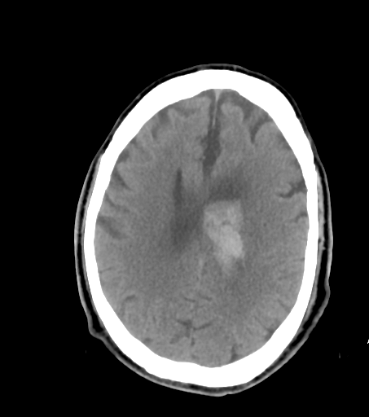
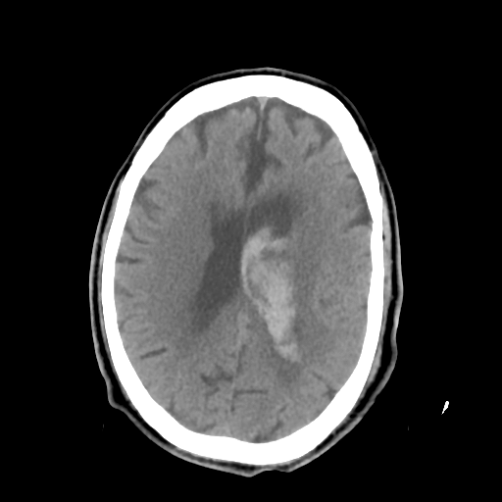
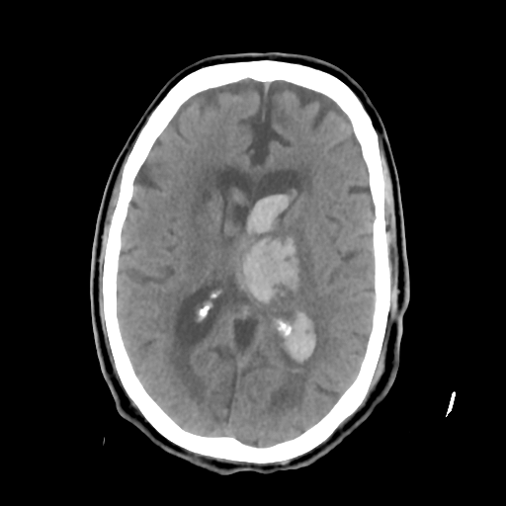
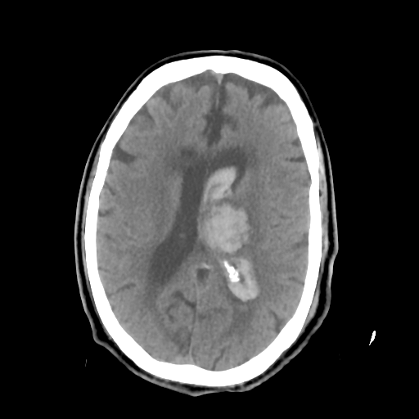
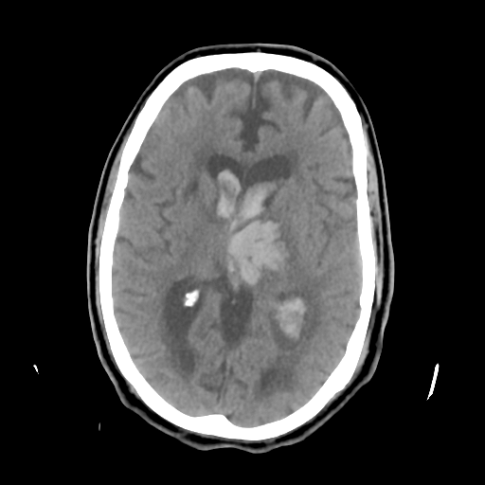
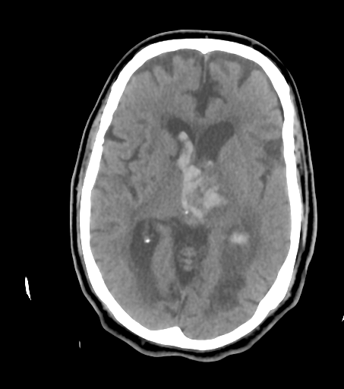
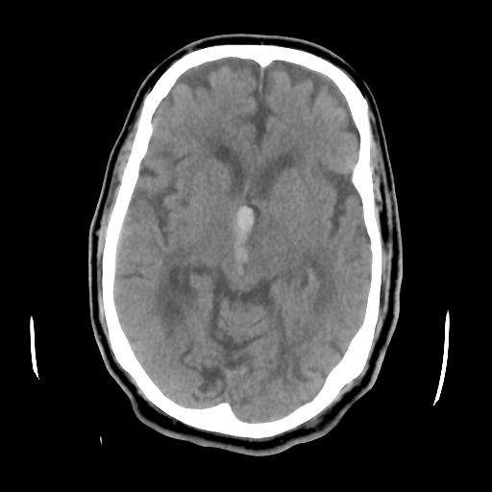
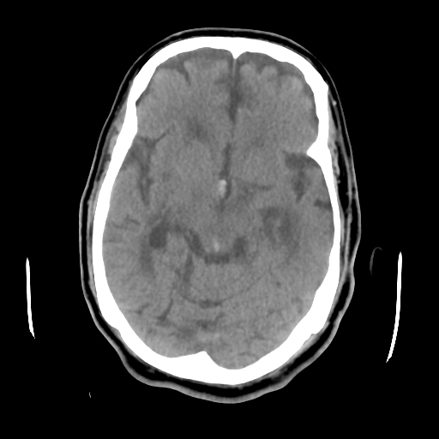
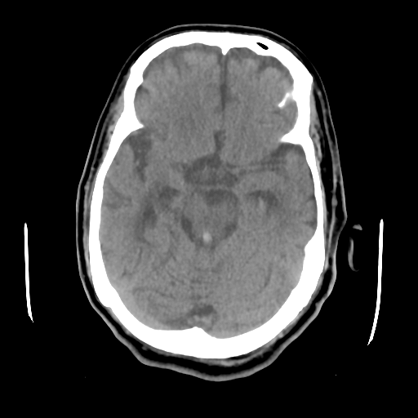
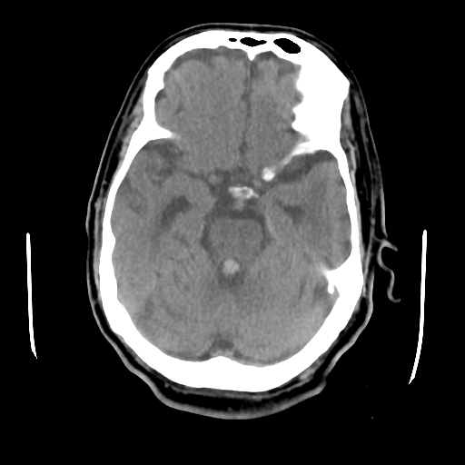
CT Brain Scan
Volume (ABC/2) = 20.0 ml

Slide 6
Further Assessment
Patient unaccompanied and last apixaban dose unknown
Call to patient’s son:
  Patient lives alone, looks after his own medication
  Last seen well yesterday at 11 a.m., found with weakness today
  Seems to have slept in his bed, got up and got dressed
  Poor compliance and recently given a blister pack to help with this - blister pack not with patient
Some lab results back: eGFR > 90
Now 11 a.m.; could be 2 to 24 h after onset

Slide 7
Management
Phone call to haematology
(30 min later), advised give PCC - treatment then commenced
Andexanet alfa not currently available in England for ICH
BP lowering commenced shortly afterwards
Discussed with Neurosurgery – not for immediate intervention
Transferred to High Dependency Unit for arterial line and BP management
Transferred back to local hospital on Day 6

Slide 8
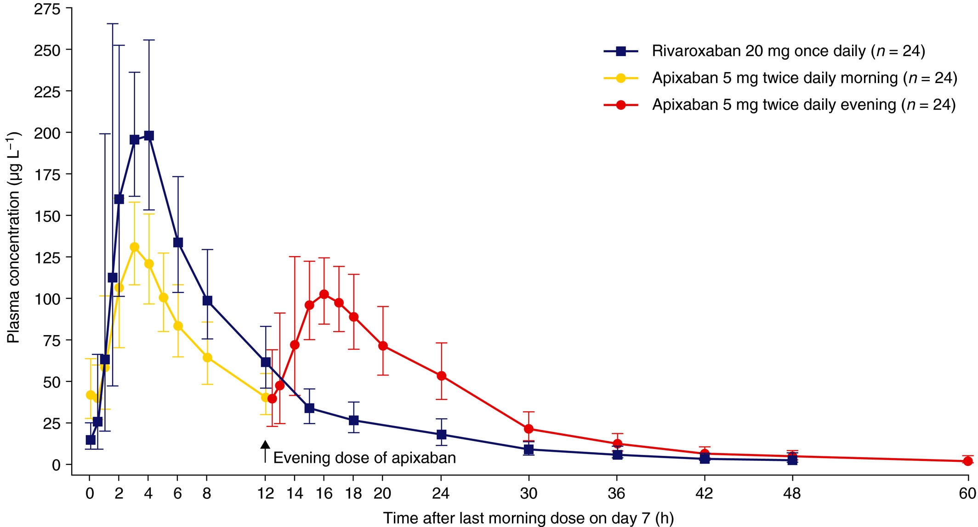
Pharmacokinetics of Anti-Xa DOACs
Taken as prescribed
Missed morning dose
Missed both doses

Slide 9
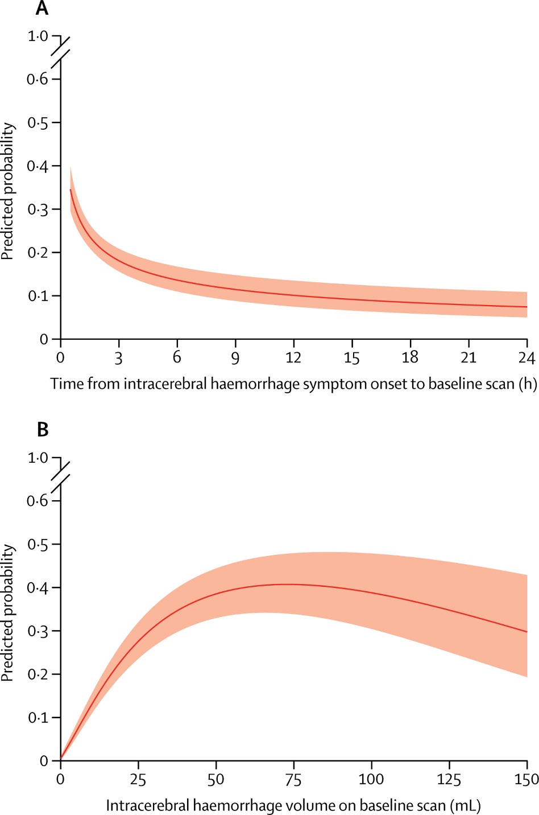
Haematoma Expansion – Risk Factors
Time
Volume
2 h
24 h
20 ml
Individual patient data meta-analysis: curves derived from 5076 patients not taking anticoagulant therapy
Model underestimated probability of expansion in 351 patients taking anticoagulant therapy
Discrimination remained good (0·73, 0·68–0·79) versus non-anticoagulated validation cohort (0·76, 0·73–0·79)

Slide 10
Summary
Approximately 10 to 20% of ICHs occur on anticoagulants
Delays increase the risk of expansion
Decide quickly whether to treat
Two key times to consider:
  Time of last anticoagulant
  Time since ICH onset
Other key patient factors:
  ICH volume (risk of expansion)
  Very poor prognosis (futility)

Slide 11



Looking for more resources
on this topic?
CME/CE in minutes
Congress highlights
Late-breaking data
Quizzes
Webinars
In-person events
Slides & resources
www.MedEdOTG.com

