Slide 1
Intracranial Hemorrhage: Decreasing Time to Treatment to Improve Outcomes
Adrian Parry-Jones, MD, PhD, FRCP
Consultant Neurologist, Northern Care Alliance NHS Foundation Trust
Geoffrey Jefferson Brain Research Centre
University of Manchester
Manchester, UK

Slide 2



Resource Information
About This Resource
These slides are one component of a continuing education program available online at MedEd On The Go titled Meet the Experts: Managing Life-Threatening Bleeding in Anticoagulated Patients in the Emergency Department
Program Learning Objectives:
Demonstrate the ability to delineate reversal from repletion for life-threatening bleeding in the anticoagulated patient
Demonstrate the ability to distinguish treatment implications for intracerebral, cerebellar, subdural, and subarachnoid hemorrhage in the anticoagulated patient
Distinguish between gastrointestinal bleeding in the anticoagulated patient, which requires observation in the ICU, versus life-threatening bleeding, which requires specific reversal therapy
Review specific reversal and repletion management by the emergency physician for anticoagulated patients with trivial to major trauma
MedEd On The Go®
www.mededonthego.com
This content or portions thereof may not be published, posted online or used in presentations without permission.
This content can be saved for personal use (non-commercial use only) with credit given to the resource authors.
To contact us regarding inaccuracies, omissions or permissions please email us at support@MedEdOTG.com

Slide 3
Disclaimer
The views and opinions expressed in this educational activity are those of the faculty and do not necessarily represent the views of Total CME, LLC, the CME providers, or the companies providing educational grants. This presentation is not intended to define an exclusive course of patient management; the participant should use their clinical judgment, knowledge, experience, and diagnostic skills in applying or adopting for professional use any of the information provided herein. Any procedures, medications, or other courses of diagnosis or treatment discussed or suggested in this activity should not be used by clinicians without evaluation of their patient's conditions and possible contraindications or dangers in use, review of any applicable manufacturer’s product information, and comparison with recommendations of other authorities. Links to other sites may be provided as additional sources of information.

Slide 4
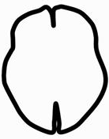
Supportive Care: Stroke Unit / Critical Care
Haematoma evacuation
evacuation
secondary injury
clearance
expansion (20%)
Anticoagulant reversal
BP lowering
Platelet transfusion
Haemostatic drugs?

Slide 5
The ABC Care Bundle
A
Anticoagulant reversal:
Reversal agents delivered in less than 60 min
Blood pressure lowering:
SBP to below 140 mmHg within 120 min
Care pathway:
Referral of appropriate patients to neurosurgery (independent prior to ICH and at least one: posterior fossa, hydrocephalus risk, GCS less than 13, vol greater than 30 ml)
B
C

Slide 6
Improving Door-to-Needle Times (VKA)
QI project to improve speed of PCC treatment
55 patients included in final analysis
Primary outcome: scan-to-needle time
  Three key changes to reduce delays:
  PCC stock in the ED
  Point-of-care INR device
  Standard protocol to deliver PCC without haematology referral for every case

Slide 7
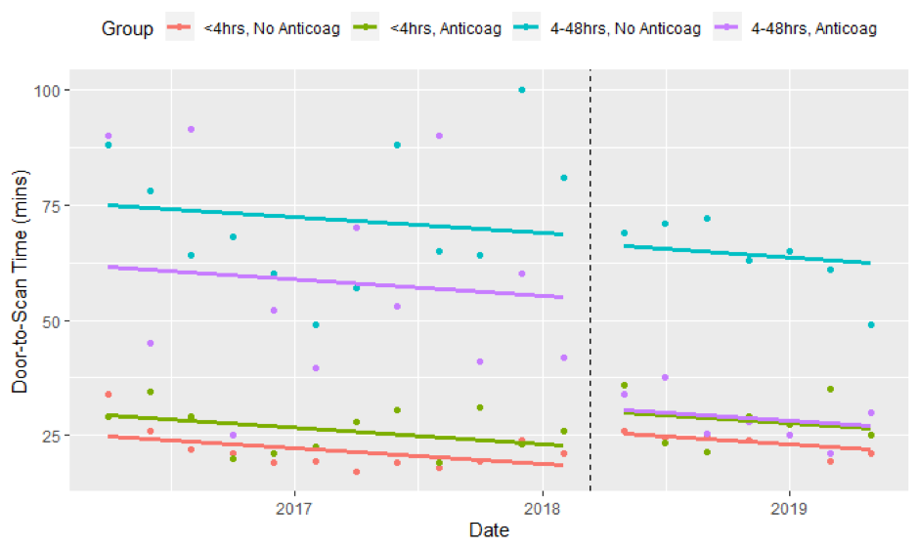
Pre-hospital Pre-alert for Anticoagulant
Pre-alert: suspected strokes 4 to 48 hr
post-onset on anticoagulants
Introduced 13 Mar 2018
Data from SSNAP – 1 Mar 2016 to 31 May 2019
4-48 h, no anticoag
4-48 h, anticoag
< 4 h, anticoag
< 4 h, no anticoag
n=4206 before
n=2408 after
31.4 min reduction (95%CI: -46.8 to -16.1; p<0.0001)

Slide 8
PDSA1 – Local Protocol Introduced
Protocol approved

Slide 9
PDSA2 – GTN Used First Line
GTN first
Protocol approved

Slide 10
PDSA3 - Stay in ED Until Target Met
GTN first
Protocol approved
Stay in ED until target reached

Slide 11
GTN first
Protocol approved
Stay in ED until target reached

Slide 12
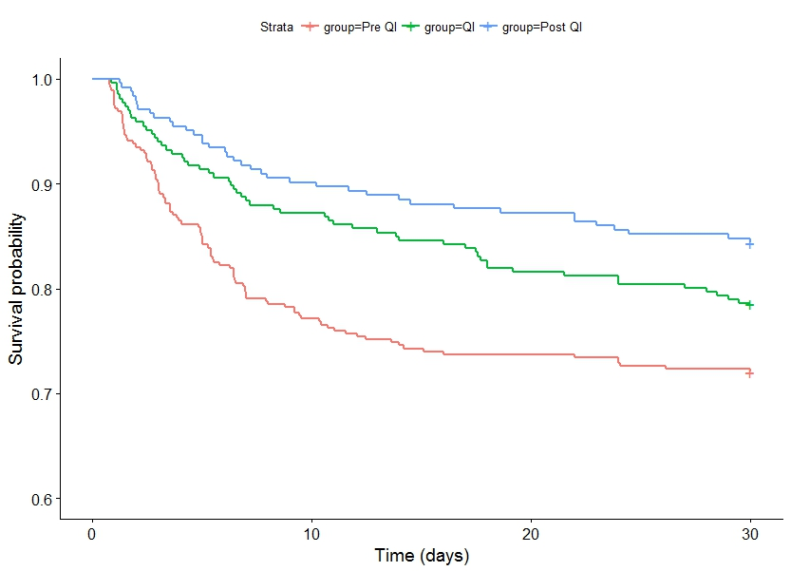
30-Day Case Fatality at Salford
Pre QI
Salford | 35.5%
SSNAP | 31.6%
Difference (pp) | +3.9 pp
QI / Post QI
Salford | 24.2%
SSNAP | 31.1%
Difference (pp) | -6.9 pp
After (n=243)
During (n=266)
Before (n=354)
Difference in difference (Salford vs England and Wales): -10.8 pp (95% CI -17.9 to -3.7), P=0.003
Parry-Jones AR, et al. Ann Neurol. 2019;86(4):495-503.

Slide 13
Summary
Bundled care is associated with better outcomes after ICH
Key components are anticoagulant reversal and BP lowering
Quality improvement is needed to optimise implementation
ABC-ICH and similar initiatives facilitate implementation

Slide 14



Looking for more resources
on this topic?
CME/CE in minutes
Congress highlights
Late-breaking data
Quizzes
Webinars
In-person events
Slides & resources
www.MedEdOTG.com

