Slide 1
Case Presentation: Management of a Patient with Anti-Factor Xa Associated Intracranial Hemorrhage (ICH)
Presenter:
Natalie Kreitzer, MD, MS Associate Professor, Emergency Medicine and Neurocritical Care University of Cincinnati College of Medicine Director of Stroke Services West Chester Hospital Cincinnati, OH, USA
Expert Emergency Medicine Panel:
Richard Body, MBChB, PhD University of Manchester Manchester, United Kingdom
Martin Möckel, MD, PhD Charité - Universitätsmedizin Hospital Berlin, Germany
Susann Järhult, MD Uppsala University Hospital Uppsala, Sweden
Moderator:
W. Brian Gibler, MD, FACEP, FACC, FAHA President, EMCREG-International University of Cincinnati College of Medicine Cincinnati, Ohio USA

Slide 2
Resource Information
About This Resource
These slides are one component of a continuing education program available online at MedEd On The Go titled Meet the Experts: Managing Life-Threatening Bleeding in Anticoagulated Patients in the Emergency Department
Program Learning Objectives:
Demonstrate the ability to delineate reversal from repletion for life-threatening bleeding in the anticoagulated patient
Demonstrate the ability to distinguish treatment implications for intracerebral, cerebellar, subdural, and subarachnoid hemorrhage in the anticoagulated patient
Distinguish between gastrointestinal bleeding in the anticoagulated patient, which requires observation in the ICU, versus life-threatening bleeding, which requires specific reversal therapy
Review specific reversal and repletion management by the emergency physician for anticoagulated patients with trivial to major trauma
MedEd On The Go®
www.mededonthego.com
This content or portions thereof may not be published, posted online or used in presentations without permission.
This content can be saved for personal use (non-commercial use only) with credit given to the resource authors.
To contact us regarding inaccuracies, omissions or permissions please email us at support@MedEdOTG.com

Slide 3
Disclaimer
The views and opinions expressed in this educational activity are those of the faculty and do not necessarily represent the views of Total CME, LLC, the CME providers, or the companies providing educational grants. This presentation is not intended to define an exclusive course of patient management; the participant should use their clinical judgment, knowledge, experience, and diagnostic skills in applying or adopting for professional use any of the information provided herein. Any procedures, medications, or other courses of diagnosis or treatment discussed or suggested in this activity should not be used by clinicians without evaluation of their patient's conditions and possible contraindications or dangers in use, review of any applicable manufacturer’s product information, and comparison with recommendations of other authorities. Links to other sites may be provided as additional sources of information.

Slide 4
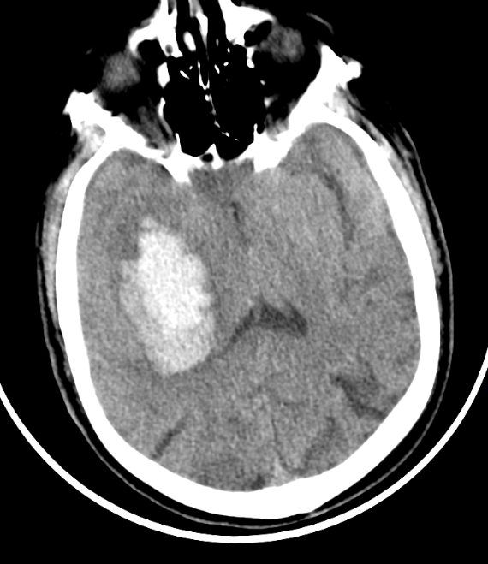
Case Presentation
58-year-old male
Acute onset left sided weakness
History of atrial fibrillation
On rivaroxaban
Next steps?
What if he needs EVD?

Slide 5
Intracerebral Hemorrhage (ICH)
10 to 15% of all stroke
Mortality 30 to 50%
74% functionally dependent at 12 months
Incidence likely to double by 2050
Due to aging and more anticoagulation

Slide 6
Factor Xa Inhibitor Reversal
Prior to andexanet alfa, in vitro testing demonstrated that PCCs may be used for reversal
ANNEXA-4 cohort: 227 subjects (64%) had an intracranial hemorrhage
Average presenting GCS 14, with 80% (95% CI, 74 to 86) excellent or good efficacy of reversal in ICH

Slide 7
Study Design
Phase IV, multicenter, international
Randomized controlled trial
Protocol
Last seen well less than 6 hours, within 15 hours last DOAC dose
Endpoint: hemostatic efficacy
Enrollment
Planned enrollment: 1200 participants
DSMB recommended trial to stop early, after 450 participants

Slide 8
Patient Follow Up
Given andexanet alfa
Nicardipine drip
Admitted to the neuro-ICU
Required an EVD
MRI without microbleeds
Discharged on day 14
Restarted DOAC one month later

Slide 9
Looking for more resources on this topic?
CME/CE in minutes
Congress highlights
Late-breaking data
Quizzes
Webinars
In-person events
Slides & resources
www.MedEdOTG.com

