Slide 1
A New Look at Risk-Assessment Models: Changing the Intermediate-Risk Tier

Slide 2
Disclaimer
The views and opinions expressed in this educational activity are those of the faculty and do not necessarily represent the views of TotalCME, Inc., the CME providers, or the companies providing educational grants. This presentation is not intended to define an exclusive course of patient management; the participant should use their clinical judgment, knowledge, experience, and diagnostic skills in applying or adopting for professional use any of the information provided herein. Any procedures, medications, or other courses of diagnosis or treatment discussed or suggested in this activity should not be used by clinicians without evaluation of their patient's conditions and possible contraindications or dangers in use, review of any applicable manufacturer’s product information, and comparison with recommendations of other authorities. Links to other sites may be provided as additional sources of information.

Slide 3
Looking Again at Risk Tiers: Are 3 Tiers Enough To Describe What We Really See in Our Patients?
In spite of advances in and validations of PAH risk scoring methods, the discrimination characteristics of the SPAHR/COMPERA, French PH Registry and REVEAL 2.0 scores are good, but not excellent, and could be further improved
It remains uncertain what the best treatment strategy is for patients who remain in the intermediate-risk group using a 3-strata approach¹
A more nuanced approach with a more refined definition of intermediate-risk patients may help better inform treatment decisions
To address this problem of the intermediate-risk group, the SPAHR investigators suggested subdividing the intermediate-risk group into intermediate–low risk and intermediate–high risk groups²
The 4-strata risk approach described by the COMPERA Registry investigators used revised scoring and cut-off points for the 6MWD, WHO FC, and NT-proBNP/BNP that may better define the risk groups³
One such analysis looked at validating this approach by assessing whether a 4-strata risk-assessment strategy was associated with survival among patients with PAH from the French PH Registry

Slide 4
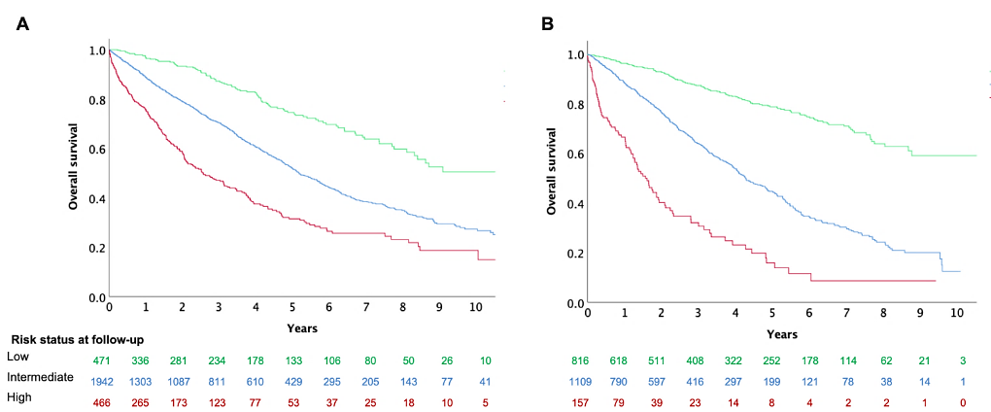
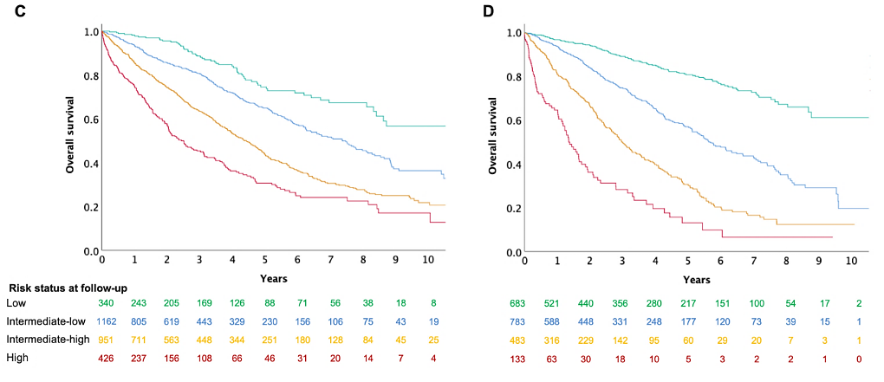
Results: Risk Assessment At Baseline
Survival According to a 3-Strata Model
Using the 3-strata SPAHR/COMPERA risk-assessment method, most patients (67%) were classified as intermediate risk at baseline, with 16% classified as low risk, and 16% classified as high risk
Using the 4-strata approach, 12% were low risk, 40% were intermediate–low risk, 33% were intermediate–high risk, and 15% were high risk
There were significant differences in survival rates across risk groups using the 3-strata approach and the 4-strata approach
3-Strata Model:
A. After diagnosis
B. First Reassessment
4-Strata Model:
C. After Diagnosis
D. First Reassessment
Survival According to a 4-Strata Model

Slide 5
Mortality Risk Increases After the First Reassessment With Increasing Risk Strata
In Cox regression models, there was increased risk of mortality after the first reassessment with increasing risk number of risk strata
As with the baseline risk assessment, the 4-strata discrimination for overall mortality after first reassessment was slightly but significantly higher compared with the 3-strata method (Harrell’s C=0.70, AIC=9242.7 vs. Harrell’s C=0.67, AIC=9299.3; p<0.001)
The 4-strata model discrimination was also higher for 1-year mortality after the first reassessment compared with the 3-strata model (Harrell’s C=0.73, AIC=2434.8, vs. Harrell’s C=0.69, AIC=2466.0; p=0.001)
Baseline Risk Assessment | Hazard Ratio* | 95% CI | 1st Follow-Up Risk Assessment | Hazard Ratio* | 95% CI
3 Strata |  |  | 3 Strata
Low | ---- |  | Low | ----
Intermediate | 2.24 | 1.81–2.78 | Intermediate | 3.39 | 2.80–4.10
High | 4.24 | 3.34–5.39 | High | 8.95 | 6.83–11.73
4 Strata |  |  | 4 Strata
Low | ---- |  | Low | ----
Intermediate–Low | 1.82 | 1.37–2.42 | Intermediate–Low | 2.65 | 2.11–3.17
Intermediate–High | 3.20 | 2.44–4.19 | Intermediate–High | 5.65 | 4.50–7.11
High | 5.19 | 3.88–6.94 | High | 11.08 | 8.23–14.92
*Hazard ratios with reference to the low-risk group

Slide 6
Changes in the 3-Strata Risk Assessment
In the overall population (n=2879), Sankey diagrams were used to represent changes in risk category using the 3-strata and 4-strata methods
According to the 3-strata method, there was an increase in the proportion of patients in the low-risk category from baseline (16%) to follow-up (28%)
10% experienced early mortality or underwent lung transplantation before a full reassessment, and 18% had no reassessment of risk available
29% of patients changed risk categories (by improving or worsening) between baseline and follow-up, with 10% remaining as stable low-risk, 31% as stable intermediate-risk, and 3% remaining as high risk
Few high-risk patients improved to the low-risk category

Slide 7
Changes in Risk Status Using the 4-Strata Method
With the 4-strata method, the proportion of patients classified as low risk improved from baseline (12%) to follow-up (24%)
A higher proportion of patients changed risk categories at follow-up with the 4-strata method (39%) than with the 3-strata method (29%)
10% of patients worsened by at least one category using the 4-strata method
  32% improved by at least one category
  10% were stable in the low-risk category
  3% of patients were “stable” in the high-risk category
Of the intermediate–low risk patients at baseline, 39% stayed at intermediate–low risk, 6% experienced early death or transplant, and 15% had no follow-up available
Of the patients who were at intermediate–high risk at baseline, ~ 48% changed risk categories, 25% remained intermediate–high risk, 10% experienced early death or transplant, and 18% had no follow-up available
The proportion of patients who were high risk and remained high risk was similar using the 3- or 4-strata approaches

Slide 8
Moving to More Risk Tiers: Will This Refine Treatment Approaches?
4-strata risk models based on refined cut-offs for FC, 6MWD, and BNP/NT-proBNP were more sensitive to prognostically relevant changes in risk compared with the 3-strata model
4-strata risk models may be useful in clinical practice and as a research tool in clinical trials
Very few (5.6%) patients were low risk at the time of diagnosis, and the long-term survival rates of patients who were low risk or intermediate–low risk at the time of diagnosis were nearly identical
The 4-strata model demonstrated changes in risk from baseline to first follow-up in 49.2% of patients compared with 31.1% in the 3-strata model
Changes in risk from baseline to first follow-up, including between intermediate–low and intermediate–high, were associated with changes in long-term mortality risk

