Slide 1
How We Categorize Risk of Mortality Must Dictate How We Treat PAH

Slide 2
Disclaimer
The views and opinions expressed in this educational activity are those of the faculty and do not necessarily represent the views of TotalCME, Inc., the CME providers, or the companies providing educational grants. This presentation is not intended to define an exclusive course of patient management; the participant should use their clinical judgment, knowledge, experience, and diagnostic skills in applying or adopting for professional use any of the information provided herein. Any procedures, medications, or other courses of diagnosis or treatment discussed or suggested in this activity should not be used by clinicians without evaluation of their patient's conditions and possible contraindications or dangers in use, review of any applicable manufacturer’s product information, and comparison with recommendations of other authorities. Links to other sites may be provided as additional sources of information.

Slide 3
Risk Stratification Shows the Majority of PAH Patients Fall Into the Intermediate-Risk Category
Monotherapy
Combination Oral Therapy
Combination Therapy Including
Parenteral Therapy
The scale of therapy depends on risk status
No. of Patients
Approximately 70% of PAH patients fall into the INTERMEDIATE-risk category at initial diagnosis
Low Risk
Intermediate Risk
High Risk

Slide 4
How We Stratify Risk Determines How We Treat The Patient
Early iterations of risk assessment algorithms stratified patients into a 3-tier system: low-, intermediate- or high-risk categories
However, with ~70% of patients falling into the intermediate-risk category, it has become clear that there is a spectrum of risk within this group
Therefore, we should consider that initial treatment strategies may differ within the intermediate-risk group, reflecting the range of disease severity
Less than half of patients achieve the goal of low-risk status
This prompts the consideration of expanding risk categories and their corresponding approaches to therapy
Success or failure of overall PAH treatment can depend on the initial treatment strategy, which should be based on the patient’s risk category

Slide 5
PAH Treatment Algorithm: WSPH 2018 (Pathway Determined by Risk Stratum)
Treatment-Naïve Patient
PAH Confirmed by Expert Center
General Measures
Supportive Therapy
CCB Therapy
Acute Vasoreactivity Test
(IPAH/hPAH/DPAH Only)
Vasoreactive
Non-Vasoreactive
Low Risk
Intermediate Risk
High Risk
(WHO FC IV)
Potential Role for Initial
Monotherapy
Initial Oral
Combination
Initial Combination
Including IV PCA
Consider Referral for Lung Transplantation
Patient Already on Treatment
After 3-6 Months of Treatment
Intermediate Risk
High Risk
Low Risk
Add On Therapy
(Double/Triple)
Structured Follow-Up
Maximal Medical Therapy and Listing for Lung Transplantation
After 3-6 Months of Treatment
Intermediate Risk
High Risk

Slide 6
PAH Treatment Algorithm: WSPH 2018 (Pathway Determined by Risk Stratum)
Treatment-Naïve Patient
PAH Confirmed by Expert Center
General Measures
Supportive Therapy
CCB Therapy
Acute Vasoreactivity Test
(IPAH/hPAH/DPAH Only)
Vasoreactive
Non-Vasoreactive
Low Risk
Intermediate Risk
High Risk
(WHO FC IV)
Potential Role for Initial
Monotherapy
Initial Oral
Combination
Initial Combination
Including IV PCA
Consider Referral for Lung Transplantation
Patient Already on Treatment
After 3-6 Months of Treatment
Intermediate Risk
High Risk
Low Risk
Add On Therapy
(Double/Triple)
Structured Follow-Up
Maximal Medical Therapy and Listing for Lung Transplantation
After 3-6 Months of Treatment
Intermediate Risk
High Risk

Slide 7
PAH Treatment Algorithm: WSPH 2018 (Pathway Determined by Risk Stratum)
Treatment-Naïve Patient
PAH Confirmed by Expert Center
General Measures
Supportive Therapy
CCB Therapy
Acute Vasoreactivity Test
(IPAH/hPAH/DPAH Only)
Vasoreactive
Non-Vasoreactive
Low Risk
Intermediate Risk
High Risk
(WHO FC IV)
Potential Role for Initial
Monotherapy
Initial Oral
Combination
Initial Combination
Including IV PCA
Consider Referral for Lung Transplantation
Patient Already on Treatment
After 3-6 Months of Treatment
Intermediate Risk
High Risk
Low Risk
Add On Therapy
(Double/Triple)
Structured Follow-Up
Maximal Medical Therapy and Listing for Lung Transplantation
After 3-6 Months of Treatment
Intermediate Risk
High Risk

Slide 8
PAH Treatment Algorithm: WSPH 2018 (Pathway Determined by Risk Stratum)
Treatment-Naïve Patient
PAH Confirmed by Expert Center
General Measures
Supportive Therapy
CCB Therapy
Acute Vasoreactivity Test
(IPAH/hPAH/DPAH Only)
Vasoreactive
Non-Vasoreactive
Low Risk
Intermediate Risk
High Risk
(WHO FC IV)
Potential Role for Initial
Monotherapy
Initial Oral
Combination
Initial Combination
Including IV PCA
Consider Referral for Lung Transplantation
Patient Already on Treatment
After 3-6 Months of Treatment
Intermediate Risk
High Risk
Low Risk
Add On Therapy
(Double/Triple)
Structured Follow-Up
Maximal Medical Therapy and Listing for Lung Transplantation
After 3-6 Months of Treatment
Intermediate Risk
High Risk

Slide 9
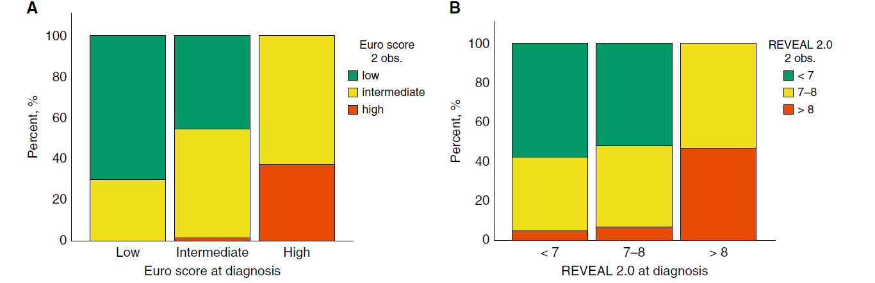
Minority of Patients on Upfront Double Combination Therapy Achieve or Maintain Low-Risk Status

Slide 10
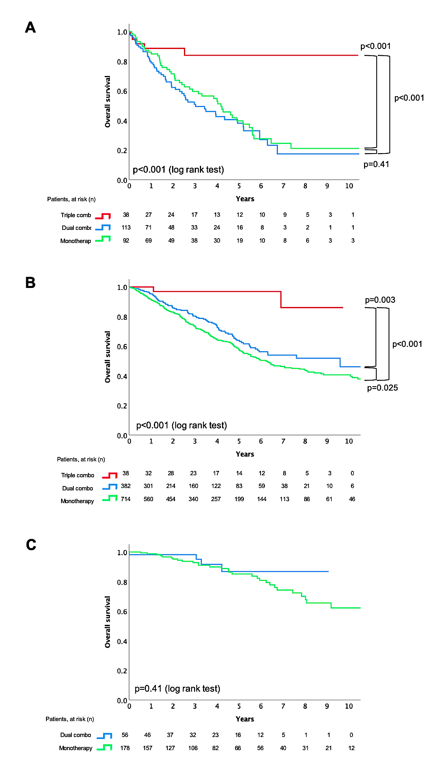
FPHN: Survival According to Initial Treatment Strategy and Baseline Risk Status
High-Risk Patients
Intermediate-Risk Patients

Slide 11
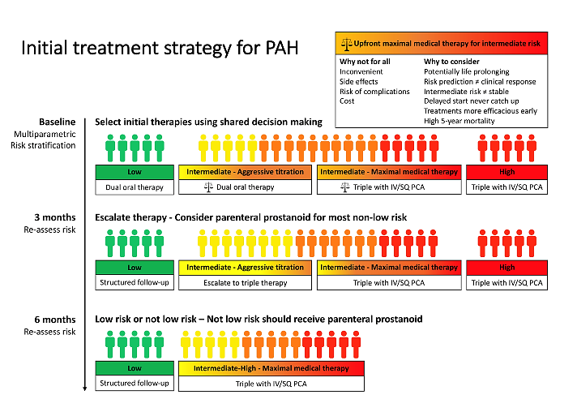
Initial Treatment Strategy for PAH
$$–$$

