Slide 1
Why Is Formal Risk Assessment Critical to Effective Treatment of PH?

Slide 2
Disclaimer
The views and opinions expressed in this educational activity are those of the faculty and do not necessarily represent the views of TotalCME, Inc., the CME providers, or the companies providing educational grants. This presentation is not intended to define an exclusive course of patient management; the participant should use their clinical judgment, knowledge, experience, and diagnostic skills in applying or adopting for professional use any of the information provided herein. Any procedures, medications, or other courses of diagnosis or treatment discussed or suggested in this activity should not be used by clinicians without evaluation of their patient's conditions and possible contraindications or dangers in use, review of any applicable manufacturer’s product information, and comparison with recommendations of other authorities. Links to other sites may be provided as additional sources of information.

Slide 3
Risk Assessment in PH: Why Is It Important?
Patient risk assessment is essential in the management of many chronic diseases
Comprehensive patient assessment in PAH allows clinicians to determine the patient’s prognosis, to monitor disease progression and the patient’s response to treatment; it also impacts treatment decisions
2015 European Society of Cardiology (ESC)/European Respiratory Society (ERS) Guidelines for pulmonary hypertension (PH) recommend that risk assessment be conducted regularly (every 3–6 months in stable patients) using multiple parameters to evaluate disease progression and patient response to treatment^{1–3}
Risk assessment in PAH patients should include a range of clinical, hemodynamic, and exercise parameters as there is no single variable that provides definitive prognostic information

Slide 4
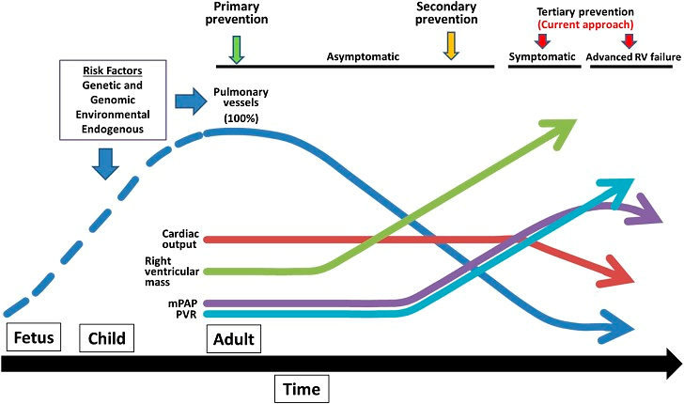
Regular Risk Assessment Is Important!
Why? Because CV Changes Start Before Symptoms Appear
*
*
Treatment Window
(Under Current Guidelines)

Slide 5
Initial Risk Assessment Correlates With Survival in PAH
Swedish PAH Register¹
French Pulmonary Hypertension Registry²
COMPERA³
100
99%
97%
100
100
92%
80
91%
Log rank, P<0.001
80
80
60
70%
73%
60
60
Survival (%)
Transplant-free Survival (%)
Survival (%)
56%
40
40
40
Low risk
Intermediate risk
High risk
25%
Meets 4 low risk criteria
Meets 3 low risk criteria
Meets 2 low risk criteria
Meets 1 low risk criterion
Meets 0 low risk criteria
Low risk
Intermediate risk
High risk
20
20
20
6%
P<0.001
0
0
0
0
1
2
3
4
5
0
1
2
3
4
5
0
1
2
3
4
5
Years
Years
Time since follow-up risk assessment (yrs)
*Low-risk criteria include: WHO/NYHA FC I–II
6MWD >440 m
RAP <8 mmHg
CI ≥2.5 L·min⁻¹·m⁻²
Variables for risk stratification included WHO/NYHA, 6MWD (m), BNP (ng/L), NT-proBNP (ng/L), RAP (mmHg), CI (L·min⁻¹·m⁻²), and SvO₂

Slide 6
Getting to Low-Risk Status Improves Survival
Swedish PAH Register¹
French Pulmonary Hypertension Registry²
COMPERA³
100
100%
98%
96%
98%
96%
100
100
90%
89%
80
80
80
80%
68%
60
50%
60
60
Survival (%)
60%
Transplant-free Survival (%)
Survival (%)
40
Log rank, P<0.001
43%
40
40
Stable “Low risk”
Improved to “Low risk”
Stable “Intermediate risk” or “high risk”
Worsened to “Intermediate risk” or “high risk”
Meets 3 low risk criteria
Meets 2 low risk criteria
Meets 1 low risk criterion
Meets 0 low risk criteria
Stable Low risk
Worsened from low to intermediate risk
Improved from intermediate to low risk
Stable Intermediate risk
Worsened from intermediate to high risk
Improved from high to intermediate risk
Stable high risk
20
20
20
P<0.800
0
0
0
0
1
2
3
4
5
0
1
2
3
4
5
0
1
2
3
4
5
Years
Years
Time since follow-up risk assessment (yrs)
Risk level based on cut-off values for FC, 6MWD, NT-proBNP, right atrial area, mRAP, pericardial effusion, CI, and SvO₂
*Low-risk criteria include: WHO/NYHA FC I–II
6MWD >440 m
RAP <8 mmHg
CI ≥2.5 L·min ⁻¹ ·m⁻²
Variables for risk stratification included WHO/NYHA, 6MWD (m), BNP (ng/L), NT-proBNP (ng/L), RAP (mmHg), CI (L·min ⁻¹ ·m⁻²), and SvO₂

Slide 7
Objectively Assessing Patient Risk and Prognosis in PAH
Risk assessment to monitor prognosis in PAH is an important part of care
Clinical, functional, exercise, and non-invasive and invasive variables have been utilized in calculators for predicting outcomes
Available risk-predicting models include:
  French Pulmonary Hypertension Registry
  PH Connection Equation
  COMPERA
  Swedish Risk Assessment Score
  Scottish Composite Score
  REVEAL risk equation (versions 1 and 2), REVEAL Lite 2
  2015 ESC/ERS Guidelines PH risk table

