Slide 1
Case Study:
Life-Threatening Traumatic Bleeds and Anticoagulation Reversal in the ED
Prof. Dr. Martin Möckel FESC, FAHA
Medical Director, Emergency and Acute Medicine
Departments Campus Mitte and Virchow
Professor of Cardiovascular Process Research
Vice Dean for Study and Teaching
Charité – Universitätsmedizin, Berlin, Germany

Slide 2
Disclaimer
The views and opinions expressed in this educational activity are those of the faculty and do not necessarily represent the views of TotalCME, Inc., the CME providers, or the companies providing educational grants. This presentation is not intended to define an exclusive course of patient management; the participant should use their clinical judgment, knowledge, experience, and diagnostic skills in applying or adopting for professional use any of the information provided herein. Any procedures, medications, or other courses of diagnosis or treatment discussed or suggested in this activity should not be used by clinicians without evaluation of their patient's conditions and possible contraindications or dangers in use, review of any applicable manufacturer’s product information, and comparison with recommendations of other authorities. Links to other sites may be provided as additional sources of information.

Slide 3
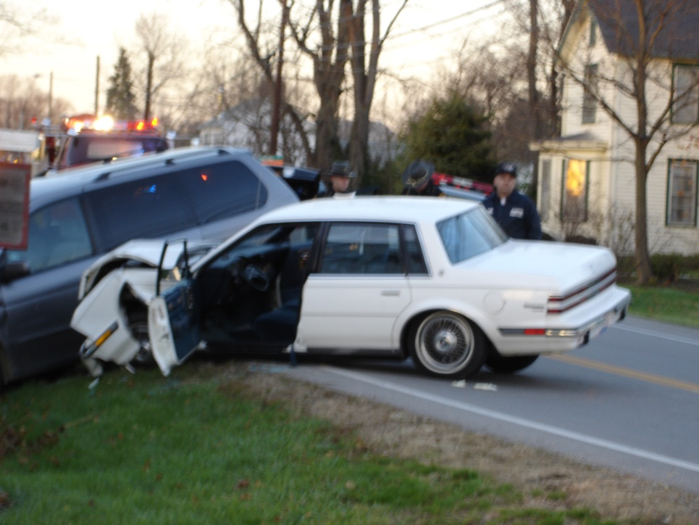
Motor Vehicle Accident
65 year old male brought in by EMS
  Unrestrained driver
  High speed collision on a rural highway
  Prolonged extrication
  Transported by local ground EMS
Initial vital signs
  Blood pressure 84/48mmHg
  Heart rate 128/min
  Respiratory rate 30/min
  Temperature 35.5 degrees Celsius (96F)

Slide 4
MVA – 65 Year Old Male
Past Medical History
  Hypertension
  Diabetes
    HbA1c – 8.2%
  Obesity
    BMI - 32
  COPD
  Atrial Fibrillation
  Coronary Artery Disease
Past Surgical History
  CABG – 5 years ago
  Knee replacement –
  2 years ago
Allergies
  None
Social History
  Alcohol – occasional
  Tobacco – 1ppd x 50 years
  Drugs – none
Medications
  Lisinopril
  Carvedilol
  Metformin
  Atorvastatin
  ASA
  Apixaban
  Albuterol
  Budesonide

Slide 5
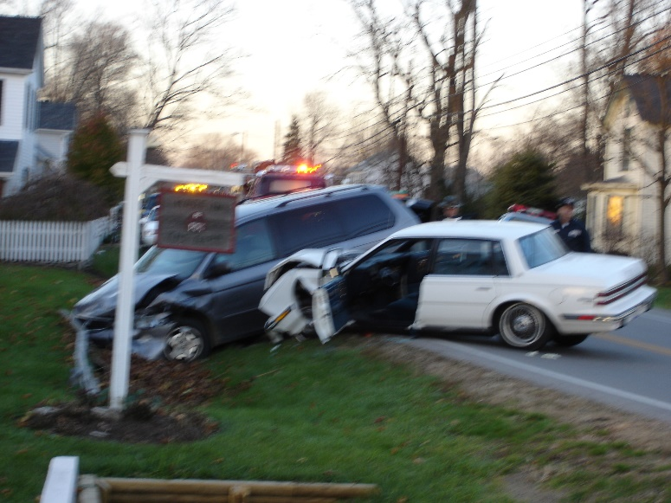
Primary Survey
Circulation
Weak, but positive distal pulses
Delayed capillary refill
Disability
Open, displaced fracture of the right distal lower extremity
Moves all 4 extremities symmetrically
Exposure
Spineboard and stiffneck
Ill appearing, diaphoretic
Airway
Patent – no blood or obstruction
Protecting his airway
Breathing
Tachypneic, not labored

Slide 6
Pertinent Physical Exam
Awake and alert
Answers questions – confused – Oriented (person, place)
No spinal tenderness – C1 - L5
Lungs clear – no wheezes
Tachypneic
Abdomen tender to palpation
Voluntary guarding
Diffuse bruising on abdomen
Musculoskeletal
  Pelvis stable to rock
  Open, displaced right lower extremity fracture
Good distal pulses
Moves all 4 extremities equally

Slide 7
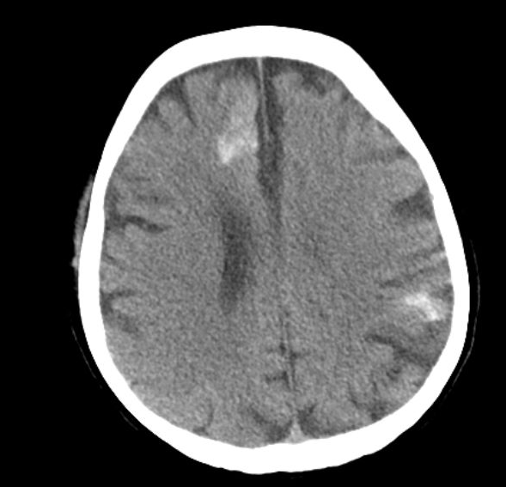
CT Head
Traumatic Brain Hemorrhage
Image courtesy of William A Knight MD

Slide 8
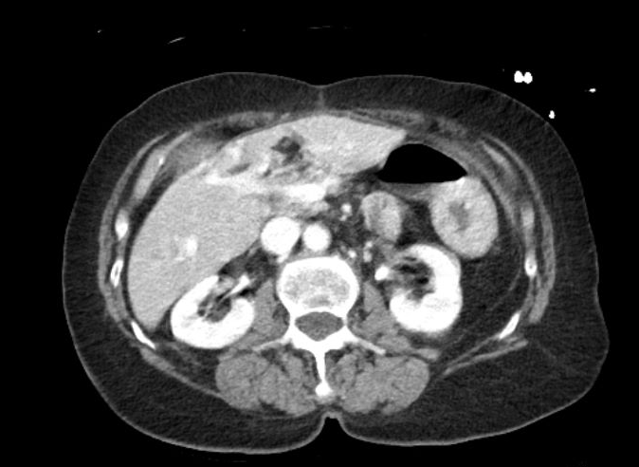
CT Abdomen and Pelvis
Grade IV Liver Laceration
Image courtesy of William A Knight MD

Slide 9

Case Summary
The patient was rescued by the Emergency Medicine and Trauma Surgery Teams
He was transfused 1:1 packed RBCs and Fresh Frozen Plasma due to his hemorrhagic shock
Last dose apixaban that morning (<8h)
He was administered Andexanet alfa (full dose)
Taken directly for exploratory laparotomy and management of the Grade IV liver laceration
Transfixation right open tibia/fibula fracture
Repeat head CT stable – no hemorrhagic expansion
Trauma ICU management x 5 days
Transferred to rehabilitation on hospital day 7
Anticoagulation for atrial fibrillation held for 2 weeks – deferred to primary care for restart

