Slide 1
Life-Threatening Traumatic Bleeds and Anticoagulation Reversal in the ED
Prof. Dr. Martin Möckel FESC, FAHA
Medical Director, Emergency and Acute Medicine
Departments Campus Mitte and Virchow
Professor of Cardiovascular Process Research
Vice Dean for Study and Teaching
Charité – Universitätsmedizin, Berlin, Germany

Slide 2
Disclaimer
The views and opinions expressed in this educational activity are those of the faculty and do not necessarily represent the views of TotalCME, Inc., the CME providers, or the companies providing educational grants. This presentation is not intended to define an exclusive course of patient management; the participant should use their clinical judgment, knowledge, experience, and diagnostic skills in applying or adopting for professional use any of the information provided herein. Any procedures, medications, or other courses of diagnosis or treatment discussed or suggested in this activity should not be used by clinicians without evaluation of their patient's conditions and possible contraindications or dangers in use, review of any applicable manufacturer’s product information, and comparison with recommendations of other authorities. Links to other sites may be provided as additional sources of information.

Slide 3
Disclosures
Martin Möckel, M.D., Ph.D, faculty for this educational event, has received consulting fees from Alexion, Bayer Healthcare, BMS, Boehringer Ingelheim, and Daiichi Sankyo.

Slide 4
Coagulopathy of Trauma
Up to 40% of traumatic deaths are result of hemorrhage
Leading preventable cause of trauma-related death
A significant number of patients arrive with coagulation changes
Trauma patients with massive hemorrhage often die as a result of coagulopathy despite surgical control of bleeding
Resuscitation with crystalloid and factor-poor blood products leads to dilution of clotting factors
Acidosis and hypothermia complete the “lethal triad”

Slide 5
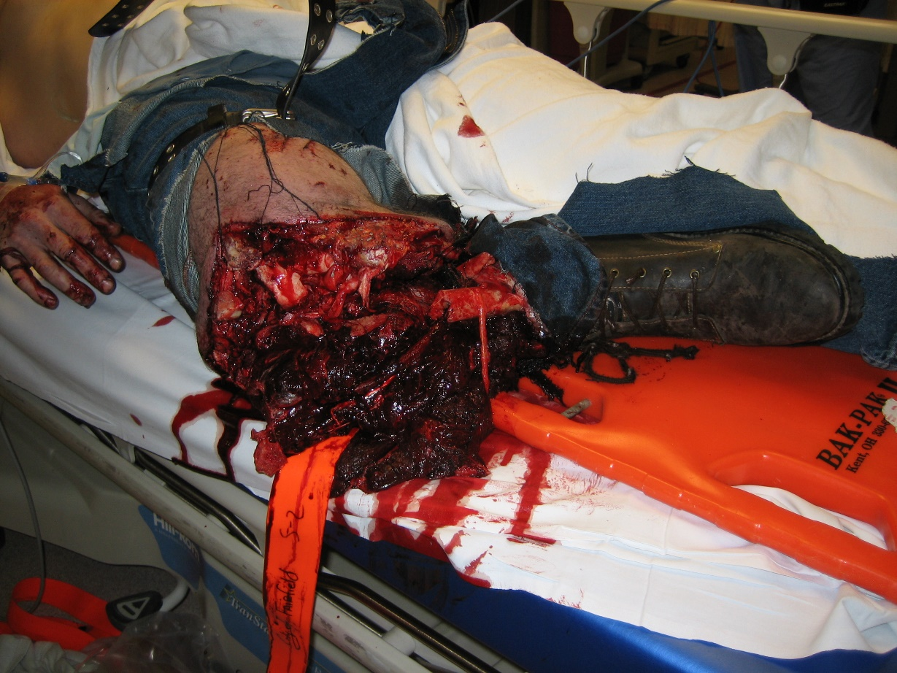
Initial Approach
Evaluate as any other trauma patient
Primary Survey - ABCD
Secondary survey
Source control
Direct compression
Tourniquet
Surgery
ex-lap, transfixation, craniotomy
Embolization
Image courtesy of William A Knight MD

Slide 6
Assess Anticoagulation Status
Vitamin K inhibitors
PT/INR
Factor Xa inhibitor
PT
Anti Xa level
TEG
DOACs
Time from last dose
Renal function
Specific assays
Direct thrombin inhibitors
PTT, dilute thrombin time
Ecarin clotting time
Thromboelastography

Slide 7
Coagulopathy of Trauma
Evidence has changed over the years
Crystalloid resuscitation
2 L Normal Saline
pRBC
Whole blood
Fresh Frozen Plasma
1:1
pRBC, FFP
1:1:1
pRBC, FFP, platelets
Acute Traumatic
Coagulopathy
Injury
Pre-hospital
resuscitation
Hyperfibrinolysis &
hypocoagulable state
Resuscitation-Associated
Coagulopathy
In-hospital
resuscitation
Consumption of
Coagulation factors
Hemostatic
Intervention
Dilution
Acidosis
Hypothermia
Post-
resuscitation
Trauma-Induced Coagulopathy

Slide 8
Pharmacologic Anticoagulation vs. Trauma Coagulopathy
Factors to consider
Last dose
Half life
Renal function
Severity and location of bleed
Surgical Options
Availability of specific reversal agent vs (off-label) use of PCC

Slide 9
Resuscitation – Reversal - Repletion
Whole blood
Plasma
Platelets
Vitamin K antagonists
Vitamin K 10 mg IV
4-factor PCC
Fresh Frozen Plasma
Factor Xa inhibitors
Andexanet alfa
4 factor PCC
Direct Thrombin Inhibitor (Dabigatran)
Idarucizumab
4 Factor PCC
Concomitant medications
Antiplatelet
Transfuse platelets, desmopressin
Comorbidities
Uremia
Liver
Heart disease
Baseline risk of thromboembolism

Slide 10
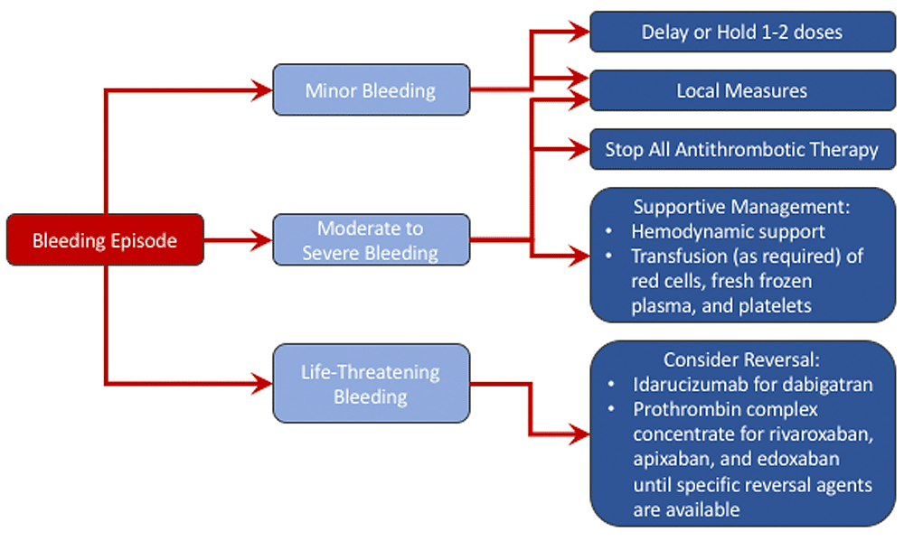
Approach to Managing Bleeding Complications
Protamine
Andexanet alfa
Idarucizumab
4-F PCC
Intervention
Surgery, non-Surgical

Slide 11
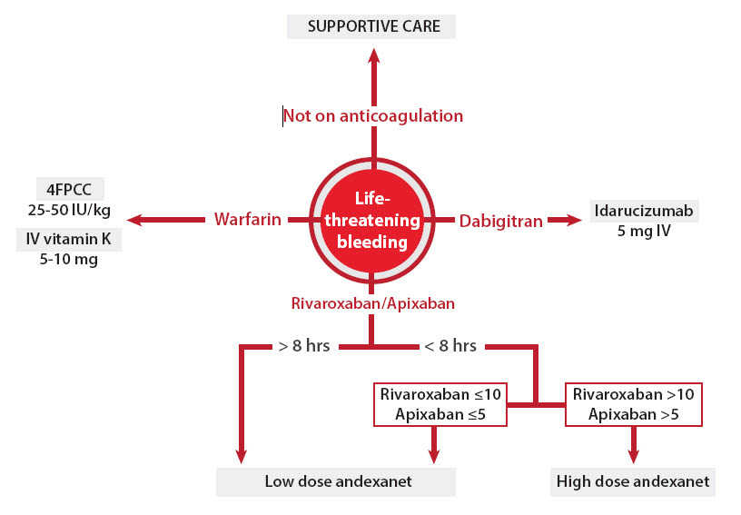
Treatment Algorithm: Reversal of Anticoagulation
Dabigatran

