Slide 1

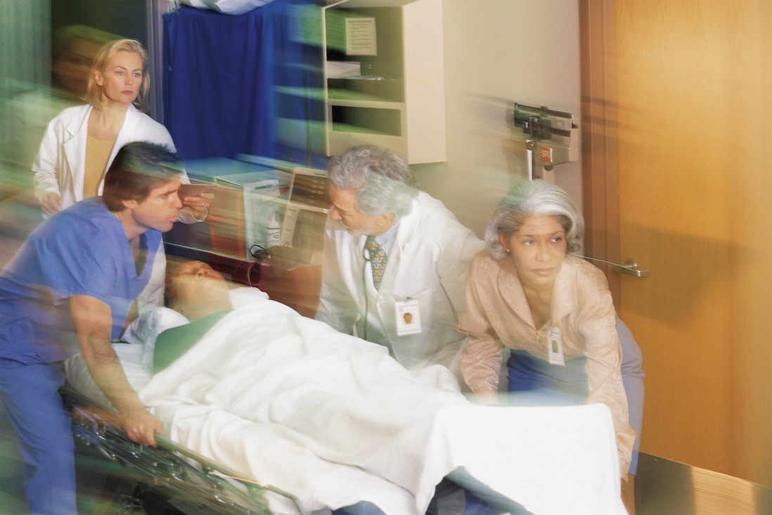
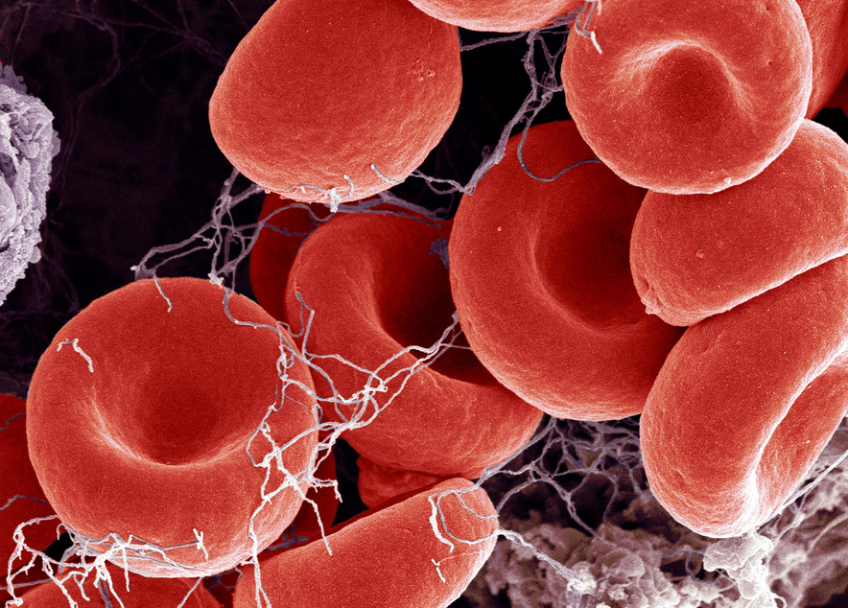

Case Study: Life-Threatening GI Bleeds and Anticoagulation Reversal in the ED
Richard Body, MB ChB, PhD
University of Manchester
Manchester, United Kingdom

Slide 2
DISCLAIMER
The views and opinions expressed in this educational activity are those of the faculty and do not necessarily represent the views of TotalCME, Inc., the CME providers, or the companies providing educational grants. This presentation is not intended to define an exclusive course of patient management; the participant should use their clinical judgment, knowledge, experience, and diagnostic skills in applying or adopting for professional use any of the information provided herein. Any procedures, medications, or other courses of diagnosis or treatment discussed or suggested in this activity should not be used by clinicians without evaluation of their patient's conditions and possible contraindications or dangers in use, review of any applicable manufacturer’s product information, and comparison with recommendations of other authorities. Links to other sites may be provided as additional sources of information.

Slide 3
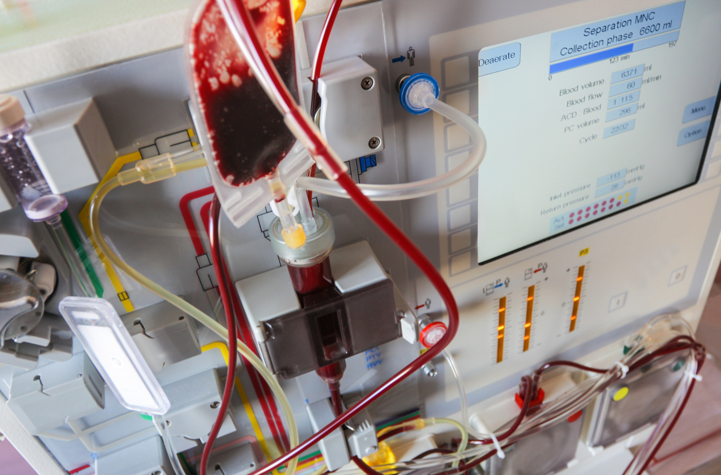

CASE STUDY
A 75-year-old man taking apixaban presenting with upper GI bleeding

Slide 4
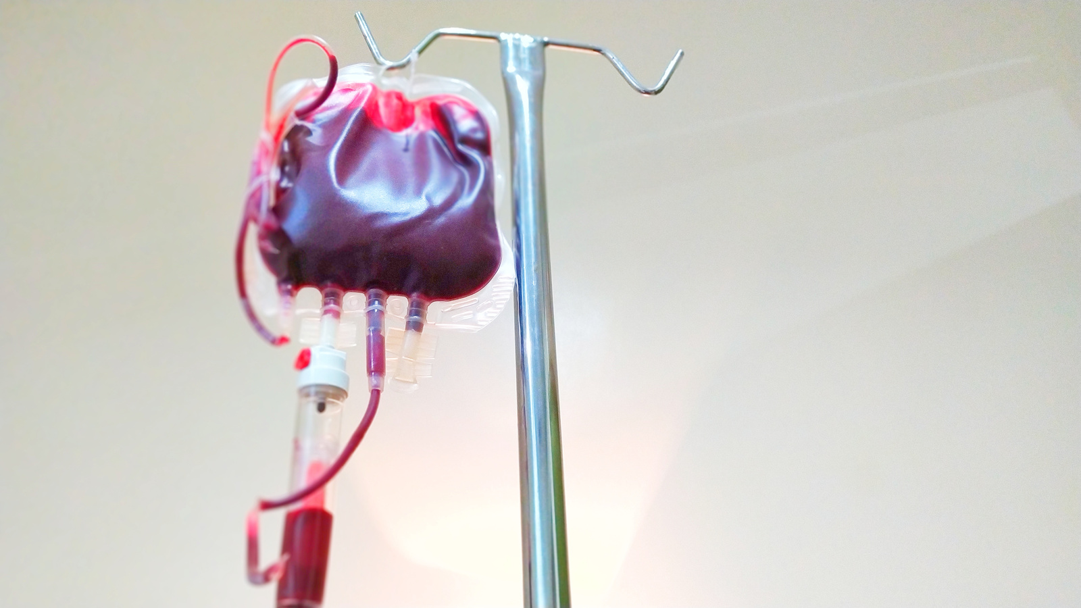
CASE STUDY
HISTORY
Vomiting bright red blood for 2 hours
Became unresponsive in the ambulance
Takes apixaban for atrial fibrillation
Last dose unknown, presumed to be a few hours ago
EXAMINATION
Airway patent
Blood pressure 80/40, heart rate 130 irregular
Actively vomiting blood
GCS 11/15, E2 V4 M5
PRESENTING FEATURES

Slide 5

1
THE BASICS
Activate Major Haemorrhage Pathway
2 large bore IV cannulas
Blood gas, blood count, crossmatch, coagulation profile, apixaban level
FIRST,
RESUSCITATE
2
REPLACE BLOOD
O positive
Get FFP ready
Await platelet count
3
CALL FOR HELP
Gastroenterology
Radiology
Haematology

Slide 6
1
PREPARATION
NG tube
Optimise physiology
Experienced team
SECURE THE
AIRWAY
2
TECHNIQUE
Head-up
SALAD technique
Low-dose induction, high-dose paralytic

Slide 7
1
INFORMATION TO DATE
No history of varices
No stigmata of liver disease
No risk factors for varices
CONSIDER
THE CAUSE
2
APPROACH
No TXA
No proton-pump inhibitor
No terlipressin/ octreotide
Urgent upper GI endoscopy

Slide 8
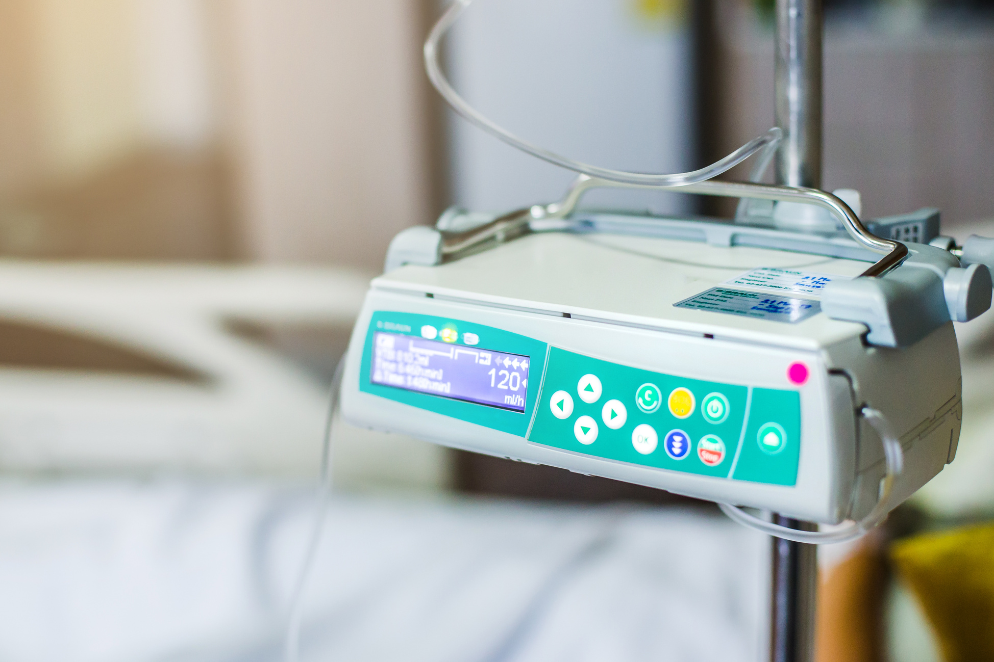
REVERSAL/ REPLETION
STRATEGY
The patient is eligible for andexanet alfa.
Treatment is indicated as soon as possible.

Slide 9
1
ENDOSCOPY
Endoscopy in the Resus Room shows gastric erosions only
2
CT SCAN
PROGRESS
Contrast CT scan shows no contrast extravasation
Large bowel thickening consistent with colitis, possibly ischaemic
3
PATIENT CONDITION
The patient's condition stabilised
No further drop in haemoglobin
Now approximately 6 hours post-arrival
Taken to Critical Care

