Slide 1

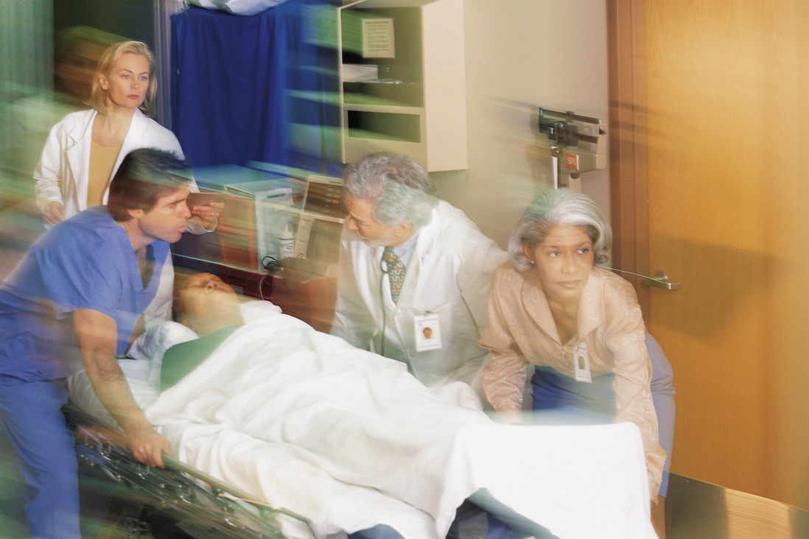
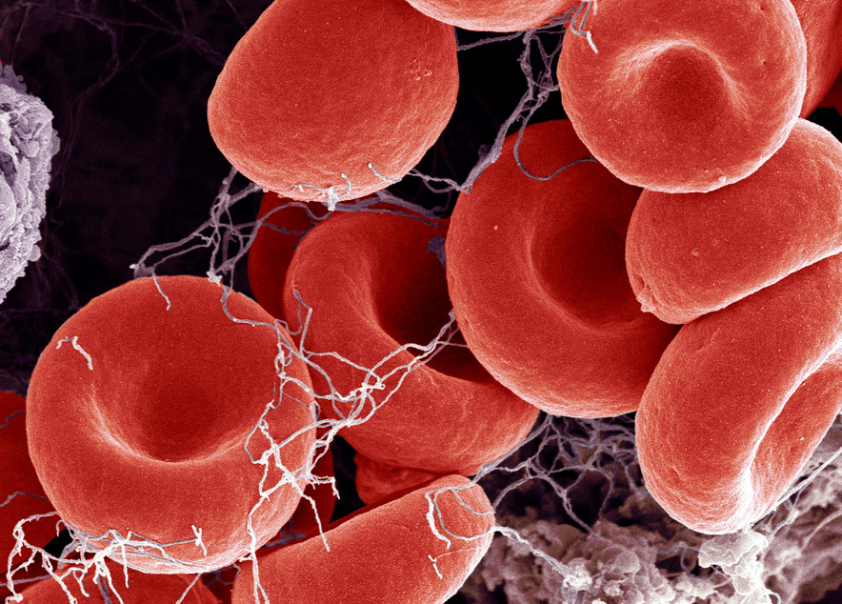

Life-Threatening GI Bleeds and Anticoagulation Reversal in the ED
Richard Body, MB ChB, PhD
University of Manchester
Manchester, United Kingdom

Slide 2
DISCLAIMER
The views and opinions expressed in this educational activity are those of the faculty and do not necessarily represent the views of TotalCME, Inc., the CME providers, or the companies providing educational grants. This presentation is not intended to define an exclusive course of patient management; the participant should use their clinical judgment, knowledge, experience, and diagnostic skills in applying or adopting for professional use any of the information provided herein. Any procedures, medications, or other courses of diagnosis or treatment discussed or suggested in this activity should not be used by clinicians without evaluation of their patient's conditions and possible contraindications or dangers in use, review of any applicable manufacturer’s product information, and comparison with recommendations of other authorities. Links to other sites may be provided as additional sources of information.

Slide 3
DISCLOSURES
Richard Body, MB ChB, PhD, faculty for this educational event, has received consulting fees from Abbott Point of Care, Aptamer Group, Beckman Coulter, Creavo, LumiraDx, Radiometer, Roche Diagnostics, and Siemens Healthineers.

Slide 4


FIRST, RESUSCITATE
ABCDE with special considerations
AIRWAY
CIRCULATION
  Consider early intubation
  NG tube prior to RSI
  SALAD approach
  Head-up
  Low induction, high paralytic
  Replace blood with blood
  Platelets if count <50
  FFP if PT >1.5 x normal
  Cryoprecipitate if fibrinogen <1.5g/L despite FFP
CORRECT HYPOTHERMIA!
ABCDE, airway, breathing, circulation, disability, exposure; FFP, fresh frozen plasma; PT, prothrombin time; RSI, rapid sequence intubation; SALAD, suction assisted laryngoscopy and airway contamination

Slide 5

THINK ABOUT THE CAUSE
Upper GI bleed
AORTO-ENTERIC FISTULA
VARICEAL
NON-VARICEAL
  Presents with massive haemorrhage
  Consider in patients with known aortic pathology
  Terlipressin/octreotide
  Ceftriaxone
  Consider Blakemore/Segstaken tube
  No proton pump inhibitors
  No terlipressin/octreotide
  No TXA!
Theatre
Urgent endoscopy
TXA, tranexamic acid

Slide 6
THINK ABOUT THE CAUSE
Lower GI bleed
  Most commonly diverticular
  Haemorrhoidal
  Angioectasia
  Rectal proctopathy following radiotherapy
  Colitis, Cancer, Polyps
  Consider CT angiography
  If no lower GI source found, consider upper GI endoscopy
  Reserve surgery for cases that cannot be resolved using radiological or endoscopic means

Slide 7



REVERSAL & REPLETION
COUMARIN/WARFARIN
4-factor PCC
Vitamin K
DOACs
Xa inhibitors: Andexanet alfa
IIb inhibitors: Idarucizumab

Slide 8
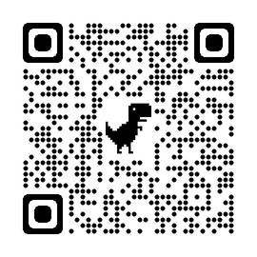
ANDEXANET ALFA
  Only 62 patients with GI bleeding evaluated for efficacy in the ANNEXA-4 trial
  No control group
  Cost of one treatment (BNF): ~£22K
  Specific reversal agent
  82% of patients shown to achieve excellent or good haemostasis at 12h
  NICE recommendation
NICE Technology Appraisal 697
ANNEXA-4, Novel Antidote to the Anticoagulation Effects of Factor Xa Inhibitors; BNF, British National Formulary; NICE, National Institute for Health and Care Excellence (UK)

Slide 9
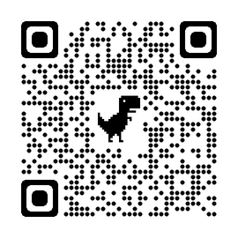
IDARUCIZUMAB
  Specific reversal agent
  Median maximal reversal of dabigatran 100%
  Normal peri-procedural haemostasis in 93% of patients
  NICE recommendation
  Only 137 patients with GI bleeding in the REVERSE-AD trial
  No control group
  Cost ~£2,400 (BNF)
Pollack et al, NEJM 2017

Slide 10



IN SUMMARY
First, resuscitate
Think about the cause
Reverse and/or replete

