Slide 1

Case Study:
Intracranial Hemorrhage and Anticoagulation Reversal in the ED
Barbra Backus, MD, PhD
Emergency Physician
Franciscus Gasthuis and Vlietland Rotterdam, Netherlands
@barbrabackus

Slide 2
Disclaimer
The views and opinions expressed in this educational activity are those of the faculty and do not necessarily represent the views of TotalCME, Inc., the CME providers, or the companies providing educational grants. This presentation is not intended to define an exclusive course of patient management; the participant should use their clinical judgment, knowledge, experience, and diagnostic skills in applying or adopting for professional use any of the information provided herein. Any procedures, medications, or other courses of diagnosis or treatment discussed or suggested in this activity should not be used by clinicians without evaluation of their patient's conditions and possible contraindications or dangers in use, review of any applicable manufacturer’s product information, and comparison with recommendations of other authorities. Links to other sites may be provided as additional sources of information.

Slide 3
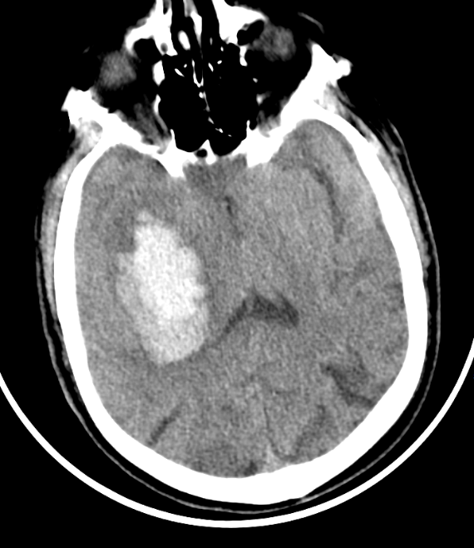
Case Study
58 year old female
Acute onset left sided weakness
History of atrial fibrillation
On Rivaroxaban 15 mg
What are your next steps?

Slide 4

Specific Intracranial Hemorrhage Management
Neurosurgery / radiology / hematology consultation
Lower blood pressure
Reversal of anticoagulation → start immediately
Hyperosmolar therapy to reduce ICP
CT angiogram

Slide 5
Decision on Reversal Strategy
Coumarin Blocks Synthesis of Factors II, VII, IX, and X
Intrinsic Pathway
Extrinsic Pathway
Xa
Rivaroxaban
Apixaban
Edoxaban
Betrixaban
REPLETION
Prothrombin (II)
Thrombin (IIa)
Dabigatran
REVERSAL
Fibrinogen (I)
Fibrin
(Ia)
DOACs Show Targeted Activity
XIIIa
Cross-linked
Fibrin clot

Slide 6
Decision on Reversal Strategy
Idarucizumab
5 gr iv
4F PCC
25-50 IE/kg iv
Vitamin K
1-10 mg iv
Andexanet Alfa
400-800 mg iv
Tranexamic acid 1 gr iv

Slide 7
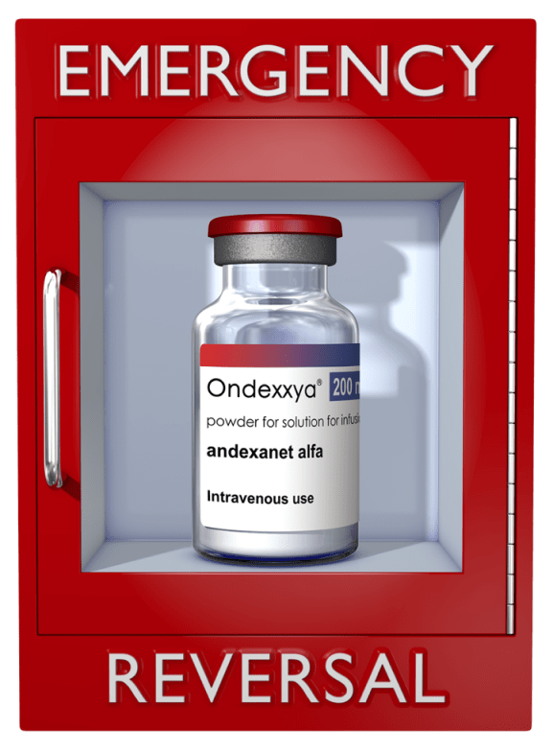
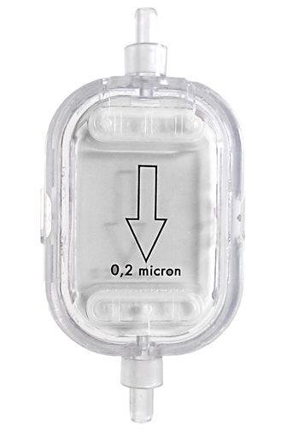
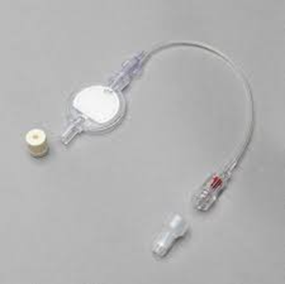
Practical Steps of Antidote
Availability (Andexanet alfa in your hospital? Where?)
Instruction of your team (protocol, dosage, infusion)
Material / use of filter
Correct dosage
Costs

Slide 8
Practical Steps / Dosage
Fxa inhibitor
Last individual dose
Time since last individual dose
< 8 hours
≥ 8 hours
Unknown
≤ 5mg
> 5 mg or unknown
low
low
low
Apixaban
HIGH
low
HIGH
≤ 10mg
> 10 mg or unknown
low
low
low
Rivaroxaban
HIGH
low
HIGH

Slide 9
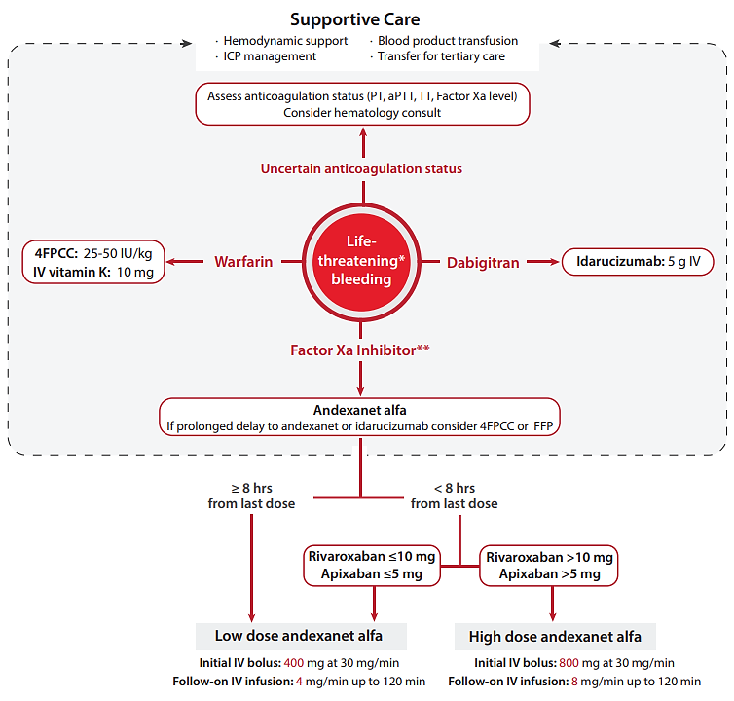
Treatment Algorithm for the Reversal of Anticoagulation:
EMCREG-International
Dabigatran

Slide 10
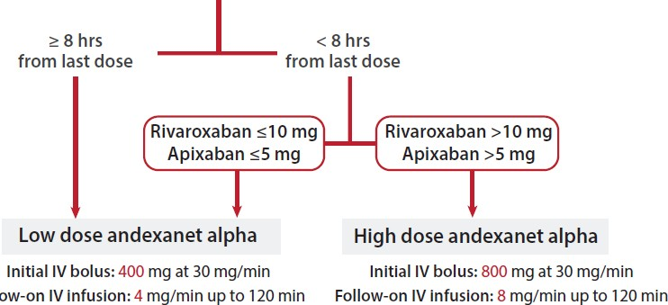
Use of Andexanet Alfa
Low dose andexanet alfa
High dose andexanet alfa
Follow-on IV infusion:

Slide 11
Summary
Patients on OAC carry a risk of severe intracranial bleeding
In case of severe bleeding first supportive care
Knowledge of reversal strategies is important for Emergency Physicians
Most important, which OAC, when and how much
For Coumarin derivates: replete with 4FPCC and Vitamin K
For DOACs: use a specific reversal agent, right dosage, right protocol, use filter

