Slide 1
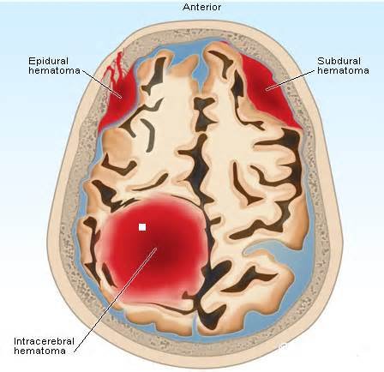

Intracranial Hemorrhage and Anticoagulation Reversal in the ED
Barbra Backus, MD, PhD
Emergency Physician
Franciscus Gasthuis and Vlietland Rotterdam, Netherlands
@barbrabackus

Slide 2
Disclaimer
The views and opinions expressed in this educational activity are those of the faculty and do not necessarily represent the views of TotalCME, Inc., the CME providers, or the companies providing educational grants. This presentation is not intended to define an exclusive course of patient management; the participant should use their clinical judgment, knowledge, experience, and diagnostic skills in applying or adopting for professional use any of the information provided herein. Any procedures, medications, or other courses of diagnosis or treatment discussed or suggested in this activity should not be used by clinicians without evaluation of their patient's conditions and possible contraindications or dangers in use, review of any applicable manufacturer’s product information, and comparison with recommendations of other authorities. Links to other sites may be provided as additional sources of information.

Slide 3
Intracranial Bleeding
Increasing with age, (vascular) comorbidity and use of anticoagulants
FXa inhibitor-related ICH affect 0.33-0.5% of patients per year
  30-day mortality range of 45-48%
80% of ICH patients treated with Andexanet Alfa had excellent or good hemostatic efficacy 12 hours after infusion
  30-day mortality ↓ to 16% (37/229) for ICH

Slide 4

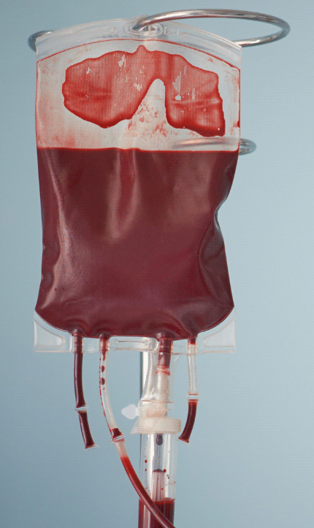
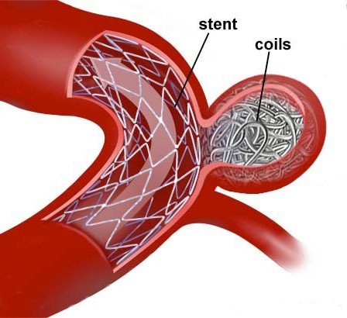
Oral Anticoagulant Related Bleeding
Resuscitation and hemodynamic support
Beware of hematoma expansion, RR control
Order blood when needed
Tranexamic acid 1 gram iv
Targeted intervention–interventional
radiology
Reversal of anticoagulants?

Slide 5
Reversal or Repletion Indicated?
Is this patient really anticoagulated? Medication used?
Which anticoagulant is this patient using?
When was the last time medication was taken?
What is the half-life of the medication?
What is the renal function?
 | Warfarin | Dabigatran | Rivaroxaban | Apixaban
Half-life, hour | 40 | 14-17 | 5-9 | 10-14
Peak onset of action, hour | > 4 | 2 | 2-4 | 1-4
Renal clearance, % | negligible | 80 | 35 | 27

