Slide 1
Optimizing Therapeutic Selection for a Patient With Newly Diagnosed BRAF V600e-Mutated Metastatic Melanoma
Allison Betof Warner, MD, PhD
Assistant Professor of Medicine (Oncology)
Mark and Mary Stevens Endowed Scholar in Melanoma
Director, Melanoma Program
Director, Solid Tumor Cellular Therapy
Leader, Melanoma & Cutaneous Oncology Clinical Research Group
Stanford University School of Medicine
Stanford, CA

Slide 2



Resource Information
About This Resource
These slides are one component of a continuing education program available online at MedEd On The Go titled Leveraging LAG-3: Innovative Immunotherapy Combinations for First-Line Metastatic Melanoma Treatment
Program Learning Objectives:
Describe the synergistic interaction between LAG-3 and other immune checkpoints
Evaluate recent practice-changing data on the use of LAG-3/PD-1 combination ICI therapy in patients with
metastatic melanoma
Select appropriate evidence-based dual ICI treatment regimens for newly diagnosed patients with metastatic melanoma
Recognize and manage treatment-related adverse events associated with the use of LAG-3/PD-1 combination ICI regimens
MedEd On The Go®
www.mededonthego.com
This content or portions thereof may not be published, posted online or used in presentations without permission.
This content can be saved for personal use (non-commercial use only) with credit given to the resource authors.
To contact us regarding inaccuracies, omissions or permissions please email us at support@MedEdOTG.com

Slide 3
Disclaimer
The views and opinions expressed in this educational activity are those of the faculty and do not necessarily represent the views of Total CME, LLC, the CME providers, or the companies providing educational grants. This presentation is not intended to define an exclusive course of patient management; the participant should use their clinical judgment, knowledge, experience, and diagnostic skills in applying or adopting for professional use any of the information provided herein. Any procedures, medications, or other courses of diagnosis or treatment discussed or suggested in this activity should not be used by clinicians without evaluation of their patient's conditions and possible contraindications or dangers in use, review of any applicable manufacturer’s product information, and comparison with recommendations of other authorities. Links to other sites may be provided as additional sources of information.

Slide 4
Case History
68-year-old Caucasian man with a history of stage IIA cutaneous melanoma in 2019 on his left shoulder which was treated with wide local excision and sentinel lymph node biopsy
Initial PET scan at time of diagnosis was negative for metastatic disease
Patient had regular dermatology follow up with no evidence of recurrence until fall 2022 when he presented with a large non-painful mass on his left shoulder. FNA in clinic was positive for recurrent melanoma
PET scan: 10 cm mass on L shoulder, L axillary lymphadenopathy, 5 new FDG-avid 1-2 cm pulmonary nodules in both lungs consistent with metastatic disease
Seen in medical oncology clinic. ECOG 0. Exam notable for L shoulder mass, palpable L axillary lymphadenopathy. CBC and CMP within normal limits. LDH was not elevated
Core biopsy of lung nodule confirms metastatic melanoma. Next-generation sequencing shows BRAF V600E mutation
Brain MRI negative for intracranial metastasis

Slide 5
What Should You Do Next?
Start targeted therapy with BRAF inhibitor
Start targeted therapy with combination BRAF + MEK inhibitors
Start a dual immune checkpoint inhibitor regimen
Start a single agent anti-PD-1 regimen

Slide 6
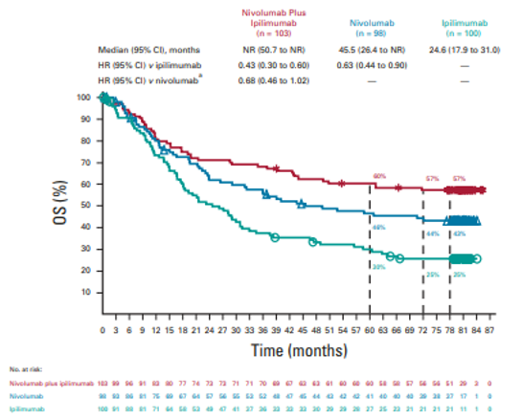
Dual Versus Single Agent ICI in BRAF-Mutant Metastatic Melanoma: CheckMate-067

Slide 7
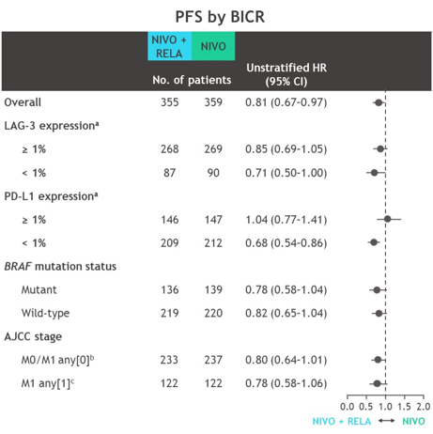
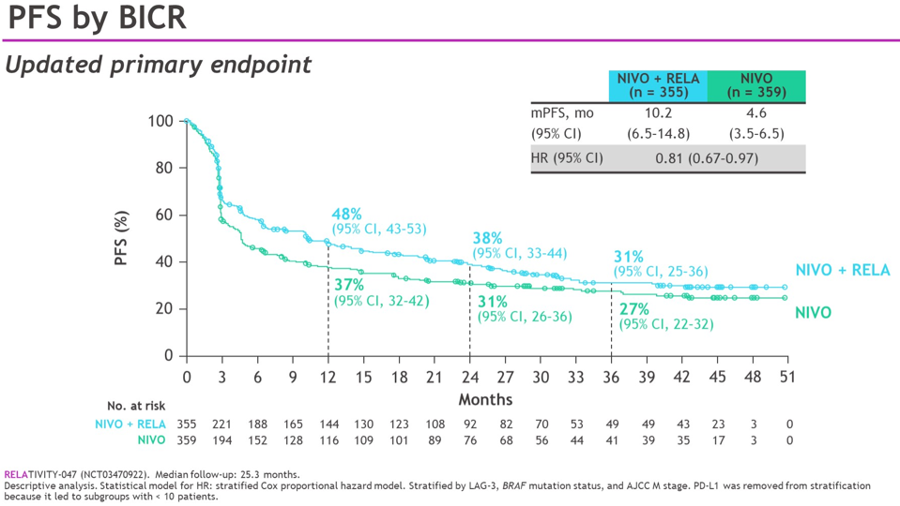
Dual Versus Single Agent ICI in BRAF-Mutant Metastatic Melanoma: RELATIVITY-047

Slide 8
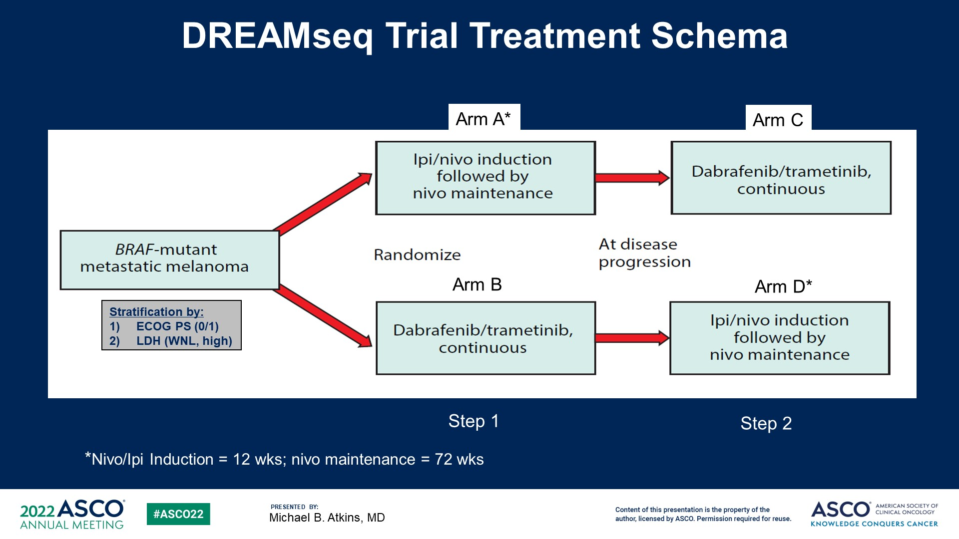
What Is the Optimal Sequence of Therapy for Patients with BRAF-Mutant Melanoma?
DREAMseq Trial Design (ECOG-ACRIN 6134)

Slide 9
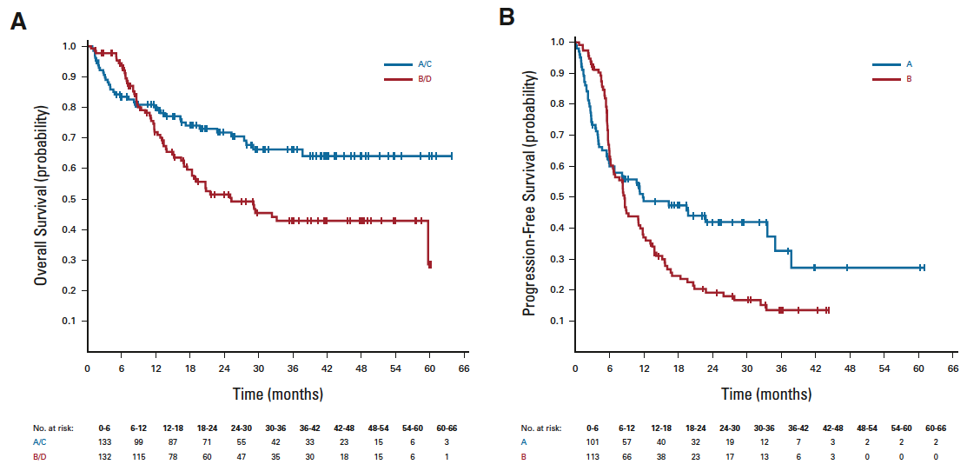
DREAMseq: What Is the Optimal Sequence of Therapy for Patients with BRAF-Mutant Melanoma?
At disease progression: dabraf/tramet continuous
Ipi/nivo induction followed by nivo maintenance
At disease progression: ipi/nivo induction followed by nivo maintenance
Dabraf/tramet continuous

Slide 10
What Is the Optimal Sequence of Therapy for Patients with BRAF-Mutant Melanoma?
SECOMBIT
Arm A
Encorafenib + binimetinib
until progression
NIVO/IPI
until progression
Patients with untreated, metastatic BRAF^{V600}-mutated melanoma
(N = 251 )
NIVO/IPI
until progression
Encorafenib + binimetinib
until progression
Arm B
Encorafenib + binimetinib
for 8 weeks
NIVO/IPI
until progression
Encorafenib + binimetinib
until progression
Arm C

Slide 11
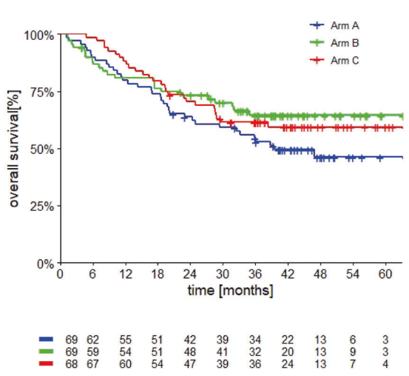
SECOMBIT: What Is the Optimal Sequence of Therapy for Patients with BRAF-Mutant Melanoma?
Encor/bini followed by nivo/ipi
Nivo/ipi followed by encor/bini
Encor/bini x 8 weeks then
nivo/ipi followed by encor/bini

Slide 12
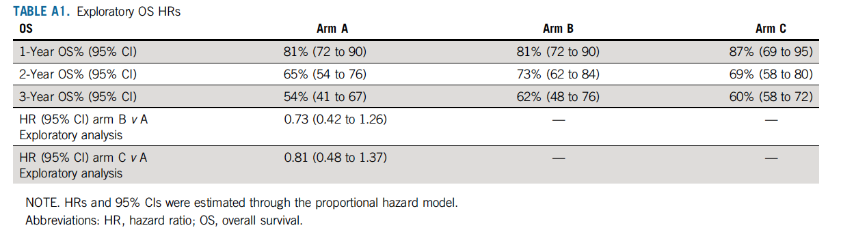
What Is the Optimal Sequence of Therapy for Patients with BRAF-Mutant Melanoma?
Arm A: Encor/bini followed by nivo/ipi
Arm B: Nivo/ipi followed by encor/bini
Arm C: Encor/bini x 8 weeks then
nivo/ipi followed by encor/bini

Slide 13
Summary
CheckMate-067 demonstrated an overall survival benefit of dual immunotherapy with anti-CTLA4/anti-PD-1 over single agent immunotherapy in BRAF-mutant metastatic melanoma
RELATIVITY-047 demonstrated a progression free survival benefit of dual immunotherapy with anti-LAG-3/anti-PD-1 over single agent immunotherapy in BRAF-mutant metastatic melanoma
DreamSeq and SECOMBIT support sequencing dual immunotherapy prior to BRAF-targeted therapy in newly diagnosed BRAF-mutant metastatic melanoma

Slide 14



Looking for more resources
on this topic?
CME/CE in minutes
Congress highlights
Late-breaking data
Quizzes
Webinars
In-person events
Slides & resources
www.MedEdOTG.com

