Slide 1
Navigating Treatment-Related Adverse Effects in LAG-3 Combination ICI Therapy for Metastatic Melanoma
Allison Betof Warner, MD, PhD
Assistant Professor of Medicine (Oncology)
Mark and Mary Stevens Endowed Scholar in Melanoma
Director, Melanoma Program
Director, Solid Tumor Cellular Therapy
Leader, Melanoma & Cutaneous Oncology Clinical Research Group
Stanford University School of Medicine
Stanford, CA

Slide 2



Resource Information
About This Resource
These slides are one component of a continuing education program available online at MedEd On The Go titled Leveraging LAG-3: Innovative Immunotherapy Combinations for First-Line Metastatic Melanoma Treatment
Program Learning Objectives:
Describe the synergistic interaction between LAG-3 and other immune checkpoints
Evaluate recent practice-changing data on the use of LAG-3/PD-1 combination ICI therapy in patients with metastatic melanoma
Select appropriate evidence-based dual ICI treatment regimens for newly diagnosed patients with metastatic melanoma
Recognize and manage treatment-related adverse events associated with the use of LAG-3/PD-1 combination ICI regimens
MedEd On The Go®
www.mededonthego.com
This content or portions thereof may not be published, posted online or used in presentations without permission.
This content can be saved for personal use (non-commercial use only) with credit given to the resource authors.
To contact us regarding inaccuracies, omissions or permissions please email us at support@MedEdOTG.com

Slide 3
Disclaimer
The views and opinions expressed in this educational activity are those of the faculty and do not necessarily represent the views of Total CME, LLC, the CME providers, or the companies providing educational grants. This presentation is not intended to define an exclusive course of patient management; the participant should use their clinical judgment, knowledge, experience, and diagnostic skills in applying or adopting for professional use any of the information provided herein. Any procedures, medications, or other courses of diagnosis or treatment discussed or suggested in this activity should not be used by clinicians without evaluation of their patient's conditions and possible contraindications or dangers in use, review of any applicable manufacturer’s product information, and comparison with recommendations of other authorities. Links to other sites may be provided as additional sources of information.

Slide 4
Case History
43-year-old man with BRAF-wildtype cutaneous melanoma metastatic to the lungs and liver is started on nivolumab + relatlimab every 4 weeks
He tolerates cycles 1 and 2 well with no evidence of toxicity
He presents to clinic for evaluation prior to cycle 3 and reports loose stool progressing to diarrhea for the last 3 days. His baseline is one formed bowel movement daily. Three days ago, he had 4 loose bowel movements. Yesterday, he had 8 episodes of watery diarrhea, including two that woke him from sleep overnight. He has already had 3 episodes of diarrhea this morning
He denies abdominal pain or blood in his stool. He does report some mucous in the stool
C3 of nivolumab + relatlimab is held and the patient is started on 1 mg/kg prednisone

Slide 5
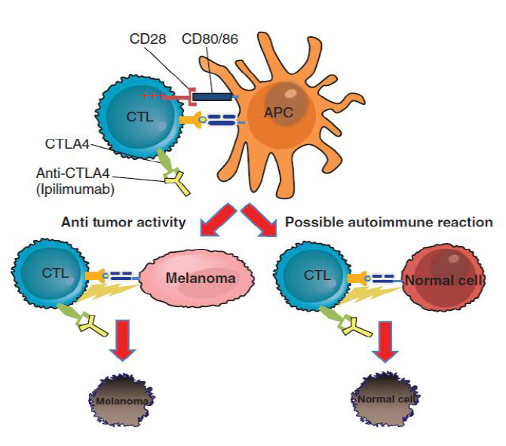
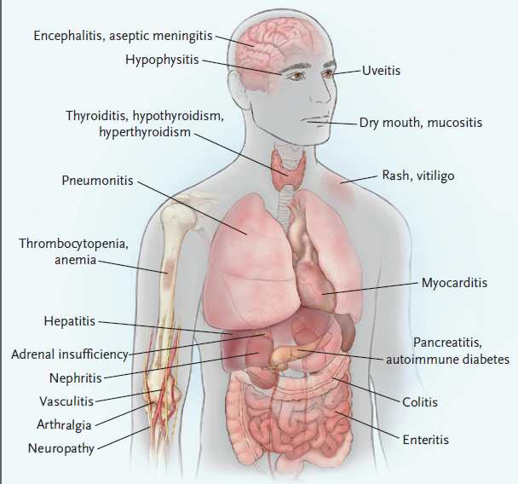
Immune-Related Adverse Events

Slide 6
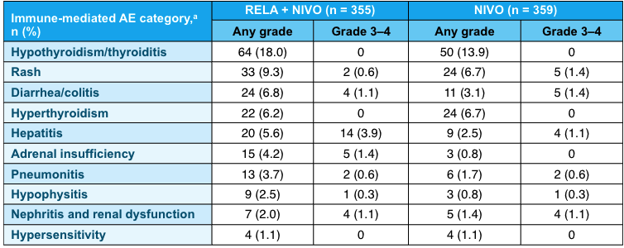
Toxicity of Nivolumab + Relatlimab
RELATIVITY-047: Nivolumab + Relatlimab vs. Nivolumab

Slide 7
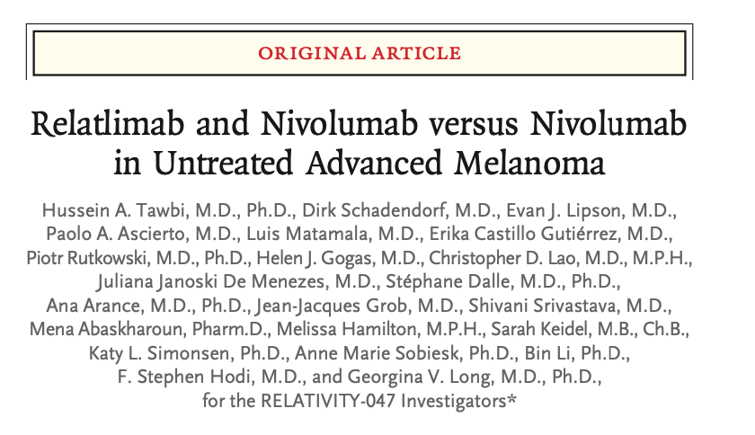
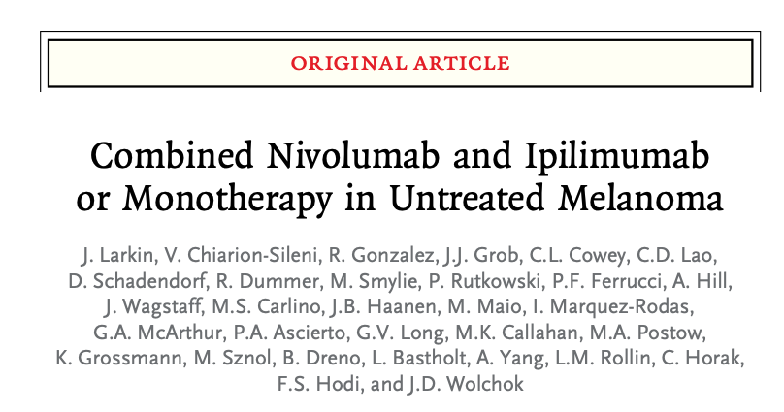
Toxicity of Dual Immune Checkpoint Regimens
Grade 3 or 4 treatment related-adverse events:
Relatlimab + Nivolumab: 18.9%
Nivolumab: 9.7%
Any grade treatment-related adverse events leading to discontinuation:
Relatlimab + Nivolumab: 14.6%
Nivolumab: 6.7%
Grade 3 or 4 treatment related-adverse events:
Ipilimumab + Nivolumab: 55%
Nivolumab: 16.3%
Any grade treatment-related adverse events leading to discontinuation:
Ipilimumab + Nivolumab: 36.4%
Nivolumab: 7.7%

Slide 8
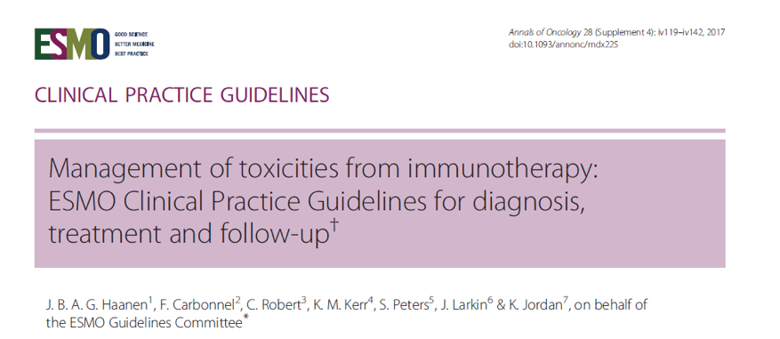
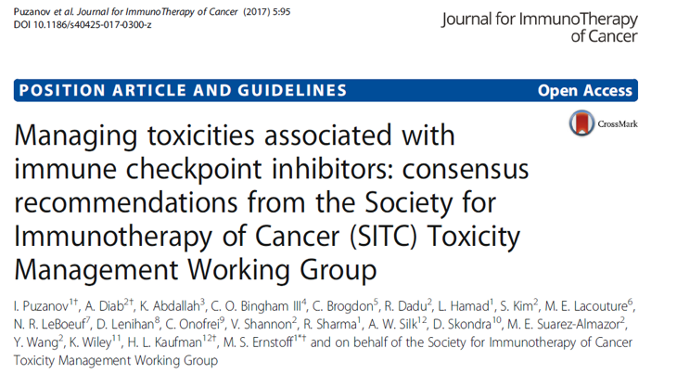
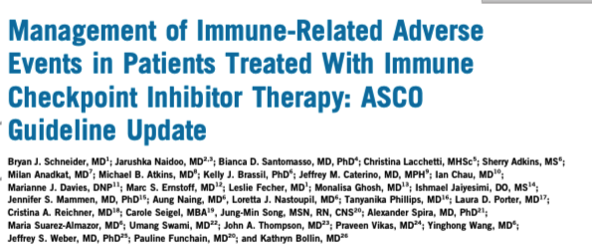

Guideline-Based Management of irAEs

Slide 9
Summary
Treatment with immune checkpoint inhibitors can be complicated by immune-related adverse events
Nivolumab + relatlimab has about 10% higher risk of toxicity than nivolumab alone
irAEs are manageable but require early recognition and often require systemic corticosteroids
Guidelines exist to facilitate appropriate management of irAEs

Slide 10



Looking for more resources on this topic?
CME/CE in minutes
Congress highlights
Late-breaking data
Quizzes
Webinars
In-person events
Slides & resources
www.MedEdOTG.com

