Slide 1
Future Directions: Targeting LAG-3 in Melanoma Treatment
Hussein Tawbi, MD, PhD
Professor
Deputy Chair, Department of Melanoma Medical Oncology
Co-Director, Andrew M. McDougall Brain Metastasis Clinic & Program
Melanoma Medical Oncology, Investigational Cancer Therapeutics
UT MD Anderson Cancer Center
Houston, TX

Slide 2
Resource Information
About This Resource
These slides are one component of a continuing education program available online at MedEd On The Go titled Leveraging LAG-3: Innovative Immunotherapy Combinations for First-Line Metastatic Melanoma Treatment
Program Learning Objectives:
Describe the synergistic interaction between LAG-3 and other immune checkpoints
Evaluate recent practice-changing data on the use of LAG-3/PD-1 combination ICI therapy in patients with metastatic melanoma
Select appropriate evidence-based dual ICI treatment regimens for newly diagnosed patients with metastatic melanoma
Recognize and manage treatment-related adverse events associated with the use of LAG-3/PD-1 combination ICI regimens
MedEd On The Go®
www.mededonthego.com
This content or portions thereof may not be published, posted online or used in presentations without permission.
This content can be saved for personal use (non-commercial use only) with credit given to the resource authors.
To contact us regarding inaccuracies, omissions or permissions please email us at support@MedEdOTG.com

Slide 3
Disclaimer
The views and opinions expressed in this educational activity are those of the faculty and do not necessarily represent the views of Total CME, LLC, the CME providers, or the companies providing educational grants. This presentation is not intended to define an exclusive course of patient management; the participant should use their clinical judgment, knowledge, experience, and diagnostic skills in applying or adopting for professional use any of the information provided herein. Any procedures, medications, or other courses of diagnosis or treatment discussed or suggested in this activity should not be used by clinicians without evaluation of their patient's conditions and possible contraindications or dangers in use, review of any applicable manufacturer’s product information, and comparison with recommendations of other authorities. Links to other sites may be provided as additional sources of information.

Slide 4
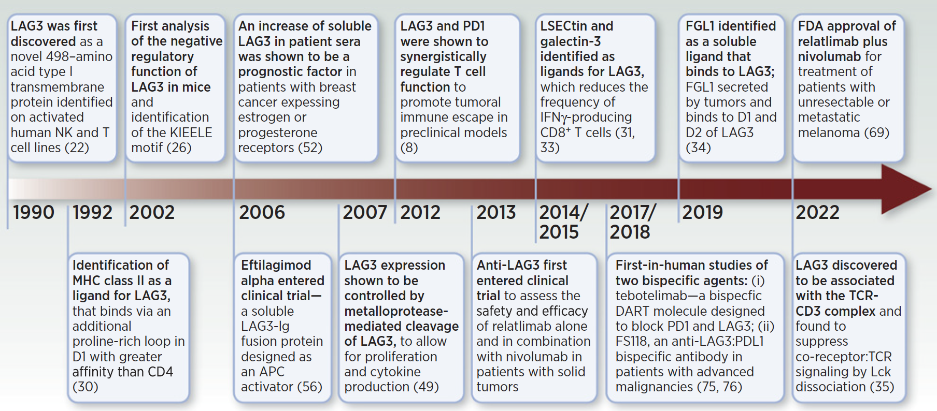
Milestones in LAG-3 Blockade

Slide 5
PFS by BICR
Updated primary endpoint
 | NIVO + RELA (n = 355) | NIVO (n = 359)
mPFS, mo | 10.2 | 4.6
(95% CI) | (6.5–14.8) | (3.5–6.5)
HR (95% CI) | 0.81 (0.67–0.97)
100
80
60
48% (95% CI, 43–53)
PFS (%)
38% (95% CI, 33–44)
40
31% (95% CI, 25–36)
NIVO + RELA
37% (95% CI, 32–42)
20
31% (95% CI, 26–36)
27% (95% CI, 22–32)
NIVO
0
0
3
6
9
12
15
18
21
24
27
30
33
36
39
42
45
48
51
No. at risk
Months
NIVO + RELA
355
221
188
165
144
130
123
108
92
82
70
53
49
49
43
23
3
0
NIVO
359
194
152
128
116
109
101
89
76
68
56
44
41
39
35
17
3
0
RELATIVITY-047 (NCT03470922). Median follow-up: 25.3 months. Descriptive analysis. Statistical model for HR: stratified Cox proportional hazard model. Stratified by LAG-3, BRAF mutation status, and AJCC M stage. PD-L1 was removed from stratification because it led to subgroups with < 10 patients.

Slide 6
OS
Updated secondary endpoint
 | NIVO + RELA (n = 355) | NIVO (n = 359)
mOS, mo | NR | 33.2
(95% CI) | (31.5–NA) | (25.2–45.8)
HR (95% CI) | 0.82 (0.67–1.02)
100
77% (95% CI, 72–81)
80
62% (95% CI, 56–67)
54% (95% CI, 49–59)
NIVO + RELA
60
52% (95% CI, 46–57)
OS (%)
72% (95% CI, 67–76)
40
58% (95% CI, 53–63)
NIVO
48% (95% CI, 43–54)
42% (95% CI, 36–49)
20
0
0
3
6
9
12
15
18
21
24
27
30
33
36
39
42
45
48
51
No. at risk
Months
NIVO + RELA
355
334
305
287
270
258
241
226
197
179
160
136
128
122
120
78
26
2
NIVO
359
329
301
278
253
238
224
211
185
162
144
118
106
104
100
64
17
0
RELATIVITY-047 (NCT03470922). Median follow-up: 25.3 months. Descriptive analysis. Statistical model for HR: stratified Cox proportional hazard model. Stratified by LAG-3, BRAF mutation status, and AJCC M stage. PD-L1 was removed from stratification because it led to subgroups with < 10 patients.

Slide 7
Best Overall Response Per BICR
Updated secondary endpoint
44%
(95% CI, 38–49)
42%
(n = 150)
31%
(n = 109)
34%
(95% CI, 29–39)
CR: 18%
(n = 64)
16%
(n = 57)
CR: 18%
(n = 63)
16%
(n = 57)
PR: 26%
(n = 91)
PR: 16%
(n = 58)
NIVO + RELA vs NIVO ORR difference of 9.8% (95% CI, 2.8–16.8)
Median duration of response was not reached in both the NIVO + RELA (NR [95% CI, 39.4–NA]) and NIVO (NR [95% CI, 39.8–NA]) arms
RELATIVITY-047 (NCT03470922). Median follow-up: 25.3 months. Descriptive analysis. 26 patients (7.3%) in the NIVO + RELA arm and 26 patients (7.2%) in the NIVO arm were classified as unable to determine.

Slide 8
PFS, OS, and ORR by LAG-3 and PD-L1 Expression
PFS by BICR
OS
ORR by BICR
 | Subgroup | NIVO + RELA | NIVO
 |  | No. of patients |  | Unstratified HR (95% CI)
Overall |  | 355 | 359 | 0.78 (0.64–0.94)
LAG-3 expression ≥ 1% < 1% |  | 268 | 269 | 0.80 (0.64–1.00)
 |  | 87 | 90 | 0.72 (0.50–1.03)
PD-L1 expression ≥ 1% < 1% |  | 146 | 147 | 0.96 (0.70–1.31)
 |  | 209 | 212 | 0.68 (0.53–0.86)
PD-L1 expression ≥ 1% and LAG-3 expression ≥ 1% |  | 134 | 140 | 0.97 (0.70–1.34)
PD-L1 expression ≥ 1% and LAG-3 expression < 1% |  | 12 | 7 | Not calculated
PD-L1 expression < 1% and LAG-3 expression ≥ 1% |  | 134 | 129 | 0.66 (0.48–0.89)
PD-L1 expression < 1% and LAG-3 expression < 1% |  | 75 | 83 | 0.72 (0.49–1.06)
Unstratified HR (95% CI)
0.81 (0.64–1.01)
0.78 (0.59–1.03)
0.88 (0.59–1.33)
0.84 (0.57–1.24)
0.78 (0.59–1.04)
0.80 (0.53–1.21)
Not calculated
0.75 (0.51–1.08)
0.87 (0.56–1.34)
NIVO + RELA | NIVO
ORR, %
43.1 | 32.6
47.0 | 35.3
31.0 | 24.4
52.7 | 44.9
36.4 | 24.1
54.5 | 44.3
33.3 | 57.1
39.6 | 25.6
30.7 | 21.7
NIVO +
RELA
Unweighted ORR difference (95% CI)
10.5 (3.4–17.5)
11.7 (3.4–19.8)
6.6 (-6.5 to 19.5)
7.8 (-3.6 to 19.0)
12.3 (3.5–20.8)
10.2 (-1.6 to 21.6)
Not calculated
14.0 (2.6–24.8)
9.0 (-4.7 to 22.4)
NIVO
ORR, %
NIVO + RELA
NIVO
NIVO + RELA
NIVO
NIVO + RELA
NIVO
PFS, OS, and ORR favored NIVO + RELA over NIVO regardless of LAG-3 and PD-L1 expression (stratification factors)

Slide 9
PFS, OS, and ORR Across Prespecified Subgroups (1 of 2)
PFS by BICR
OS
ORR by BICR
 | Subgroup | NIVO + RELA | NIVO
 |  | No. of patients |  | Unstratified HR (95% CI)
Overall |  | 355 | 359 | 0.78 (0.64–0.94)
Age | ≥ 18 and < 65 years | 187 | 196 | 0.82 (0.64–1.06)
 | ≥ 65 years | 168 | 163 | 0.74 (0.56–0.98)
 | ≥ 75 years | 66 | 60 | 0.68 (0.43–1.07)
Sex | Male | 210 | 206 | 0.71 (0.55–0.91)
 | Female | 145 | 153 | 0.89 (0.67–1.19)
Histology (disease subtype)
 | Cutaneous nonacral | 250 | 253 | 0.78 (0.62–0.98)
 | Acral | 40 | 42 | 0.84 (0.51–1.36)
 | Mucosal | 23 | 28 | 0.64 (0.32–1.25)
BRAF mutation status
 | Mutant | 136 | 139 | 0.77 (0.57–1.05)
 | Wild-type | 219 | 220 | 0.78 (0.61–0.99)
Unstratified HR (95% CI)
0.81 (0.64–1.01)
0.78 (0.57–1.08)
0.83 (0.60–1.15)
0.84 (0.50–1.39)
0.88 (0.65–1.19)
0.73 (0.52–1.03)
0.83 (0.62–1.11)
1.04 (0.60–1.79)
1.13 (0.55–2.34)
0.76 (0.51–1.15)
0.83 (0.63–1.09)
ORR, % |  | Unweighted ORR difference (95% CI)
43.1 | 32.6 | 10.5 (3.4–17.5)
39.6 | 28.6 | 11.0 (1.5–20.2)
47.0 | 37.4 | 9.6 (-1.0 to 19.9)
47.0 | 33.3 | 13.6 (-3.5 to 29.6)
48.1 | 35.0 | 13.1 (3.7–22.3)
35.9 | 29.4 | 6.5 (-4.2 to 16.9)
47.2 | 38.3 | 8.9 (0.2–17.3)
30.0 | 11.9 | 18.1 (0.4–34.9)
30.4 | 25.0 | 5.4 (-18.2 to 29.3)
42.6 | 30.9 | 11.7 (0.3–22.7)
43.4 | 33.6 | 9.7 (0.6–18.6)
NIVO + RELA
NIVO
NIVO + RELA
NIVO
NIVO + RELA
NIVO
NIVO + RELA
NIVO
PFS, OS, and ORR favored NIVO + RELA over NIVO across key prespecified subgroups

Slide 10
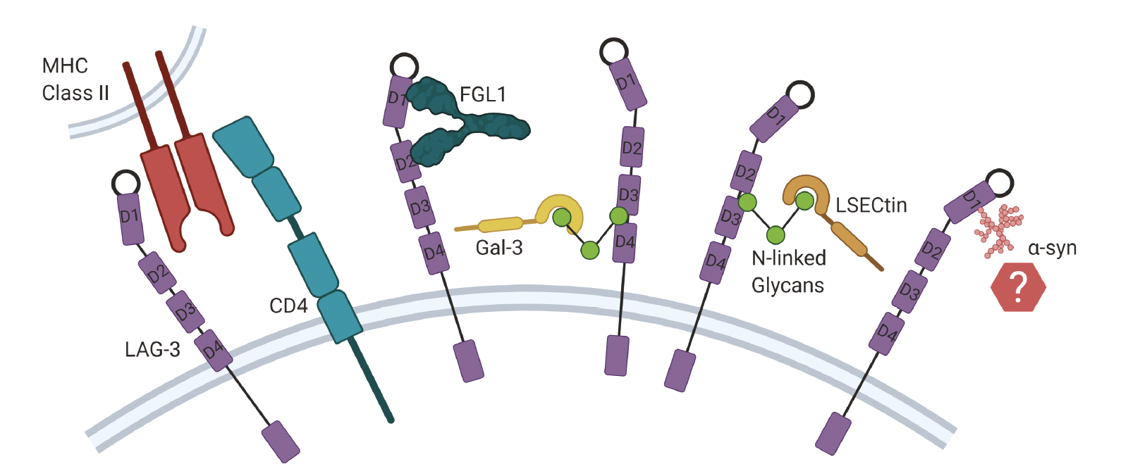
LAG-3 Ligand, MHC Class II?

Slide 11
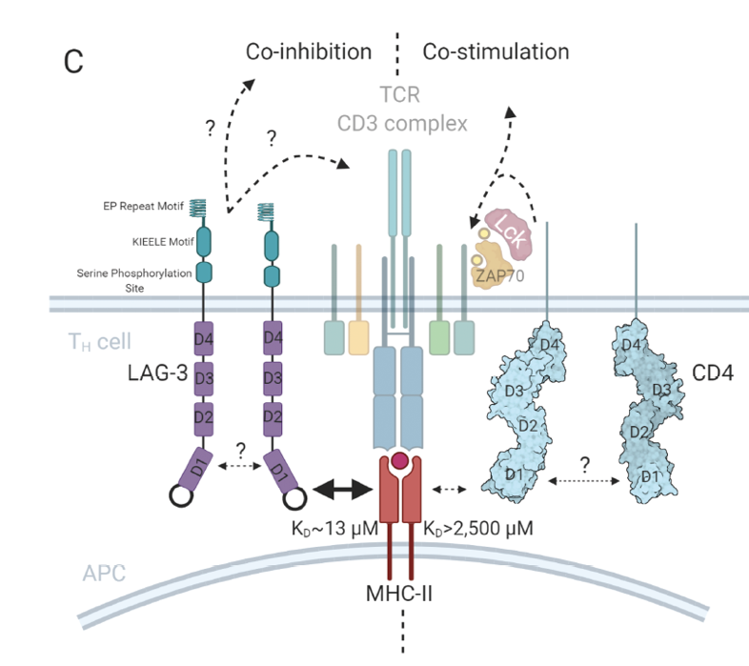
LAG-3 Intracellular Signaling
LAG-3 dimerization required for optimal MHCII binding
No ITIM & unique intracellular KIEELE motif
Role of EP Repeat & Serine phosphorylation site FxxL more relevant
Co-localization with TCR/CD3 complex
LAG-3 activation leads to decreased ZAP70 phosphorylation
LAG-3 modulates TCR signaling

Slide 12
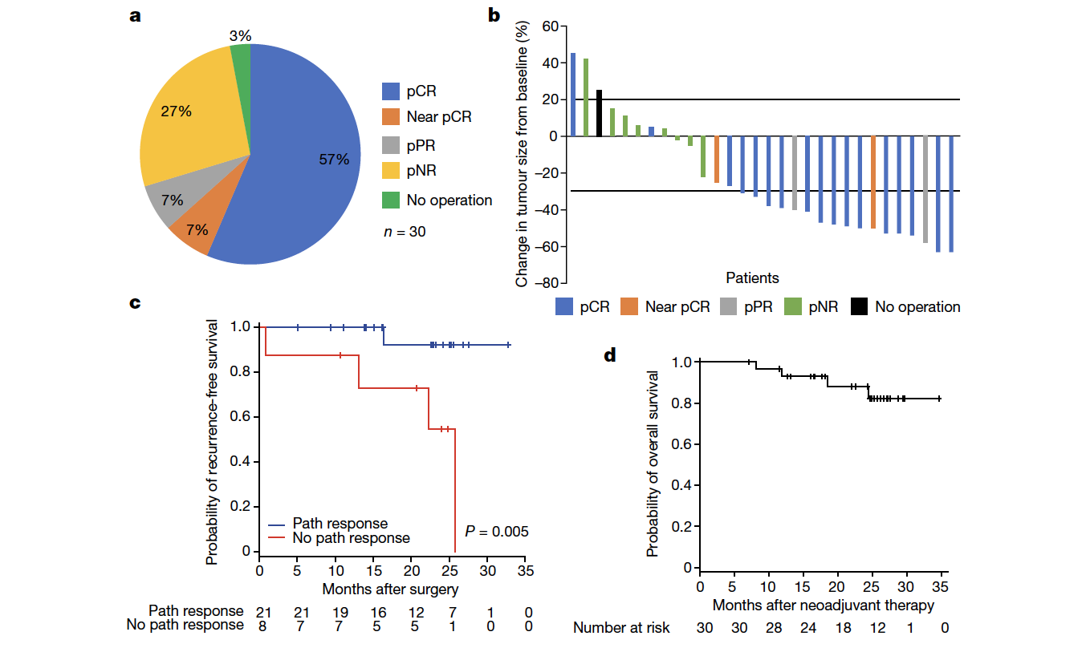
Neoadjuvant Relatlimab + Nivolumab
pCR of 57%
No grade 3 to 4 toxicity in neoadjuvant phase
pCR associated with excellent RFS

Slide 13
Phase II of Nivo + Rela in Untreated MBM (BLUEBONNET)
Cohort
Safety MRI to monitor intracranial disease at
4 weeks*
Efficacy MRI to monitor intracranial response at
12 weeks
NIVO 480mg+RELA 160mg q4w
NIVO 480mg+RELA 160mg q4w x 2 doses
n = 30
NIVO 480mg+RELA 160mg q4w
Clinically stable
Responders
*Not a response imaging evaluation, asymptomatic progression will be allowed to continue.
◊SRS allowed at progression as needed
Key eligibility:
1 or greater measurable, unirradiated MBM (0.5-3.0 cm)
Prior SRT in 5 or less MBM
Previous treatment with BRAFi/MEKi permitted
No prior checkpoint inhibitor therapy for advanced disease
Exclusion criteria: Neurological symptoms; steroids greater than 10 days; WBRT; prior treatment with checkpoint inhibitors; leptomeningeal disease
Primary endpoint: Intracranial ORR by modified RECIST
Select secondary endpoints: CBR, PFS, OS
Exploratory endpoint: SRS-assisted PFS
Hypothesis: Nivo + rela is safe and will result in higher intracranial efficacy comparable to nivo alone
Statistics- 82% power to detect difference between 20% and 40%, BOP2 futility monitoring

Slide 14
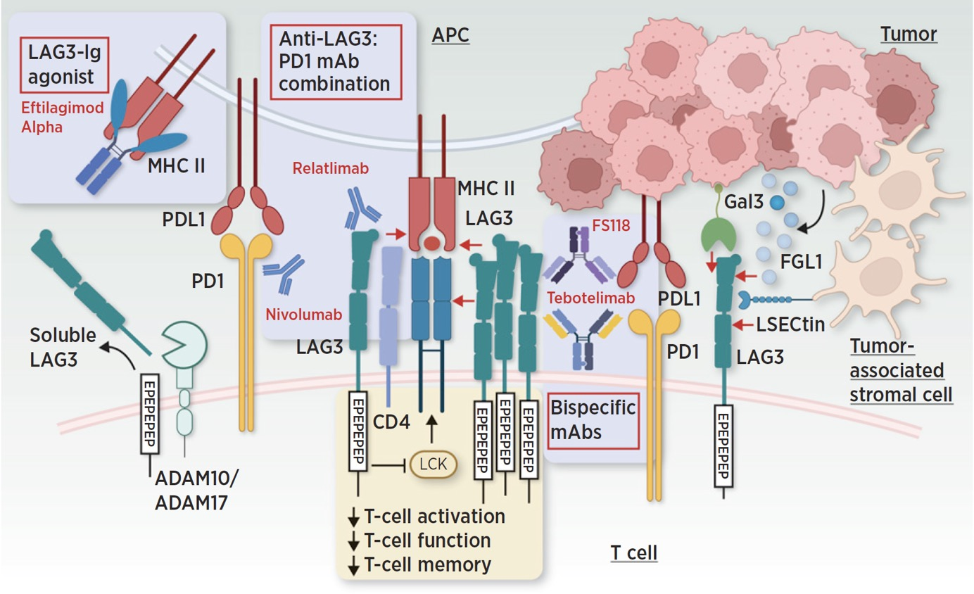
Agents in Development Targeting LAG-3

Slide 15
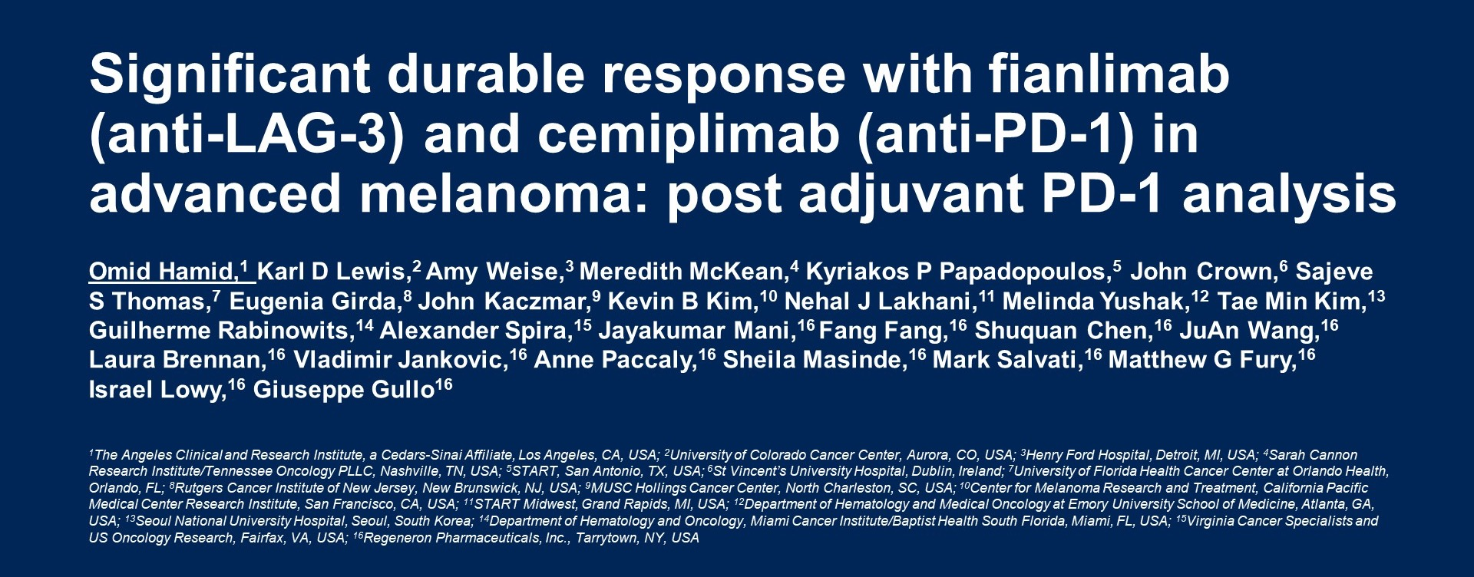
Significant durable response with fianlimab <br />(anti-LAG-3) and cemiplimab (anti-PD-1) in advanced melanoma: post adjuvant PD-1 analysis

Slide 16
Tumor response: combined cohorts

Slide 17
Unanswered Questions
Structure and function of LAG-3
Biomarkers of response and resistance
Impact of anti-LAG-3 + anti-PD1 in other settings in melanoma
Brain metastases
Adjuvant stage III
Adjuvant stage II
Rare melanoma subtypes (acral, mucosal, uveal, desmoplastic)
Other combos: anti-LAG-3 + anti-CTLA4 +/- anti-PD1
Other agents- bispecifics, other targets

Slide 18
Take Home Message
LAG-3 is a novel checkpoint with unique immune suppressive properties
LAG-3 blockade is now validated as a therapeutic target in combination
FDA approval in melanoma starts a new era of investigation
Many unanswered questions that provide opportunities to improve upon existing therapies and re-invigorate drug development
Biomarkers of response and resistance critical to drive future breakthroughs

Slide 19
Looking for more resources on this topic?
CME/CE in minutes
Congress highlights
Late-breaking data
Quizzes
Webinars
In-person events
Slides & resources
www.MedEdOTG.com

