Slide 1
First Line Treatment Of Metastatic Melanoma After Adjuvant Anti-PD-1
Allison Betof Warner, MD, PhD
Assistant Professor of Medicine (Oncology)
Mark and Mary Stevens Endowed Scholar in Melanoma
Director, Melanoma Program
Director, Solid Tumor Cellular Therapy
Leader, Melanoma & Cutaneous Oncology Clinical Research Group
Stanford University School of Medicine
Stanford, CA

Slide 2



Resource Information
About This Resource
These slides are one component of a continuing education program available online at MedEd On The Go titled Leveraging LAG-3: Innovative Immunotherapy Combinations for First-Line Metastatic Melanoma Treatment
Program Learning Objectives:
Describe the synergistic interaction between LAG-3 and other immune checkpoints
Evaluate recent practice-changing data on the use of LAG-3/PD-1 combination ICI therapy in patients with metastatic melanoma
Select appropriate evidence-based dual ICI treatment regimens for newly diagnosed patients with metastatic melanoma
Recognize and manage treatment-related adverse events associated with the use of LAG-3/PD-1 combination ICI regimens
MedEd On The Go®
www.mededonthego.com
This content or portions thereof may not be published, posted online or used in presentations without permission.
This content can be saved for personal use (non-commercial use only) with credit given to the resource authors.
To contact us regarding inaccuracies, omissions or permissions please email us at support@MedEdOTG.com

Slide 3
Disclaimer
The views and opinions expressed in this educational activity are those of the faculty and do not necessarily represent the views of Total CME, LLC, the CME providers, or the companies providing educational grants. This presentation is not intended to define an exclusive course of patient management; the participant should use their clinical judgment, knowledge, experience, and diagnostic skills in applying or adopting for professional use any of the information provided herein. Any procedures, medications, or other courses of diagnosis or treatment discussed or suggested in this activity should not be used by clinicians without evaluation of their patient's conditions and possible contraindications or dangers in use, review of any applicable manufacturer’s product information, and comparison with recommendations of other authorities. Links to other sites may be provided as additional sources of information.

Slide 4
Case History
52-year-old woman presented to clinic with a history of stage IIIB BRAF-wildtype cutaneous melanoma 2.5 years prior. She was treated with 1 year of adjuvant nivolumab, which she tolerated without immune-related adverse events. She completed adjuvant anti-PD-1 1.5 years ago. She was followed with PET scans every 3 months for the last 2.5 years with no evidence of recurrence
2 weeks ago, she palpated an inguinal mass at the site of prior lymph node involvement. FNA confirmed melanoma.
PET scan showed a 3 cm inguinal lymph node, a gluteal soft tissue metastasis, and R adrenal gland metastasis
Brain MRI was negative for metastatic disease
On exam: ECOG 0. CBC and CMP were within normal limits. Baseline LDH was not elevated
Treatment was initiated with dual checkpoint inhibition

Slide 5
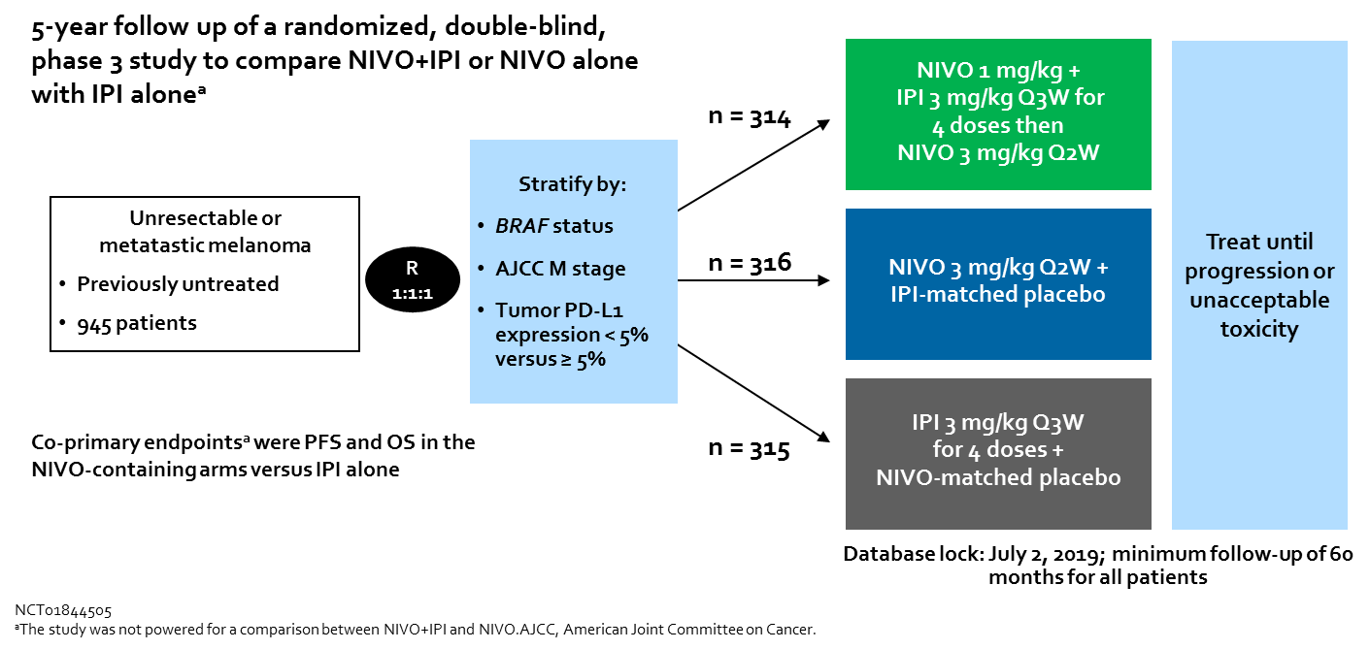
CheckMate-067 Trial

Slide 6
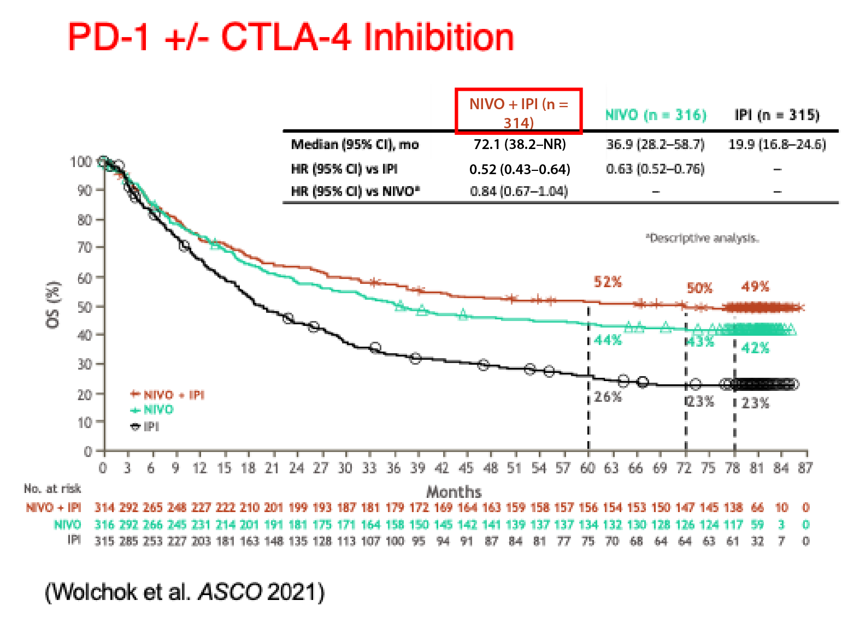
CheckMate-067 Trial
 | NIVO+IPI (n = 313) |  | NIVO (n = 313) |  | IPI (n = 311)
Patients reporting event | Any grade | Grade 3/4 | Any grade | Grade 3/4 | Any grade | Grade 3/4
Treatment-related AE, % | 96 | 59 | 87 | 23 | 86 | 28
Treatment-related AE leading to discontinuation, % | 42 | 31 | 13 | 8 | 15 | 14
Treatment-related death, n (%) | 2 (1) |  | 1 (< 1) |  | 1 (< 1)

Slide 7
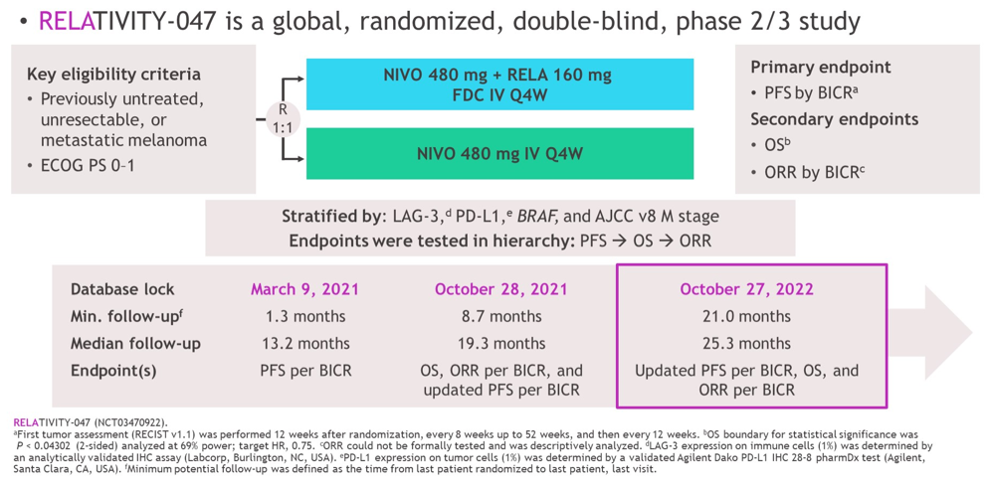
RELATIVITY-047 Trial

Slide 8
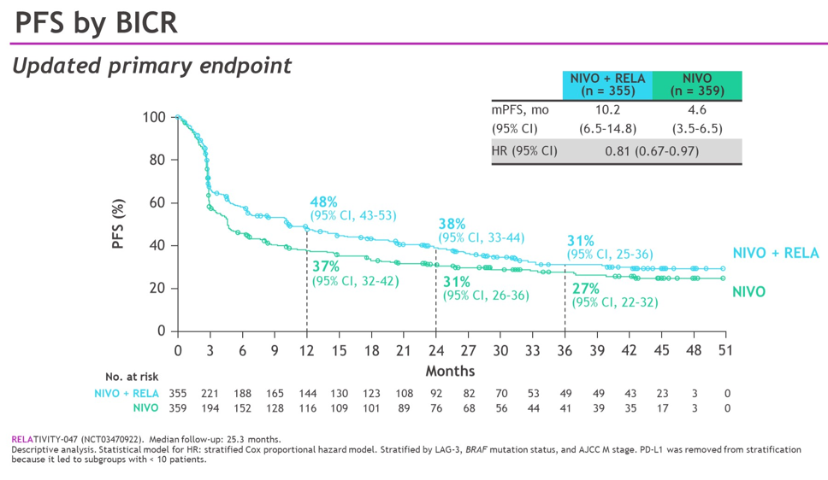
RELATIVITY-047 Trial

Slide 9
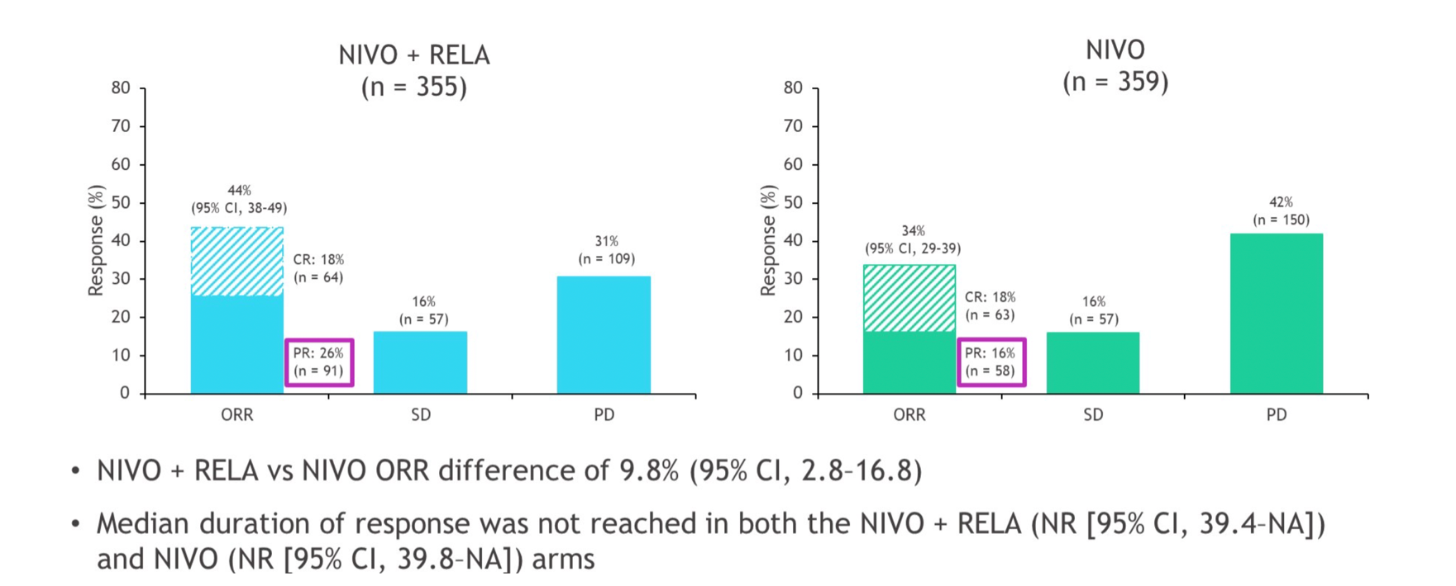
RELATIVITY-047 Trial

Slide 10
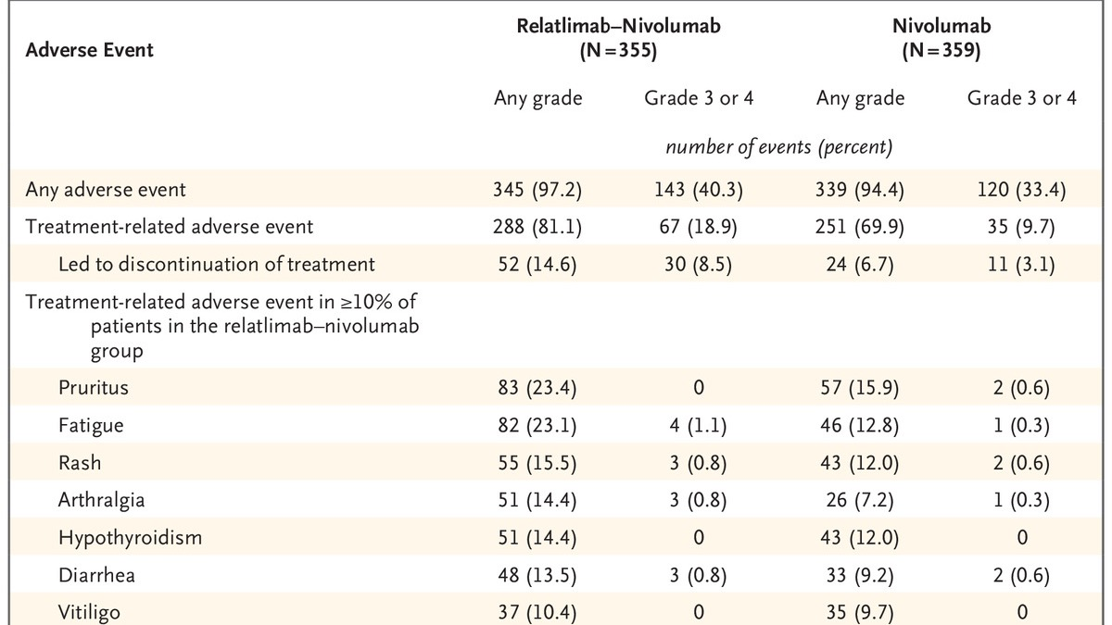
RELATIVITY-047 Trial: Adverse Events

Slide 11
RELATIVITY-020 Trial: Phase I/IIa Nivo/Rela in Advanced Melanoma that Progressed on Anti-PD-1/PD-L1 Therapy
Key eligibility criteria:
Advanced unresectable or metastatic melanoma
Documented disease progression while on a prior anti–PD-(L)1-containing regimen
Eligibility criteria varied by treatment cohort
Part D1 Treatment:
Nivolumab and relatlimab 240/80 mg q2weeks
Nivolumab and relatlimab 480/160 mg q4weeks
Part D2 Treatment:
Nivolumab and relatlimab 480/160 mg q4weeks
Primary endpoint: assess safety as measured by the rates of adverse events (AEs), serious AEs (SAEs), and AEs leading to discontinuation of treatment, deaths, and laboratory abnormalities

Slide 12
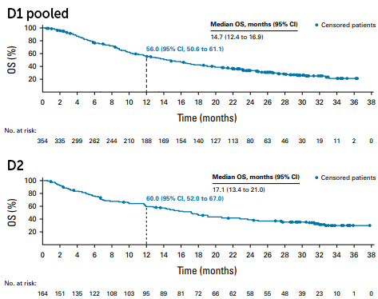
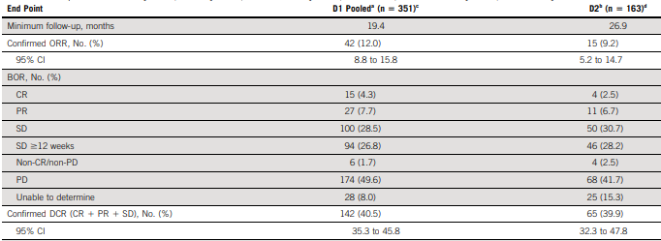
RELATIVITY-020 Trial: Phase I/IIa Nivo/Rela in Advanced Melanoma that Progressed on Anti-PD-1/PD-L1 Therapy
Overall survival Kaplan Meier curves
Comparison of ORR, BOR and Confirmed DCR by BICR

Slide 13
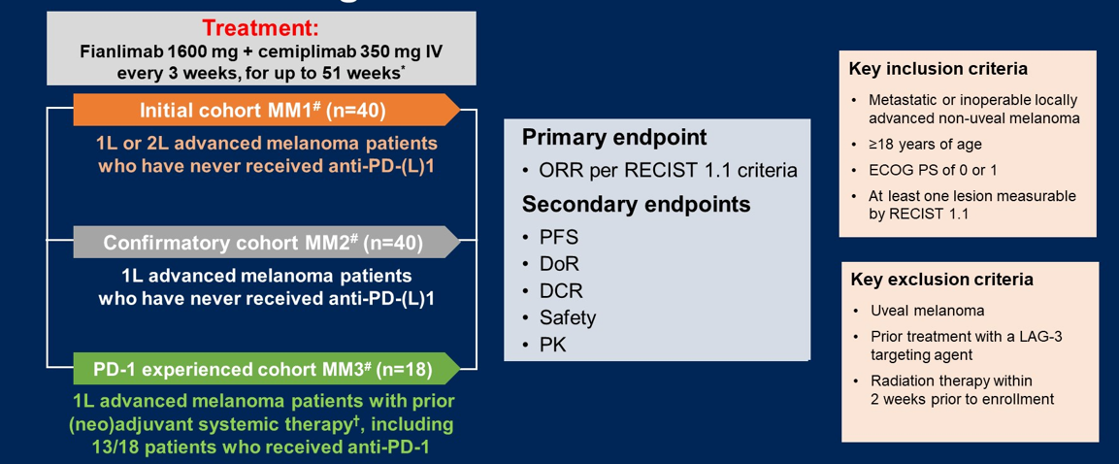
Fianlimab (Anti-LAG-3) + Cemiplimab (Anti-PD-1) Dosing Schema

Slide 14
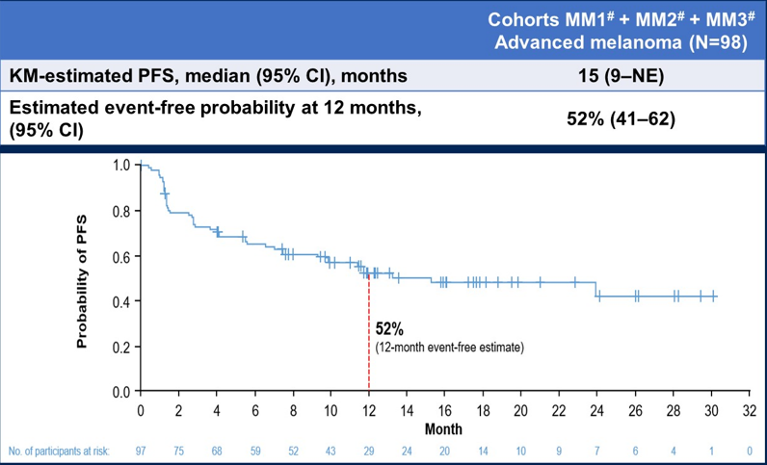
Fianlimab 1600mg + Cemiplimab 350mg IV Every 3 Weeks

Slide 15
Summary
For most patients with good performance status, dual checkpoint inhibition is preferred over single agent anti-PD-1 for newly diagnosed metastatic melanoma
Nivolumab + relatlimab has a higher ORR and superior PFS to nivolumab (RELATIVITY-047). Rates of grade 3-4 irAEs are about 10% higher than with single-agent
Patients with unresectable melanoma treated with ipilimumab + nivolumab have a median OS of 72.1 months (CheckMate-067). Grade 3-4 treatment related adverse events occurred in 59% of patients
Minimal data to date studying 1L immunotherapy given after adjuvant anti-PD1 therapy
1L, first line; irAE, immune-related adverse event.

Slide 16



Looking for more resources on this topic?
CME/CE in minutes
Congress highlights
Late-breaking data
Quizzes
Webinars
In-person events
Slides & resources
www.MedEdOTG.com

