Slide 1
Who’s on First: Accurate Recognition of Schizophrenia Candidates That Would Benefit From LAI Antipsychotic Therapy
Leslie Citrome, MD, MPH
Clinical Professor of Psychiatry and Behavioral Sciences
New York Medical College
Valhalla, NY

Slide 2



Resource Information
About This Resource
These slides are one component of a continuing education program available online at MedEd On The Go titled LAI Antipsychotics for Schizophrenia: Early Intervention Strategies to Improve Outcomes
Program Learning Objectives:
Address the barriers that prevent clinicians from switching patients with SCZ to an LAI antipsychotic medication earlier during treatment
Utilize measurement-based care in clinical practice to identify treatment nonadherence in SCZ patients
Categorize what subpopulations of SCZ patients are good candidates for LAI antipsychotic therapy
Integrate LAI antipsychotics earlier as maintenance therapy in suboptimally treated or nonadherent SCZ patients
MedEd On The Go®
www.mededonthego.com
This content or portions thereof may not be published, posted online or used in presentations without permission.
This content can be saved for personal use (non-commercial use only) with credit given to the resource authors.
To contact us regarding inaccuracies, omissions or permissions please email us at support@MedEdOTG.com

Slide 3
Disclaimer
The views and opinions expressed in this educational activity are those of the faculty and do not necessarily represent the views of Total CME, LLC, the CME providers, or the companies providing educational grants. This presentation is not intended to define an exclusive course of patient management; the participant should use their clinical judgment, knowledge, experience, and diagnostic skills in applying or adopting for professional use any of the information provided herein. Any procedures, medications, or other courses of diagnosis or treatment discussed or suggested in this activity should not be used by clinicians without evaluation of their patient's conditions and possible contraindications or dangers in use, review of any applicable manufacturer’s product information, and comparison with recommendations of other authorities. Links to other sites may be provided as additional sources of information.

Slide 4
How to Choose: Evidence-Based Practice Is
Patient-Centered Care/Therapy!
Keeping up with new information and making sense of it
Your brain
Clinical
judgment
Relevant
scientific
evidence
EBM
Your patient’s brain
Patients’ values and preferences

Slide 5
What Is the Evidence for LAIs?
Studies have consistently demonstrated:
The importance of continuous medication treatment of schizophrenia to minimize the risk of relapse
There are substantial adherence challenges for patients with chronic disorders
Superior overall effectiveness of LAIs versus oral antipsychotics
Caregivers may prefer LAIs
Patients may prefer LAIs
Clinical
judgment
Relevant
scientific
evidence
EBM
Patients’ values and preferences

Slide 6
Guidelines Recommend/Suggest LAIs
Beyond Nonadherence
APA Practice Guideline for the Treatment of Patients With Schizophrenia¹
Florida Best Practice Psychotherapeutic Medication Guidelines²
APA suggests that patients receive treatment with an LAI if they prefer such treatment or if they have a history of poor or uncertain adherence
Initial treatment: monotherapy with an SGA other than clozapine—either oral, or oral antipsychotic followed by the same SGA-LAI

Slide 7
Guidance on LAI Use in Schizophrenia Treatment Is Essentially Universal
Guideline | Use for a first episode | Use for maintenance | Use for non-adherence | Use based on patient preference
CINP, 2013 | NR | NR | Y | NR
UNHCR, 2017 | NR | NR | Y | NR
WFSBP, 2021, 2017, 2013 | NR | Y | NR | NR
RANZCP, 2016 | Y | Y | Y | Y
CPA, 2017 | Y* | NR | NR | Y
AFPBN, 2013 | N | Y | NR | Y
Italian guidelines, 2008 | NA | NA | NA | NA
Polish Psychiatric Association, 2019 | NR | NR | Y | NR
Singapore Ministry of Health, 2011 | N | Y | Y | Y
NICE, 2014 | N | Y | Y | Y
SIGN, 2013 | N | Y | Y | Y
BAP, 2020 | N | Y | Y | Y
APA, 2021 | NR | NR | Y | Y
TMAP, 2008 | Y | Y | Y | NR
NJ DMHS, 2005 | Y | Y | Y | NR
Schizophrenia PORT, 2010 | N | Y | NR | Y
AACP, 2017 | NR | Y | Y | Y
Oregon Health Authority, 2019 | NR | Y | Y | Y
Florida Medicaid programme, 2020 | Y | Y | Y | Y

Slide 8
One Example of Many:
LAI Antipsychotics Reduce Readmission Rates
1
Only oral vs. none
0.8
LAI vs. only oral
LAI vs. none
0.6
In a recent study comparing the effectiveness of LAI and oral antipsychotics in preventing readmission of patients with schizophrenia, data collected from 75,274 patients hospitalised with schizophrenia over a 10-year period (2008–2017) showed that LAIs reduced readmission rates by 29% compared with oral medication in real-world settings. Moreover, LAIs reduced the readmission rate by 58% in patients with repeated admissions.
Incidence rate ratio
0.4
15
No medication
Only oral medication
LAI medication
12
0.2
9
Incidence rate
(events per 10 person-years)
6
0
3
0
1st episode
without SGA
before
1^{s}t episode
with SGA
before
2nd episode
3rd episode
4th or
more episode

Slide 9
Meta-Analysis: LAI APs Are Associated with Lower Risks of Hospitalization or Relapse Versus Oral APs

Slide 10
Real-World Observation: LAIs Lower Risk of Rehospitalization After First Hospitalization for Schizophrenia
Nationwide cohort of 2,588 consecutive patients hospitalized for the first time with a diagnosis of schizophrenia
Any depot injection compared with equivalent oral formulation
Rehospitalization | Rehospitalization
Adjusted Hazard Ratio | 95% CI | p
0.36 | 0.17 - 0.75 | 0.007

Slide 11
Prospective Clinical Trial: LAIs Improved Survival Time Until Relapse in Early-Phase Treatment
A 12-month prospective study compared 83 patients with early schizophrenia randomly assigned to LAI or oral antipsychotics after a 3-week oral stabilization phase
Exacerbation and/or Relapse
Fewer patients in the LAI group experienced a psychotic exacerbation and/or relapse
versus the oral group
Mean Time to Relapse
Mean time to relapse was higher
with LAI versus oral

Slide 12
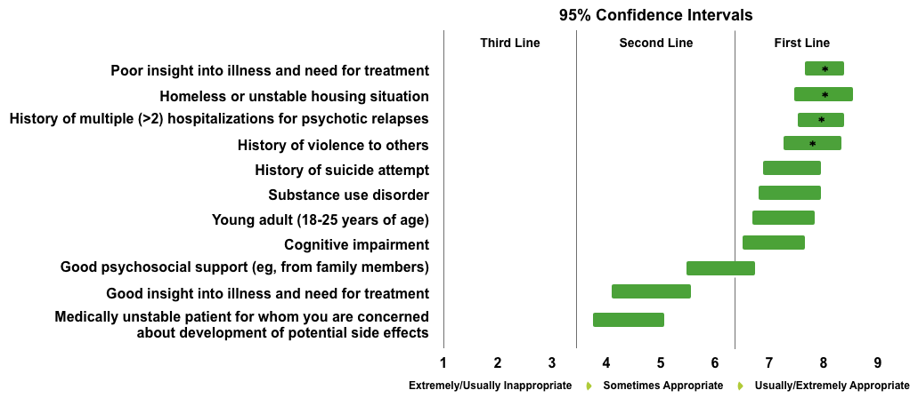
Expert Consensus Supports a Wider Use of LAIs in Schizophrenia

Slide 13

The Principal Obstacle to LAI Antipsychotic Use

Slide 14



Looking for more resources
on this topic?
CME/CE in minutes
Congress highlights
Late-breaking data
Quizzes
Webinars
In-person events
Slides & resources
www.MedEdOTG.com

