Slide 1
Too Soon Is Not Soon Enough: Initiation of LAIs Sooner to Manage Symptoms of Suboptimally Treated Schizophrenia
Christoph U. Correll, MD
Professor of Psychiatry and Molecular Medicine
Zucker School of Medicine at Hofstra/Northwell
Hempstead, NY

Slide 2
Resource Information
About This Resource
These slides are one component of a continuing education program available online at MedEd On The Go titled LAI Antipsychotics for Schizophrenia: Early Intervention Strategies to Improve Outcomes
Program Learning Objectives:
Address the barriers that prevent clinicians from switching patients with SCZ to an LAI antipsychotic medication earlier during treatment
Utilize measurement-based care in clinical practice to identify treatment nonadherence in SCZ patients
Categorize what subpopulations of SCZ patients are good candidates for LAI antipsychotic therapy
Integrate LAI antipsychotics earlier as maintenance therapy in suboptimally treated or nonadherent SCZ patients
MedEd On The Go®
www.mededonthego.com
This content or portions thereof may not be published, posted online or used in presentations without permission.
This content can be saved for personal use (non-commercial use only) with credit given to the resource authors.
To contact us regarding inaccuracies, omissions or permissions please email us at support@MedEdOTG.com

Slide 3
Disclaimer
The views and opinions expressed in this educational activity are those of the faculty and do not necessarily represent the views of Total CME, LLC, the CME providers, or the companies providing educational grants. This presentation is not intended to define an exclusive course of patient management; the participant should use their clinical judgment, knowledge, experience, and diagnostic skills in applying or adopting for professional use any of the information provided herein. Any procedures, medications, or other courses of diagnosis or treatment discussed or suggested in this activity should not be used by clinicians without evaluation of their patient's conditions and possible contraindications or dangers in use, review of any applicable manufacturer’s product information, and comparison with recommendations of other authorities. Links to other sites may be provided as additional sources of information.

Slide 4
Illness phases^{1–3}
10–45%
(FES: 24%²)
Relapse (placebo ‡):
≤3 mo: 37%
4-6 mo: 50%
7-12 mo: 64%
13-36 mo: 79%
Resistance
Any duration:‡
57.3%
Exacerbation
Relapse
Relapse (FES):
12 mo: 16%
24 mo: 54%
36 mo: 63%
48 mo: 75%
60 mo: 82%
18–65%
(FES: 40–87%)
Illness severity
Response
Any duration: 7–52%
(FES: 17–81%)
Remission
Remission:
6 mos: 44%
12 mos: 52%
24 mos: 47%
>24 mos: 49%
13.5% (8–20%)†
(FES: 21%³)
Recovery
Acute Stabilization Maintenance Treatment Phase

Slide 5
Relapse Prevention is of Crucial Importance
Long-term symptoms and disability
Increased risk of suicide attempts
Multiple relapses and subsequent exacerbations
Decrease in treatment response
Progressive decline in brain structure
Greater use of healthcare resources
Increased burden on family and caregivers

Slide 6
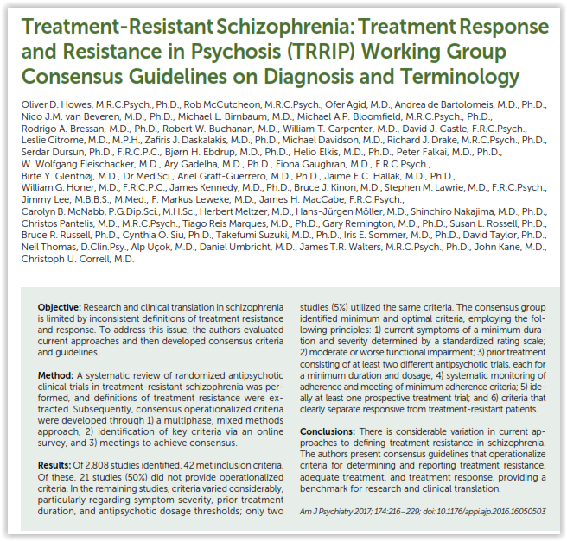
Notes:
6

Slide 7
Long-Acting vs Oral Antipsychotics: Meta-analytic Comparison of 137 Studies (n=397,319) Across Three Designs
 | Number of studies | N
RCT | 32 | 8577
Cohort studies | 65 | 377,447
Pre-post studies | 40 | 11,295
LATs were associated with a lower risk of admission to hospital or relapse than OAPs in all three study designs
 | N | n | RR | 95% CI | p
RCT | 29 | 7,833 | 0·88 | 0·79–0·99 | 0·033
Cohort studies | 44 | 106,136 | 0·92 | 0·88–0·98 | 0·004
Pre-post studies | 28 | 17,876 | 0·44 | 0·39–0·51 | <0·001
LAIs were superior to oral antipsychotics in 60 (18·3%) of 328 comparisons, no different in 252 (76·8%), and less beneficial in 16 (4·9%) comparisons
CI, confidence interval; LAT, long-acting therapy; N, studies; n, subjects; OAP, oral antipsychotic; RCT, randomised controlled trial; RR, risk ratio. LATs were also superior to OAPs when preferential order of hospitalisation/relapse was reversed

Slide 8
Reduction in any-, suicide- and natural-cause mortality in patients with schizophrenia on vs. off antipsychotics
Outcome
Risk ratio (95% CI)
Mortality from all causes
Any SGA LAT (n=3)
Clozapine (n=3)
Any LAT (n=2)
Any oral SGA (n=4)
Any FGA LAT (n=3)
Any SGA (n=4)
Any oral antipsychotic (n=4)
Any antipsychotic (n=11)
Any FGA (n=5)
Mortality from suicide
Clozapine (n=2)
Any SGA LAT (n=1)
Any LAT (n=1)
Any oral SGA (n=2)
Any FGA LAT (n=1)
Any SGA (n=2)
Mortality from natural causes
Clozapine (n=2)
Any oral SGA (n=2)
Any oral antipsychotic (n=1)
Any SGA (n=2)
Any SGA LAT (n=1)
Any LAT (n=1)
Any FGA LAT (n=1)
Any antipsychotic (n=3)
0.39 (0.27–0.56)
0.43 (0.34–0.55)
0.47 (0.39–0.58)
0.47 (0.45–0.50)
0.50 (0.43–0.57)
0.53 (0.44–0.63)
0.64 (0.51–0.80)
0.71 (0.59–0.84)
0.73 (0.55–0.97)
0.22 (0.16–0.30)
0.43 (0.24–0.78)
0.60 (0.47–0.77)
0.64 (0.54–0.74)
0.64 (0.49–0.85)
0.68 (0.56–0.82)
0.50 (0.29–0.86)
0.57 (0.52–0.62)
0.62 (0.59–0.66)
0.65 (0.48–0.89)
0.66 (0.52–0.84)
0.69 (0.62–0.77)
0.70 (0.62–0.78)
0.76 (0.59–0.97)
.
0.0
0.2
0.4
0.6
0.8
1
Risk ratio (95% CI)

Slide 9
Overlapping dimensions of remission in first-episode schizophrenia
First-episode schizophrenia: n=98 Follow-up: 24 months on a long-acting antipsychotic
Robust improvement in core psychopathology (Cohen’s d=3.36) and functionality (d=1.78), mostly occurring within the first 6 months of treatment
Improvement in subjective quality of life was less marked (d=0.37) and slower, only reaching significance after 12 months of treatment
Only 9% of patients achieved functional remission and good quality of life without symptomatic remission
Symptomatic remission,
70%
44%
43%
Recovery
29%
Functional remission,
56%
Good overall quality of life,
61%
38%
Adapted from Phahladira L, et al. NPJ Schizophr 2020.

Slide 10
Preventive and Earlier LAT Initiation Improve Outcomes More than Reactive and Later LAT Initiation
Initiation of OAP (index date)
Adherent to OAP
Non-adherent to OAP
No SCH-related IP or ER visit
SCH-related IP or ER visit
No SCH-related IP or ER visit
SCH-related IP or ER visit
Strategy #1
Strategy #2
1 visit
≥2 visits
1 visit
≥2 visits
Strategy #3
Strategy #4
Strategy #3
Strategy #4
Patients with schizophrenia (N=13,444) who had not received antipsychotic treatment for ≥12 months prior to starting oral antipsychotics, without ER visit or hospitalisation for schizophrenia for ≥12 months. ER, emergency room; IP, inpatient; LAT, long-acting therapy; OAP oral antipsychotic; SCH, schizophrenia.

Slide 11
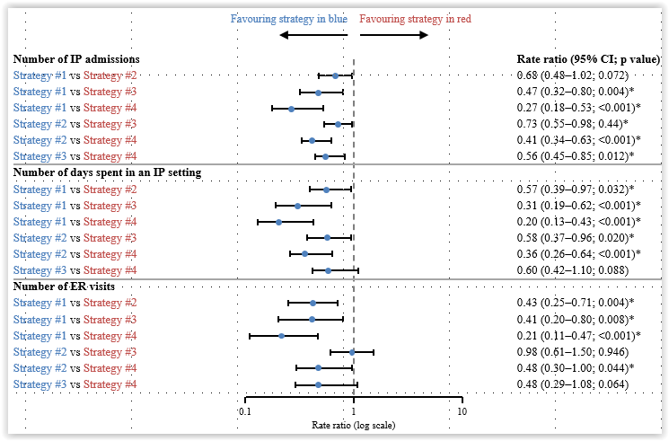
Fewer Inpatient Admissions and ER visits from Medicaid Beneficiaries with Schizophrenia Following Earlier, Event-Driven LAT Initiation Sequencing Strategies

Slide 12
Within-Subject Case Series Study of People with Schizophrenia in Hong Kong: Patient Characteristics
Characteristic | Overall (N = 70,396) | Individuals prescribed both OAs and LAIs during observation (n = 23,719)
Sex, No. (%) Female Male | 37,200 (52.8) 33,196 (47.2) | 11,397 (48.1) 12,322 (51.9)
Age, mean (SD), years At first schizophrenia diagnosis At cohort entry At time of event | 42.0 (15.7) 44.2 (15.8) n/a | 39.0 (12.7) 41.7 (12.8) n/a
Death No. (%) of patients who died during observation period Age at death, mean (SD), years | 12,493 (17.7) 66.1 (16.7) | 3,650 (15.4) 59.5 (14.9)
Mean duration of drug exposure | Years (SD)
OA alone | 5.0 (5.1)
LAI alone | 1.4 (2.8)
OA + LAI | 4.4 (5.1)

Slide 13
Within-Subject Case Series Study of People with Schizophrenia in Hong Kong: Primary Outcomes
Rate of outcome events between the full treatment period of LAIs alone and the full treatment period of OAs alone was compared within the same individual.
Compared with OAs, LAIs were associated with a significant reduction in hospitalizations for any cause, hospitalizations for psychiatric disorders, hospitalizations for schizophrenia, and incident suicide attempts.
Primary outcome event | Adjusted incidence rate ratio^{b} (IRR) (LAIs vs OAs) | P value
All-cause emergency department visits | 0.99 | 0.09
All-cause hospitalizations | 0.63 | <0.001
Hospitalizations for psychiatric disorders | 0.52 | <0.001
Hospitalizations for schizophrenia | 0.53 | <0.001
Incident suicide attempt | 0.56 | <0.001

Slide 14
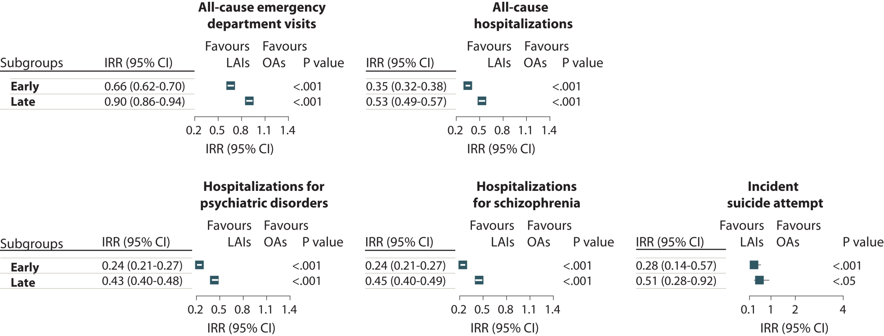
Within-Subject Case Series Study of People with Schizophrenia in Hong Kong - Subgroup analysis: Initiation time of LAIs
Early LAI initiators* have a greater reduction in primary outcome events vs late initiators (during the full treatment period).

Slide 15
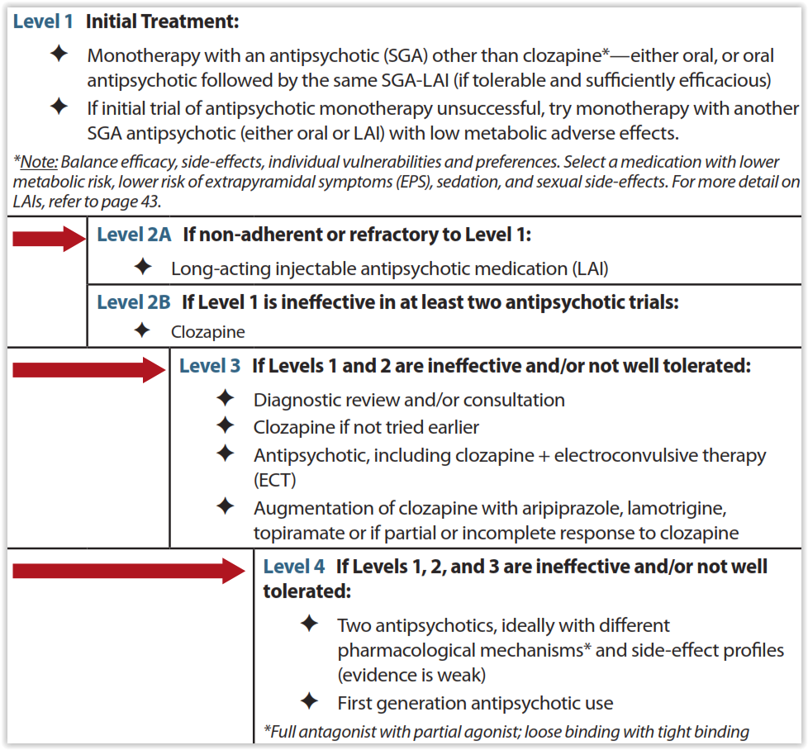
Florida Guidelines 2019-2020 for the Treatment of Schizophrenia

Slide 16
Conclusions
Acute and long-term goals need to be combined
Maintenance therapy for relapse prevention is a critical goal on the road toward remission and recovery
Risks and benefits and patient preferences need to be balanced when choosing individual treatments
High-risk groups for relapse and breakthrough psychosis require extra attention
Earlier and more frequent offering of LATs is a key element of preventive psychiatry for people with schizophrenia, reducing treatment discontinuation, relapse, hospitalization and MORTALITY, and improving functioning

Slide 17
Looking for more resources on this topic?
CME/CE in minutes
Congress highlights
Late-breaking data
Quizzes
Webinars
In-person events
Slides & resources
www.MedEdOTG.com

