Slide 1
Overcoming Clinical Barriers to LAI Administration: Identification of the Negative Stigma Surrounding the Use of Injectable Antipsychotics
Christoph U. Correll, MD Professor of Psychiatry and Molecular Medicine Zucker School of Medicine at Hofstra/Northwell Hempstead, NY

Slide 2



Resource Information
About This Resource
These slides are one component of a continuing education program available online at MedEd On The Go titled LAI Antipsychotics for Schizophrenia: Early Intervention Strategies to Improve Outcomes
Program Learning Objectives:
Address the barriers that prevent clinicians from switching patients with SCZ to an LAI antipsychotic medication earlier during treatment
Utilize measurement-based care in clinical practice to identify treatment nonadherence in SCZ patients
Categorize what subpopulations of SCZ patients are good candidates for LAI antipsychotic therapy
Integrate LAI antipsychotics earlier as maintenance therapy in suboptimally treated or nonadherent SCZ patients
MedEd On The Go®
www.mededonthego.com
This content or portions thereof may not be published, posted online or used in presentations without permission.
This content can be saved for personal use (non-commercial use only) with credit given to the resource authors.
To contact us regarding inaccuracies, omissions or permissions please email us at support@MedEdOTG.com

Slide 3
Disclaimer
The views and opinions expressed in this educational activity are those of the faculty and do not necessarily represent the views of Total CME, LLC, the CME providers, or the companies providing educational grants. This presentation is not intended to define an exclusive course of patient management; the participant should use their clinical judgment, knowledge, experience, and diagnostic skills in applying or adopting for professional use any of the information provided herein. Any procedures, medications, or other courses of diagnosis or treatment discussed or suggested in this activity should not be used by clinicians without evaluation of their patient's conditions and possible contraindications or dangers in use, review of any applicable manufacturer’s product information, and comparison with recommendations of other authorities. Links to other sites may be provided as additional sources of information.

Slide 4
LAI Antipsychotics Are Currently Underutilized
Most clinicians report using long-acting injectable atypical antipsychotics in <10% of patients¹
Psychiatrists have not offered an LAI antipsychotic to nearly two-thirds of their patients²
Only 12.4% of patients who were not taking oral therapies as prescribed were switched to a LAI antipsychotic formulation during a 3-year prospective study³

Slide 5
Factors Influencing Treatment Adherence and Acceptance/ Use of Long-acting Antipsychotics
Clinician
(alliance, interaction,
treatment choice)
Treatment setting (inpatient, outpatient)
Caregivers and social support
(support, knowledge, attitudes)
Illness
(type, severity, duration, comorbidity)
Clinical trials
(patient selection, stringency, support)
Patient
(alliance,
cognition, knowledge, insight, stigma)
Treatment
(type, formulation, timing, efficacy, side effects)

Slide 6
Several Patient Attributes Were Cited as Influencing Qualification for LAI Antipsychotic Treatment
Mean rating of the attributes potentially influencing the qualification for LAI treatment
Hazard risk for others
Noncompliance in the past
Suicidal risk
Relapse in the past
Depot experienced
Well informed
2 Antipsychotics
High level of education
Open to drug treatment
High level of insight
Good therapeutic alliance
High level of participation in decisions
First episode
Unclear diagnosis
0
1
2
3
4
5
6
7
8
9
10
The primary patient characteristic influencing the psychiatrist’s decision to initiate LAI antipsychotic therapy was “hazard risk for others”

Slide 7
Overestimation of Reasons for Rejection of LAIs by Doctors or Nurses (PINK) vs. LAT inexperienced Patietns (YELLOW) vs. LAT-experienced Patients (GREEN) Except for Observation Time with OLA-LAT
Large impact to
say NO to LAT
Doctors’ or nurses’
beliefs
(n=63)
Patients’ concern
(pt on tablet)
(n=101)
Patients’
experience
(pt on LAT)
(n=63)
No
impact
Pain
Bound to
the clinic
Observation
Time with
OLA-LAT
Embarass-
ment
Less
self
dependent
Can’t decide
yourself
when drug
is taken
Feeling of
being
controlled
Stigma

Slide 8
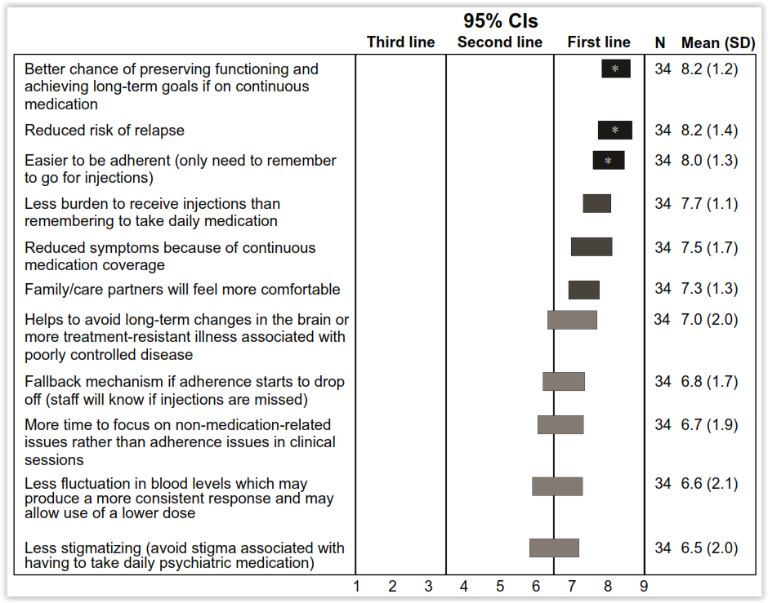
Expert Consensus Survey: Points to Discuss with Patients when Offering LAIs

Slide 9
Patients Are Willing to Accept LAI Antipsychotic Therapy When Properly Informed
In a survey of psychiatrists:
Patient refusal was cited as a primary reason for not prescribing LAI antipsychotics¹
In a survey of patients without LAI antipsychotic experience:
79% cited having never been informed about the option by their psychiatrist²
75% of psychiatrists felt that they informed the patient, but only 33% of patients felt informed²
In a survey of patients with ≥3 months of LAI antipsychotic experience:
Injectable antipsychotics were the preferred formulation³
70% of patients felt better supported in their illness by virtue of regular contact with the doctor or nurse who administered their injection³

Slide 10
Psychiatrists Cite Multiple Reasons for Not Prescribing LAI Atypical Antipsychotics
100
90
86%
80%
75%
80
71%
68%
70
58%
60
Psychiatrists, %
50
40
31%
30
20
10
0
Sufficient Adherence to Oral
Patient Refusal
Antipsychotic Not Available as LAI
Costs of Drug
Not Appropriate Option After Relapse
Poorer Control of Effect Compared to Oral Drug
High EPS Risk With LAI

Slide 11
Communication Matters
A study of communication patterns in the offer of LAIs made by psychiatrists to patients with schizophrenia at 10 community mental health clinics found that:
Only 9% of the communication of psychiatrists presenting LAIs to patients focused on positive aspects
Consequently, in only 11 of 33 LAI treatment recommendations (33%) were accepted by patients
During a post-visit interview, in which LAIs were presented in a more positive light and with more information, 27 of 28 patients (96%) who seemed to decline the initial recommendation changed their mind, stating that they would be willing to try LAI treatment.

Slide 12
PRELAPSE: Staff training
For all Centers: Study Design & Procedures
(1 half day)
For LAI Centers: Specific Training (2 half days)
KNOWLEDGE
COMMUNICATION (MI-konsistent)
Role of nonadherence in relapse & hospitalisation
Shared decision-making principles
Study rationale & overview
Rationale for LAI use & for selection of AOM in early-phase schizophrenia
Discussion of LAIs with patients and families
Characteristics of early
psychosis patients
Suggested “scripts”
Recruitment & retention strategies
Effectiveness of LAIs
Role plays
FAQs
Good clinical practice
Discussion of optimal ways to transition to LAIs
ORGANIZATION
Data management
Suggestions for overcoming LAI logistical barriers
Prescribing guidelines for LAIs
AE querying & reporting

Slide 13
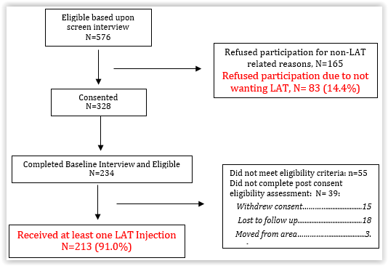
76.6% of FEP and Early-Phase SCZ Patients Received at least One Injection with ARI LAI

Slide 14
Controversies Around LAIs: Negative vs Positive Perceptions (1)
LAI Perception |  | Controversies Affected
Negative | Positive | Benefits of LAIs | Target population | When to initiate | HCP training | Patient interaction
LAIs result in injection-site reactions¹⁴ | SGA-LAIs have improved formulations over FGA-LAIs, with fewer injection-site reactions¹⁴ | X |  |  | X
There are intolerable side effects with LAIs^{14,29,32} | AE frequency and AE-related discontinuations are the same or lower^{18,32,43} and mortality is lower for LAIs vs OAs^{39,40} | X |  |  | X | X
Patients on an LAI experience breakthrough psychosis^{36,37} | The rate of breakthrough psychosis is similar among LAIs and OAs³⁷ and the benefit-risk ratio supports use of LAIs²³ | X |  | X | X
Patients on LAIs can also become non-adherent to LAI use²⁷ | Adherence rates are higher^{18,87} and discontinuation rates are lower for LAI vs OAs^{18,32}, nonadherent patients can be immediately identified⁷¹, and relapses are delayed due to longer half-lives of LAIs ²⁸ | X | X
Many HCPs lack experience/knowledge of LAIs;¹⁰ limiting target population | HCPs can be educated;⁷⁴ HCPs with LAI prescribing experience are supportive of LAIs⁴⁷ |  | X |  | X
LAI dosing is difficult to adjust and it would be dangerous to treat patients without knowing if the most appropriate medication has been selected⁴⁹ | Per drug prescribing information and recommendations, a short trial with an OA or short-duration LAIs should occur to assess tolerability and efficacy, followed by a transition to the LAI formulation of the same drug ⁵⁰ |  | X | X

Slide 15
Controversies Around LAIs: Negative vs Positive Perceptions (2)
LAI Perception |  | Controversies Affected
Negative | Positive | Benefits of LAIs | Target population | When to initiate | HCP training | Patient interaction
The infrastructure needed to administer injections is complex and resources are limited⁴⁴ | The long-term nature of the disease and improved outcomes with LAIs is worthy of training professionals and setting up a coordinated care teams^{14,18,39,42} |  | X | X | X
Suggesting an LAI early will impede patient autonomy⁸³ | Early treatment success correlates with acceptance of treatment and adherence^{3,15} |  |  | X | X
Initial recommendation of an LAI can negatively impact the patient’s level of trust with the physician early on in treatment ⁵⁵ | Shared and collaborative care can be developed early keep patients involved,^{57,58} and earlier use of LAIs is associated with better outcomes than later initiation⁶³⁻⁶⁵ |  |  | X | X
LAI treatment can be complicated and it is best to wait until after multiple relapses to see if it should be initiated⁶² | Relapse has a very negative impact on patients; LAIs can reduce relapses/ hospitalizations and effective treatment should be started as soon as possible^{34,35,52} | X |  | X | X | X
There are few SGA-LAI options⁶⁶ and it is difficult to manage LAI-related side effects^{14,29,32} | HCPs can be educated on the benefits of SGA- vs FGA-LAIs regarding increased tolerability^{18,32,72} and several SGA options⁸⁸ | X |  |  | X | X
Recommendation of an LAI will negatively affect the doctor–patient relationship⁵⁵ | Patients actually feel better about their relationships with providers while taking an LAI because of more interactions⁶⁷ |  |  |  | X | X

Slide 16
Controversies Around LAIs: Negative vs Positive Perceptions (3)
LAI Perception |  | Controversies Affected
Negative | Positive | Benefits of LAIs | Target population | When to initiate | HCP training | Patient interaction
Patients are adherent to OAs and there is no reason to use an LAI since the long-acting medication is only for the chronically ill^{19,59} | Adherence to OAs is overestimated and adherence is higher/discontinuation lower with LAIs vs OAs; missed doses of an LAI can be identified immediately⁸⁷ | X | X |  | X
Patients do not want to take an LAI/injectable medication^{66,70} | Patients who were encouraged to take an LAI by their physician largely agreed^{66,74} |  |  |  | X
Providers do not have proper resources to set up the infrastructure needed to administer LAIs^{59,73} | A system of coordinated care^{57,89} can be organized by collaborating with experts and specialty clinics |  |  |  | X
Patients do not feel sick, that they need treatment or are unaware of how the disease will impact their lives^{12,90} | Educational material and involvement of family members can promote a shared decision-making process and address FAQs^{57,75} |  |  |  |  | X
There is patient anxiety over side effects of LAIs^{12,15,90} and patients should not be stressed by suggesting this treatment option | Planned discussion and educational material can provide insight into improved tolerability (and efficacy) of LAIs vs OAs^{15,67} | X |  |  |  | X
Cognitive/mental state of patients is impaired⁷⁷ and any effort to support LAI use will appear like coercion | Providing educational material and a recommendation does not involve a threat and is not coercion⁸⁴ |  |  |  | X | X

Slide 17
Conclusions
Despite overwhelming evidence across different study designs showing high rates of treatment non-adherence and multiple advantages of LAIs over oral antipsychotics, including higher treatment persistence and functioning and lower relapse and mortality risk, LAIs remain underutilized
Reasons are multifactorial but include patient, caregiver, societal, treatment and treatment provider factors-on
Mis-conceptions and stigma around LAIs are manifold
These mis-conceptions and stigma need to be identified and addressed head-on
When this is done, particularly targeting the treatment team members, acceptability and use of LAIs is high, even among patients with early-phase schizophrenia

Slide 18



Looking for more resources on this topic?
CME/CE in minutes
Congress highlights
Late-breaking data
Quizzes
Webinars
In-person events
Slides & resources
www.MedEdOTG.com

