Slide 1
ACC.24 Integrating Complex Data Into Clinical Practice What Is Really New in Electrophysiology, a Joint Symposium of the Heart Rhythm Society and the American College of Cardiology
Manesh R. Patel, MD
Richard S. Stack Distinguished Professor, Chief, Division of Cardiology
Co-Director, Duke Heart Center, Duke Clinical Research Institute
Duke University, Durham, NC

Slide 2
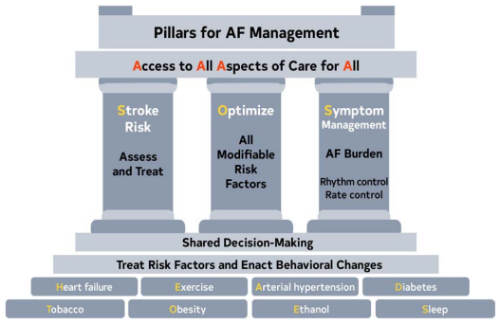
2023 ACC/AHA/ACCP/HRS Afib Guideline
Global burden of Afib is growing
Aging increases likelihood of developing Afib
All aspects of Afib Care ~ SOS
S: Assess and treat stroke risk
O: Optimize all modifiable risk factors
S: Symptom management

Slide 3
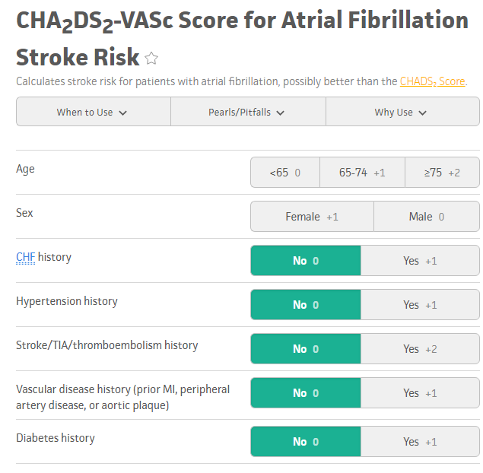
S: Assess and Treat Stroke Risk
Make sure to assess the risk
CHADS VASC of 2 in men, or greater for either sex, consider and treat with anticoagulants with a preference for direct oral anticoagulants (DOACS)
In patients with a CHADS VASC of 1, use shared decision-making and consider other risk factors

Slide 4
O: Optimize All Modifiable Risk Factors
5.2.1 Weight Loss in Individuals Who Are
Overweight or Obese
5.1 Primary Prevention
Recommendation for Primary Prevention Referenced studies that support the recommendation are summarized in the Online Data Supplement.
COR | LOE | Recommendation
1 | B-NR | 1. Patients at increased risk of AF should receive comprehensive guideline-directed LRFM for AF, targeting obesity¹, physical inactivity², unhealthy alcohol consumption³, smoking⁴, diabetes⁵, and hypertension.⁶
Recommendation for Weight Loss in Individuals Who Are Overweight or Obese Referenced studies that support the recommendation are summarized in the Online Data Supplement.
COR | LOE | Recommendation
1 | B-R | 1. In patients with AF who are overweight or obese (with body mass index [BMI] >27 kg/m²), weight loss is recommended, with an ideal target of at least 10% weight loss to reduce AF symptoms, burden, recurrence, and progression to persistent AF.¹⁻⁴

