Slide 1
What’s the Best Available Evidence for Reversal of Life-Threatening Bleeds?
Craig I. Coleman, PharmD, FASHP, FACC
Professor of Pharmacy Practice
School of Pharmacy
University of Connecticut
Hartford Hospital
Hartford, CT

Slide 2



Resource Information
About This Resource
These slides are one component of a continuing education program available online at MedEd On The Go titled Keeping It Real: Reversing Effects of Anticoagulation in the Modern Era with Real World Data
Program Learning Objectives:
Evaluate recent practice-changing data that can be applied to practice in the presence of a life-threatening bleed in the presence of anticoagulation
Apply the latest evidence-based approaches to maximize management prognostic outcomes for life-threatening bleeds
MedEd On The Go®
www.mededonthego.com
This content or portions thereof may not be published, posted online or used in presentations without permission.
This content can be saved for personal use (non-commercial use only) with credit given to the resource authors.
To contact us regarding inaccuracies, omissions or permissions please email us at support@MedEdOTG.com

Slide 3
Disclaimer
The views and opinions expressed in this educational activity are those of the faculty and do not necessarily represent the views of Total CME, LLC, the CME providers, or the companies providing educational grants. This presentation is not intended to define an exclusive course of patient management; the participant should use their clinical judgment, knowledge, experience, and diagnostic skills in applying or adopting for professional use any of the information provided herein. Any procedures, medications, or other courses of diagnosis or treatment discussed or suggested in this activity should not be used by clinicians without evaluation of their patient's conditions and possible contraindications or dangers in use, review of any applicable manufacturer’s product information, and comparison with recommendations of other authorities. Links to other sites may be provided as additional sources of information.

Slide 4
Andexanet Alfa in Major Bleeding with Factor Xa Inhibitors
Patients with acute major bleeding within 18 hours of FXa inhibitor administration were enrolled
The safety population included all patients
The efficacy population included patients with baseline anti-FXa activity levels above predefined thresholds
Had to meet major bleeding criteria (modified ISTH definition)
Major bleeding criteria, hemostatic efficacy, and thrombotic events were assessed by an independent adjudication committee
Excellent or good hemostatic efficacy, defined by a scale used in previous reversal studies, assessed at 12 hours
Group | No. of patients/ Total No. | Percent Excellent or Good Hemostasis (95% CI)
Overall | 274/342 | 80 (75-84)
Site of bleeding
GI | 61/74 | 82 (72-90)
ICH | 195/246 | 79 (74-84)
Other | 18/22 | 82 (60-95)

Slide 5
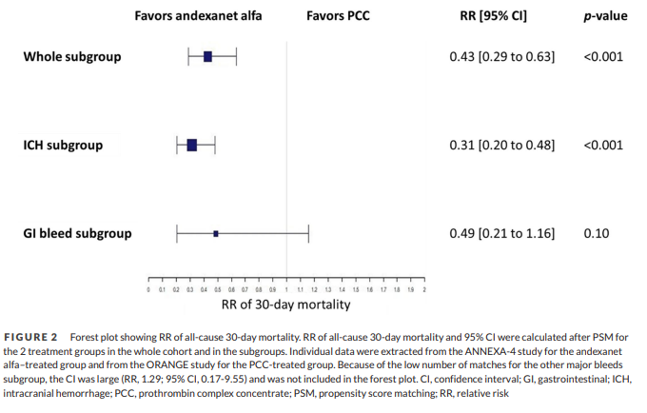
Mortality at 30-Days with Andexanet Alfa Versus PCC for Life-Threatening DOAC-Related Bleeding
Two patient-level datasets were used:
  ANNEXA-4 for those who received andexanet alfa
  ORANGE (a prospective, observational study of anticoagulated patients in UK hospitals) for PCC patients
Patients were propensity score* matched based on demographic and clinical characteristics
322 ANNEXA-4 patients treated with andexanet alfa (mean age=77.7 years; 64.9% ICH) were matched with 88 ORANGE patients treated with PCC (mean age=74.9 years, 67.1% ICH)
57% reduction in the RR of 30-Day Death with Andexanet

Slide 6
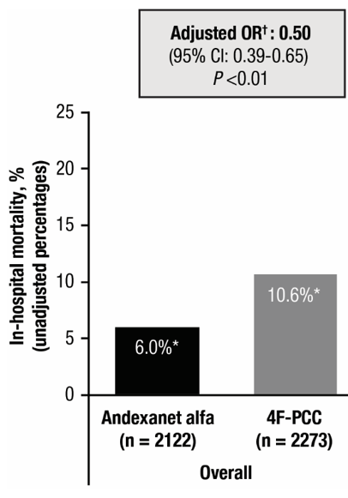
Comparing In-Hospital Mortality with Andexanet Alfa Versus 4-Factor Prothrombin Complex Concentrate
DATA SOURCE
Electronic medical records from 359 US hospitals
TIMING
Discharge Dates:
Wave 1: May 2018 – Sept 2021
Wave 2: Oct 2021 – Sept 2022
INCLUSION
Age ≥18 years
Hospitalized for anticoagulant-related major bleed
Rivaroxaban or apixaban use at time of bleeding event
Treatment with andexanet alfa or 4F-PCC during hospitalization
Documented discharge disposition

Slide 7



Looking for more resources
on this topic?
CME/CE in minutes
Congress highlights
Late-breaking data
Quizzes
Webinars
In-person events
Slides & resources
www.MedEdOTG.com

