Slide 1
Anticoagulant-Associated Major Bleeding Is a Significant Problem: How Do I Address in Patients on DOACs?
Deborah Siegal, MD, MSc, FRCPC
Tier 2 Canada Research Chair in Anticoagulant Management of Cardiovascular Disease
Associate Professor, University of Ottawa
Scientist, Ottawa Hospital Research Institute
Ottawa, Canada

Slide 2



Resource Information
About This Resource
These slides are one component of a continuing education program available online at MedEd On The Go titled Keeping It Real: Reversing Effects of Anticoagulation in the Modern Era with Real World Data
Program Learning Objectives:
Evaluate recent practice-changing data that can be applied to practice in the presence of a life-threatening bleed in the presence of anticoagulation
Apply the latest evidence-based approaches to maximize management prognostic outcomes for life-threatening bleeds
MedEd On The Go®
www.mededonthego.com
This content or portions thereof may not be published, posted online or used in presentations without permission.
This content can be saved for personal use (non-commercial use only) with credit given to the resource authors.
To contact us regarding inaccuracies, omissions or permissions please email us at support@MedEdOTG.com

Slide 3
Disclaimer
The views and opinions expressed in this educational activity are those of the faculty and do not necessarily represent the views of Total CME, LLC, the CME providers, or the companies providing educational grants. This presentation is not intended to define an exclusive course of patient management; the participant should use their clinical judgment, knowledge, experience, and diagnostic skills in applying or adopting for professional use any of the information provided herein. Any procedures, medications, or other courses of diagnosis or treatment discussed or suggested in this activity should not be used by clinicians without evaluation of their patient's conditions and possible contraindications or dangers in use, review of any applicable manufacturer’s product information, and comparison with recommendations of other authorities. Links to other sites may be provided as additional sources of information.

Slide 4
Bleeding Complications Limit OAC Use
Bleeding rates
DOACs vs. VKA
2% to 4% per year
10% to 12% per year
Major bleeding
Clinically relevant non-major bleeding
50%
Intracranial bleeding
Major bleeding
14-
40%
GI bleeding
25%
Vary according to OAC indication
Possible differences between DOACs, but no head-to-head trials (yet)

Slide 5
OAC-Related Bleeding Increases the Risk of Death
Hemorrhagic stroke
Subdural bleeding
Extracranial bleeding
HR 27
(95% CI 21 to 34)
HR 7
(95% CI 5 to 10)
HR 5
(95% CI 5 to 6)

Slide 6




Bleed Management Framework
REDUCE
Prevention is the first step
REFER
Early supportive measures and interventions
REVERSE
Or hemostatic therapy for severe bleeds
RESUME
Reassess anticoagulants after bleeding

Slide 7
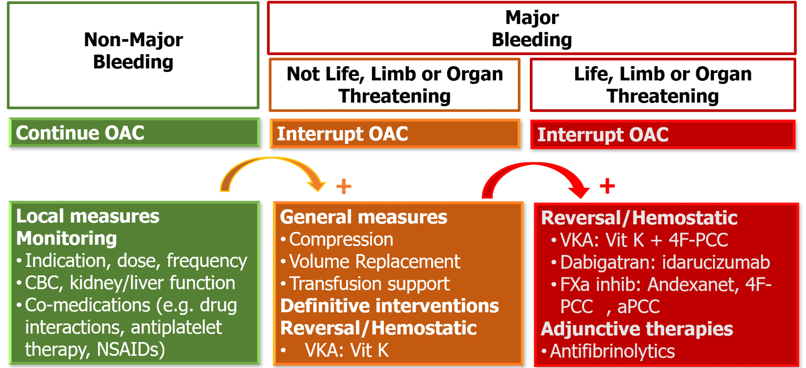
Bleed Severity Guides Acute Management
Harm with lack of benefit with TXA in GI bleeding

Slide 8
Use Reversal/Hemostatic Agents Judiciously
DOAC present in “significant” quantity = suspected or measured
Severe or life-threatening bleeding
Critical organ bleeding
Ongoing bleeding (despite measures to control)
Bleeding with expected long delay for hemostasis
Urgent surgery (cannot be done safely)

Slide 9
Is DOAC Present in “Significant” Quantity*?
Test | Dabigatran | Rivaroxaban | Apixaban | Edoxaban
PT/INR |  | +/-
aPTT | +/-
Thrombin time | ✓
Dilute thrombin time | ✓
Ecarin clotting time | ✓
Anti-Xa assays |  | ✓ | ✓ | ✓

Slide 10
Use Reversal/Hemostatic Agents Judiciously
Severe bleed
DOAC present in “significant” quantity
Reversal (andexanet, idarucizumab) or hemostatic therapy (4-factor PCC) warranted

Slide 11
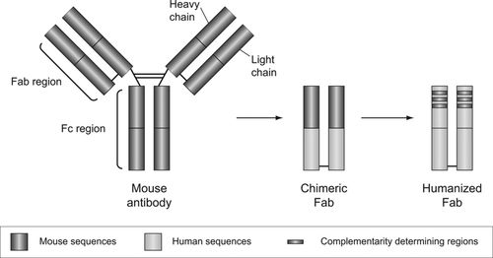
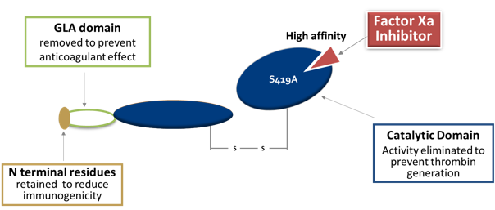
Which Agents REVERSE DOAC Effect?
 | Idarucizumab | Andexanet alfa
Structure | Humanized Fab fragment | Human rFXa variant
Target | Dabigatran | FXa inhibitors
Binding | Non-competitive | Competitive
Indication | Urgent surgery/procedure Life-threatening/uncontrolled bleeding | Reversal of apixaban or rivaroxaban for life-threatening or uncontrolled bleeding
Dose | 5 g IV | Dosing dependent on FXa inhibitor and timing of last dose

Slide 12
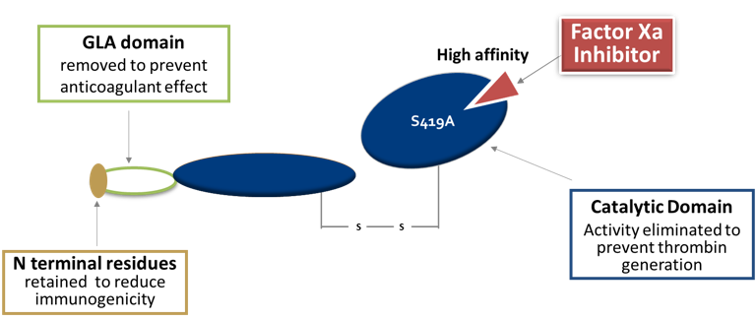
Treatments for Major Bleeding: Factor Xa Inhibitors
Other
4F-PCC 2000u (or 25-50 u/kg max?)
Activated charcoal (if FXaI <2 hours)
Andexanet alfa (dosed according to type of factor Xa inhibitor and last ingestion)
Andexanet alfa

Slide 13
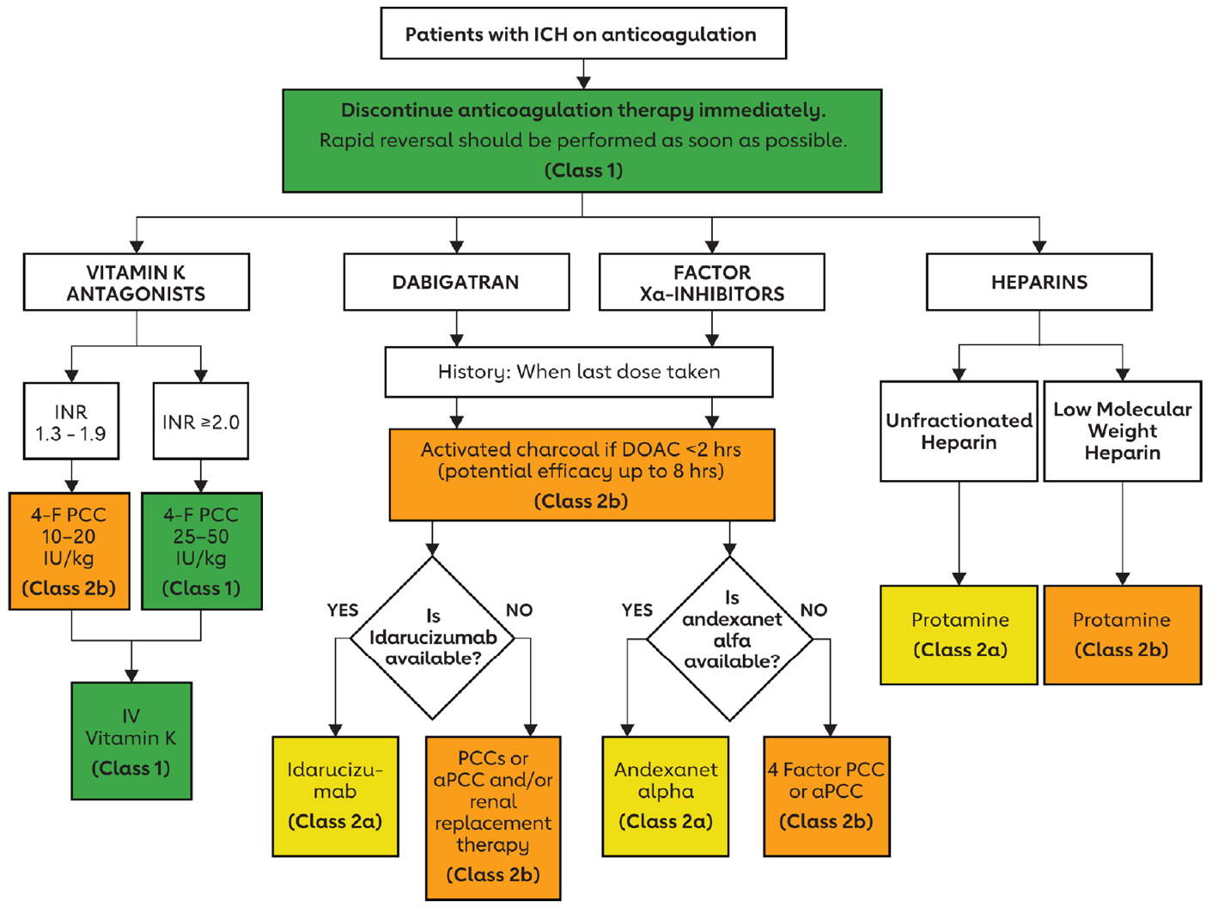
Anticoagulant Reversal for ICH: AHA-ASA Guidelines

Slide 14
AHA/ASA Guidelines
In patients with NVAF and spontaneous ICH, the resumption of anticoagulation to prevent thrombo-embolic events and reduce all-cause mortality may be considered based on weighing benefit
and risk
In patients with AF and spontaneous ICH in whom the decision is made to restart anticoagulation, initiation ≈7 to 8 weeks after ICH may be considered after weighing specific patient characteristics
In patients with AF and spontaneous ICH deemed ineligible for anticoagulation, left atrial appendage closure may be considered to reduce the risk of thromboembolic events
(COR 2b, LOE B-NR)
(COR 2b, LOE C-LD)
(COR 2b, LOE C-LD)

Slide 15
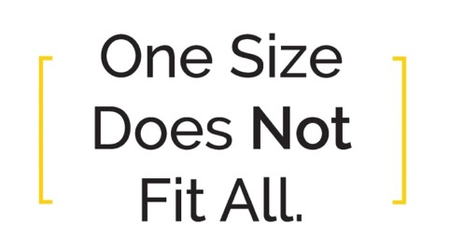
Approach to Anticoagulation After Bleeding
Has bleeding stopped?
No
Yes
Ongoing indication for OAC
Yes
Manage Bleeding
Delay OAC restart
Provide supportive therapies
Identify source
Procedure/surgery?
Reversal or hemostatic therapies if major bleed and clinically significant OAC levels
Address contributory comorbidities
Review co-medications
Thrombotic Risk
Type of thrombosis
Absolute risk
Short- and long-term effects
Bleeding Risk
Site of bleeding, interventions
Absolute risk
Short- and long-term effects
No
ACC’s ManageAnticoag App
Shared Decision-Making
https://www.acc.org/tools-and-practice-support/mobile-resources/features/manageanticoag
Discontinue OAC
Education/counseling
Follow-up: Reassess risk of thrombosis and bleeding
Resume OAC
Baseline labs
Review co-medications
Optimize drug and dose
Education/counseling
Follow-up: Reassess risk of thrombosis and bleeding

Slide 16




Prevention
is the first step
Refer
for ensure early supportive measures and interventions
Reverse
anticoagulant effect for severe bleeds
Hemostatic therapies
if reversal agents are unavailable
Reassess
anticoagulants after bleeding has resolved

Slide 17



Looking for more resources
on this topic?
CME/CE in minutes
Congress highlights
Late-breaking data
Quizzes
Webinars
In-person events
Slides & resources
www.MedEdOTG.com

