Slide 1
Setting the Stage: Case Considerations for Bleeding Management in Anticoagulated Patients
Jan Beyer-Westendorf, MD, PhD Head of Anticoagulation and Thrombosis Clinic Head of Thrombosis Research Department of Medicine, Division of Hematology/Hemostasis Dresden University Hospital Carl Gustav Carus Dresden, Germany

Slide 2



Resource Information
About This Resource
These slides are one component of a continuing education program available online at MedEd On The Go titled Keeping It Real: Reversing Effects of Anticoagulation in the Modern Era with Real World Data
Program Learning Objectives:
Evaluate recent practice-changing data that can be applied to practice in the presence of a life-threatening bleed in the presence of anticoagulation
Apply the latest evidence-based approaches to maximize management prognostic outcomes for life-threatening bleeds
MedEd On The Go®
www.mededonthego.com
This content or portions thereof may not be published, posted online or used in presentations without permission.
This content can be saved for personal use (non-commercial use only) with credit given to the resource authors.
To contact us regarding inaccuracies, omissions or permissions please email us at support@MedEdOTG.com

Slide 3
Disclaimer
The views and opinions expressed in this educational activity are those of the faculty and do not necessarily represent the views of Total CME, LLC, the CME providers, or the companies providing educational grants. This presentation is not intended to define an exclusive course of patient management; the participant should use their clinical judgment, knowledge, experience, and diagnostic skills in applying or adopting for professional use any of the information provided herein. Any procedures, medications, or other courses of diagnosis or treatment discussed or suggested in this activity should not be used by clinicians without evaluation of their patient's conditions and possible contraindications or dangers in use, review of any applicable manufacturer’s product information, and comparison with recommendations of other authorities. Links to other sites may be provided as additional sources of information.

Slide 4
Background
Increasing proportions of patients receive (long-term) anticoagulation
Traumatic, but also spontaneous major bleeding are the most common severe complications also in patients receiving direct oral anticoagulants (DOACs)
Intracranial hemorrhage (ICH) is the most feared bleeding manifestation, with often devastating outcomes
Gastrointestinal (GI) bleeding is the most frequent nontraumatic major bleeding manifestation in routine care
Targeted, effective, fast, and safe reversal of antithrombotic treatment is increasingly important in the emergency management of anticoagulated patients

Slide 5


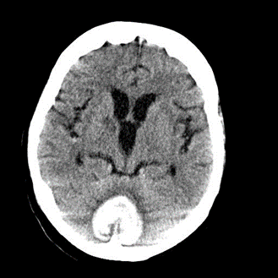
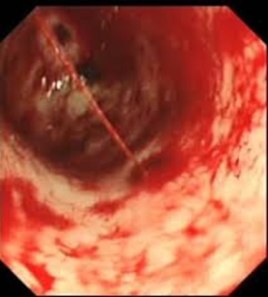
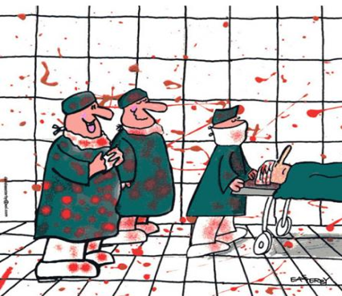
Increasing Need for Reversal of Antithrombotic Drugs
https://de.toonpool.com/cartoons/operation%20blood_30173

Slide 6

Key Point
Speed and efficacy of reversal strategies
Large impact on clinical outcomes

Slide 7
Time-Critical Problems Regarding Reversal of Anticoagulation in Major Bleeding Situations
Increase in blood loss or hematoma volume = damage
Asymptomatic phase
Time until presentation
Time until administration of reversal agents
Time until effective reversal
Duration of action of reversal
Clinically not to be influenced
Clinically to be influenced

Slide 8
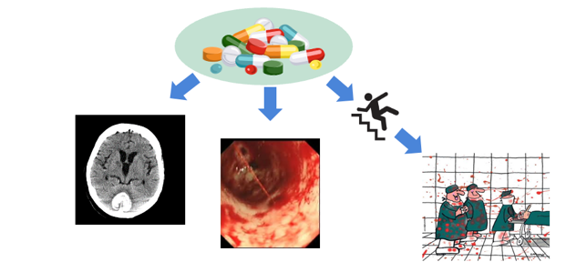
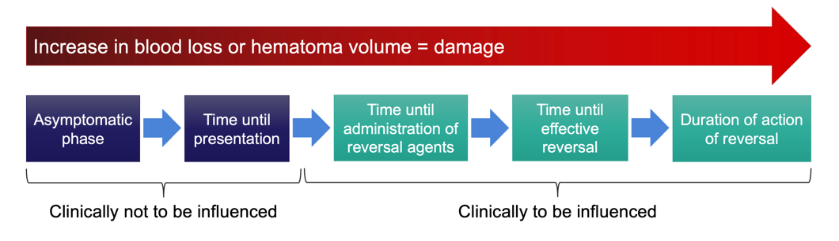
Time-to-Decision is Critical, but What Are the Challenges?
Do we know that the patient took an antithrombotic drug? And when do we know this?
Which drug?
What dosage?
When was the last intake?
Intoxication/Accumulation?
Can I measure the antithrombotic effect?
Should I measure the antithrombotic effect?
What is the recommended reversal strategy?
Is it available in my hospital?
Is the reversal agent indicated? Are there contraindications?
Is it reimbursed?
What was the indication? Can I stop the antithrombotic drug? Should I replace it? And when and how?

Slide 9



Looking for more resources on this topic?
CME/CE in minutes
Congress highlights
Late-breaking data
Quizzes
Webinars
In-person events
Slides & resources
www.MedEdOTG.com

